Slide 1

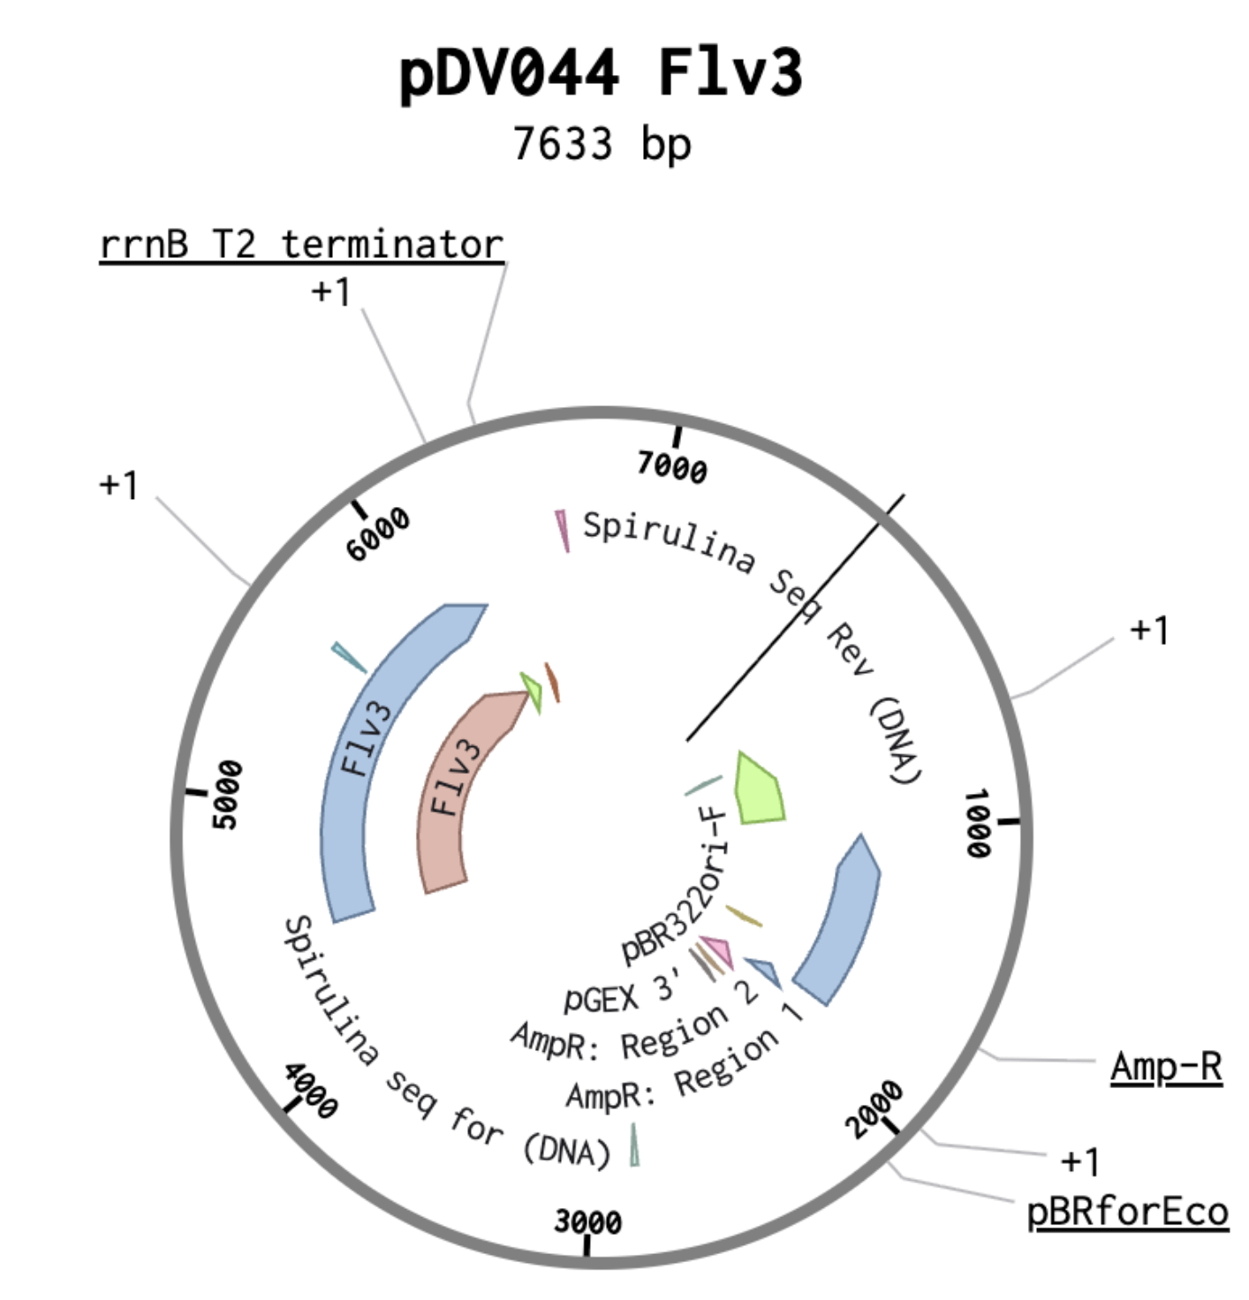
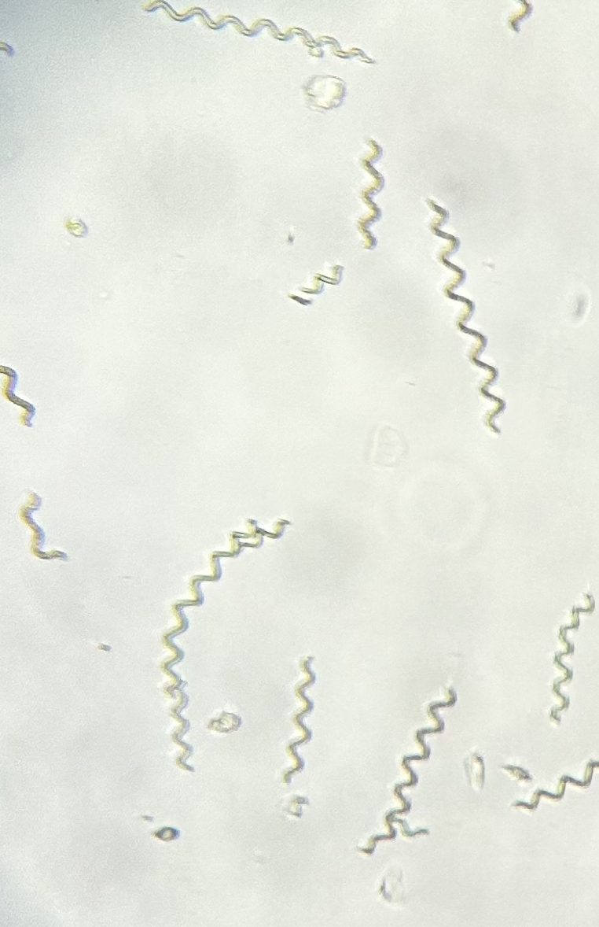
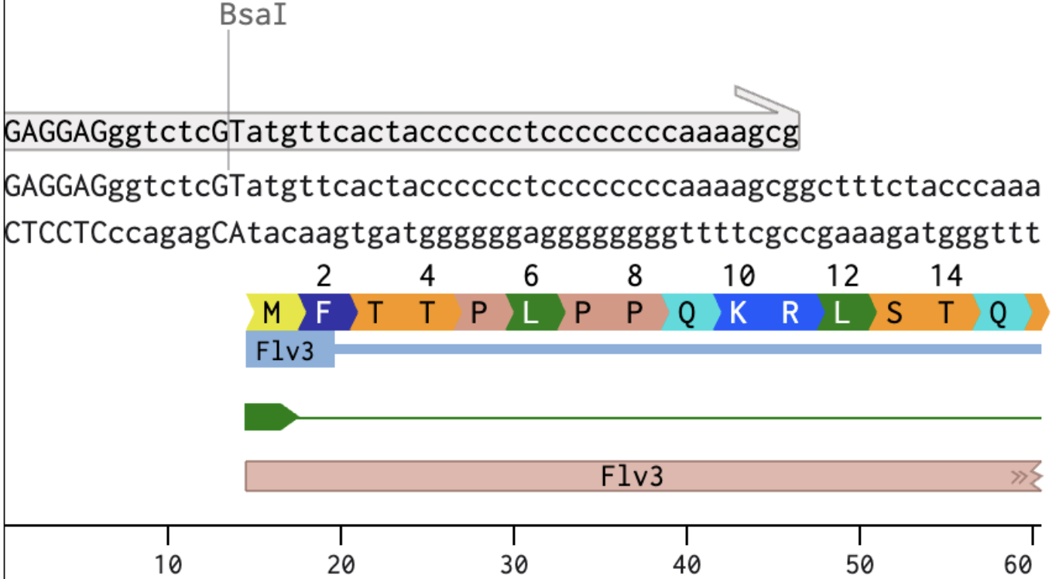
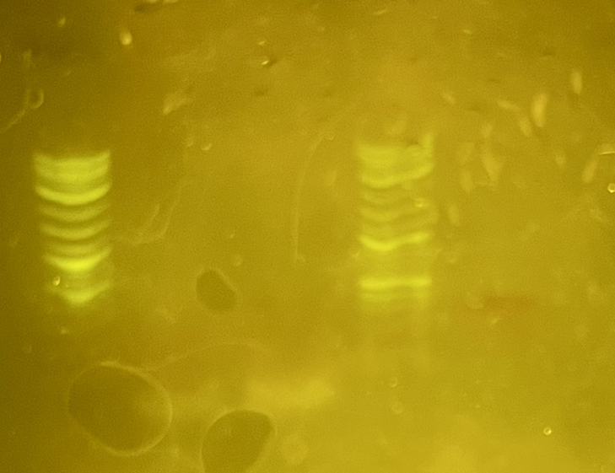
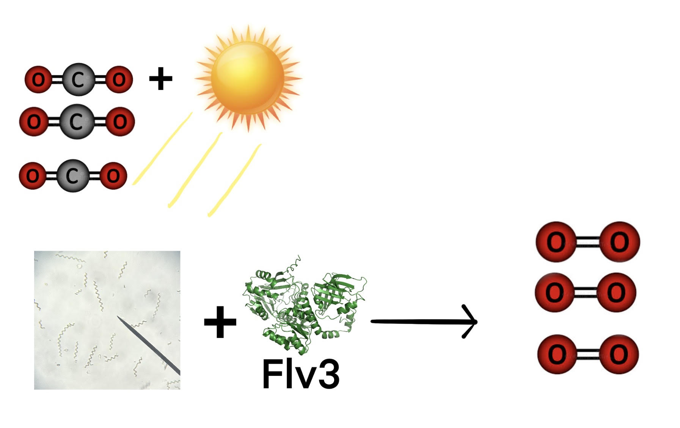







Expression of the Flv3 Gene in Spirulina to Enhance Photosynthetic Efficiency
Evan Campbell, Liam Curry, Anthony Issa, Maddox Lund, Shubh Mehrotra, Zach Parlon,
Gabe Perez, Max Richards, Ms. Heather Osborne, Dr. Jason Boock (Syracuse University)
Xaverian Brothers High School, Westwood, Massachusetts, USA
Abstract
Throughout this year, working closely with our mentor, Dr. Boock, we have designed a plasmid based on the pDV044 backbone to contain the Flv3 gene from Synechocystis. We identified the gene using NCBI BLAST. We then used the Benchling program to incorporate the gene into our plasmid and design primers for gene amplification.
To measure the rate of photosynthesis, our procedure uses changes in water pH to detect the efficiency of the photosystems. This method ensures the system remains open, with oxygen readily available to spirulina without risking damage or death. It uses the principle that removing CO₂ from water raises the pH because fewer hydrogen ions are present, making the water more basic, allowing the photosystems to work efficiently. The hope is that, as the plasmid-containing spirulina removes CO₂ faster than spirulina without the plasmid, the pH will rise faster.
We selected spirulina for our study because of its global abundance and its potential for use in bioengineering efforts to reduce atmospheric CO₂. Future work will focus on optimizing Flv3 expression and testing additional environmental conditions to directly assess whether this engineered spirulina is viable for improved photosynthetic efficiency and CO₂ reduction.
Science Content
Team Content
We are a returning team from Westwood, Massachusetts representing Xaverian Brothers High School. As a senior heavy team last year, we welcomed six new Junior members. Following up our theoretical work done last year, we focused on experimental research to progress our project. Over the course of the year, we have gained knowledge in various techniques such as PCR, gel electrophoresis, plasmid isolation and transformation.
Next Steps
Going forward, there is still a lot of work to be done. We hope to accomplish the following:
Reattempt PCR of the gene of interest
Reattempt isolation of plasmid
Verify success of previous two steps by gel electrophoresis
Build the plasmid with the gene of interest
Verify success
Transform plasmid into spirulina
Verify chromosomal integration of the gene
Test impact on photosynthesis rate and CO₂ reduction levels
Map of the pDV044 plasmid backbone with the Flv3 gene
We found our gene of interest and the gene sequence identifier sll0550 from an article on Springer Nature Link. We then used this gene sequence identifier to find the gene sequence through NCBI.
Spirulina
We then used the program Benchling and the identified gene sequence to design primers and a cloning strategy.
One of our designed primers
A lack of bands means that no DNA was present → Both PCR and plasmid isolation failed.
L
- DNA
+ DNA
L
pDV044
Introduction/Background
The increasing concentration of carbon dioxide (CO₂) in the atmosphere is a major
contributor to climate
Change. We hypothesize
that Flv3 expression in
spirulina will accelerate
photosynthesis and
reduce levels of
atmospheric CO₂.
Acknowledgements
We’d like to thank Heather Osborne, Hiroko Kaczmarek, Jason Boock,
Chloe Franklin from BioBuilder, and all the Xaverian Brothers High School Students who attend our club as well
as anyone else who may have contributed to our project.
References
Spirulina
Purple smudges are sample dye
Faint bands are primers

