Slide 1

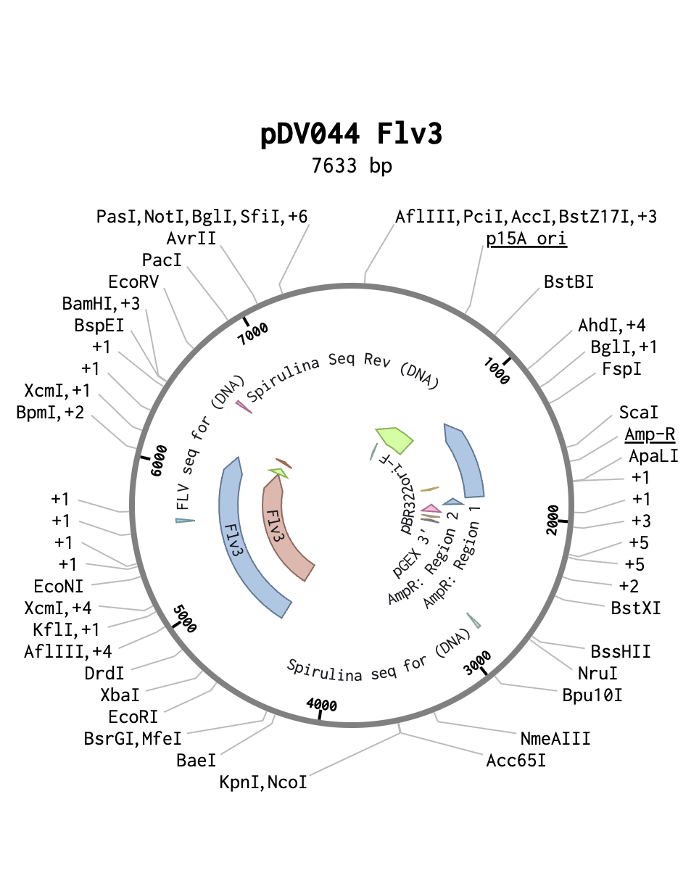






Expression of the Flv3 Gene in Spirulina to Enhance Photosynthetic Efficiency
Evan Campbell, Liam Curry, Anthony Issa, Madox Lund, Shubh Mehrotra, Zach Parlon, Gabe Perez, Max Richards, Ms. Heather Osborne, Dr. Jason Boock (Syracuse University)
Xaverian Brothers High School, Westwood, Massachusetts, USA
Objective:
  Transform Arthrospira platensis with the gene Flv3 to increase photosynthetic rate.
  Why?
    Previous research shows that overexpression of the gene in Synechocystis increases photosynthetic rate.
Techniques
  Plasmid Isolation
  PCR
  Golden Gate Assembly
  Plasmid Digest
  Standard Transformation
Limitations
  High possibility of error as most of the techniques are new for all members of the team.

