Slide 1

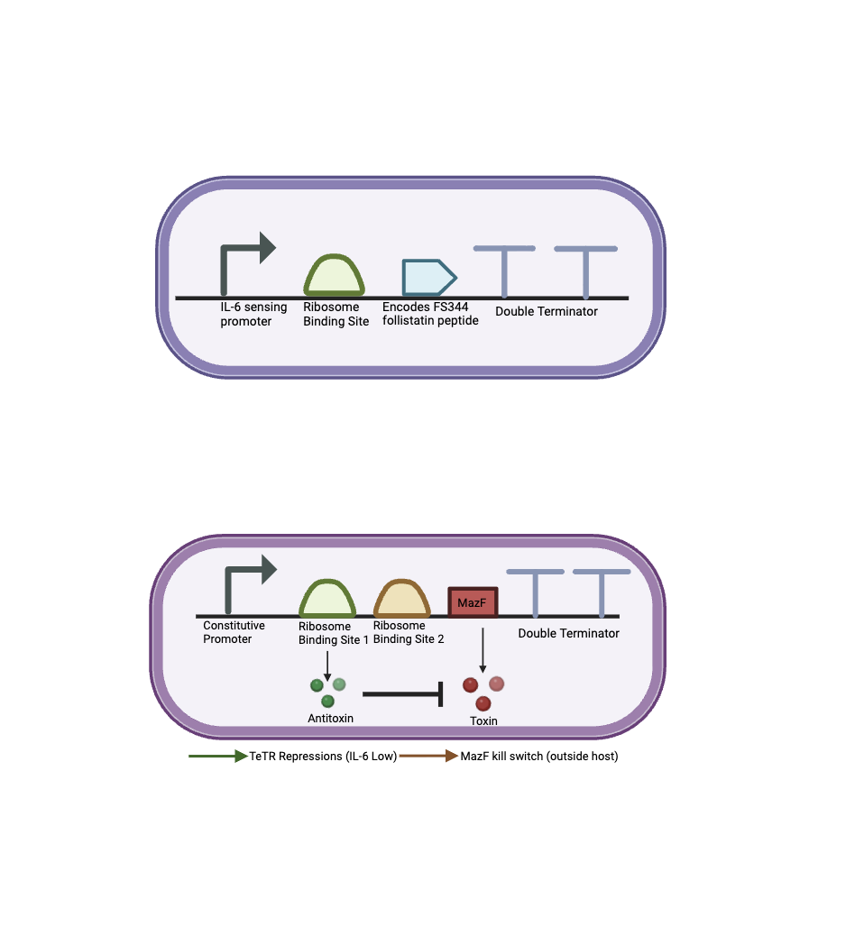
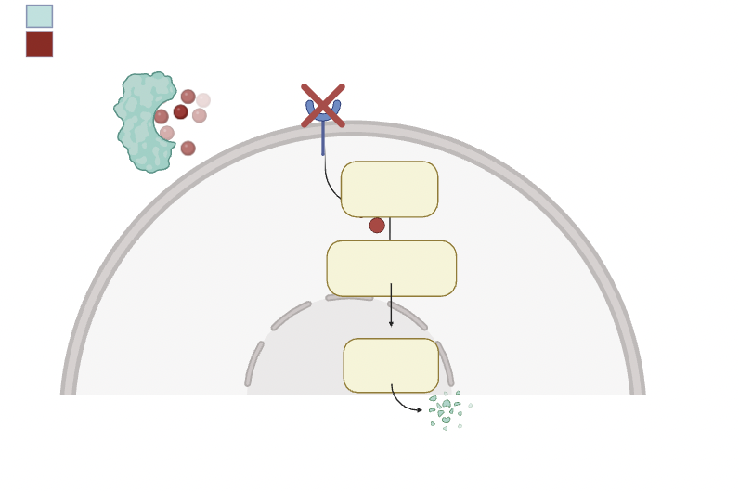
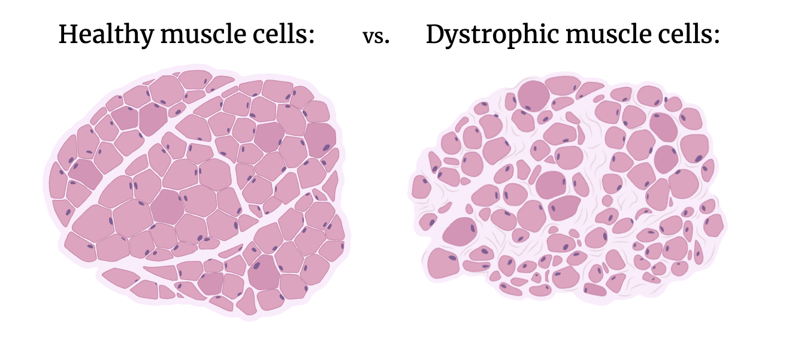
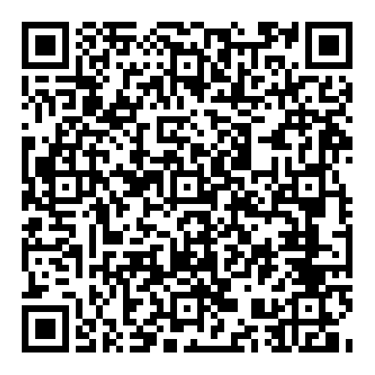
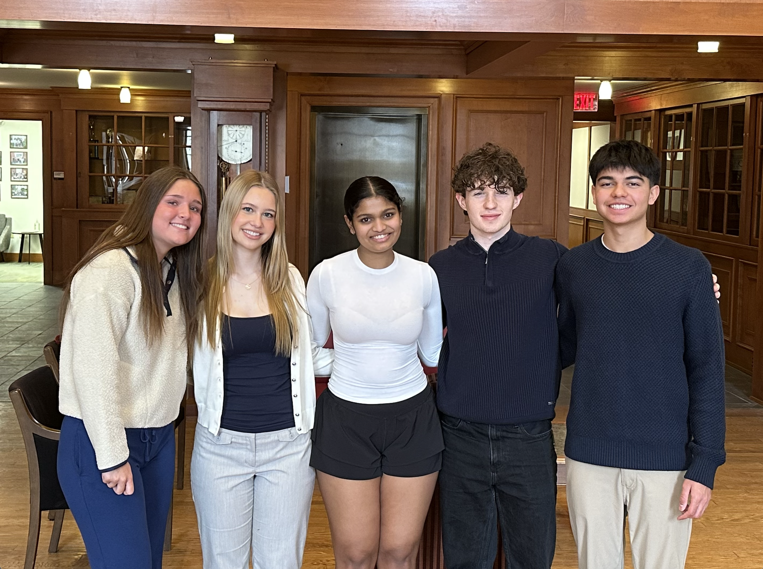






Engineering an IL-6 Responsive Probiotic for Dynamic Follistatin Secretion and Myostatin Inhibition
Lydia Stropki, Adelaide Baran, Arya Shirsat, Colton Waters, Sanam Mody, Ms. Vivien Marmerstein, Dr. Kosuke Seki (University of California, San Francisco)
Western Reserve Academy, Hudson, OH, USA
Abstract:
Duchenne Muscular Dystrophy (DMD) is the most common form of muscular dystrophy, affecting 20,000 children worldwide yearly. Muscle degenerative conditions, including the genetic disorder DMD and age-related sarcopenia, share pathological mechanisms such as progressive muscle wasting and elevated myostatin signaling. Existing therapies rely on systemic drug administration or gene-based approaches, which can take years to develop. They also raise safety concerns, costs, and a lack of a long-term solution. We propose using the chassis Limosilactobacillus reuteri (formerly Lactobacillus reuteri) as a gut-safe probiotic. Elevated interleukin-6 (IL-6), a cytokine released during inflammation and muscle stress, signals disease activity. Our system uses an IL-6-responsive promoter to detect this state and drive FST-344 (specific follistatin protein used) expression. The resulting follistatin protein suppresses myostatin signaling by preventing receptor binding, thereby promoting muscle preservation. To ensure homeostatic control and prevent overproduction, the circuit incorporates a TetR-regulated repression loop. For additional biosafety and regulatory control, the design incorporates a mazF-based kill switch and a feedback mechanism to limit expression and trigger cell termination. This oral, sensor-regulated delivery system offers a potentially scalable, noninvasive, and adaptable alternative to traditional gene therapies and systemic drug regimens.
Device 1: IL-6 Responsive Follistatin Expression
Prevents Myostatin from binding to the Receptors
Myostatin
Follistatin
Receptor (ALK)
Smad activation
Nuclear translocation
Inducible promoter turns on when IL-6 levels are high, FS344 binds to myostatin and reduces inhibitory effect on muscle growth.
Gene
regulation
Device 2: Biosafety Control (Gut-Restricted PH Level Kill Switch)
Promoting muscle protein degradation.
Follistatin blocks the signaling receptor, therefore inhibiting the attachment of Myostatin.
Background:
Standard treatments for muscle loss rely on genetic editing or systemic drug administration with high costs, safety concerns, and problems with accessibility
We plan to solve these problems with an alternative treatment through a gut-safe probiotic that will detect and administer follistatin when needed.
Through synthetic biology, we aim to avoid the side effects associated with long-term corticosteroid use, with its nonspecific effects, and with gene replacement therapy, which relies on adeno-associated viruses for delivery, provoking immune responses.
Healthy Muscle Cells vs. Dystrophic Muscle Cells
Next steps:
Encoding Follistatin gene into Limosilactobacillus reuteri to move onto further testing stages
The end goal would be to test as a probiotic solution for DMD in a medical environment and hope to limit the effects of the disease.
References Here:
The kill switch uses a constitutive promoter to drive safety gene expression, where RBS1 produces the MazE antitoxin for survival and RBS2 produces the MazF toxin to trigger cell death if containment is lost. TeTR provides transcriptional repression under safe conditions preventing premature toxic expression.
Our Approach:
We are using genetically modified Limosilactobacillus reuteri to create a probiotic that express genes for follistatin to combat Muscular Dystrophy.
Team Content:
We are a new team made up of 4 members, all new to the BioBuilder Club from Western Reserve Academy.
All of us have a love for biology and scientific research connecting us to synthetic biology. Since we are mostly comprised of seniors, this project will likely be picked up by new students next year.
Picture (Left to Right) Lydia, Adelaide, Arya, Colton, and Sanam
(All figures created in BioRender)
Acknowledgements:
We would like to thank Ms. Marmerstein and our mentor Kosuke Seki for their unwavering support and knowledge to make our project possible!
Notes:
Move things to make text bigger in device
Put picture with team content
Move title to be straight

