Slide 1


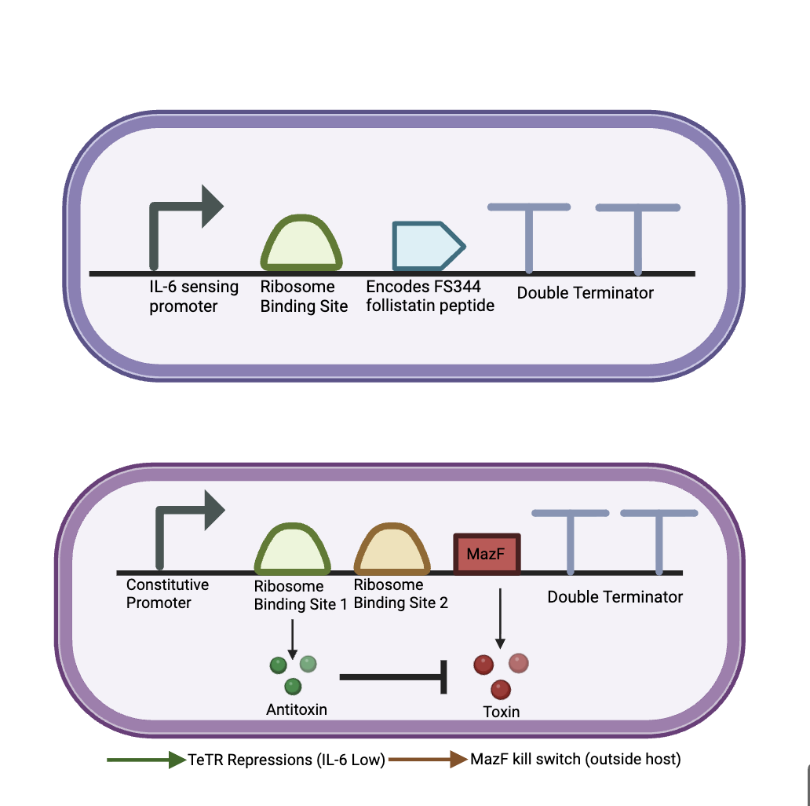
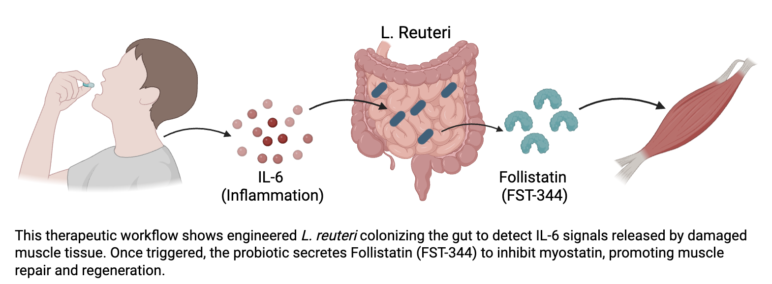






Engineering an IL-6 Responsive Probiotic for Dynamic Follistatin Secretion and Myostatin Inhibition
Adelaide Baran, Sanam Mody, Arya Shirsat, Lydia Stropki, Colton Waters, Ms. Vivien Marmerstein, Dr. Kosuke Seki (UCSF), Western Reserve Academy, Hudson, Ohio, United States of America
Project objective
Engineer a probiotic (L. reuteri) that produces follistatin in response to IL-6, to treat muscle dystrophy
Provide a self-regulating alternative to steroids by secreting Follistatin to block myostatin.
Device 2: Biosafety Control (Gut Restricted PH Level Kill Switch
Device 1: IL-6 Responsive Follistatin Expression
Techniques
IL-6 responsive promoter → Follistatin production.
Using a TetR "off switch" for dosing and a mazF "kill switch" for biocontainment.

