Slide 1

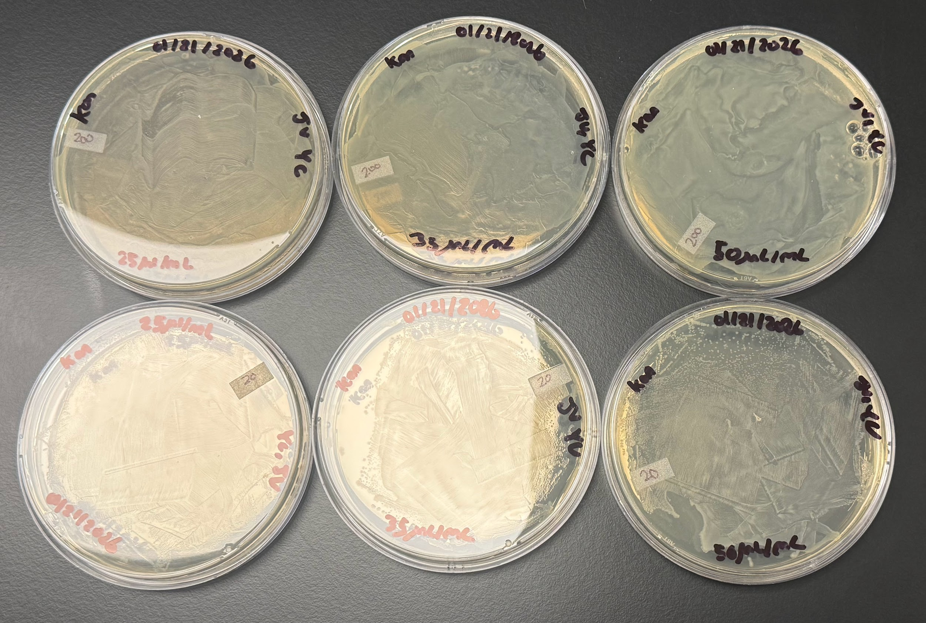
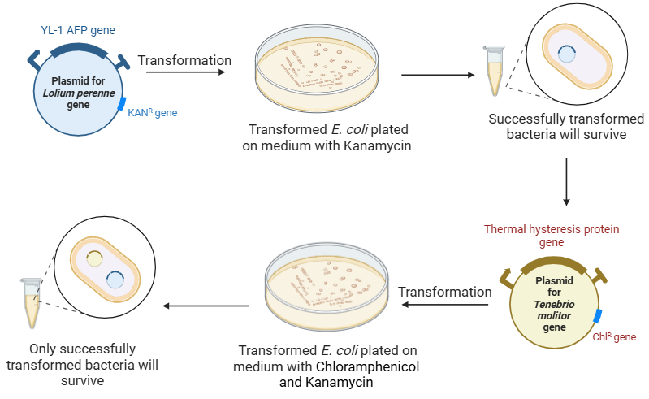
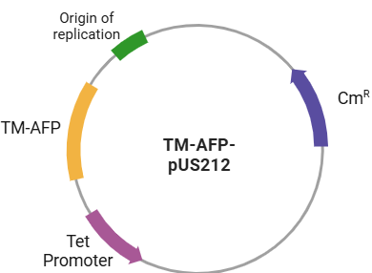

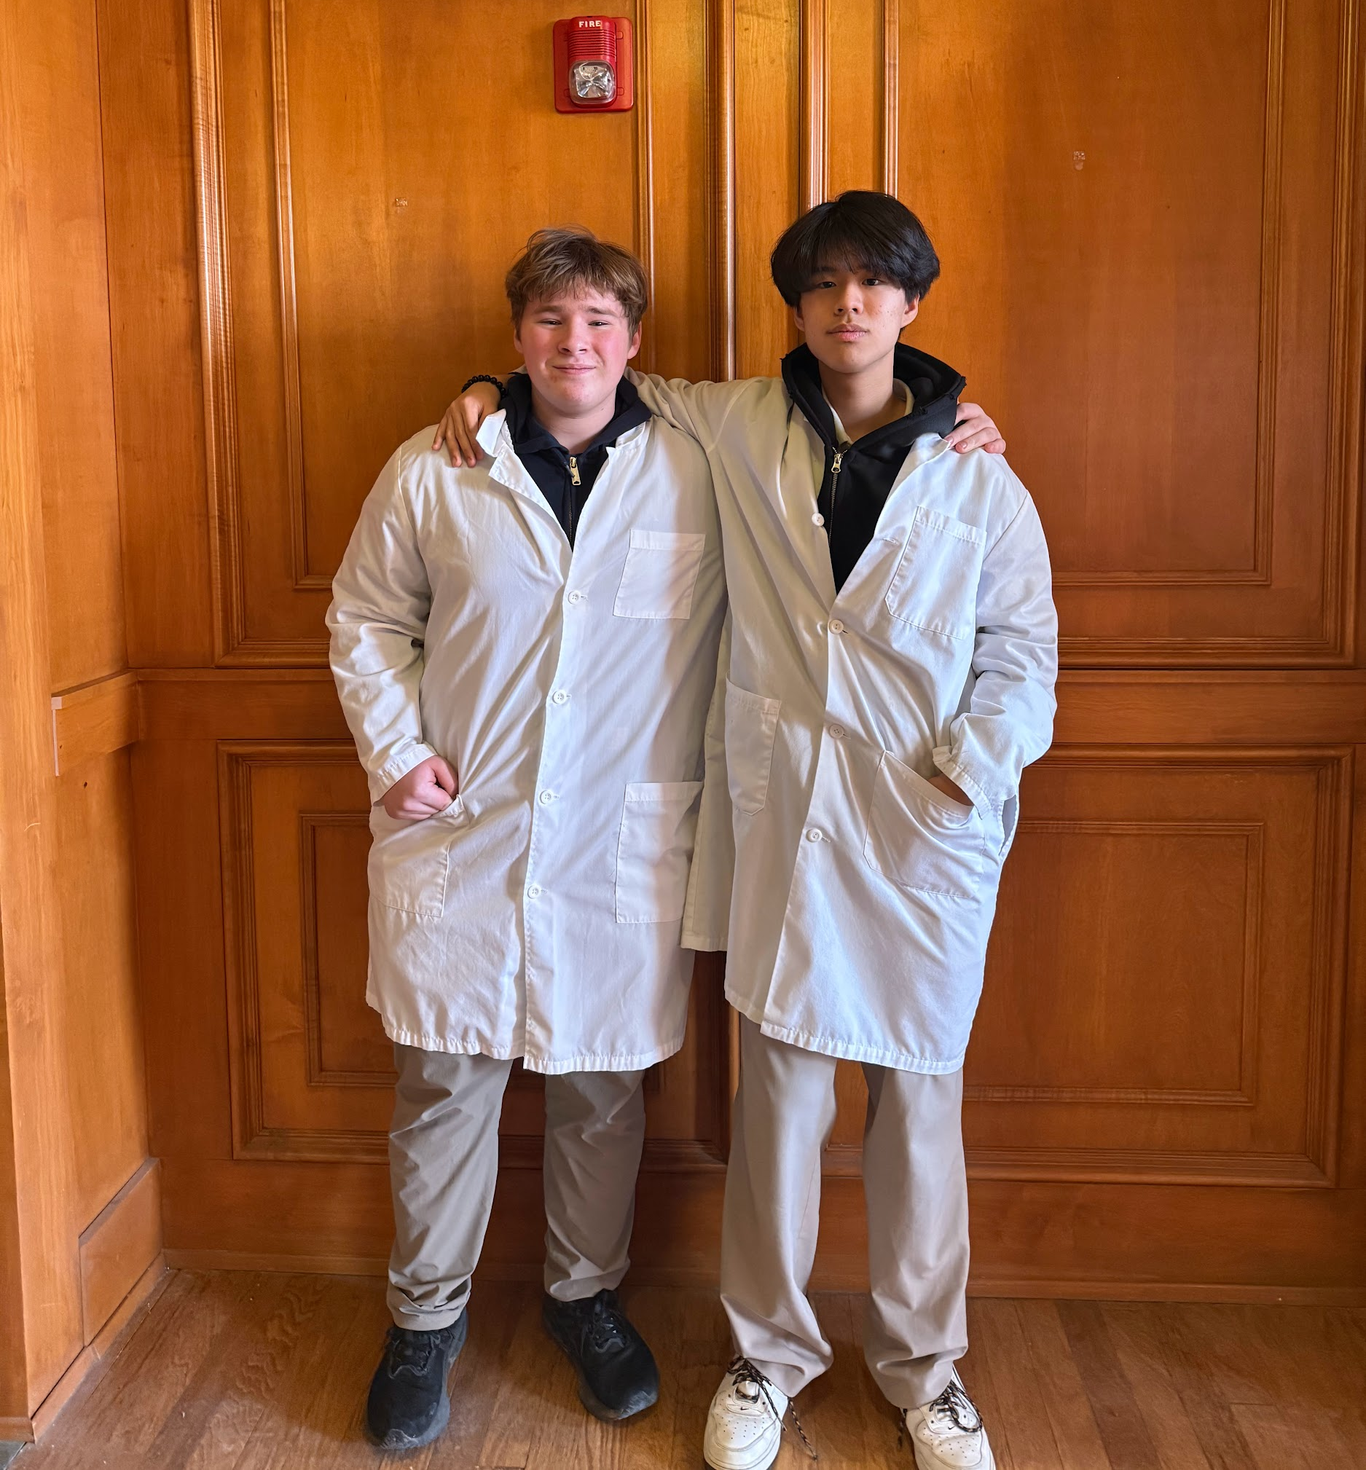
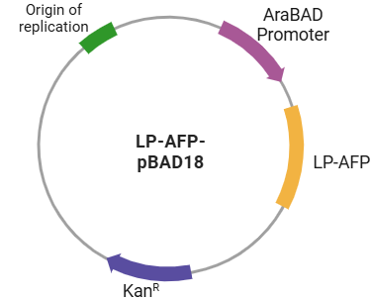

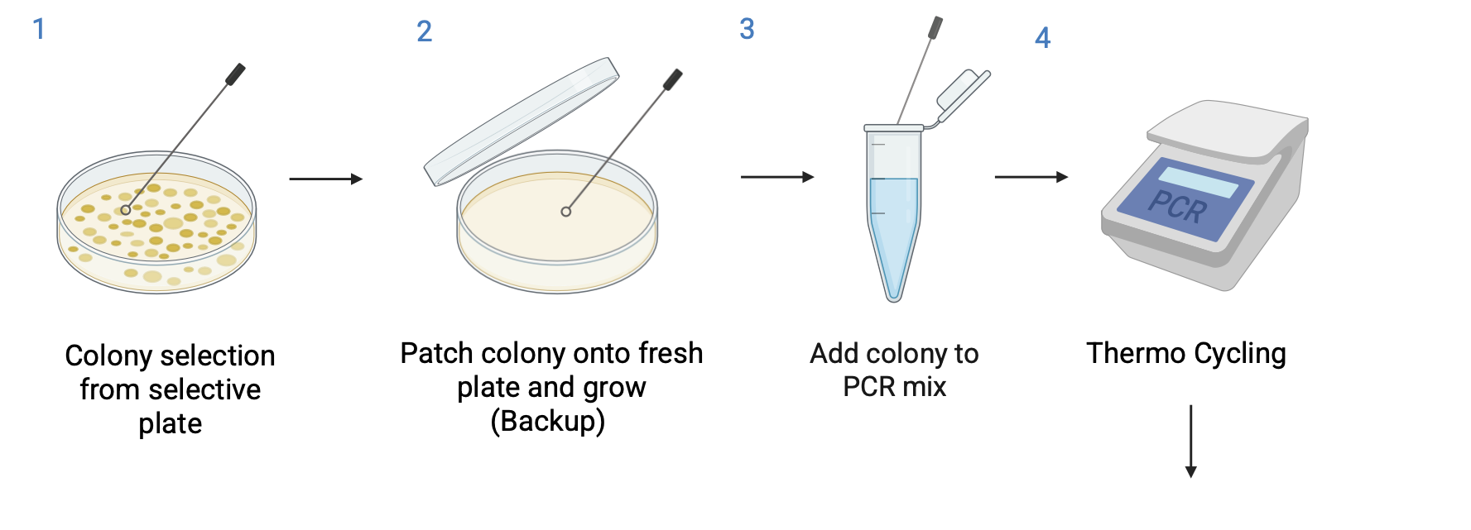
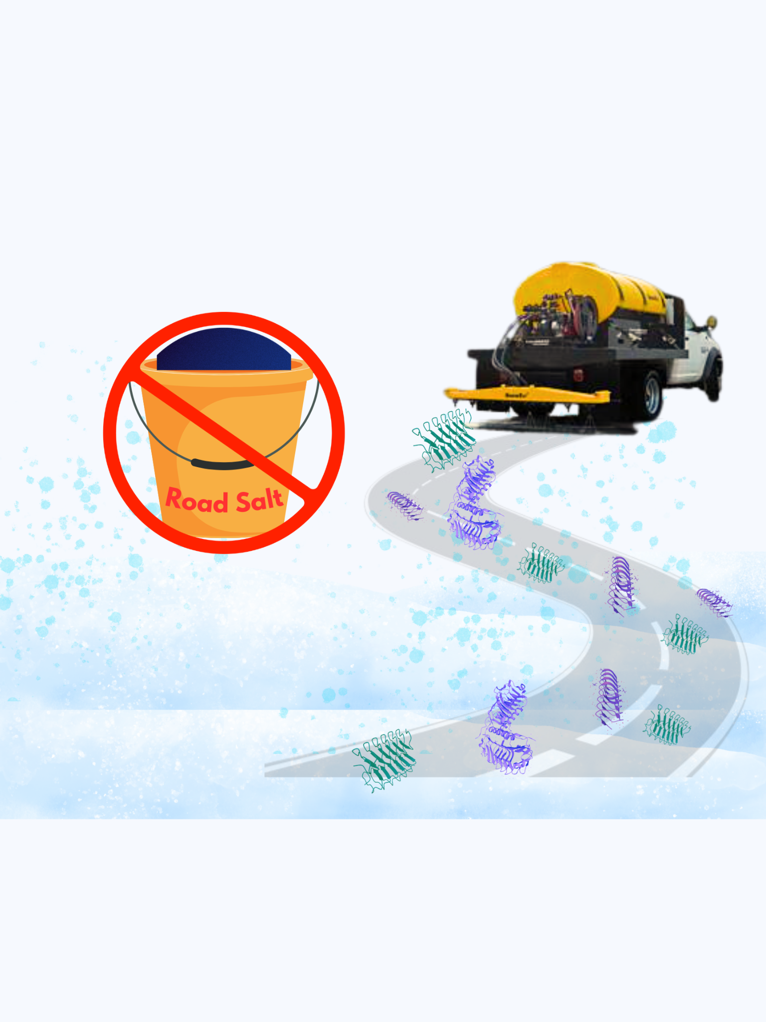
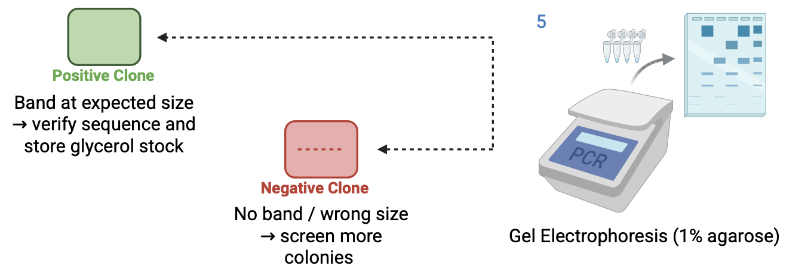

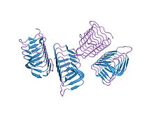






Road Salt Alternative Using AFPs
James Vacca, Yunwoo Choi, Vivien Marmerstein, Dr. Becky Meyer (MIT)
Western Reserve Academy, Hudson, Ohio
Abstract
Annual U.S. vehicle crashes on snowy and icy roads result in more than 1,300 deaths and 116,800 injuries. However, using chemical road salt to prevent accidents has negative consequences, including corrosion and nearby water contamination. Our more eco-friendly design utilizes naturally occurring antifreeze proteins (AFPs) to prevent ice formation on road surfaces. This project aimed to construct two plasmids, one expressing an AFP from Lolium perenne (perennial ryegrass) and one from Tenebrio molitor (mealworm). Both genes are controlled by inducible promoters in the Escherichia coli chassis. Proteins will be extracted from the transformed E. coli using cell lysis, centrifugation, and solubilization to release the inclusion bodies containing the proteins. AFPs will then be purified through affinity chromatography to ensure high purity for functionality and stability tests. In preliminary transformations, robust colony growth was observed for the T. molitor AFP construct, whereas no colonies formed for the L. perenne construct, indicating differential cloning or selection efficiency that will guide our next optimization steps. The application of these AFPs offers a sustainable and eco-friendly alternative to traditional road salt, mitigating environmental damage while preventing risks of icy roads.
Workflow of Genetic Engineering to Application of AFPs
Two Components for High Performance AFP
Tenebrio molitor is a freeze-susceptible mealworm that survives the cold winter by producing AFPs. We introduce a YL-1 (Type 1 AFP) gene from this species to enable the production of AFP in E. coli.
Perennial ryegrass (Lolium perenne) produces AFPs to protect itself against the cold. Its gene encoding an ice recrystallization inhibition (IRI) protein can be incorporated alongside the other genes to produce AFPs.
Chassis - E.coli DH5alpha for its ability to produce large amounts of plasmid DNA. Also, BL21 for its demonstrated efficiency in the pilot-scale production of AFP in several publications.
Our Kanamycin selective plates plated with E. coli DH5a containing our pBAD18-Kan plasmid. No visible colony growth.
Plasmids Transformation in E. coli
Plasmid Designs
Meet the Team
Next Steps
Plate and select colonies from our E. coli containing pUS212
Perform a recovery step on our E. coli containing pBAD18-Kan
Run PCR and/or Electrophoresis to confirmation digest to confirm correct plasmid insertion
Induce protein expression
Purify and Quantify Protein
Our team consists of two seniors: one returning member and one new member. This is the project’s third year.
Background
Road Salt's Negative Impact: Due to the harmful effects of road salt, including vehicle corrosion, infrastructure, and the infiltration of salt in ecosystems and well water, we are creating an environmentally safe alternative road salt.
Mechanism of AFPs: AFPs adhere to the surface of forming ice crystals, as depicted in the figure below. This prevents water molecules from joining the ice nucleus at the attachment sites. The interaction alters ice crystal growth and shape, creating a convex surface on the liquid-facing side where AFPs bind, thus modifying the ice's growth pattern.
PCR procedure
Colony PCR Screening for Insert Verification
Colony PCR will be used to screen transformants for successful plasmid insertion.
Standard vector-flanking primers annealing upstream and downstream of the multiple cloning site (MCS) will be used for both constructs, allowing detection of insert presence by amplicon size relative to empty vector controls.
Products will be resolved by gel electrophoresis on a 1% agarose gel. Positive clones will display a band at the expected insert size (~290 bp for TM-AFP, ~330 bp for LP-AFP), while negative clones will show either no band or a smaller empty-vector band.
Acknowledgements
We extend our gratitude to Vivien Marmerstein for her support and guidance throughout our project and to our mentor Dr. Becky Meyer for sharing her valuable knowledge and experiences.
References
AFPs
Application of AFPs on road surfaces to prevent ice formation

