Slide 1

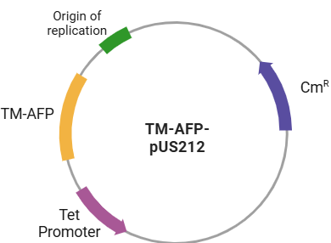
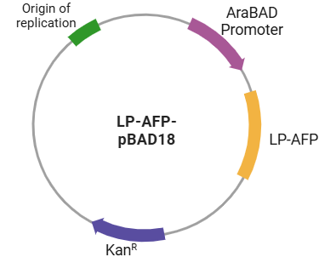
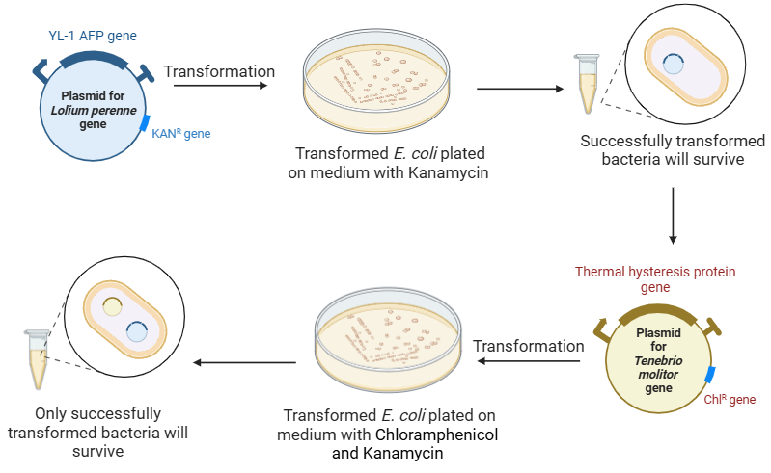
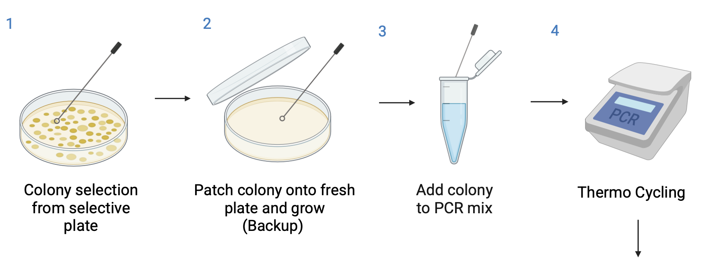
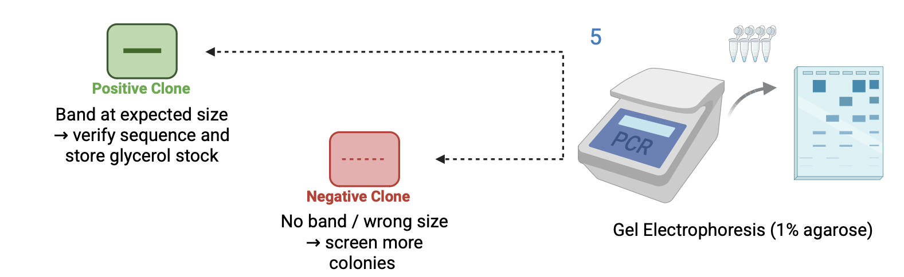






Road Salt Alternative Using AFPs
James Vacca, Yunwoo Choi, Vivien Marmerstein, Dr. Becky Meyer (MIT)
Western Reserve Academy, Hudson, Ohio
Objective
This project seeks to address the environmental and infrastructural challenges posed by road salts through the creation of antifreeze proteins (AFPs).
Our design involves the transformation of Escherichia coli with two separate plasmids, each carrying a gene sequence for AFPs derived from mealworms and winter ryegrass. These AFPs operate by attaching to the surface of forming ice crystals, effectively preventing ice formation at sub-zero temperatures.
Figure 1. LP-AFP -pBAD18 plasmid
Figure 2. TM-AFP-pUS212 plasmid
Figure 3. Transformation of plasmids
Figure 4. PCR procedure

