Slide 1

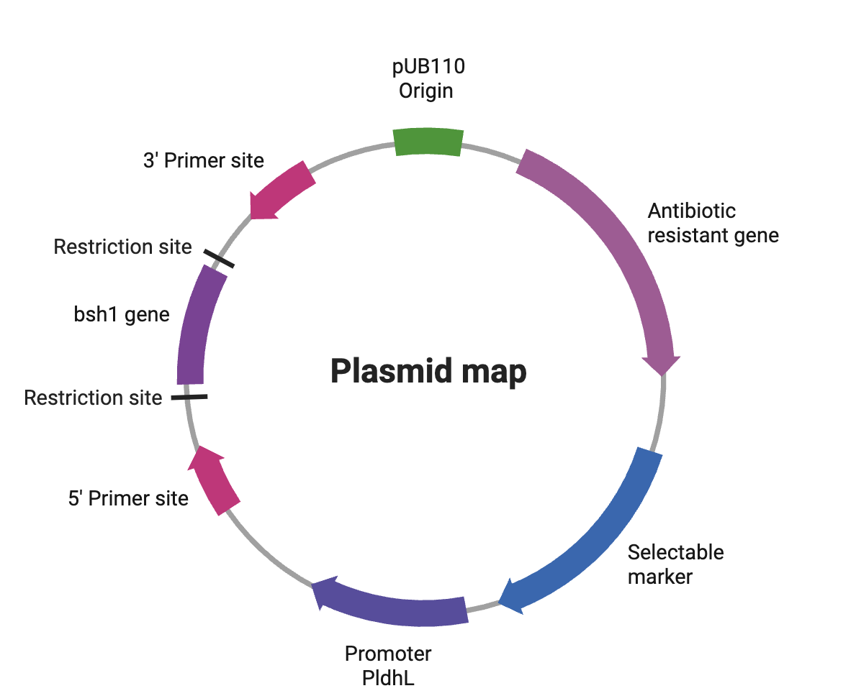

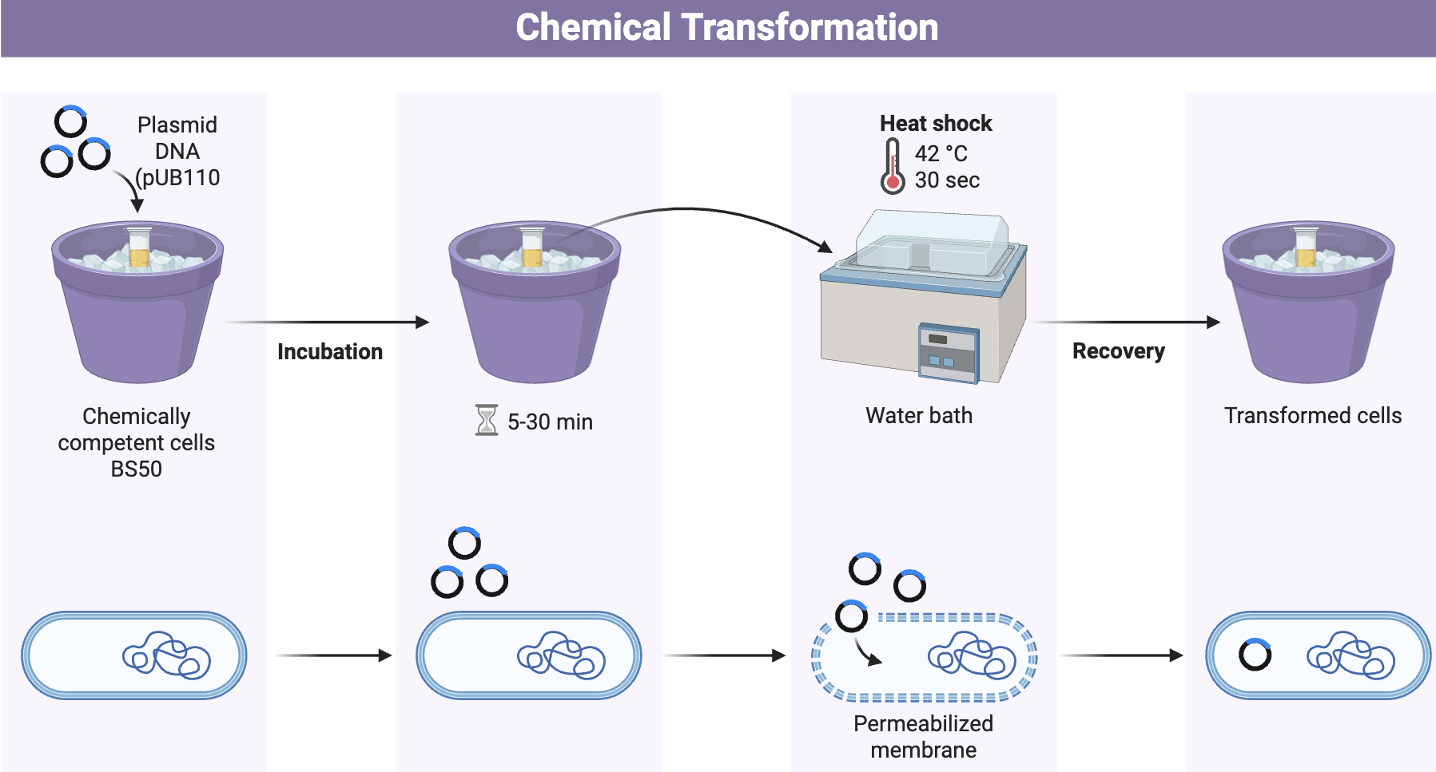
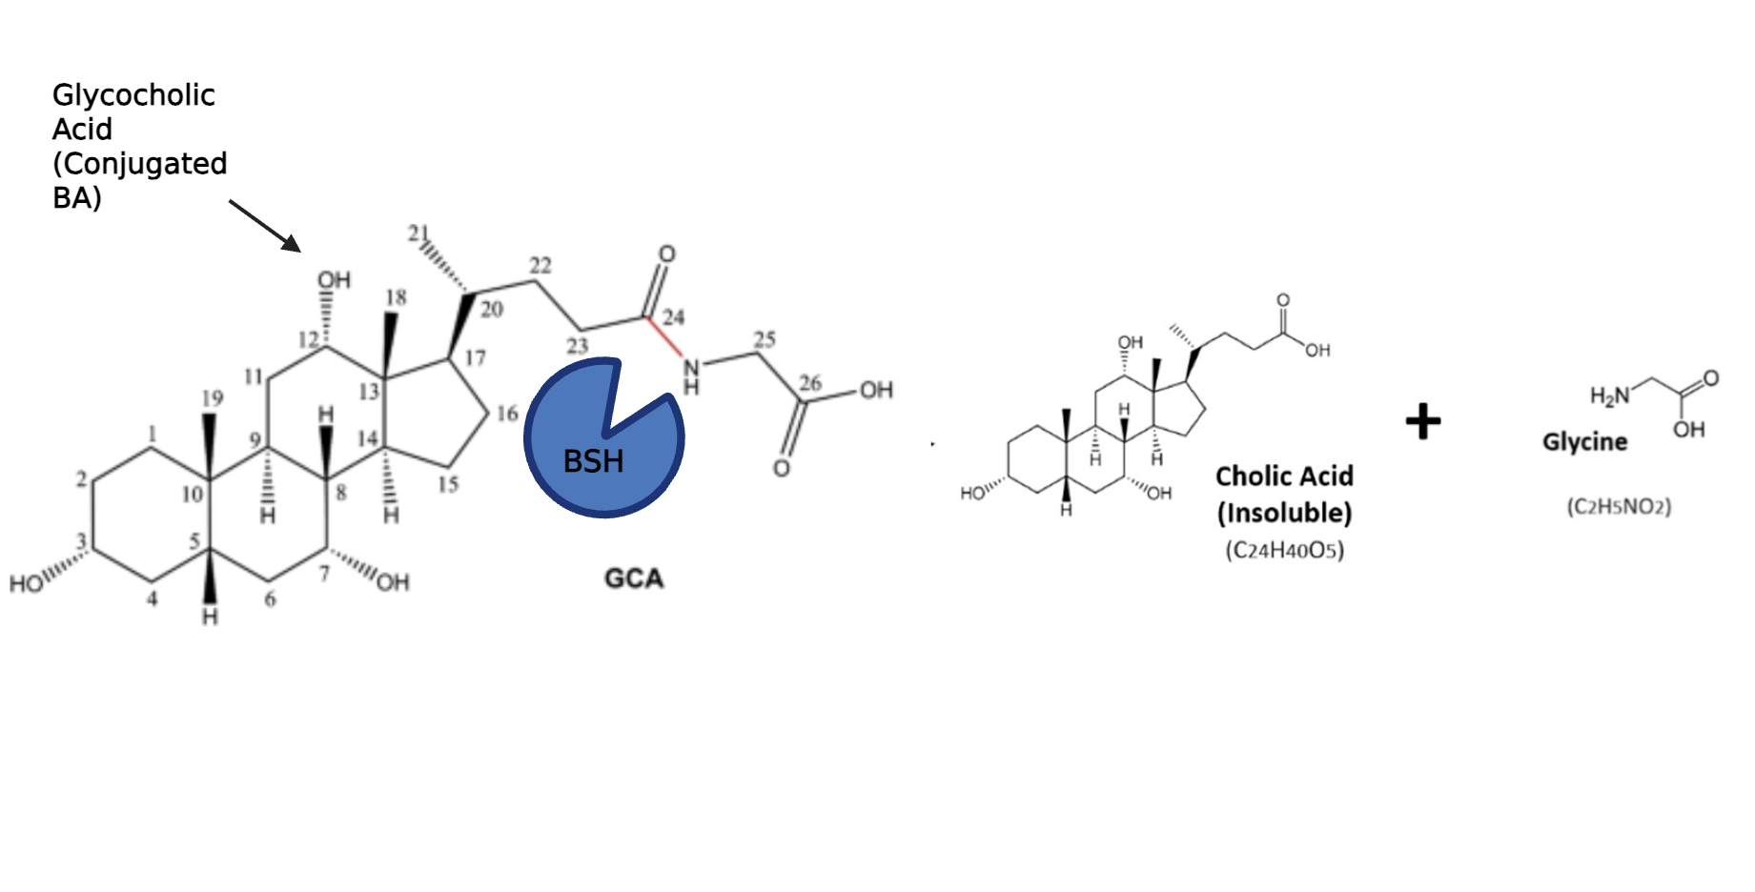







Targeting the Gut-Brain Axis: A Multi-Pathway Engineered Yogurt for Mild Depressive Symptoms
Elisabetta Huff, Mitchell Hooten, Josephine Lo, Ben Ross, Evan Sun, Vivien Marmerstein , Dr. Becky Meyer (MIT)
Western Reserve Academy, Hudson, Ohio
Abstract
Depression remains a global crisis with an estimated 332 million people suffering from symptoms. Current drug solutions, such as Selective Serotonin Reuptake Inhibitors (SSRIs), fail to address the internal inflammation and gut microbiome imbalances that promote depressive symptoms. Our project proposes a yogurt base with an enhanced probiotic to mitigate mild, subclinical depressive symptoms through the gut-brain axis. The yogurt will include Bacillus subtilis (BS50), a probiotic safe for human consumption, that has been engineered to produce bile salt hydrolase (bsh). By inserting the bsh1 gene from Lactobacillus plantarum RK21, the production of the bsh enzyme will decrease inflammation in the gut by interrupting production of interleukin 6 (IL6), an inflammatory cytokine present in patients with depression. BS50 inherently includes the trp operon that synthesizes tryptophan, an amino acid that’s the only precursor to serotonin: serotonin is a vital neurotransmitter, with low levels linked to depression. Following successful genetic modification, the engineered BS50 will be incorporated into a yogurt culture for fermentation, allowing the probiotic to function within a familiar and accessible food matrix. Our product creates a food-based intervention that integrates synthetic biology, nutrition, and microbiome science to offer a holistic alternative to traditional therapies for milder symptoms.
Design Process
Future Steps
We will determine the safe and effective level of BSH production in the gut to minimize adverse effects, evaluate yogurt and probiotic shelf life, and assess the safety of antibiotic-resistance plasmids within the human gut microbiome.
Meet the Team
We are a new team of five from Western Reserve Academy who all share a common interest in mental health and nutrition! (Left to Right) Evan, Elisabetta, Josephine, Ben, Mitch.
Figure 2: Isolate the bsh1 gene from Lactobacillus Plantarum RK21 and insert into plasmid backbone pUB110. We will use the constitutive promoter PldhL.
Introduction
Depression affect millions worldwide and can range from mild symptoms to Major Depressive Disorder (MDD). We designed a probiotic yogurt containing engineered Bacillus subtilis with the bsh1 gene from Lactobacillus Plantarum RK21 to express bile salt hydrolase. Bile acids increase IL6 production by acting as signaling molecules that trigger pro-inflammatory pathways. Bile salt hydrolase reduces IL6 by catalyzing the hydrolysis of amide bonds between bile acids, splitting them into free amino acids (glycine or taurine) and unconjugated bile acids (Reference Figure 3). Produced by gut microbiota, this enzymatic action alters the bile acid structure, leading to reduced reabsorption, increased fecal excretion, and subsequent lowering of cholesterol.
Figure 3: Heat shock transformation will be used to insert the plasmid into the BS50 (chemically competent cells) transforming into BS50 with bsh1 gene from L. Plantarum RK21 before introducing them into the yogurt.
Figure 1: The bsh enzyme cleaves the amide bond at carbon 24 (red line) on the Glycocholic acid (one of the many types of conjugated bile acids), releasing a base cholic acid and a free glycine.
Acknowledgements
We would like to thank Ms. Vivien Marmerstein for her valuable feedback and support throughout our project as well as our mentor Dr. Becky Meyer for sharing her valuable knowledge and guiding us through parts of our project.
References

