Slide 1


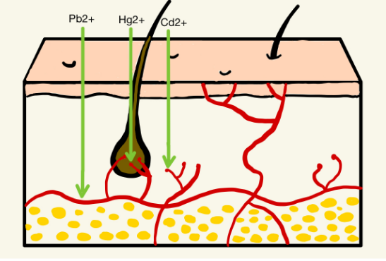
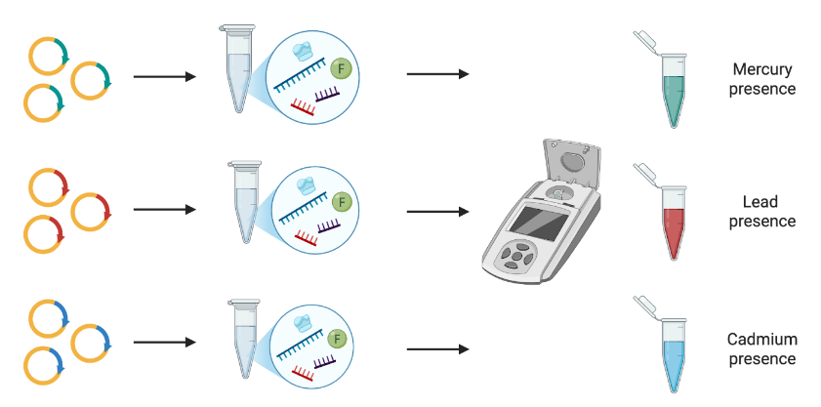
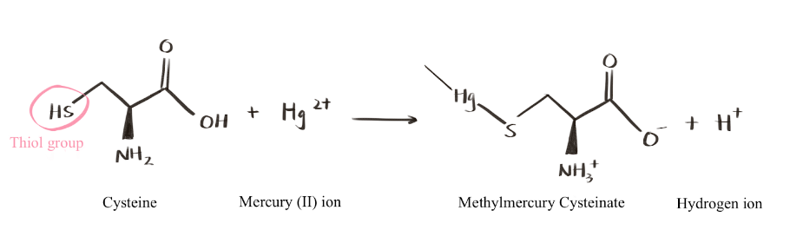







In Vitro Biosensor for Detecting Heavy Metals in Cosmetics
Jungin Yoon and Maya Vaden, Ms.Vivien Marmerstein, Dr. Hiroko Kaczmarek (Biobuilder)
Western Reserve Academy, Hudson, Ohio, United States
Abstract
Background
Meet the team!
Next steps:
Troubleshooting: Find errors or mistakes, redo the lab protocols so that the Pb would express mCherry fluorescence.
Expand detection to other heavy metals, specifically mercury and cadmium, by designing and testing the corresponding regulatory proteins and promoters (MerR/PmerT and CadR/PCadA).
Test real cosmetic products to ensure the system works in complex mixtures, not just standard solutions.
Heavy metal use in cosmetics poses detrimental health risks. In the United States, 41% of consumers aged 30 to 59 use makeup daily, and over 90% of cosmetics contain one or more of the following toxic elements: mercury, lead, or cadmium. Heavy metals are often used in cosmetics to boost their function. For example, mercury in whitening creams inhibits melanin production, a substance responsible for skin pigmentation. When cosmetics are directly applied to the skin, metal ions enter the body through hair follicles and sweat pores then reach the bloodstream, allowing it to bind to proteins, disrupt their function by accumulating in various organs, causing health issues such as dizziness, insomnia, neurological damage. Therefore, monitoring heavy metals in cosmetic products is essential. However, current testing requires specialized laboratories, trained personnel, and complex procedures. Our project aims to develop an TX-TL test solution that detects heavy metals in cosmetics. The presence of metal ions will bind to metal-responsive proteins, triggering the corresponding promoter to initiate the translation of fluorescent protein genes, revealing different colors. It will not only empower consumers to test their products at home but also enable cosmetic manufacturers to evaluate the composition of raw materials.
The global cosmetics market was valued at 374.18 billion US dollars in 2023 and is estimated to reach 417.24 billion by 2030 (Cosmetics Market, n.d.). However, this rapidly growing industry is responsible for exposing humans to heavy metals that can harm our health. According to Health Canada, in most Sub-Saharan countries, more than 90% of cosmetics tested positive for Lead (Pb), Cadmium (Cd), Mercury (Hg), etc. (Raza-Naqvi et al., 2022). Since cosmetics are directly applied to the skin, heavy metals can easily enter the body through hair follicles and sweat pores to the blood capillaries (Raza-Naqvi et al., 2022).
Thus, it attacks the thiol group of the amino acid Cysteine in proteins, distorting the tertiary structure of proteins, leading to the loss of biological functions. Meanwhile, Lead attacks the hydroxyl (-OH) group. Since the body cannot metabolize or eliminate these heavy metals, prolonged exposure may lead to skin irritation, neurotoxicity, organ damage, and, in severe cases, cancer (Dinake et al., 2023, p. 1). Therefore, monitoring the concentration of heavy metals in cosmetic products is essential.
Hi! We are the Heavy Metal Heroes from Western Reserve Academy!
[left] Jungin (Janie) Yoon and [right] Maya Vaden.
This is our second year working on this project!
Over time, these metals accumulate in the body and interfere with biological processes by displacing normal functional groups by competing for electrons (Raza-Naqvi et al., 2022). As illustrated in Figure 2, Mercury has a high affinity for thiol (-SH) groups, a chemical compound.
Figure 2: Penetration of heavy metals through human skin.
References and acknowledgements
We would like to extend our gratitude to Ms. Marmerstein for always being so supportive and giving her insight to our project and to our mentor, Dr. Hiroko Kaczmarek, for her invaluable advice and guidance.
Figure 3: Electrophilic substitution of mercury at the thiol group of cysteine.
Figure 1: Detection flowchart for heavy metal identification using a cell-free TX-TL biosensor.

Slide 2

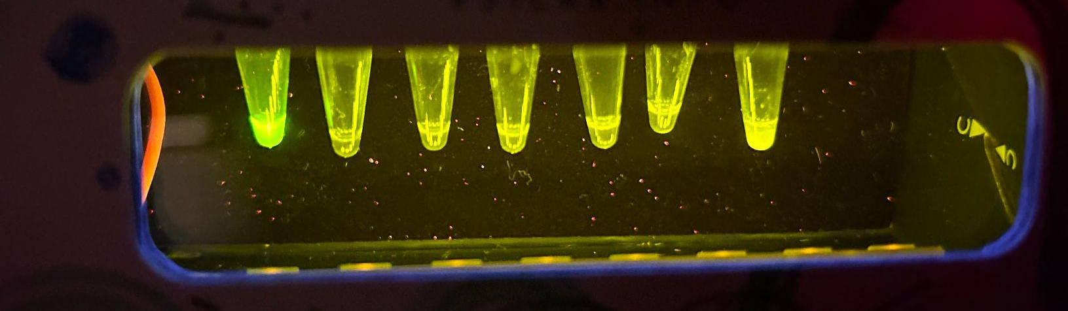
In Vitro Biosensor for Detecting Heavy Metals in Cosmetics
Jungin Yoon and Maya Vaden, Ms.Vivien Marmerstein, Dr. Hiroko Kaczmarek (Biobuilder)
Western Reserve Academy, Hudson, Ohio, United States
Science Content
Meet the team!
Next steps:
Troubleshooting: Find errors or mistakes, redo the lab protocols so that the Pb would express mCherry fluorescence.
Expand detection to other heavy metals, specifically mercury and cadmium, by designing and testing the corresponding regulatory proteins and promoters (MerR/PmerT and CadR/PCadA).
Test real cosmetic products to ensure the system works in complex mixtures, not just standard solutions.
Hi! We are the Heavy Metal Heroes from Western Reserve Academy!
[left] Jungin (Janie) Yoon and [right] Maya Vaden.
This is our second year working on this project!
Figure 1: Genetic circuits for mercury, lead, and cadmium detection.
Cell-free TX-TL reactions were assembled using the myTX-TL Pro system to evaluate lead detection. The Master Mix solution contained myTX-TL Pro Master Mix, Pro Helper Plasmid, linear T7_pbrR DNA encoding the PbrR transcription factor, and linear pbrA-mCherry DNA containing the pbrA promoter upstream of the mCherry reporter gene. Pb²⁺ solutions were prepared through dilution to generate a range of lead concentrations and added for response analysis of the circuit. A positive control reaction was prepared to confirm the function of the TXTL system. The positive control contained myTX-TL Pro Master Mix, Pro Helper Plasmid, and a T7-deGFP plasmid to enable expression of deGFP fluorescence. A negative control reaction was assembled using myTX-TL Pro Master Mix and Pro Helper Plasmid with deionized water in order to evaluate background fluorescence. The expectations are that the negative control not displaying GFP with the positive control displaying GFP. All Master Mixes added by lead should display mCherry fluorescence.
In order to build this biosensor, we created the linear DNA through Benchling. We designed specialized genetic circuits in order to identify the biological components for heavy metal detection. Our lead detection circuit includes a lead-responsive transcription factor, PbrR, that binds and activates the pPbrA promoter. Once activated, the circuit expresses mCherry, which will then produce a red signal. This process will be replicated with the respective promoters and proteins to detect mercury and cadmium. At the molecular level, the genetic circuit is comprised of three primary components: a metal-responsive transcription factor, a specific promoter, and a fluorescent reporter gene. In the case of testing for Lead, the PbrR transcription factor acts as a sensor that remains inactive until it encounters and binds with the heavy metal, then undergoing a structural chance and binding with the promoter and starting the transcription of the reporter gene. This process results in the production of a fluorescent protein that serves as visual indicator. By integrating these pathways for mercury, lead, and cadmium into a single, cell-free mixture, the biosensor will be able to give an indication of each heavy metal through different colors: red, green, and blue.
To validate the lead-detection system, prepare a dilution of lead of 0 ppm, 5 ppm, 10 ppm, 100 ppm, and 1000 ppm, as well as a positive and negative control in order to test the sensitivity and response of our lead detection circuit across a range of concentrations.
References and acknowledgements
We would like to extend our gratitude to Ms. Marmerstein for always being so supportive and giving her insight to our project and to our mentor, Dr. Hiroko Kaczmarek, for her invaluable advice and guidance.
Positive
Control
Negative
Control
10
ppm
1000
ppm
1
ppm
5
ppm
100
ppm
Figure 2: TXTL solutions mixed with different concentrations of Pb.

