Slide 1

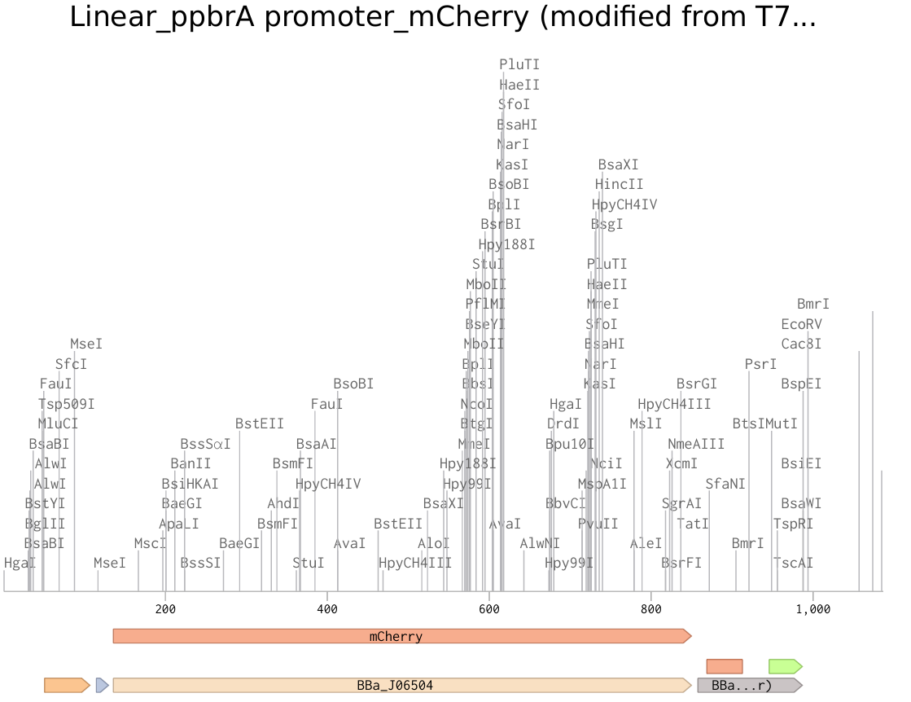

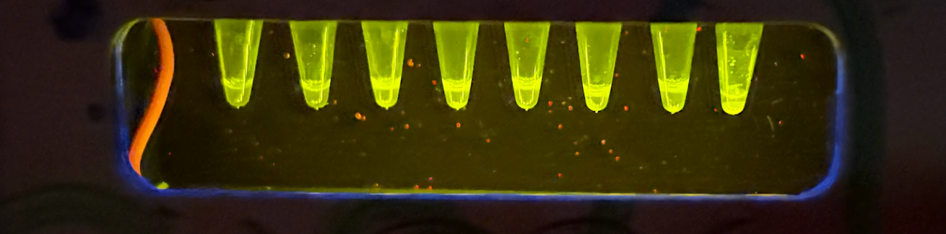






In Vitro Biosensor for Detecting Heavy Metals in Cosmetics
Jungin Yoon and Maya Vaden, Ms. Vivien Marmerstein, Dr. Hiroko Kaczmarek (Biobuilder)
Western Reserve Academy, Hudson, Ohio, United States
Objective
Our project aims to develop a three-in-one biosensor to detect harmful metals in cosmetics, specifically mercury, lead, and cadmium. We envision the product for direct use by consumers to evaluate their own cosmetics, as well as by companies to evaluate their raw materials. We started with creating the in vitro TX-TL biosensor kit for Lead (Pb).
Figure 2: Linear ppbrA promoter_mCherry DNA.
Expected Results: We expect for the solution to change hue when the cosmetics are added. For lead, we expect our designed system to produce red fluorescence from mCherry in response to different concentrations of lead in the solution. Negative control should not turn GFP with the Positive control displaying GFP.
(a)
(b)
(c)
Figure 1: Genetic circuits for (a) mercury, (b) lead, and (c) cadmium detection.
Each circuit is initiated by a metal-specific regulatory protein & promoter, driving the expression of a fluorescent reporter gene.
Metal-responsive promoter triggers fluorescent protein expression in the presence of different concentrations of lead. Images of expressed fluorescence will captured and analyzed using ImageJ.
Negative
Control
Positive
Control
0
ppm
100
ppm
10
ppm
1000
ppm
5
ppm
50
ppm
Figure 3: TXTL solutions mixed with different concentrations of Lead.

