Slide 1

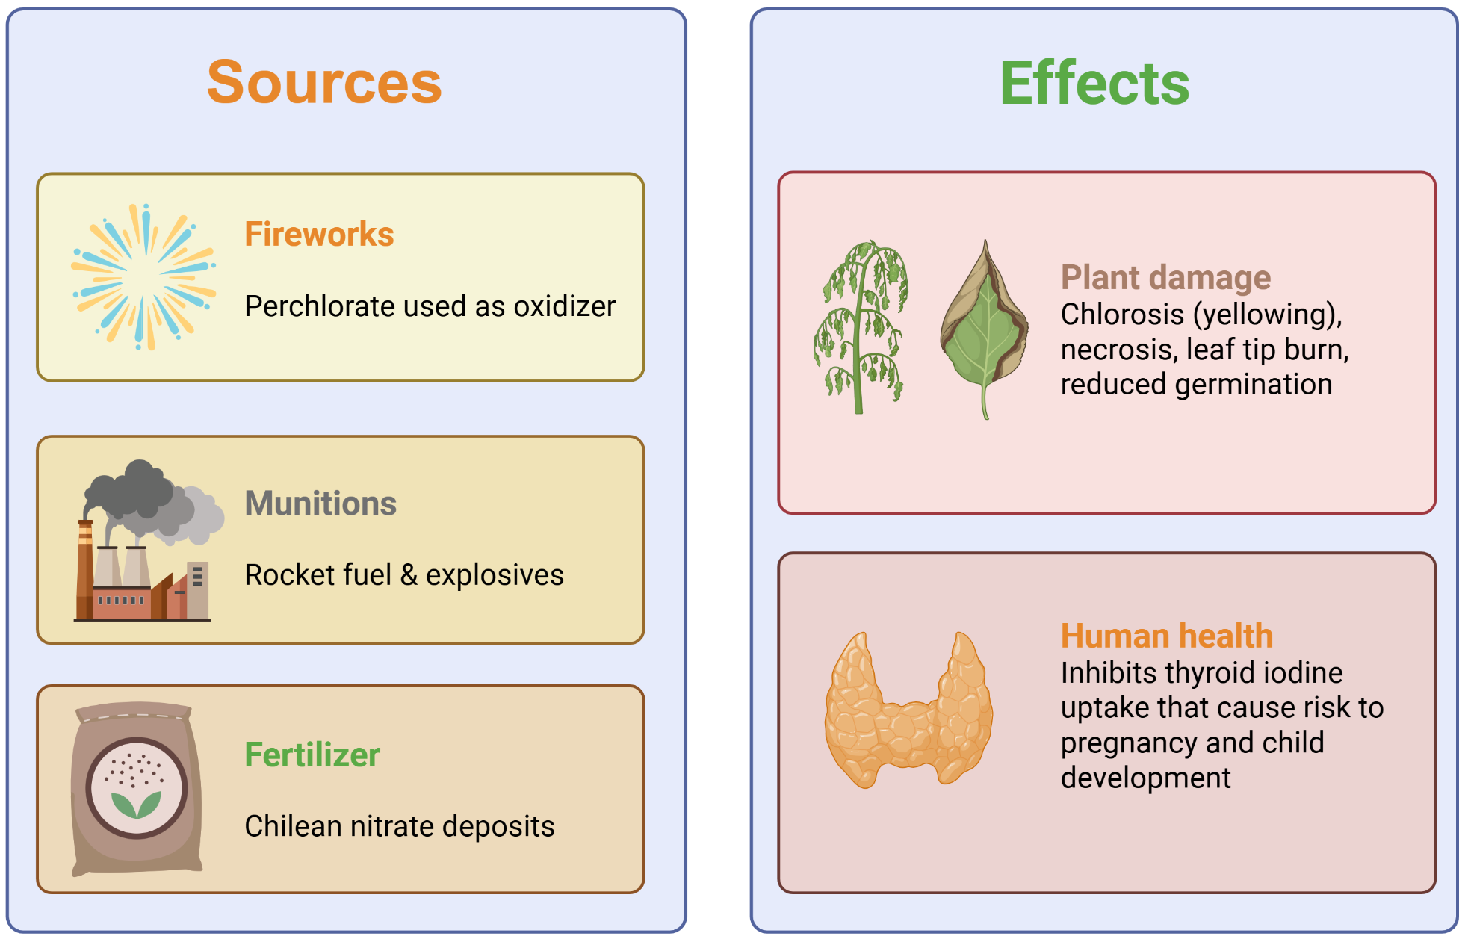
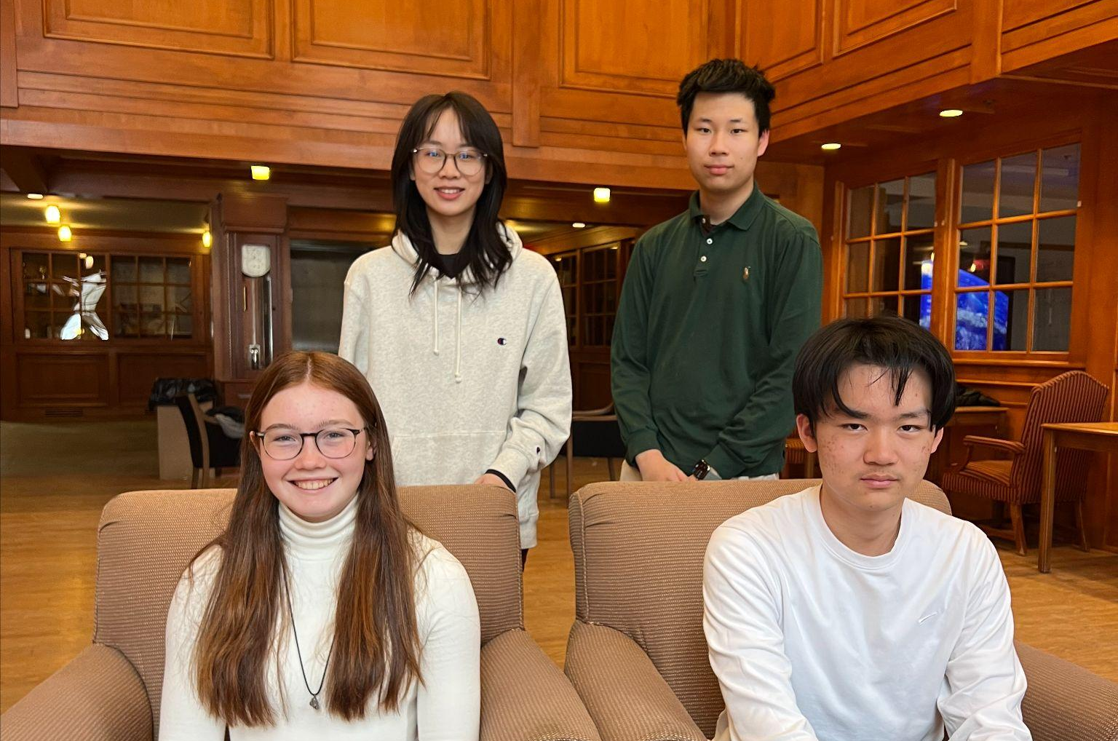












Aerobic bioremediation of perchlorate contamination via a novel Pseudomonas stutzeri construct
Stephanie Qin, Anna Barger, Alex Wang, Joe Yang, Ms. Vivien Marmerstein, Dr. Eric Young (936-Technologies)
)
Western Reserve Academy, Hudson, Ohio, United States
Abstract
Perchlorates (ClO₄⁻) are harmful chemicals commonly found in arid and semi-arid regions worldwide. While they are naturally occurring, perchlorate concentrations have increased drastically due to anthropogenic activities. This presents a major challenge to agriculture in arid regions and risks contaminating groundwater drinking supplies. Even at microgram levels, perchlorate is toxic—for example, when present in the soil, they interfere with plant growth by competitively inhibiting nutrient uptake. Current treatments are often expensive and ineffective, and potential bioremediation strategies rely on anaerobic pathways that are unachievable in nature. This paper aims to engineer a three-step degradation pathway in Pseudomonas stutzeri, a bacterium capable of withstanding harsh, arid environments. Enzymes expressed from a plasmid operon will first reduce perchlorate, after which the resulting intermediates will be processed by the chassis’ endogenous chlorate reduction and dismutation pathways to finally produce chloride and oxygen. A flavodiiron protein module will also be introduced to prevent intracellular oxygen accumulation, ensuring perchlorate will not be outcompeted as the terminal electron acceptor and thereby allowing the system to function in aerobic conditions. If successful, this chassis could be deployed directly to contaminated soil and water sources, providing a cost-effective approach to perchlorate pollution without the need for additional infrastructure.
Introduction
Perchlorates are noted groundwater and soil contaminants. They occur naturally in arid areas around the globe, but are also produced as byproducts during munitions manufacturing and the setting off of fireworks: as such, their concentrations around the globe have drastically increased over the past several decades. Despite this pressing issue they remain entirely unregulated at the federal level in the United States, even though they are noted to be dangerous in microgram concentrations. There are several possible solutions to treating perchlorate contamination such as ion exchange or selective membrane filtration; however, both these methods are limited by their cost and generation of waste. Almost all solutions experience limited scalability and have not been tested on a large scale. Our project counters this by creating a biological solution that can be implemented across the Earth’s arid areas using Pseudomonas stutzeri, a bacterium largely resistant to desiccation and irradiation. We will implement a 3-step reduction method using enzymes placed inside a recombinant plasmid as well as an Flavodiiron Protein (FDP) module to prevent oxygen from acting as a preferred electron acceptor in the cell. Finally, we will implement a chassis kill switch that operates based on lack of perchlorate presence, ensuring that once perchlorates have been broken down the bacteria will not continue to operate in the environment.
Team: We are a returning school, but a new team with four members. We meet as an afterschool activity in replacement of a sport and love biology and engineering. Most of our members also take our school’s Synthetic Biology and Cancer Immunology courses!

Slide 2
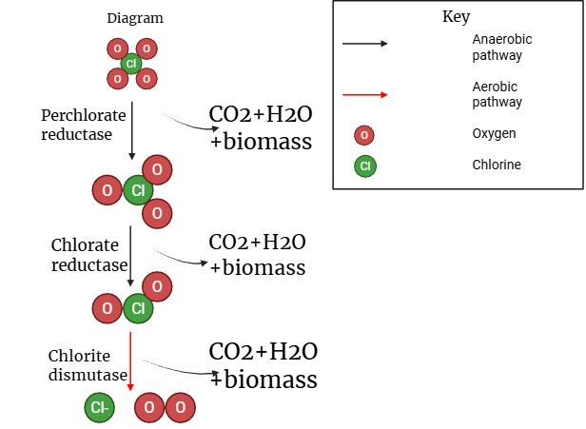
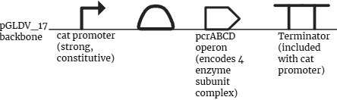

Aerobic bioremediation of perchlorate contamination via a novel Pseudomonas stutzeri construct
Stephanie Qin, Anna Barger, Alex Wang, Joe Yang, Ms. Vivien Marmerstein, Dr. Eric Young (936-Technologies)
)
Western Reserve Academy, Hudson, Ohio, United States
Design I
Three-step Pathway for Perchlorate Remediation
1. Reduction I
  Perchlorate (ClO₄⁻) => Chlorate (ClO₃⁻)
  Catalyzed by the 4-subunit operon Perchlorate Reductase
  Expression of pcrABCD Operon in P. stutzeri via broad host range plasmid pBBR1
2. Reduction II
  Chlorate (ClO₃⁻) => Chlorite (ClO₂-)
  Catalyzed by chlorate reductase, via endogenous clr gene
3. Dismutation
  Chlorite (ClO₂-) => Chloride (Cl⁻) + Oxygen (O₂)
  Catalyzed by chlorate dismutase, via endogenous cld gene
Design II
Chassis, plasmid, and parts
Chassis: The chassis P. stutzeri is selected because of its ability to perform both aerobic and anaerobic respiration, excellent resistance to desiccation and DNA damage due to radiation, and the fact that it already contains genes for the second reduction and dismutation pathways. Specifically, the strain DSM50227 we will use is originally isolated from soil and water, and that it maintains plasmid better than most other strains. To maintain optimal growth for P. stutzeri, it will be cultured in Luria-Bertani (LB) broth and incubated at 30°C under anaerobic conditions.
Flavodiiron Protein (FDP) Oxygen-consuming module: Oxygen is ubiquitous in arid soil and water. Its high electronegativity makes it a more favorable electron acceptor than perchlorate, potentially diverting electrons away from perchlorate reductase and inhibiting its function. The FDP module addresses this competition by reducing oxygen to water upon binding to flavodiiron proteins. It also consumes molecular oxygen generated as a byproduct of chlorite dismutation, preventing feedback inhibition of the reduction pathway. The module will be activated when oxygen levels rise.
Next Steps
Obtain and validate successful chromosomal insertion of the oxygen-reducing plasmid before introducing the perchlorate breakdown plasmid through antibiotic resistance selection.
Confirm protein expression with SDS-PAGE and/or Western blotting.
Use ion chromatography or mass spectrometry to validate effective functioning of the perchlorate breakdown operon genes.
Assess the effectiveness of endogenous cld and clr genes encoding chlorate reductase and chlorite dismutase, respectively, and introduce additional copies from external sources if current expression is insufficient to sustain necessary pathway flux.
Assess chlorite toxicity and, if necessary, upregulate chlorite dismutase and downregulate chlorate reductase to minimize intracellular accumulation.
Explore the potential of CO₂ fixation or biosynthesis pathways via co-culturing the current host with another engineered strain.
References and Acknowledgements
We would like to thank our mentor, Dr. Eric J. Young, our faculty advisor, Miss Marmerstein, and the WRA Science Department for their support of this project.
Works Cited

