Slide 1

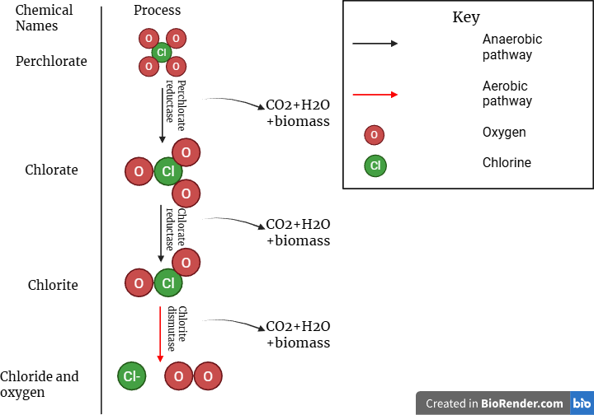
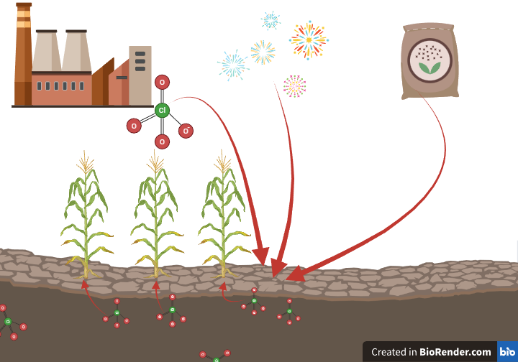
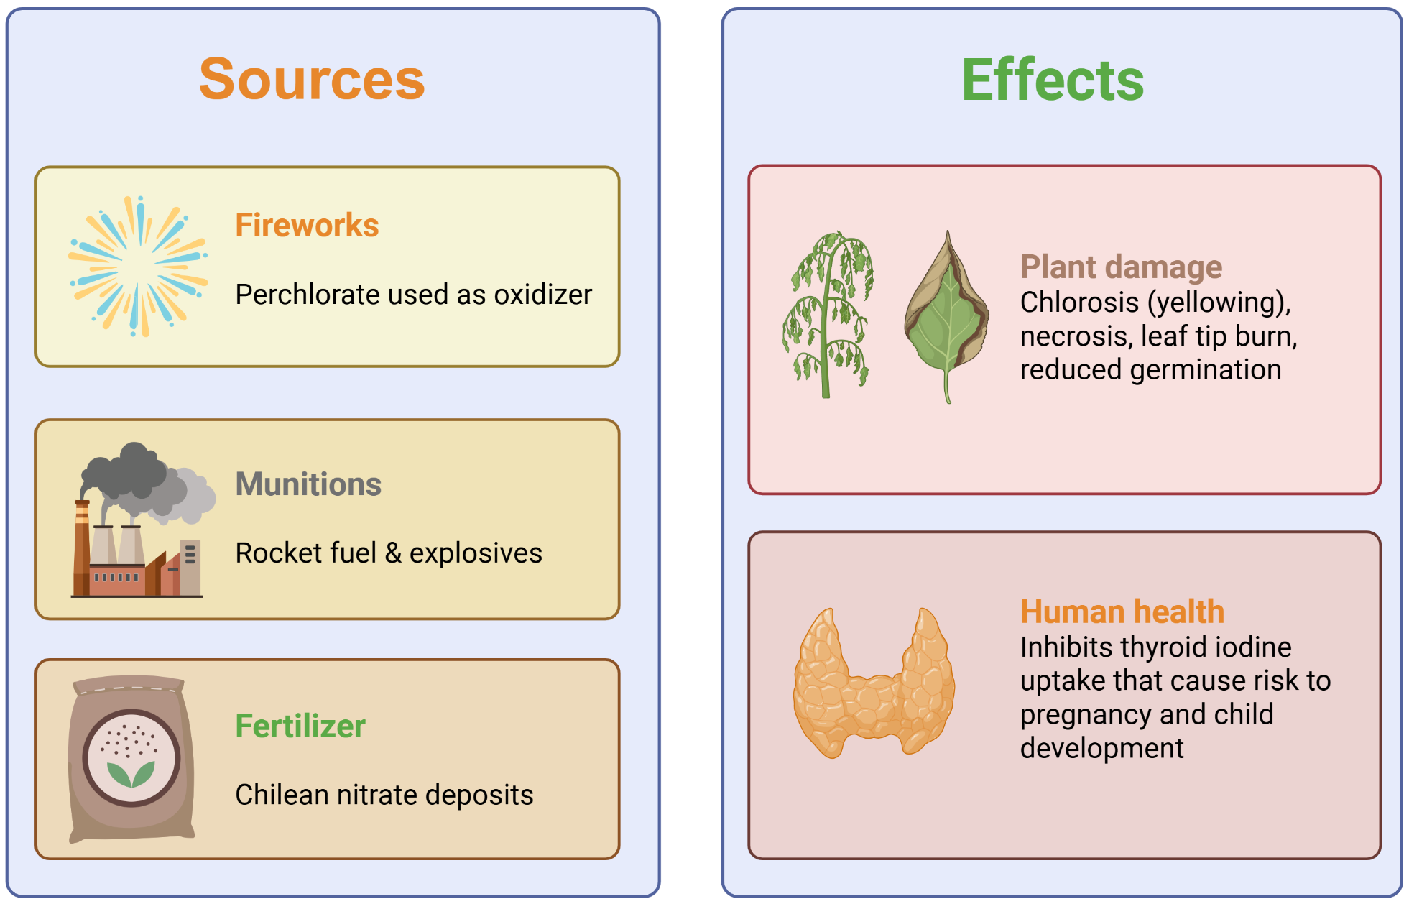
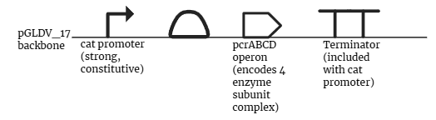






Aerobic bioremediation of perchlorate contamination via a novel Pseudomonas stutzeri construct
Stephanie Qin, Anna Barger, Alex Wang, Joe Yang, Ms. Vivien Marmerstein, Dr. Eric Young (936-Technologies)
Western Reserve Academy, Hudson, Ohio, United States
Achieving in situ bioremediation of perchlorates via genetically engineered P. stutzeri bacterium
Uses 3 step reduction pathway to produce chloride and oxygen
Circumventing oxygen competition with FDP system in second plasmid
CO2, H2O and biomass produced as by-products

