Slide 1

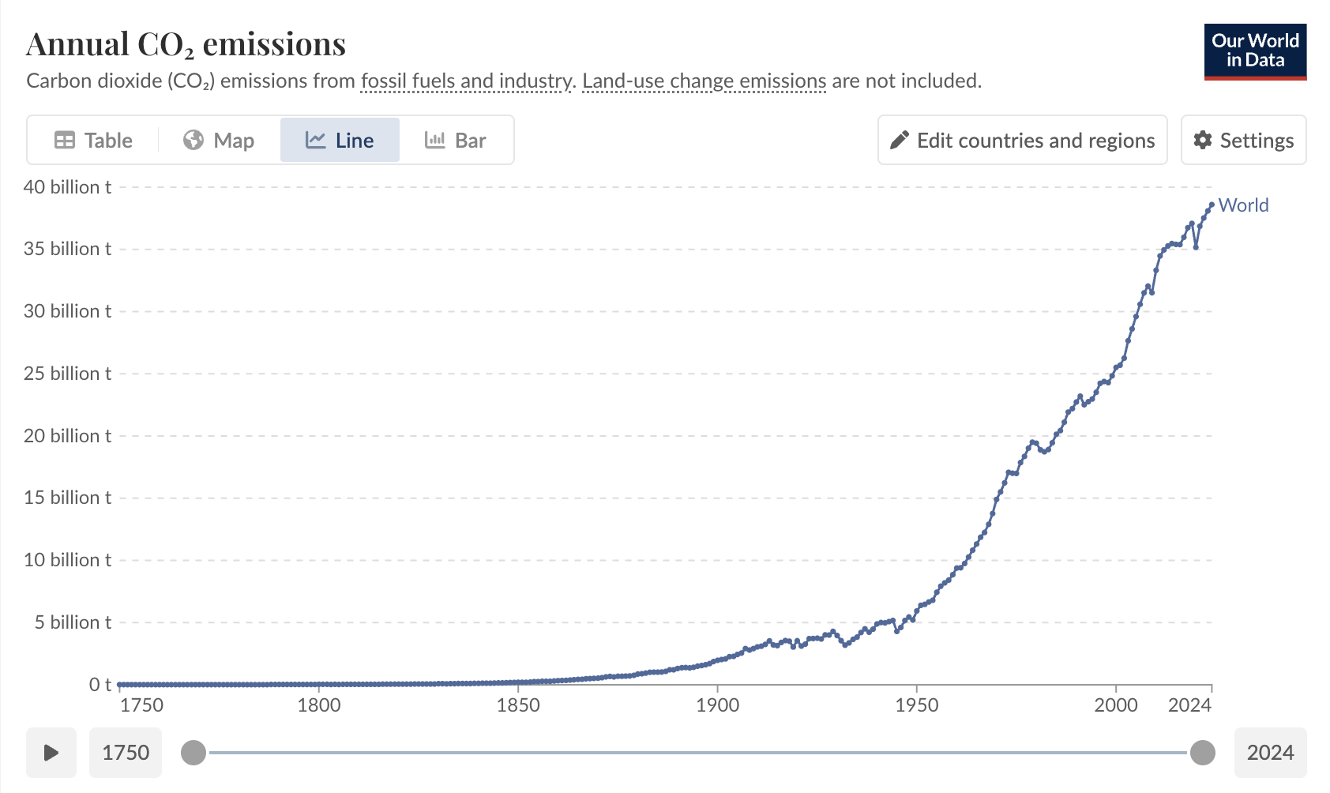
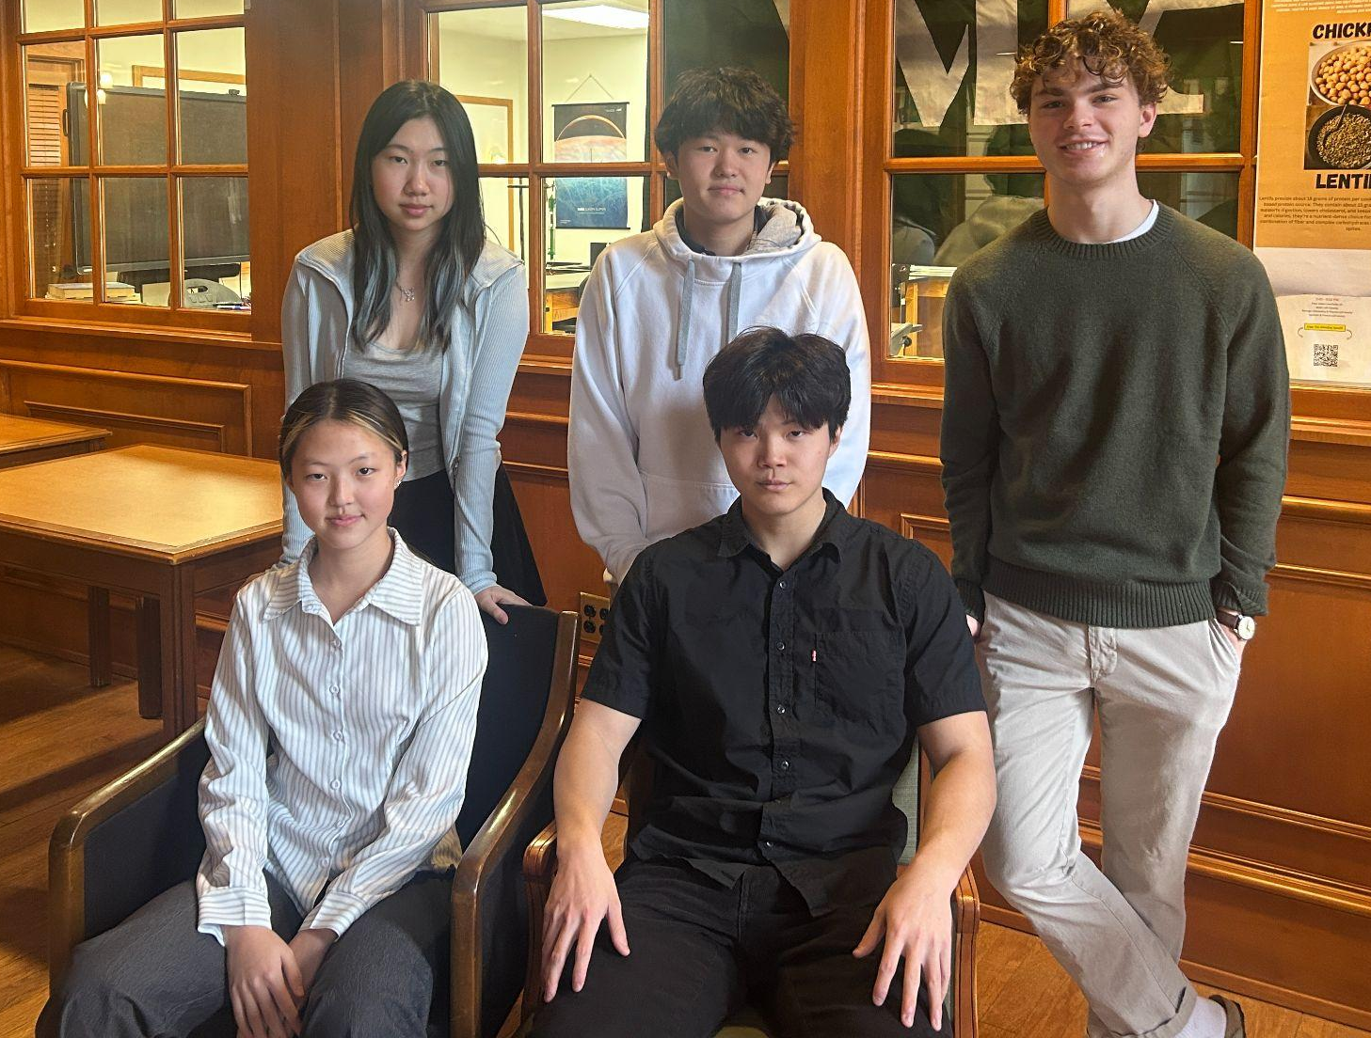
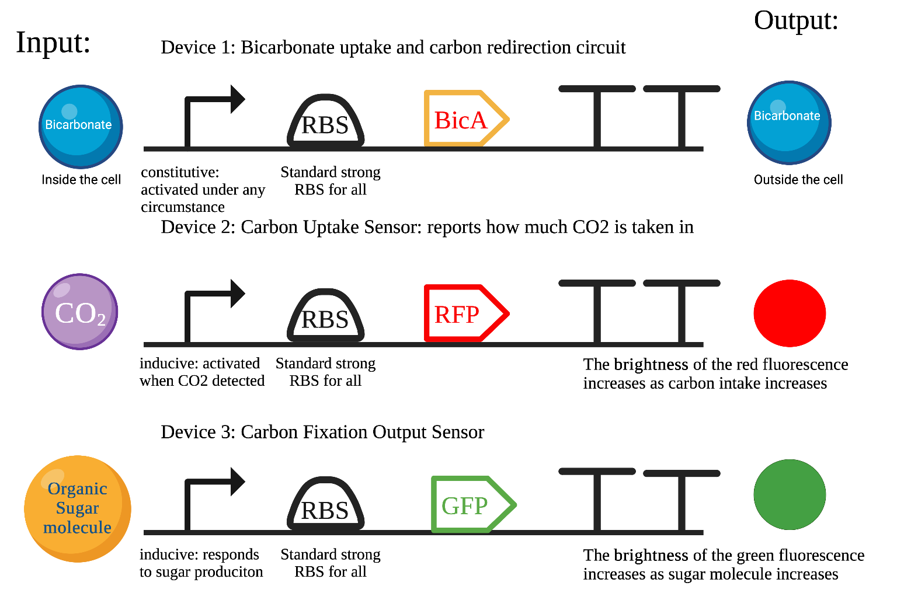
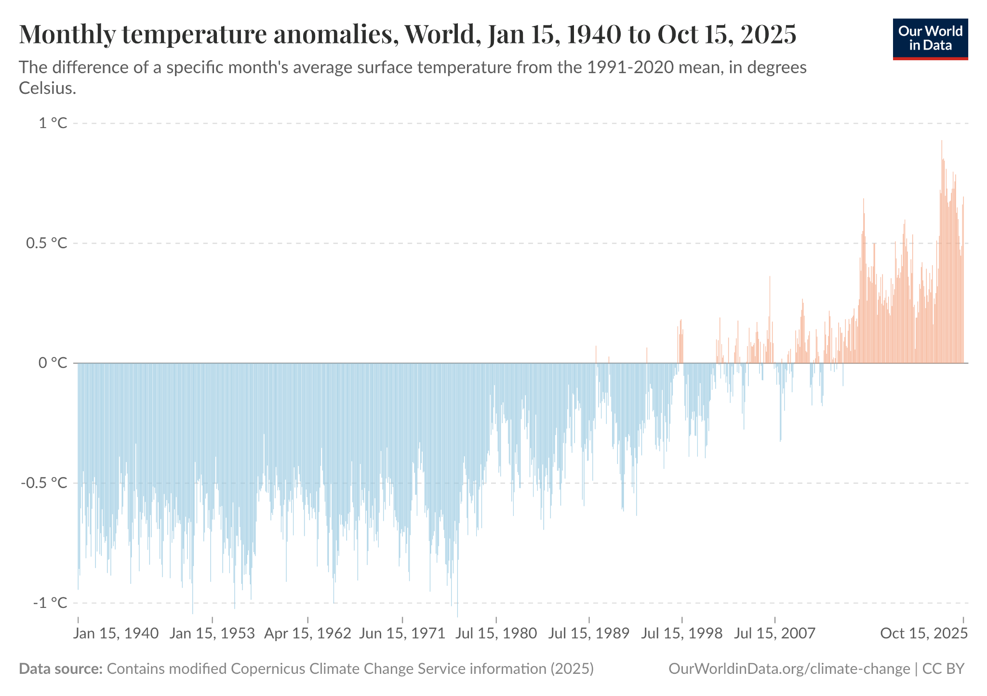







Enhancing CO2 Fixation and Biofuel Production Efficiency Using Cyanobacteria
Jaeyun Lee, Roberts Sartor, Ryo Nakano, Boran (Emily) Zhang, Yirou (Rose) Huang, Ms. Vivien Marmerstein, Aditya Pandharinath Sarnaik (Arizona State University)
Western Reserve Academy, Hudson, Ohio
Abstract
Industrial activities have driven CO2 levels to 421 ppm, a value not seen in 4 million years of recorded history. The resulting global warming has led to dangerous environmental hazards such as wildfires, floods, and ocean heat waves, costing the U.S. over $2.915 trillion since 1980. However, existing solutions like Storage and Bioenergy with Carbon and Sequestration (BECCS) and Direct Air Carbon Capture (DACC) require extremely high costs and energy devotion. Synthetic Biology provides a possible solution that bypasses all these pitfalls by utilizing Cyanobacteria’s ability to capture carbon dioxide. Cyanobacteria are uniquely suited for the requirements because of their photosynthetic system and carbon-concentrating mechanism, which enhances CO2 uptake around the Rubisco Enzyme. Specifically, the overexpression of bicA, a sodium-dependent bicarbonate transporter, increases inorganic carbon availability and decreases carbon limitation. We will monitor the biosynthesis process with an enzyme-based biosensor that detects cellular stress and bottlenecks, ensuring efficiency and effectiveness. This single system, comprising carbon uptake, fixation, and conservation, not only reduces atmospheric CO2 by capturing it but also generates valuable biofuels, offering a dual approach to mitigating climate change.
Scientific Content
The design will consist of 2 modifications to cyanobacteria to enhance inorganic carbon uptake while simultaneously monitoring carbon assimilation.
The bicA coding sequence is placed under a constitutive promoter with an optimized RBS to drive continuous overexpression, increasing bicarbonate import and intracellular inorganic carbon levels. The bicA overexpression cassette will be integrated into the Neutral Site I (NSI) locus of the Synechococcus elongatus PCC 7942 chromosome to ensure stable expression without disrupting endogenous metabolic pathways.
To evaluate whether enhanced bicarbonate results in increased carbon fixation, we incorporated 2 biosensors. The first biosensor uses a carbon-responsive promoter driving RFP, so red fluorescence increases when bicarbonate uptake rises. The second biosensor uses a sugar-responsive promoter driving GFP, so green fluorescence increases when carbon is successfully fixed into organic molecules. Comparison of the two outputs can indicate mismatches in synthetic efficiency due to bottlenecks.
Next Steps
Our team will grow our modified cyanobacteria strain (Synechococcus elongatus) in photobioreactors under controlled light and carbon dioxide levels. We will measure the amount of carbon dioxide they absorb using an infrared gas analyzer (IRGA) and test the amount of biofuel/byproducts using gas chromatography (GC). We will be able to create a more efficient cyanobacterial strain that can fix carbon at a much higher rate with higher biofuel production.
Team Content
Based in at a boarding school in Hudson, OH, we are a new team consisting of members from China, Korea, Japan, and Kentucky.
(From left to right)
Top: Yirou (Rose) Huang, Ryo Nakano, Roberts Sartor
Bottom: Boran (Emily) Zhang, Jaeyun Lee
Background
Greenhouse gas emission has a profound impact on society with extreme weather disasters including wildfires, record-breaking floods, and marine heatwaves.
Marine ecosystem stressors appeared that surface ocean pH levels are at their lowest in the last 2 million years.
Climate disasters cost $2.915 trillion global economic loss, displacing 140 million residents from South Africa and causing 250,000 extra deaths.
Existing carbon dioxide removal (CDR) solutions are struggling to effectively meet climate targets.
Bioenergy with carbon and sequestration (BECCS) and Direct Air Carbon Capture (DACC) require high costs and energy devotion.
Figure 1: Carbon Dioxide Emission
Figure 2: World Anomalies Temperature
Acknowledgments
We extend our gratitude to Ms. Marmerstein for her support and guidance throughout our project and to our mentor Dr. Aditya Pandharinath Sarnaik for sharing his valuable knowledge and experiences.
References
Notes:
\

