Slide 1


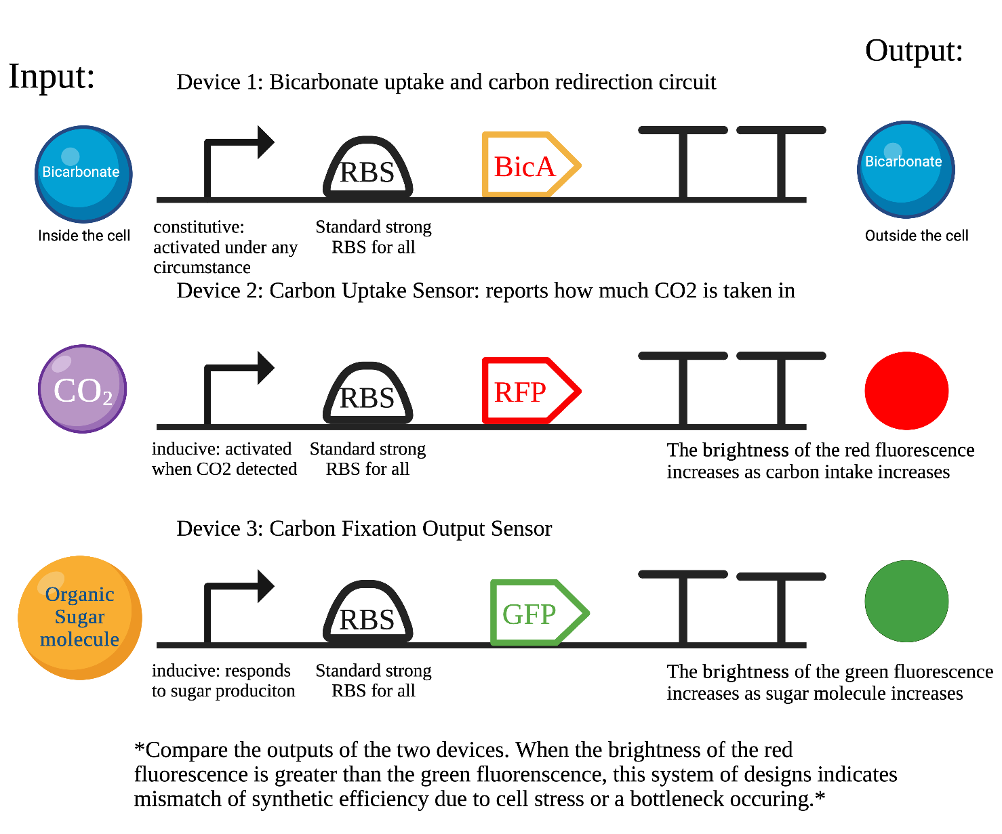
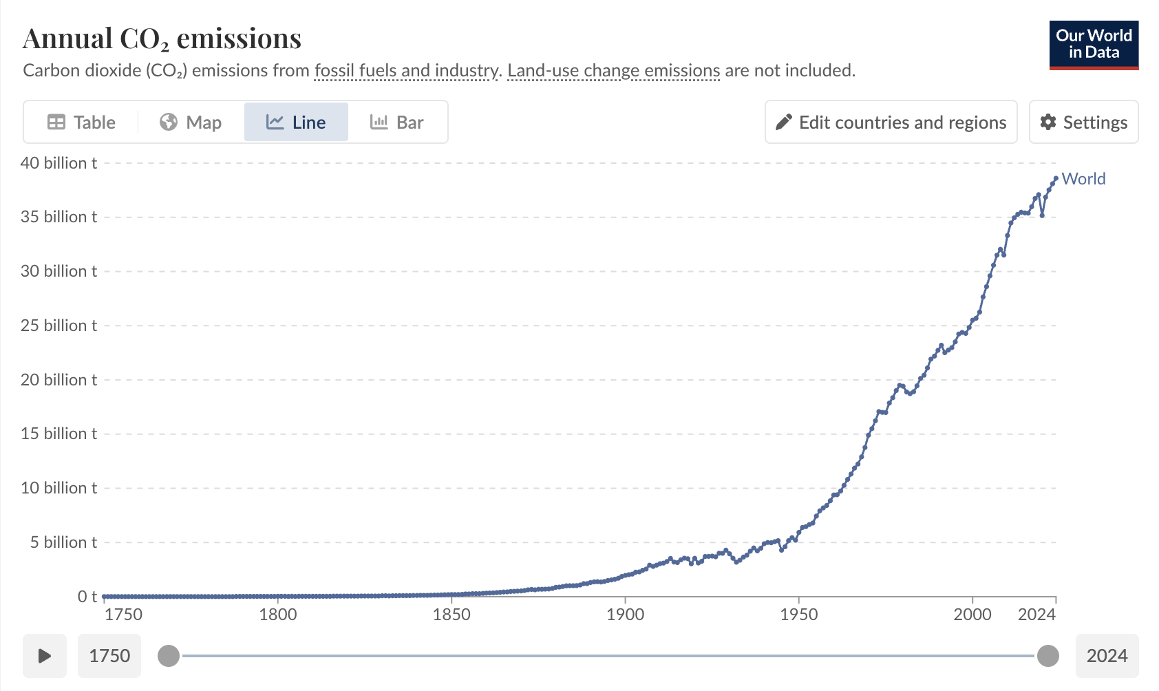






Enhancing CO2 Fixation and
Biofuel Production Efficiency Using Cyanobacteria
Jaeyun Lee, Roberts Sartor, Ryo Nakano, Boran (Emily) Zhang, Yirou (Rose) Huang, Ms. Vivien Marmerstein, Aditya Pandharinath Sarnaik (Arizona State University)
Western Reserve Academy, Hudson, Ohio
Problem
Greenhouse gas emission has profoundly affected environment and human society.
Global warming has intensified hazards, costing the U.S. over $2.915 trillion since 1980.
Objectives
Build an efficient carbon fixation and biofuel production system.
Engineer the bicA gene into cyanobacteria and overexpress to increase bicarbonate intake and reduce the bottleneck in CBB cycle.
Include a biosensor detecting the cell stress level and bottlenecks to ensure efficiency and effectiveness.
Capturing CO2 and generating valuable biofuels out of it with the goal of mitigating climate change.
Bicarbonate Uptake and Cell Stress Biosensor Design
Annual CO2 Emission Graph

