Slide 1
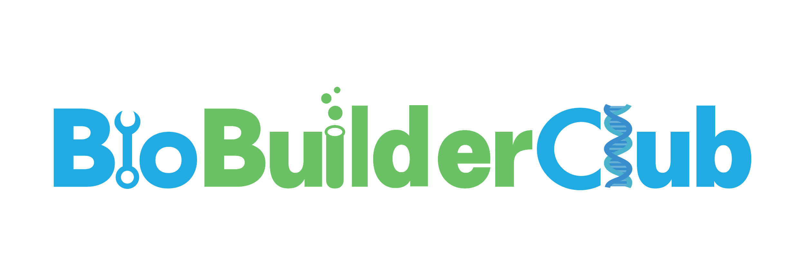
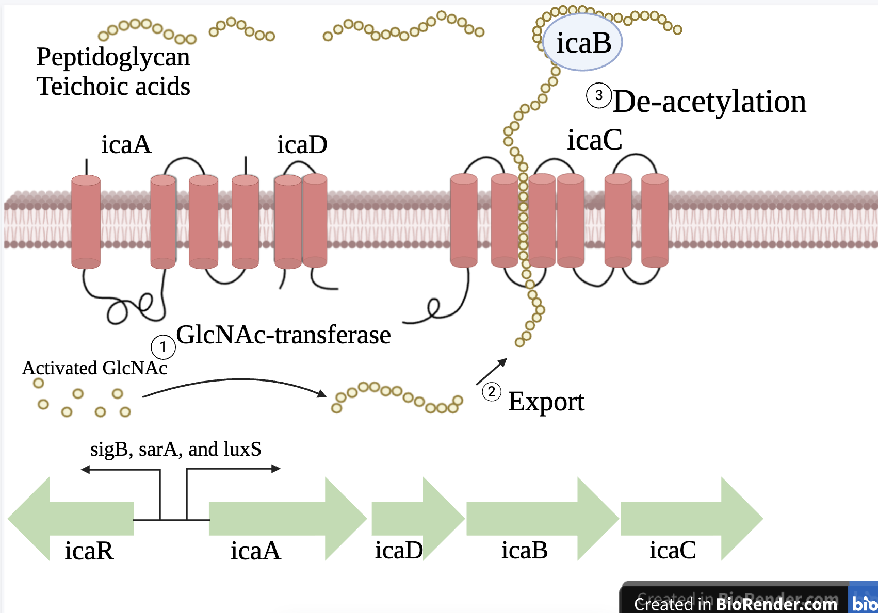
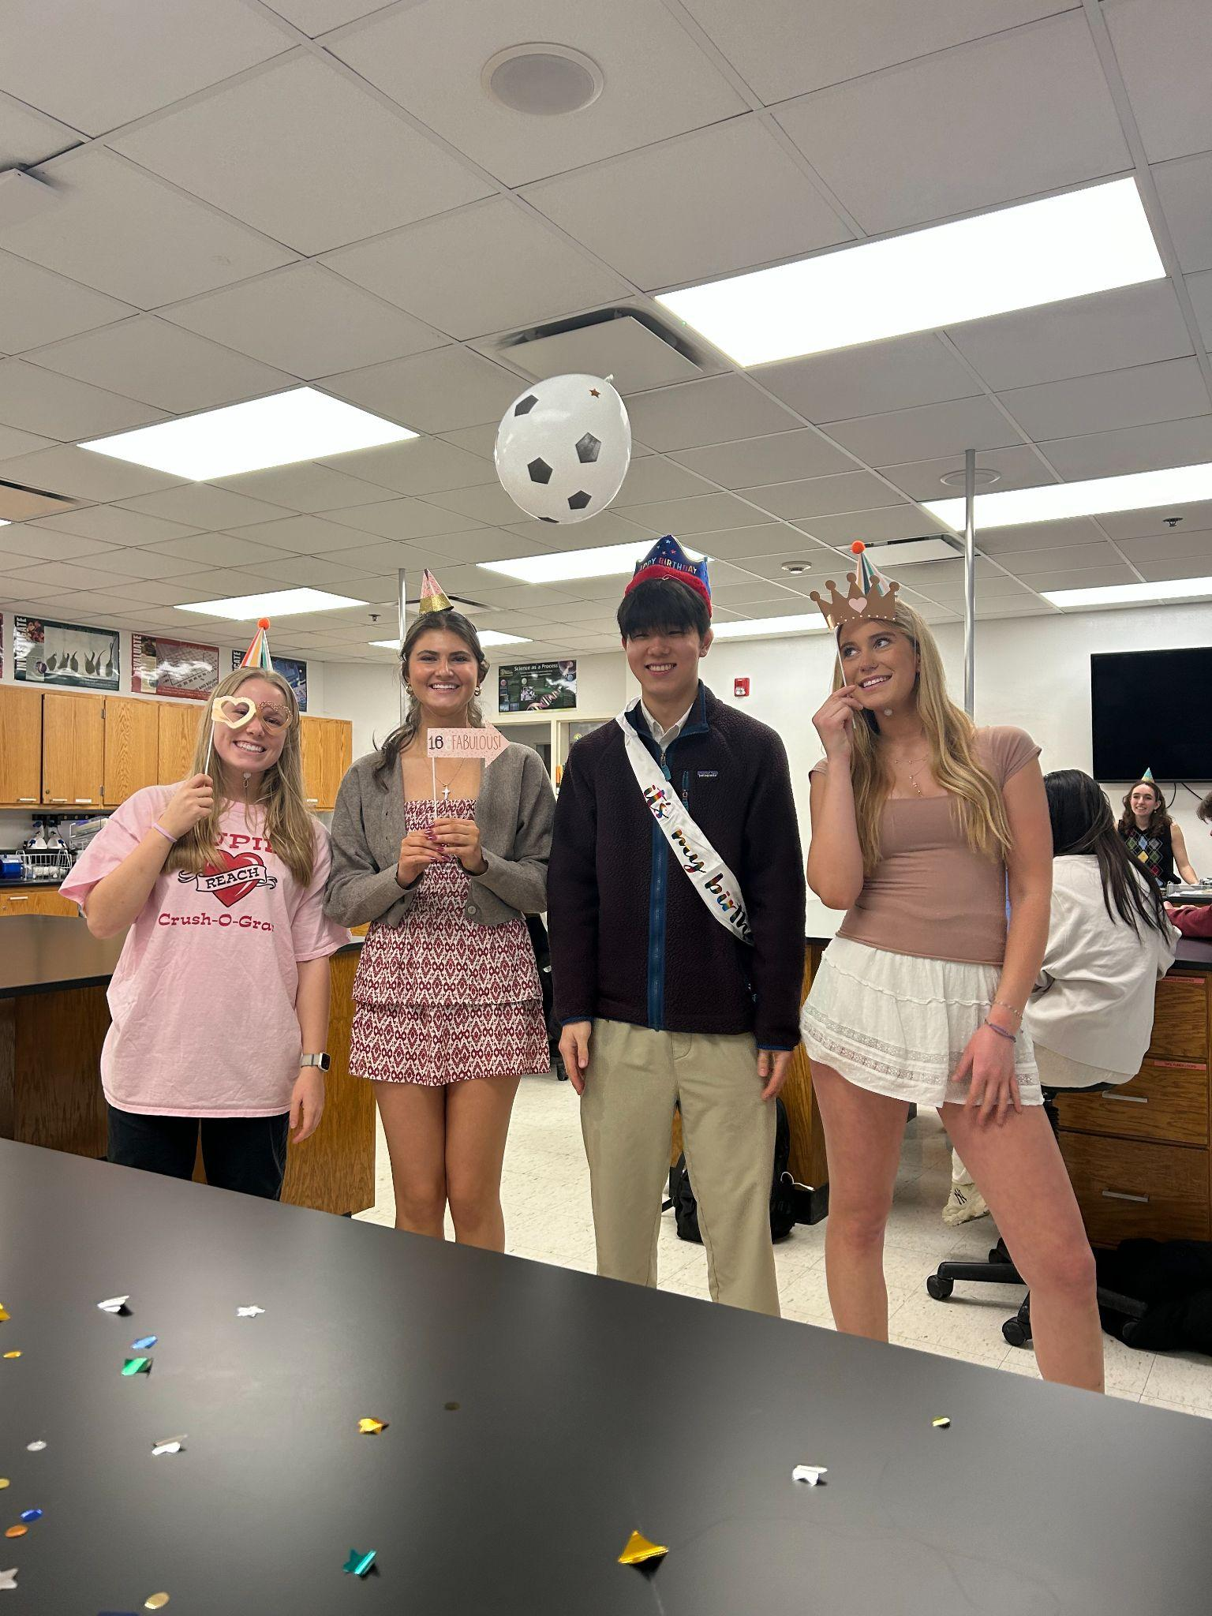
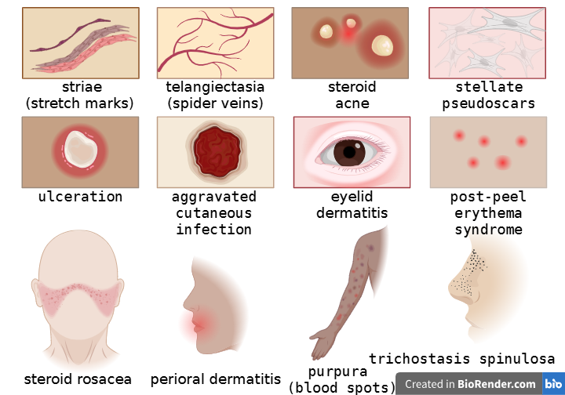
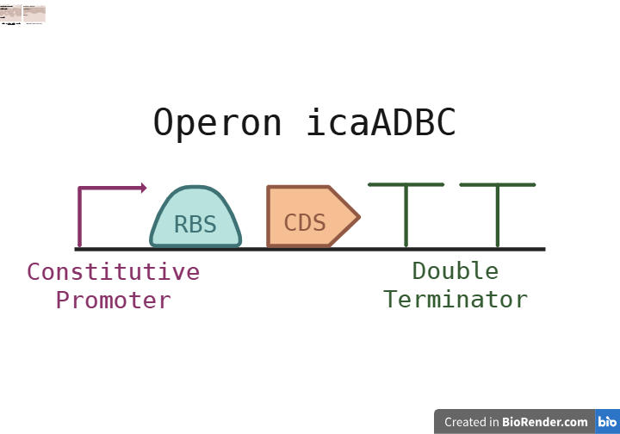







Enhancing PIA production in Staphylococcus epidermidis to treat Atopic Dermatitis
Alida Karsten, Alex Lee, Lydia Lockwood, and Delaney Pittinger
Teacher: Ms. Vivien Marmerstein, Leader: Alex Lee, Mentor: Ms. Jackie Thompson (Takeda Pharmaceuticals)
Western Reserve Academy, Hudson, Ohio, United States
Abstract
Atopic dermatitis, or eczema, is a chronic inflammatory disease that impacts 204 million globally. It is characterized by dryness, itching, and irritation of the skin caused by reduced moisture retention and increased susceptibility to irritants, commonly Staphylococcus aureus. While some find success in treating the disease with topical corticosteroids, those treatments generally come with side effects, such as skin thinning, acne, and skin pigmentation changes. While these treatments aim to reduce inflammation and symptoms, they do little to support the skin’s microbiome. Staphylococcus epidermidis supports skin health, but is under-represented in individuals with eczema, making it a safe and effective chassis for an engineered AD treatment. We will enhance this bacteria’s synthesis of polysaccharide intercellular adhesin (PIA), a major contributor to a biofilm that helps retain moisture and create a healthy skin barrier, by inserting a plasmid with the icaADBC operon (which codes for PIA synthesis) into S. epidermidis. This will help restore the skin barrier by simultaneously increasing PIA synthesis, antimicrobial peptide production (which fights S. aureus overgrowth), and nutrient availability. The biofilm formed by PIA will allow the skin to retain these nutrients and lipids. This engineered bacteria will be formulated into a cream that heals damaged skin directly, and fights underlying causes by increasing water and nutrient retention.
Science Content
Because the natural habitat of S. epidermidis is human skin, incorporating the bacteria into an eczema treatment allows the skin to naturally restore its barrier, rather than using harsh chemicals found in other therapies. This approach not only helps reduce eczema flare-ups and redness but also provides long-term support by increasing overall water retention and skin acidity. Additionally, the bacteria's ability to produce antimicrobial peptides helps the skin suppress harmful microbes that often trigger flare-ups and secondary infections, such as Staphylococcus aureus, thereby treating eczema at the source.
This process is demonstrated in Figure 2. A biofilm is a complex community of microorganisms in a matrix of polysaccharides, proteins, and nucleic acids. In this case, the biofilm is an important piece of our solution as it helps protect the components and bacteria we want to enhance in the skin barrier rather than unwanted bacteria.
S. epidermidis exopolysaccharide PIA is a major contributor to the biofilm, helping retain moisture and create a healthy skin barrier. Exopolysaccharides are sticky sugars that trap nutrients and water, helping keep the skin hydrated and balanced for longer. By enhancing the natural components of S. epidermidis and using engineered plasmids carrying the icaADBC operon, we can increase PIA production, antimicrobial peptide production, and nutrient availability. The modified gene would confer S. epidermidis with a stronger biofilm, strengthening the skin barrier and increasing water retention via PIA.
Figure 3:
Team Context
We are a new team from Western Reserve Academy. There are four members on our team and we have been enjoying the process of creating a theoretical solution to combat eczema. We have been meeting with our mentor, Jackie Thompson, on a regular basis and are grateful for the guidance she has provided us with. Our group has also enjoyed getting to know more about each other through this project, as it has been a knowledgeable experience in a synthetic biology context, but also in creating and fostering new friendships.
Next Steps
A vital next step for our project would be identifying and locating specific plasmids that are compatible with our project’s goals. We are currently studying the pLI50 plasmid, however, there are countless plasmid options that could work with our project and we will need carefully examine those.
The long term goal for our project is to eventually use the modified gene to create a natural treatment in the form of a topical cream. To complete this, we will need to complete trials in the lab.
Figure 2:
The icaADBC operon in S. epidermidis
produces PIA, allowing the bacteria to form a biofilm that helps protect the skin barrier.
Meet the Team!
(From left to right) Lydia Lockwood, Delaney Pittinger, Alex Lee, Alida Karsten
Our solution uses the operon icaADBC,which is located in S. epidermidis and is responsible for synthesizing PIA (polysaccharide intercellular adhesin), a component of the biofilm.
Background
AD reduces ceramide and lipid content in the stratum corneum
weakens corneocyte cohesion
disorganization
increased permeability
irregularities and areas of barrier
breakage in epidermal layer
uneven dermis
Figure 1:
Corticosteroids are the most popular and effective treatment option for eczema today. However, their side effects are numbered.
References and Acknowledgements
We would like to especially thank Ms. Vivien
Marmerstein and Ms. Jackie Thompson for being
mentors to our team throughout this project. We
could not have done it without them!

