Slide 1


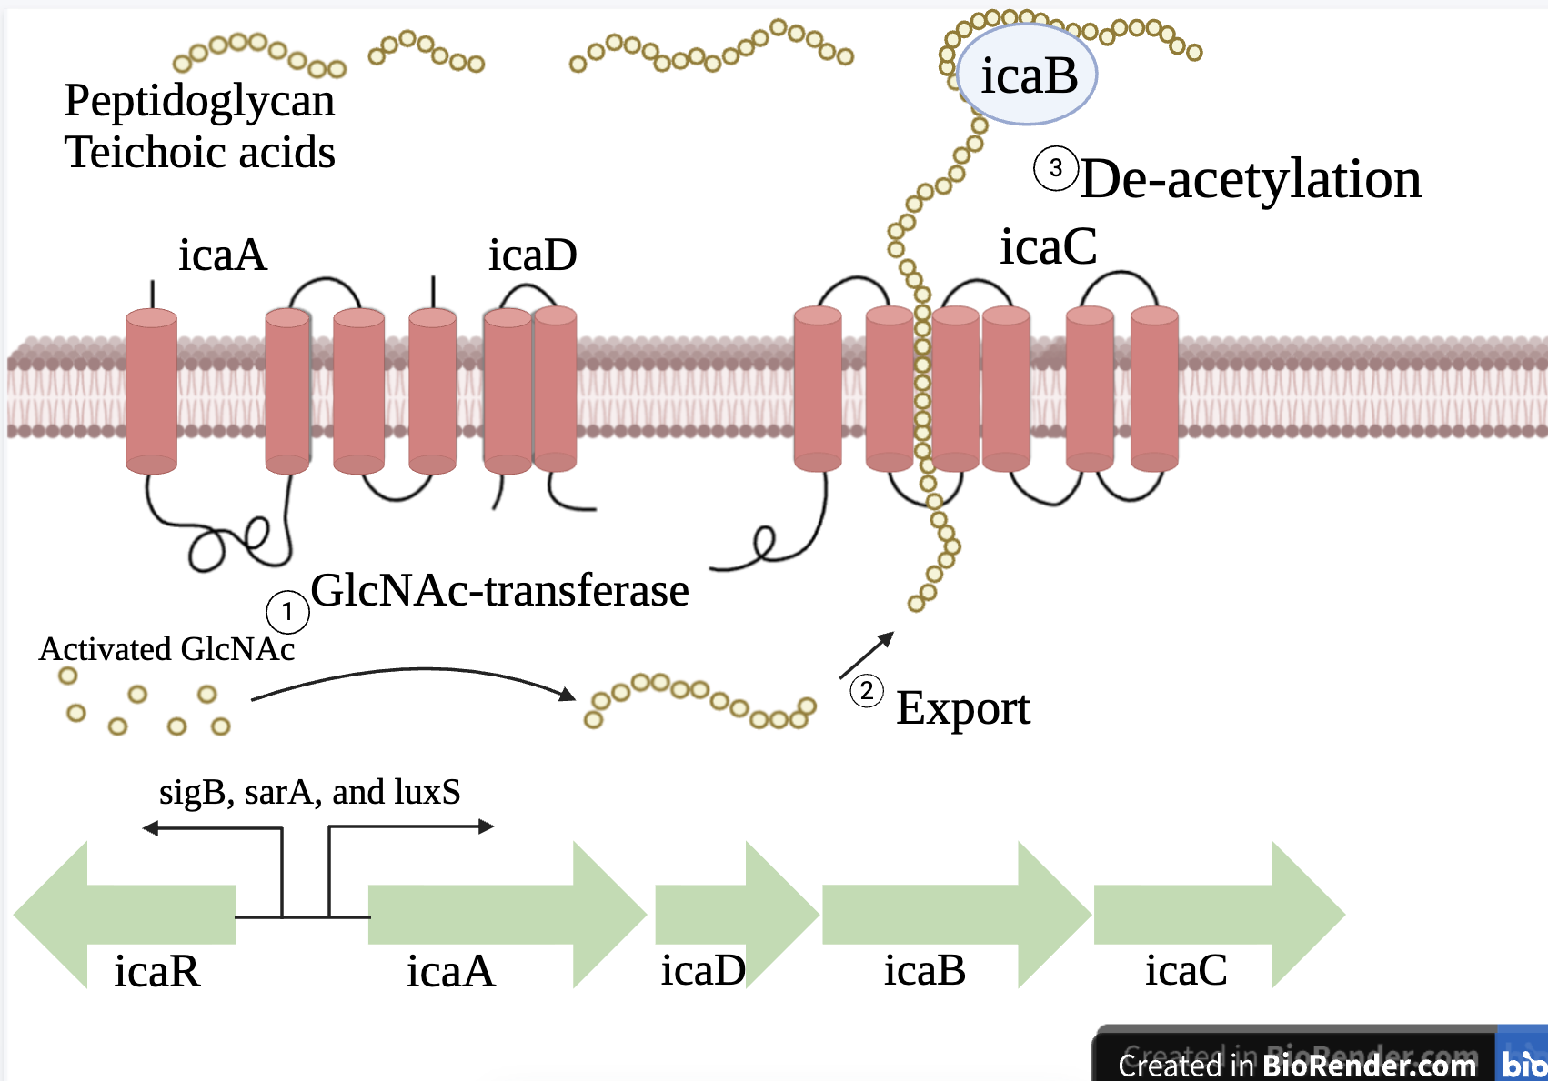
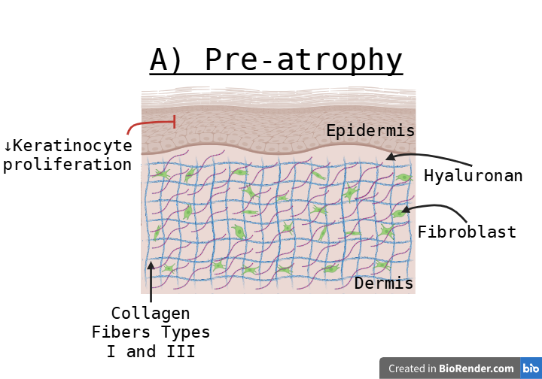
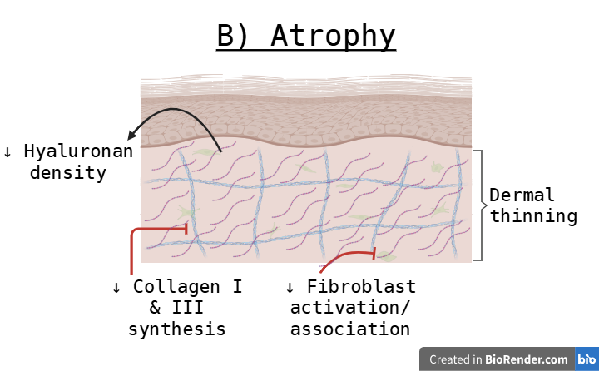
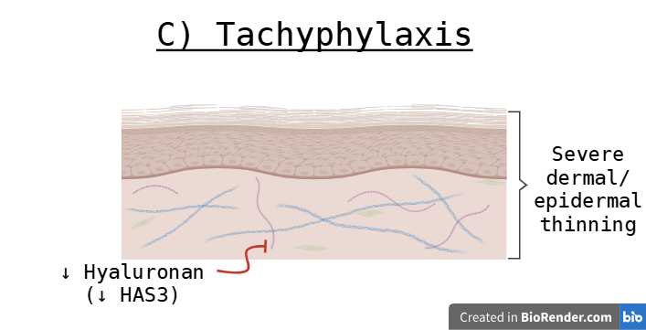
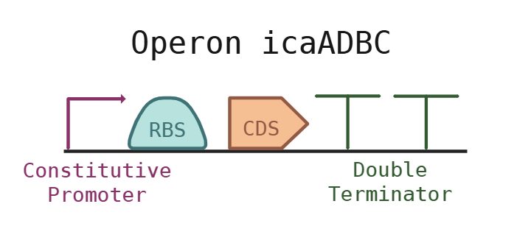






Enhancing PIA production in Staphylococcus epidermidis to treat Atopic Dermatitis
Alida Karsten, Alex Lee, Lydia Lockwood, and Delaney Pittinger
Ms. Vivien Marmerstein, Leader: Alex Lee, Ms. Jackie Thompson (Takeda Pharmaceuticals)
Western Reserve Academy, Hudson, OH, United States
Figure 2:
Eczema impacts over 204 million people worldwide. Our project aims to engineer a naturally occurring skin bacteria to treat eczema to replace the harsh corticosteroid treatments currently used.
Our treatment genetically engineers Staphylococcus epidermidis to increase the synthesis of polysaccharide intercellular adhesin (PIA) by inserting a plasmid with the icaADBC operon (which codes for PIA synthesis) into the bacteria.
After formulating this engineered bacteria into a cream, we expect the results to combat against the dry and itchy skin eczema causes by increasing water and nutrient retention.
Figure 1: Stages of Corticosteroid Induced Skin Thinning
Figure 3:

