Slide 1

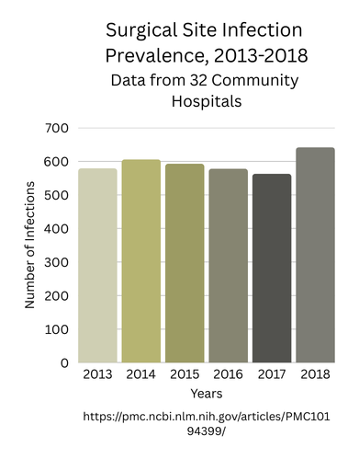
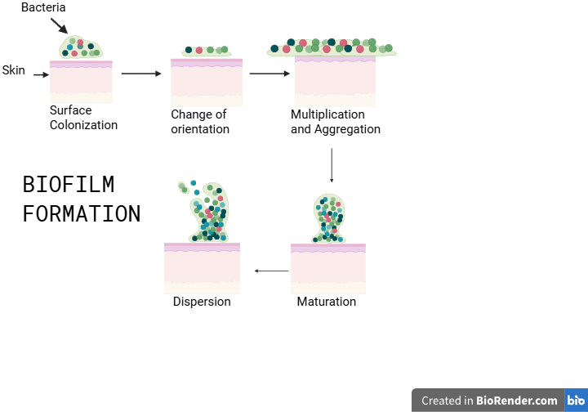






Beyond Antibiotics: Coating sutures in phage-derived depolymerase to combat surgical site infections
Anna Barger, Madison Glass, Collin Si, Lauren Smeltzer, Ms. Vivien Marmerstein, İlkay Çisil Köksaldı (ETH Zurich-D-BSSE)
Western Reserve Academy, Hudson, Ohio, United States
Background
In order to prevent pathogens from infecting surgical sites many modern sutures are coated in antibiotics such as Triclosan. They have been largely effective in decreasing surgical site infections (SSIs) over the past decades, but those that do occur are often severe and difficult to remove. A common issue with antibiotic coated sutures is the formation of biofilm,which limits the efficacy of the antibiotics and is associated with more severe infections. Our project aims to actively stop the formation of biofilm on sutures by using a depolymerase coating which will help to prevent infection, avoiding increasing antibiotic resistance, reducing hospital stays, and limiting costs, and overall improve patients quality of life. We are designing a protein production microbe, and hope to optimize our chassis for this. We hope to use Escherichia coli (E. coli) DH5α as it has been used commonly for protein production and is a well known BSL 1 organism. Because the protein may harm the bacteria during production, we plan to use BBa_K20600, an arabinose inducible promoter, in order to control when the bacteria begin producing recombinant protein production - depolymerase. We plan to use a high strength promoter to maximize protein production. The ribosome binding site is derived from E. coli to ensure ease of translation from mRNA to protein. The open reading frame will code for DpoMK34 which is a phage derived depolymerase noted to be effective against A. baumannii, a common opportunistic pathogenic skin microbe that can form biofilms around sutures. Finally we plan to use two terminators to guard against leaking, also derived from E. coli to ensure ease of plasmid insertion.
Abstract
A primary risk associated with surgery comes not from the operation itself, but the risk of infection afterwards. The sutures left in place give pathogens easy access to the wound, often forming shells that are very difficult to remove, known as biofilms. To combat this, many sutures are coated in antibiotics like Triclosan. While Triclosan may reduce pathogenic colonization for a short time, biofilms can form, limiting their effectiveness, having no impact on pre-established biofilms. Beyond the financial burden placed on healthcare systems, surgical site infections, or SSIs, negatively impact patients' quality of life, extending hospital stays, delaying recovery time, and increasing morbidity rates. Biofilms are not entirely impervious to attack though, in nature, bacteriophages use an enzyme called depolymerase to kill bacteria by breaking down the biofilms that protect them. Our project proposes transforming the genetic code for a phage derived depolymerase, DpoMK34, into Escherichia coli for protein production. The product would then be purified using histidine tagging before being used to coat the sutures, preventing biofilms from forming. By targeting the mechanisms underlying biofilm formation, rather than relying on traditional antibiotics, enzyme based antimicrobial sutures can reduce SSIs while minimizing cost and health risks.

Slide 2
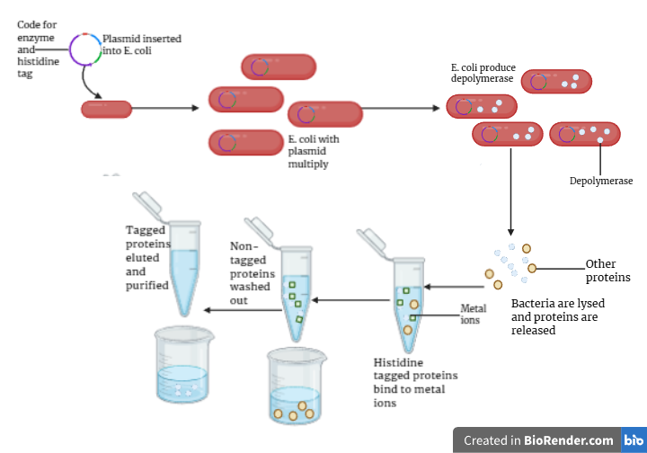
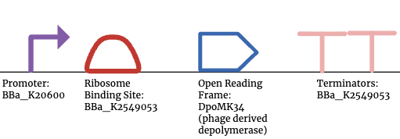

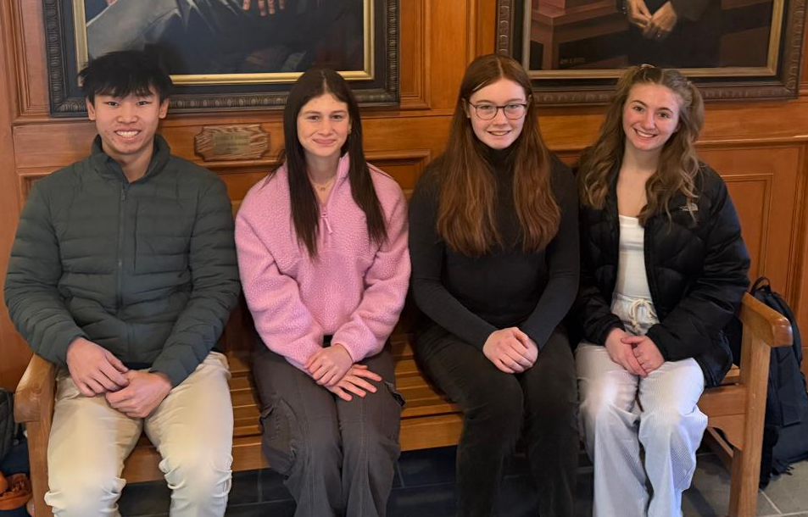
Beyond Antibiotics: Coating sutures in phage-derived depolymerase to combat surgical site infections
Anna Barger, Madison Glass, Collin Si, Lauren Smeltzer, Ms. Vivien Marmerstein, İlkay Cisil Köksaldı (ETH Zurich-D-BSSE)
Western Reserve Academy, Hudson, Ohio, United States
Histidine tagging method
Parts Diagram
Future Experiments
We plan to test our depolymerase producing organisms in three stages. First, we will identify the best environment and culturing method to maximally produce the depolymerase. Then, we will experiment with the depolymerase solution, measuring how it acts against biofilms in the sutures and how it interacts with other antibiotics present on the sutures. Finally, we will experiment with different storage conditions and strategies to ensure that the depolymerase solution can remain stable over long periods of time, and include actively testing our solution on real biofilm. Next year, two returning members plan on taking our school’s Synthetic Biology 2 course. We would then begin to gather the tools and materials to create a fully functional coated suture and being to test the reliability and output of the system. In addition, we would also work on the strategies to ensure the sutures storage sustainability and hopefully document our work for further publication.
In order to successfully purify the depolymerase proteins, a code for a histidine tag is added to the plasmid. When the bacteria are lysed, the depolymerase with a histidine tag will bind to metal ions in the tube while non-tagged proteins are washed out, purifying the depolymerase
REFERENCES AND ACKNOWLEDGEMENTS
We’d like to thank our mentor, İlkay Cisil Köksaldı, our teacher, Ms. Vivien Marmerstein, and the Western Reserve Academy science department.
Next Steps
A next key step will include actively testing our solution on real biofilm. Next year, two returning members plan on taking our school’s Synthetic Biology 2 course. We would then begin to gather the tools and materials to create a fully functional coated suture and being to test the reliability and output of the system. In addition, we would also work on the strategies to ensure the sutures storage sustainability and hopefully document our work for further publication.
Team Content
We are a new team composed of 4 members (left to right), Collin, Madison, Anna, Lauren, taking our school’s Synthetic Biology 1 course. We are interested in the medical field and microbiology.
Works Cited
Notes:
Background
A common issue with antibiotic coated sutures is the formation of biofilm, limiting the power of the antibiotics and causing surgical site infections. We are trying to actively stop the formation of biofilm on sutures by using a depolymerase coating, helping to prevent infection, avoid antibiotic resistance, reduce hospital stays and costs, and overall improve patients quality of life. We are designing a protein production microbe, and so hope to optimize our chassis for this. We hope to use Escherichia coli (E. coli) DH5α as it has been used commonly for protein production and is a well known BSL 1 organism. Because the protein may harm the bacteria during production we plan to use BBa_K20600, an arabinose inducible promoter, in order to control when the bacteria begin begin producing recombinant protein production - depolymerase. We plan to use a high strength promoter to maximize protein production. The ribosome binding site is derived from E. coli to ensure ease of translation from mRNA to protein. The open reading frame will code for DpoMK34 which is a phage derived depolymerase noted to be effective against A. baumannii, a common opportunistic pathogenic skin microbe that can form biofilms around sutures. Finally we plan to use two terminators to guard against leaking, also derived from E. coli to ensure ease of plasmid insertion.

