Slide 1


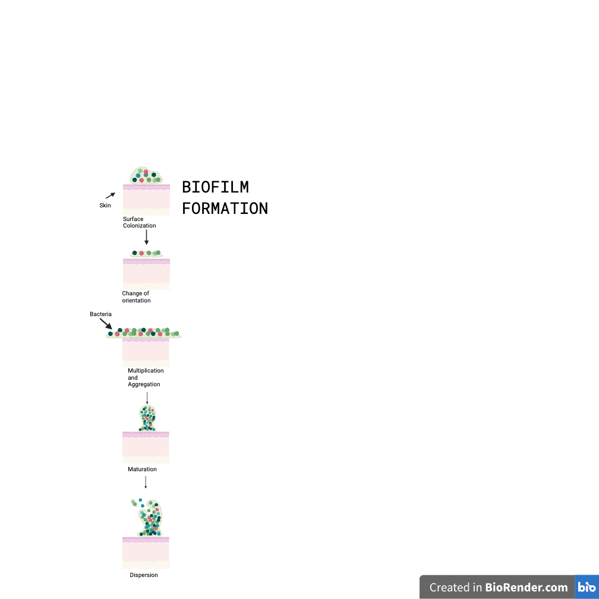
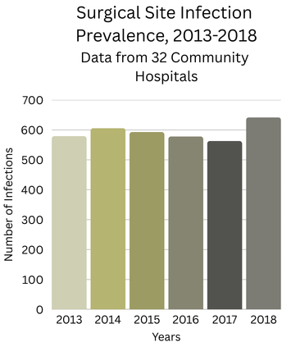
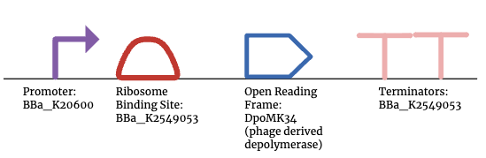






Beyond Antibiotics: Coating sutures in phage-derived depolymerase to combat surgical site infections
Anna Barger, Madison Glass, Collin Si, Lauren Smeltzer, Ms. Vivien Marmerstein, İlkay Çisil Köksaldı (ETH Zurich-D-BSSE)
Western Reserve Academy, Hudson, Ohio, US
Reduce prevalence of SSIs by coating sutures in a phage-derived depolymerase solution
Transform gene for DpoMK34 (phage derived depolymerase) into Escherichia coli
Use histidine tagging to purify and make a solution to coat sutures with
We expect to see a reduction or complete eradication of the formation of biofilm on antibiotic sutures when they are coated in depolymerase.
There will be need to determine how long depolymerase remains effective in a solution

