Slide 1
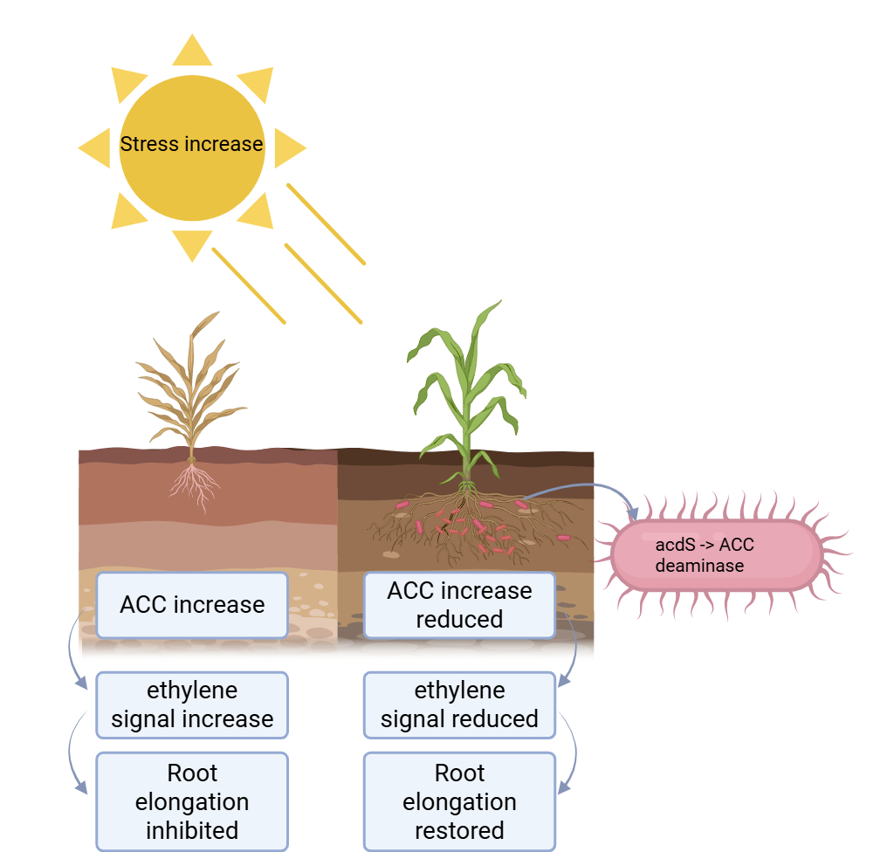
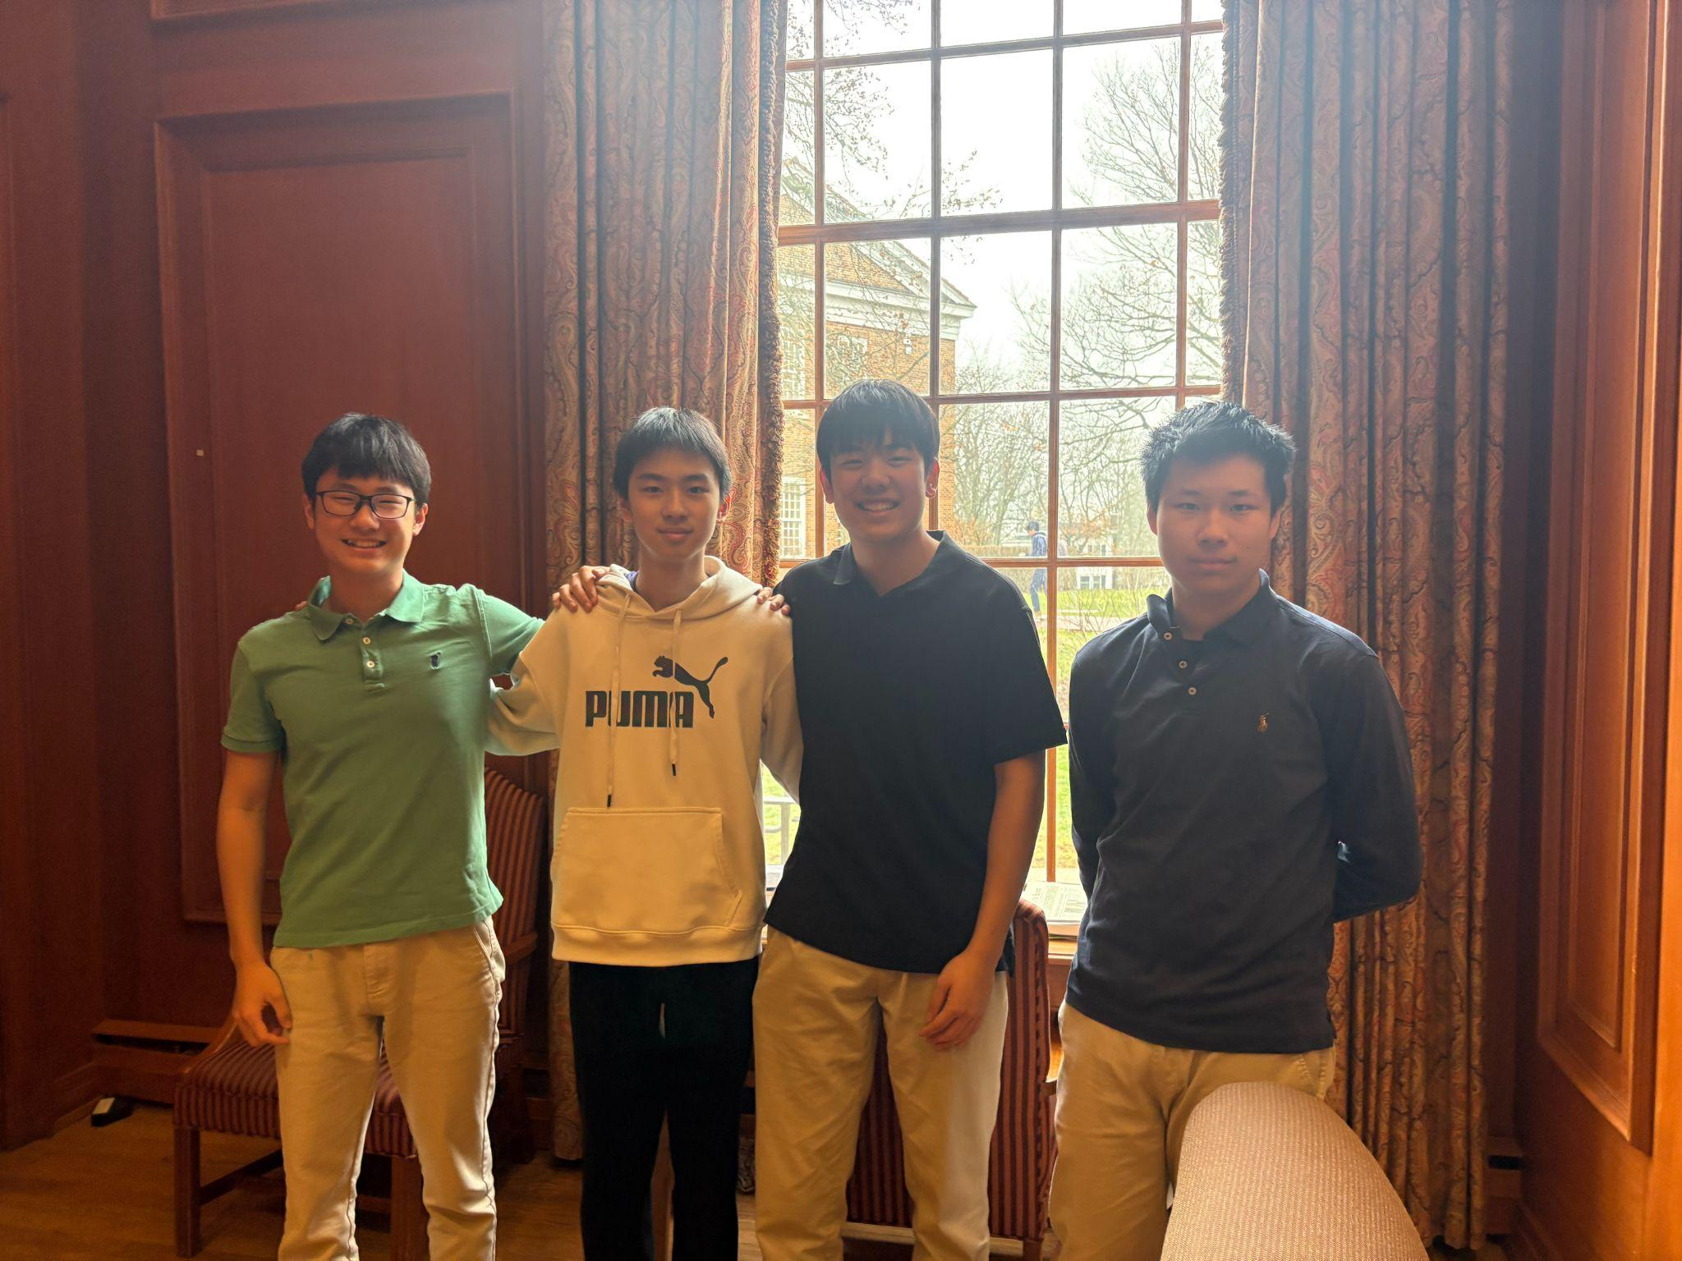







Engineering Bacillus subtilis for Drought Tolerance in Plants
Jerry Hu, Joe Yang, Justin Yin, Eason Wang, Ms. Vivien Marmerstein, Dr. Alberto Donayre (UTEC), Western Reserve Academy, Hudson, Ohio, United States
Abstract
Drought remains a worldwide issue, affecting regions that receive less rainfall than usual for extended periods. Drought stimulates plants’ production of 1-aminocyclopropane-1-carboxylate (ACC), a precursor that signals ethylene production. Increased ethylene concentration will cause greater plant stress and reduced root elongation, which leads to serious agricultural problems such as diminished crop growth and low food production, and may even trigger the collapse of the local economy. The problem significantly impacts lower income areas that lack proper irrigation. Although conventional methods, like rainwater harvesting and drip irrigation, can mitigate plant stress, they are often expensive and inconsistent. We use a readily inducible, cost-effective, low-maintenance system. Using B. subtilis (WB800) as our chassis, our goal is to express ACC deaminase via the acdS gene. Because ACC deaminase breaks down ACC, it reduces ethylene concentration and contributes to overall plant growth. Employing the XylR repressor, we add the inducer xylose to trigger ACC deaminase expression as drought occurs. As both a controllable and affordable strategy, this approach alleviates drought-induced plant stress. By providing an inducible system for ACC deaminase expression, our system will become a promising method for sustainable agriculture.
Our Team
Background
We are a new team with four members total.
In the image above (left to right): Jerry, Eason, Justin, Joe
We meet together with a shared dedication and interest to synthetic biology to solve real world problems.
Because of scheduling, we broke down into two person per group, but we stayed contacted online everyday to connect with our work.
The aim of our project is to contribute to agriculture worldwide through innovative synthetic biology methods.
We will specifically be working within the rhizosphere, the small area around the root of a plant where microbes are influenced by root secretions or exudates and associated microorganisms. In the rhizosphere, certain plant-associated bacteria naturally carry the acdS gene— the specific gene we employ in our system. This gene expresses the enzyme ACC deaminase, which converts the chemical ACC, a precursor to ethylene, into α-ketobutyrate and ammonia. During abiotic stresses like drought, the presence of ACC deaminase lowers ethylene level and thus results in significantly improved plant growth and root expansion.

Slide 2
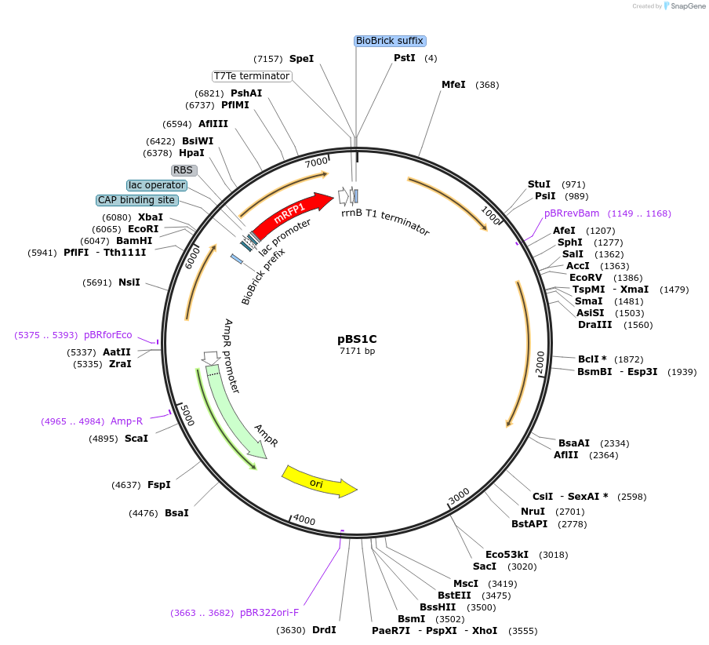
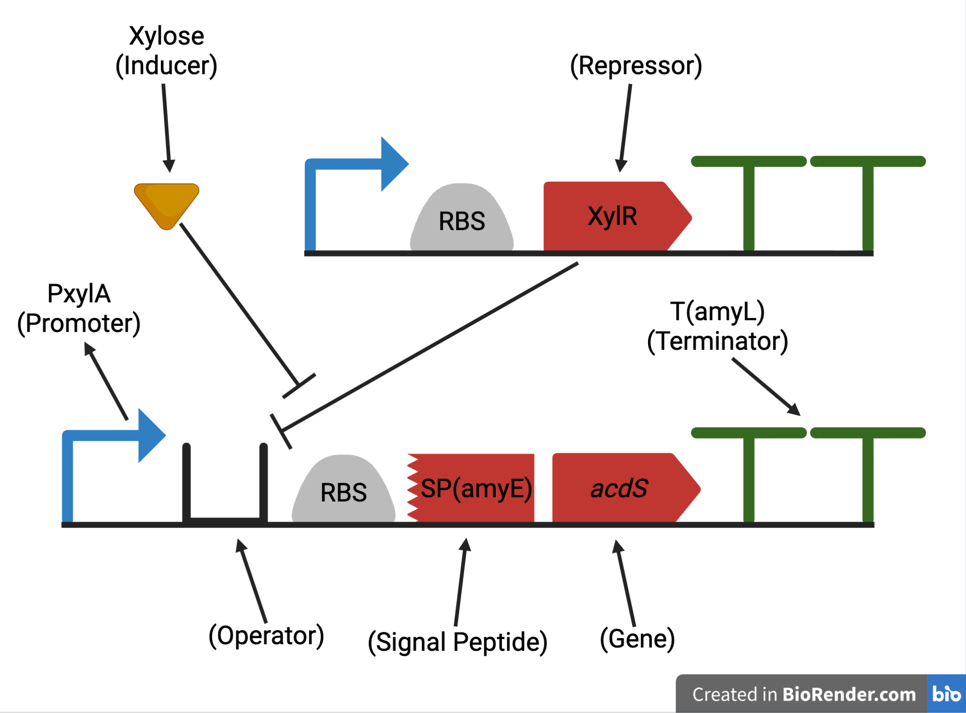

Engineering Bacillus subtilis for Drought Tolerance in Plants
Jerry Hu, Joe Yang, Justin Yin, Eason Wang, Ms. Vivien Marmerstein, Dr. Alberto Donayre (UTEC), Western Reserve Academy, Hudson, Ohio, United States
Genetic Circuit Design
Design Rationale and Implementation
Inducible control: The proposed genetic device will have an OFF-to-ON inducible switch that will be under the control of the PxylA promoter.
Repression mechanism: The XylR protein physically hinders the transcription of the target genes by binding to the operator region in the absence of an inducer.
Activation: The binding of the chemical inducer xylose to the XylR protein will result in a conformational change that will cause the XylR protein to be released from the operator region.
Enzymatic expression: The transcription of the acdS gene by the RNA polymerase will express the ACC deaminase enzyme.
Secretion pathway: The fused SP(amyE) signal peptide will be used to secrete the enzyme from the bacterium into the soil environment.
Termination: The double T(amyL) terminators will be used to terminate transcription in order to ensure the stability of the genetic device.
Extracellular Strategy: ACC exists in both the inside and outside of plants, the ACC deaminase breaks down ACC outside of the plants’ cell wall, thus indirectly decreasing the ACC amount inside of the plant through passive diffusion.
Inducible vs. Constitutive expression: The inducible system contributes to energy conservation and allows ethylene amount to be reduced only during drought conditions as ethylene is important for plants’ fruit ripening and natural aging.
Xylose Cost: While laboratory-grade xylose is expensive (about $500+ per kg from research suppliers), industrial or biomass-derived xylose is effective as an inducer and has relatively low cost (about $2-$5 per kg at scale).
Next Steps
Verify ACC deaminase expression and secretion via SP(amyE) in WB800 experimentally
Measure ethylene reduction in rhizosphere condition using gas chromatography
Experiment and compare root elongation improvement of engineered strain plant and wild type in drought stressed environment.
Core Engineering Strategy
Chassis selection: Bacillus subtilis WB800, a protease-deficient strain that is well known for its robustness as a Gram-positive bacterium in the soil environment.
Protein stability: Unlike the wild-type strain, Bacillus subtilis WB800 lacks the secretion of the eight major extracellular proteases that would otherwise degrade the expressed ACC deaminase enzyme.
Genetic integration: The integrative plasmid pBS1C will be used to integrate the genetic construct into the bacterial chromosome at the amyE locus.
References and Acknowledgements
We would like to sincerely thank our mentor, Dr. Alberto Donayre, our faculty advisor, Miss Marmerstein, and the WRA Science Department for their support of this project.

