Slide 1


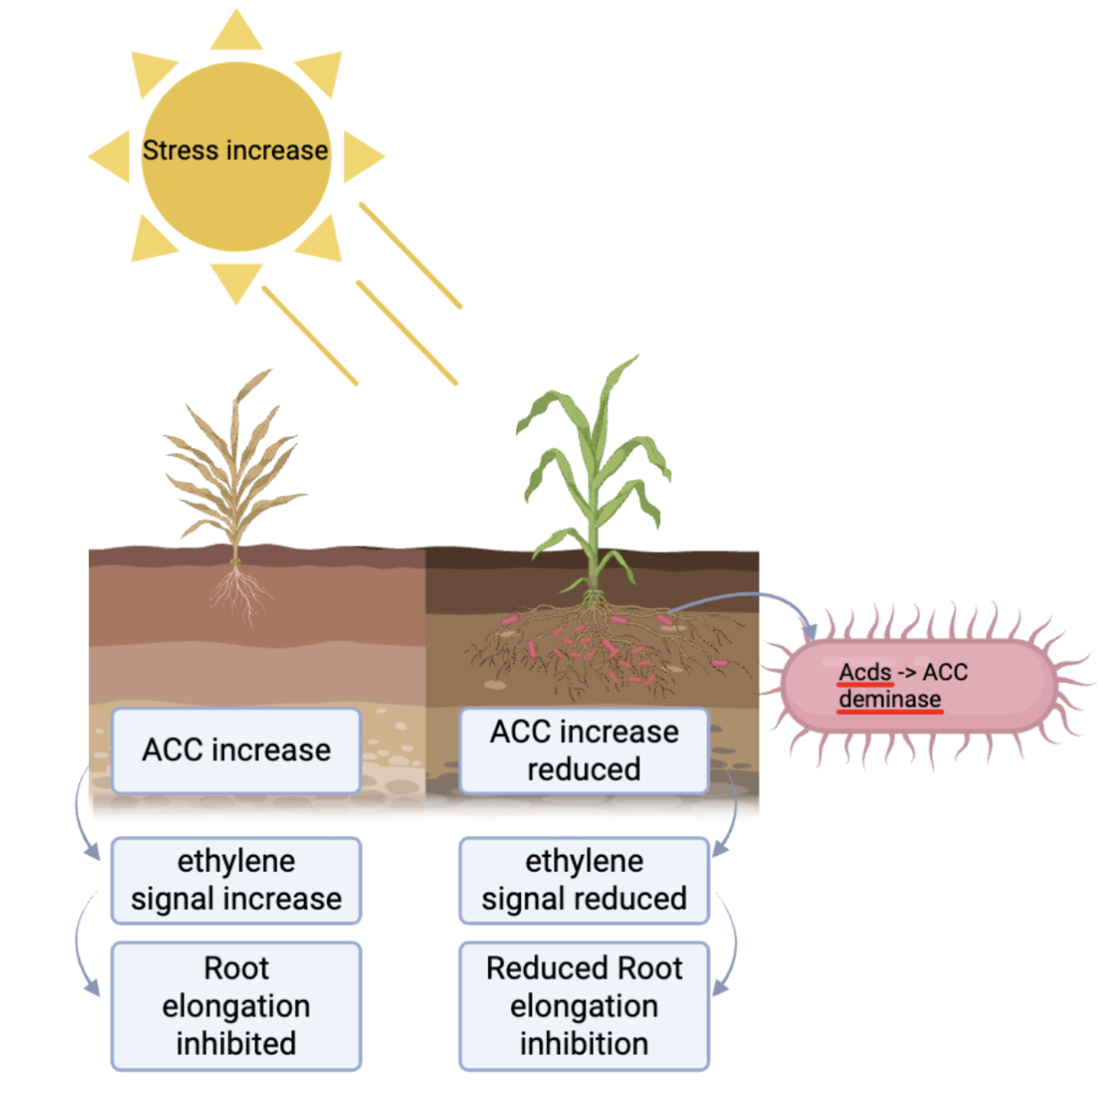







Engineering Bacillus Subtilis For Drought Tolerance in Plants
Jerry Hu, Joe Yang, Justin Yin, Eason Wang, Ms. Vivien Marmerstein, Dr. Alberto Donayre (UTEC), Western Reserve Academy, Hudson, Ohio, United States
During drought, plants overproduce ethylene (signaled by ACC), which inhibits root elongation.
We engineered Bacillus subtilis to express ACC deaminase, an enzyme that breaks down ACC and reduce ethylene production at the root interface.
We aim to decrease stress signaling, promote root growth, and improve plant survival under dry conditions.

