Slide 1

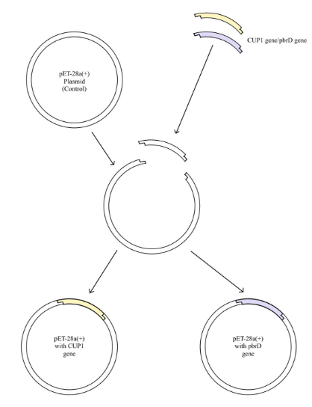





E. coli - Based Innovative Bioremediation of Environmental Lead Contaminants
Ethan Wang, Nicole Li, Aarav Doshi, Angela Park, Daniel Cao, Sophia Chau, Ahmad Bokhari, Vani Bhat, Sei Park, Sara Yousufuddin
Mrs. Rebecca Brewer, Mr. Nick Nolan
Troy High School, Troy, MI, USA
Lead contamination in drinking water remains a major public health concern in the United States, highlighting the need for effective remediation methods. The 2014 Flint Water Crisis, with toxic lead levels over 3 times the hazardous classification, cost the city billions in clean-up costs and put hundreds of thousands at risk. This study evaluates genetically modified Escherichia coli engineered to express metal-binding proteins for lead removal. Three strains were tested: wild-type, metallothionein-expressing, and PbrD-expressing cells. After protein induction and lead exposure, residual lead levels were measured. We hypothesize that PbrD-expressing E. coli will demonstrate the greatest removal efficiency, supporting its potential as a targeted and scalable strategy for improving drinking water safety
Science Content
The primary difficulty of this project lies in finding the ideal concentration to maximize without putting the E. coli at risk of death and rupture – hence releasng all sequestered lead and counteracting the original intention.
Team Content
We are a 10-member team from Troy High School in Troy, Michigan. All 10 members have taken or are taking AP Biology, and are passionate about science and innovation in the STEM world today. Our project was the culmination of countless hours of effort, arriving before and after school, and skipping lunch periods. We hope to one day make a tangible impact to better our world.
Next steps
Test across wider ranges of metal concentrations, and expand to include more ions, such as Mercury and Arsenic
in situ testing in natural environments to analyze effects in non-lab environments
Investigate methods to remove E. coli from water once sequestration method is complete
Our main goal is to explore the potential of Escherichia coli to sequester lead from water using engineered metal-binding proteins. While we have not yet conducted the experiment, we are preparing to do so by planning the early steps, including transforming E. coli with plasmids encoding CUP1 and PbrD and plating on selective media. To support this, we have ordered a transformation kit, kanamycin-selective agar plates, and the necessary plasmids and reagents, and will begin testing the lead sequestration properties of the engineered strains within the next week..
Materials and Methods
To evaluate Lead (Pb⁺²) and Copper (Cu⁺²) sequestration, E. coli cells will be transformed with pET28a plasmids containing either a control, CUP1, or PbrD gene. The transformation will involve heat shock, followed by transfer to recovery broth. Transformed cells will be selected via Kanamycin and incubated overnight prior to subsequent experimentation
References and acknowledgements
We want to express our deep gratitude Mrs. Rebecca Brewer, AP Biology Teacher at Troy High School for giving us this opportunity and allowing us to use her classroom and lab equipment. We are also greatly thankful for our mentor, Mr. Nick Nolan, MIT PhD candidate, for all the guidance and advice along the way. Finally, we would like to give our appreciation to Dr. Elizabeth Berger and the Wayne State University School of Medicine, whose generous donations made our lab vision a reality.
Introduction/Background
Bioremediation using engineered microorganisms offers a scalable and environmentally friendly alternative to traditional chemical or filtration methods.
In this study, Escherichia coli were engineered to express metal-binding proteins, including the copper-binding metallothionein CUP1 from yeast, and the lead-specific protein PbrD from Cupriavidus metallidurans
We plan to transform E. coli via heat shock and plate cells on kanamycin-selective media to verify successful plasmid uptake.
Verified colonies will be cultured, induced for protein expression, and exposed to defined lead concentrations.
Residual metal levels will be quantified via spectrophotometry to assess preliminary sequestration efficiency relative to wild-type controls.
Single colonies were selected and expression of sequestration proteins induced with IPTG. Experimental groups were placed in Lead Nitrate and Copper Nitrate in an aqueous solution and incubated for one day. Following incubation, the solution was centrifuged and the supernatant was collected and analyzed using spectrophotometry to analyze sequestration efficiency. Statistical analysis were performed as student t-tests for further analysis.
A) Lead poisoning. (2024). World Health Organization. https://www.who.int/news-room/fact-sheets/detail/lead-poisoning-and-health
B) Mohammed, G. I., Nassar, S., & Farghaly, T. A. (2025). Spectrophotometric method for detecting lead (II) ions using a chemosensor of the thiosemicarbazone-linked phenyl sulphone moiety. Science Direct, 15. https://doi.org/10.1016/j.rechem.2025.102174
C) Marbach, A., & Bettenbrock, K. (2012). lac operon induction in Escherichia coli: Systematic comparison of IPTG and TMG induction and influence of the transacetylase LacA. Journal of biotechnology, 157(1), 82-88.
According to prior literature, we expect for the PbrD experimental group to show significant increases in Lead sequestration, while the CUP1 experimental group will show a significant increase in Copper sequestration
(Figure. This is a model of the plasmid design that our team used for the experiment. PbrD and CUP1 were individually ligated into the pET28a plasmid and transformed into competent De3 E. coli cells)

