Slide 1


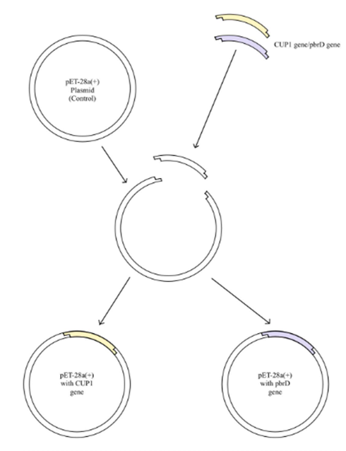
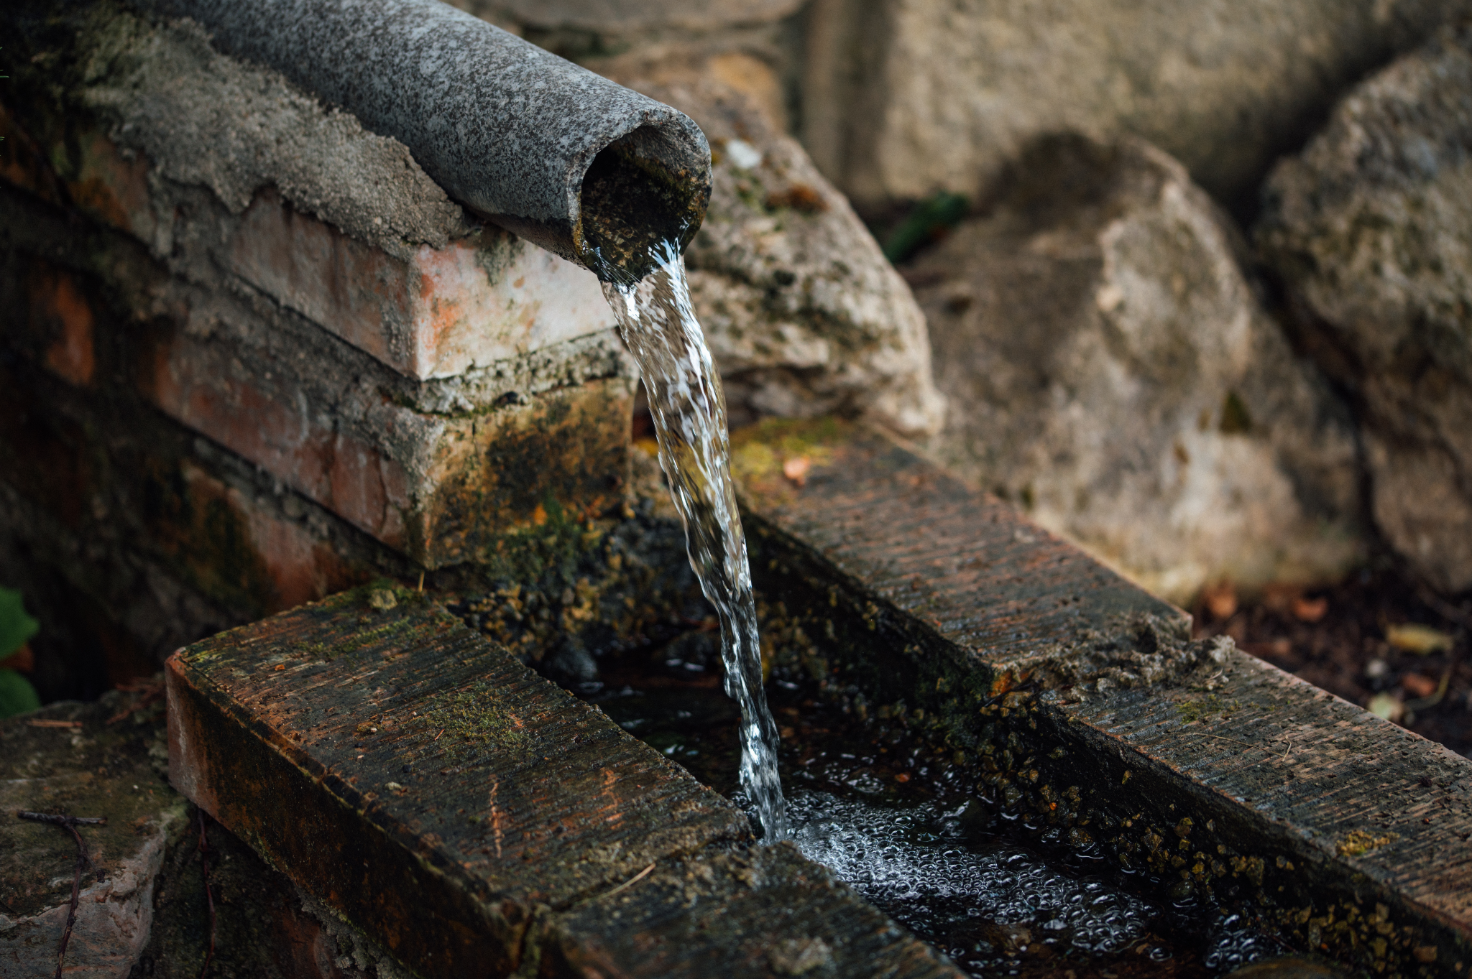






E. coli - Based Innovative Bioremediation of Environmental Lead Contaminants
Ethan Wang, Nicole Li, Aarav Doshi, Angela Park, Daniel Cao, Sophia Chau, Ahmad Bokhari, Vani Bhat, Sei Park, Sara Yousufuddin
Mrs. Rebecca Brewer, Mr. Nick Nolan
Troy High School, Troy, MI, USA
The 2014 Flint Water Crisis, and countless similar occurrences of Lead Contamination has been a public health hazard for decades
Transformed E. coli (De3) with metal sequestration genes
Placed in aqueous solutions of heavy metal ions
Metal sequestration efficiency measured via Spectrophotometry
Future aims for in situ remediation of metal contamination in nature
Step 1
Step 2
Step 3
Step 4
Gene of Interest
Transformation
Sequestration
Measurement
CUP1 and PbrD were ligated into plasmid pET-28a
Heat shock at 42º C to transform De3 strain E. coli
Transformed E. coli placed into metal solutions
Spectrophotometric analysis of test tube supernatant

