Slide 1

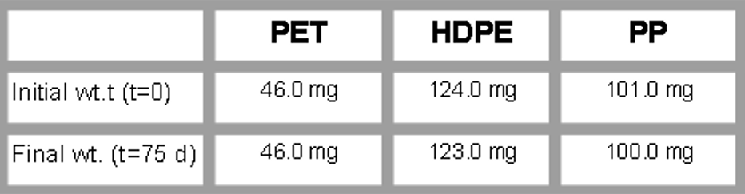
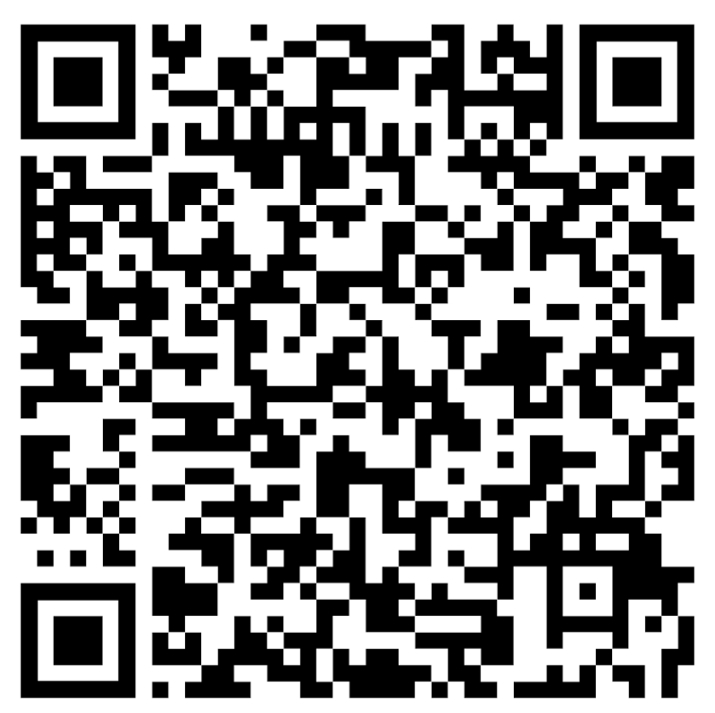
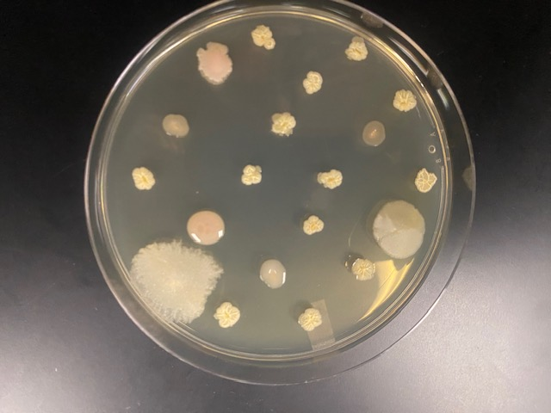






Bioprospecting for Plastic-degrading Microorganisms in Kansas Soils
Kenslee Young, Kaitlyn Locker, Joanna Li, Dazzani Marks, and Mark Harpster, PhD (instructor)
Kissaou Tchedre, MBA PhD (mentor)*
TCALC, Topeka KS, USA *Austin Community College, Austin TX, USA
Abstract
The large-scale manufacturing of plastics for consumer products has contributed significantly to the pollution of our ecosystems, as well as having created a potential health crisis due to the recently reported accumulation of microplastics in the tissues of humans and animals.¹ While select plastics exhibit biodegradation, their rates are negligible for countering the massive and constant influx of waste into the environment. To identify and isolate microorganisms that could be engineered for improved kinetics in the breakdown of a broad spectrum of plastics, we have initiated a bioprospecting approach in which soil samples in the Topeka, Kansas area are being screened for plastic-degrading capability. Preliminary studies have largely focused on developing a soil-burial assay for demonstrating degradation in unprocessed soil samples and then using degradation positive soil samples as source material for the extraction and isolation of the causative microbe(s).
Results/Discussion
Research efforts focused on the use of soil burial assays to mimic natural conditions and assess microbial degradation of plastics over time have reported modest results using a broad range of strategies and plastic test materials.⁴ In our study, pieces of 3 common plastics (i.e. PET, PP, and HDPE) were buried at a depth of ~4” in soil containers, which were kept damp at 22ºC under dim light conditions and the plastics sampled weekly over the course of 75 d for observable weight loss. The table below summarizes our current results, which show negligible, if any, evidence of degradation. As 75 d is likely an insufficient time frame for detecting measurable weight change, we will continue to monitor the weights of buried plastics in the residential soil that we report here, and initiate burial studies using soils collected from toxic waste sites.
Concurrent with developing a soil burial assay, we have initiated studies aimed at extracting microorganisms from soil for the purpose of characterizing the microbial diversity of different soils and using purified isolates to test whether they are able to degrade powderized plastics embedded in agar plates absent of a supplemental carbon source. The image shown below shows the plating on LB Lennox media of microorganisms prepared from a soil wash prepared by stirring the soil in 20mM sodium phosphate buffer pH 7.0, after which the wash was filtered and then centrifuged to remove particulates. Results to date indicate low diversity, which indicates that we need to employ more robust methods for the disassociation of microbes from soil (e.g. sonication, use of surfactants).
Team Content
This is the first year of an ambitious project that will likely continue for the next several years. As the students participating in the project are in their second year at TCALC, they are ineligible for returning next year. Research progress made at the end of this year therefore is intended to provide a solid foundation for the next team of students who enroll in the Biomedical Sciences pathway for their final year of study in 2026-2027.
While progress has been slow, this hasn’t been altogether unexpected. Isolating novel, or even previously identified, microorganisms that can degrade plastics is challenging for several reasons. Typically, research programs tasked with developing robust bioremediation strategies necessitate the involvement of personnel trained in a breadth of technical methodologies, generous funding, and access to well-equipped laboratory facilities. Despite these challenges and our limitations in experience and funding,, we are confident that we will be able to achieve some measure of success once we are able to screen soils sampled from landfills, recycling centers, and closed plastic manufacturing facilities in the Topeka area. We are currently awaiting approval for access to these sites. It is reasonable to speculate that microbial populations of these soils contain species that have adapted to using plastics as a viable carbon source. The soils we have tested to date were obtained from private residences.
Looking ahead, most of our research effort in the near and long-term will be devoted to developing a selective plate media assay for facilitating the isolation of plastic-degrading bacteria from soil and then determining their genetic identities..
Introduction/Background
Although advances have been made in identifying plastic-degrading microorganisms, microbial-based plastic bioremediation remains in an early stage of practical and economic viability.^{2,3} To address this gap, we aim to determine whether novel plastic-degrading microbes can be isolated from diverse soils and then examine their catalytic mechanisms for the purpose of identifying key enzymes that could be overexpressed to enhance biodegradation.
Our current approach includes the following:
• Evaluate soils from landfills, plastic recycling centers, and closed plastic manufacturing sites for evidence of plastic degradation using a soil burial assay.
• Optimize microflora extraction from soil by testing variables such as soil wash pH.
• Develop an optimized plastic-embedded plate clearing assay to isolate microbes that demonstrate the capacity to use plastics as a sole carbon source.
• Identify candidate microbes using MALDI-TOF mass spectrometry and then transition to the molecular genetic phase of the project.
References (QR) and Acknowledgements
We wish to thank Steph Brandt of Stormont Vail Health (Topeka, KS) for guidance and technical support and the Kansas Association of Retired School Personnel (KARSP) for a generous grant that was used to purchase laboratory consumables used in this project.

