Slide 1

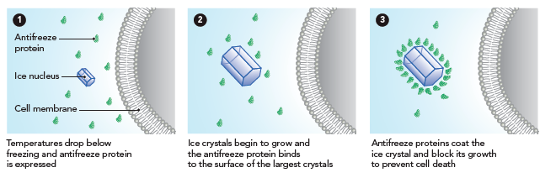
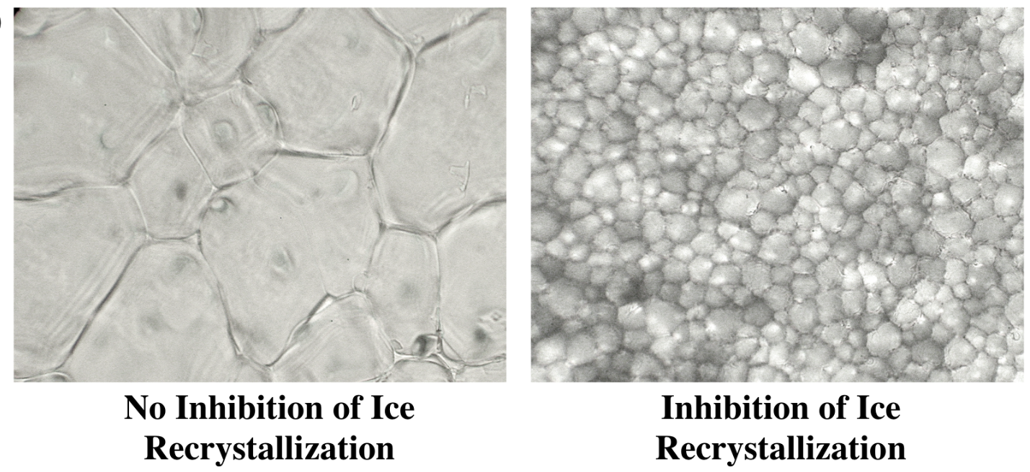
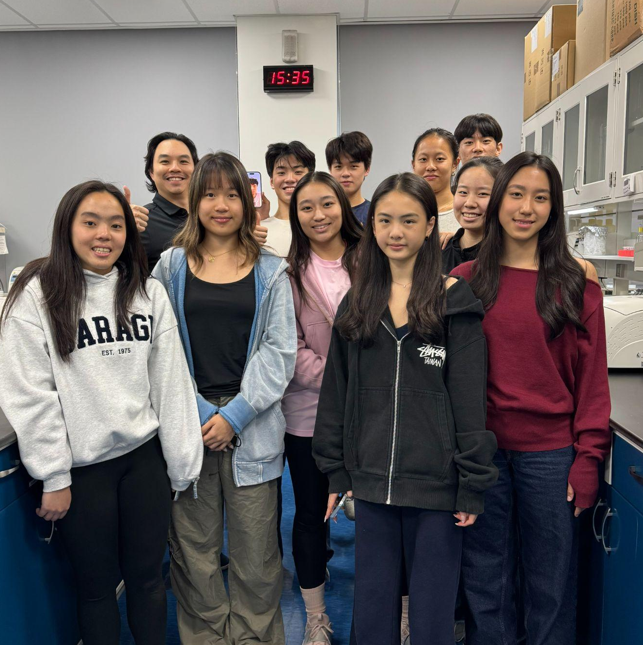
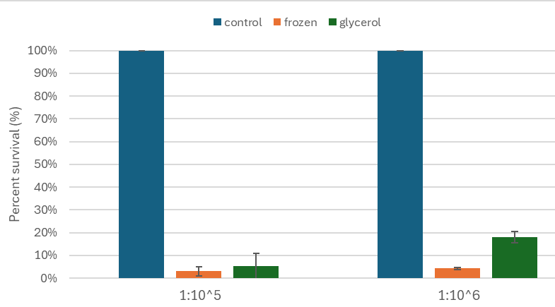
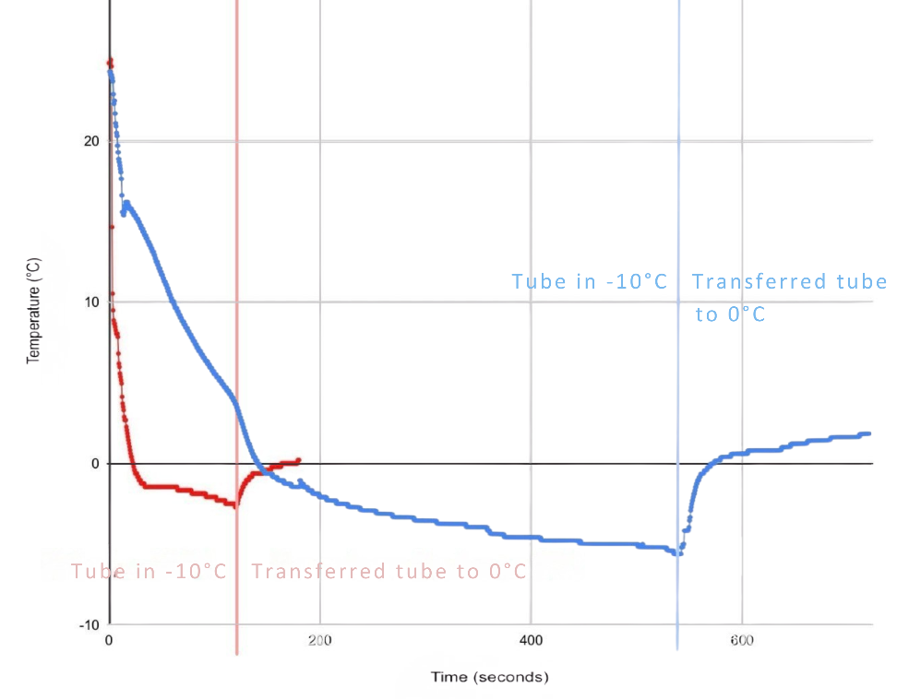






Say No to Ice Crystal Expansion: Cloning, Purifying, and Unleashing Antifreeze Proteins for Food, Aviation, and Cryopreservation
Taipei American School, Taipei, Taiwan
TAS_Taipei A: Day: Alivia Chen, Erika Chen, Mia Chen, Jocelyn Chiang, Conroy Chiu, Annabelle Huang, Jacquelyn Inocencio, Woojoo Jeong, Eva Lee, Adriel Leung, Tristin Wang, Myron Yu
TAS_Taipei B: Julie Bae, Ethan Chen, William Feung, Anya Kao, Felisha Liang, Laura Lee, Keera Tsai, Austin Wang, Florence Wu, Queenie Yeh, Dr. Hsu
Abstract
How does AFP prevent Ice Recrystallization?
Ice crystallization damages cells and materials in subzero environments, presenting challenges in medicine, food preservation, and cryopreservation. Antifreeze proteins (AFPs) are specialized polypeptides produced by cold-adapted organisms that inhibit ice growth by binding specific ice planes and inducing thermal hysteresis without altering melting points. This project aims to purify and characterize AFPs from Zoarces americanus, Lycodichthys dearborni, Pseudopleuronectes americanus, and Daucus carota recombinantly expressed in Escherichia coli, using immobilized metal ion affinity chromatography. We plan to evaluate the function of these AFP proteins in cryopreservation, food preservation, and anti-icing applications. Preliminary assays include freeze–thaw survival testing in E.coli and injections in Eisenia fetida to assess tolerance for future cryopreservation studies.Thermal hysteresis assays with glycerol confirmed reduced freezing rates. Next steps involve evaluating purified AFPs for controlled ice inhibition in biological and industrial applications.
Ice Recrystallization Inhibition
The rightmost picture shows how AFPs act as a barrier for preventing water molecules from binding to the crystal lattice and further expanding.
Figure 2. Microscopic view of ice recrystallization without inhibitor (left), with ice recrystallization inhibitor (right)
Figure 1. Flow Diagram of how Antifreeze proteins prevent ice recrystallization
Cell Viability - Preliminary Data
Thermal Hysteresis
TAS Taipei A5
Figure 3. Cell viability percentage based on the dilution factor
Compared survival of E. coli treated with 25% glycerol versus untreated cells after –80 °C freezing to assess AFP testing feasibility.
While AFP purification is ongoing, 25% glycerol—an established cryoprotectant—served as a temporary substitute.
Relative to the non-frozen control baseline, glycerol-treated cells showed significantly higher post-freezing survival.
A phenomenon where the AFP prevents ice crystal growth in between the melting and freezing point of a solution until it reaches non-equilibrium freezing point
Figure 4. Graph of Thermal Hysteresis freezing & melting point difference of dH2O (red) and 5% glycerol (blue).
Recorded temperature–time profiles of dH₂O and 5% glycerol during controlled cooling (–10 °C) and warming (0 °C).
Water (red) showed TH ≈ 2 °C, while 5% glycerol (blue) showed TH ≈ 6 °C—a threefold increase confirming assay sensitivity for AFP testing.
Note: TH = Tm − Tf, where: Tm = equilibrium melting temperature, Tf = non equilibrium freezing temperature
Dilution factor

Slide 2
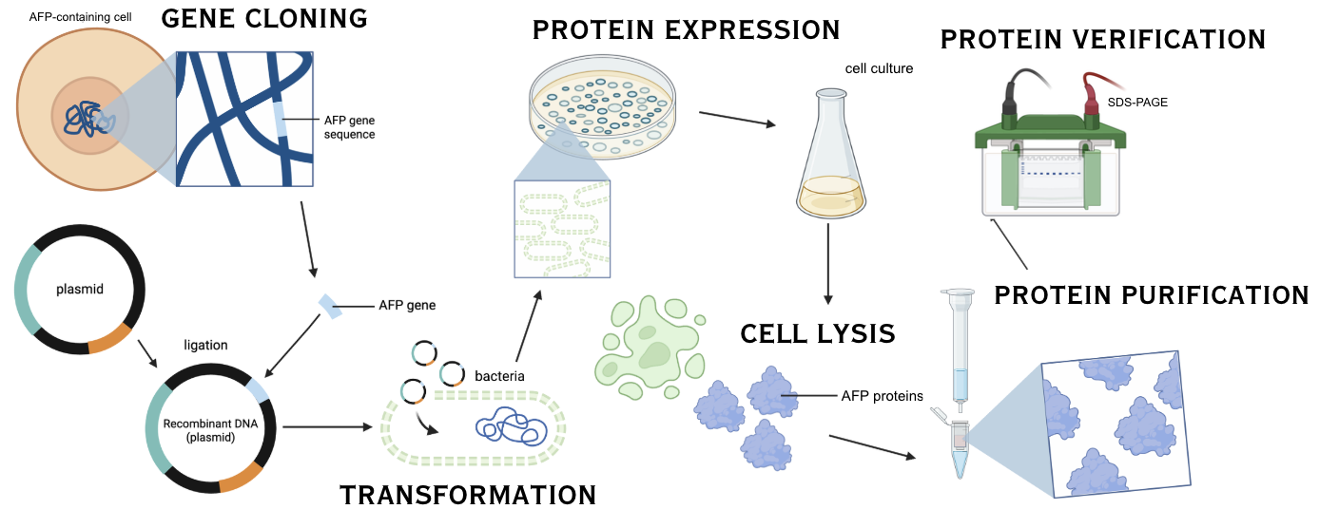
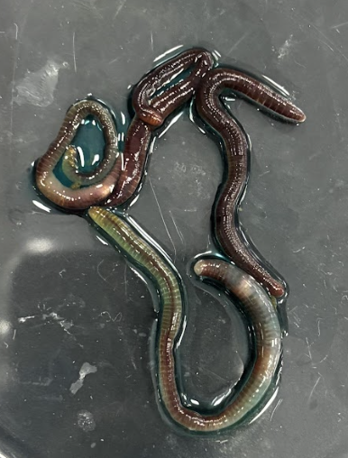
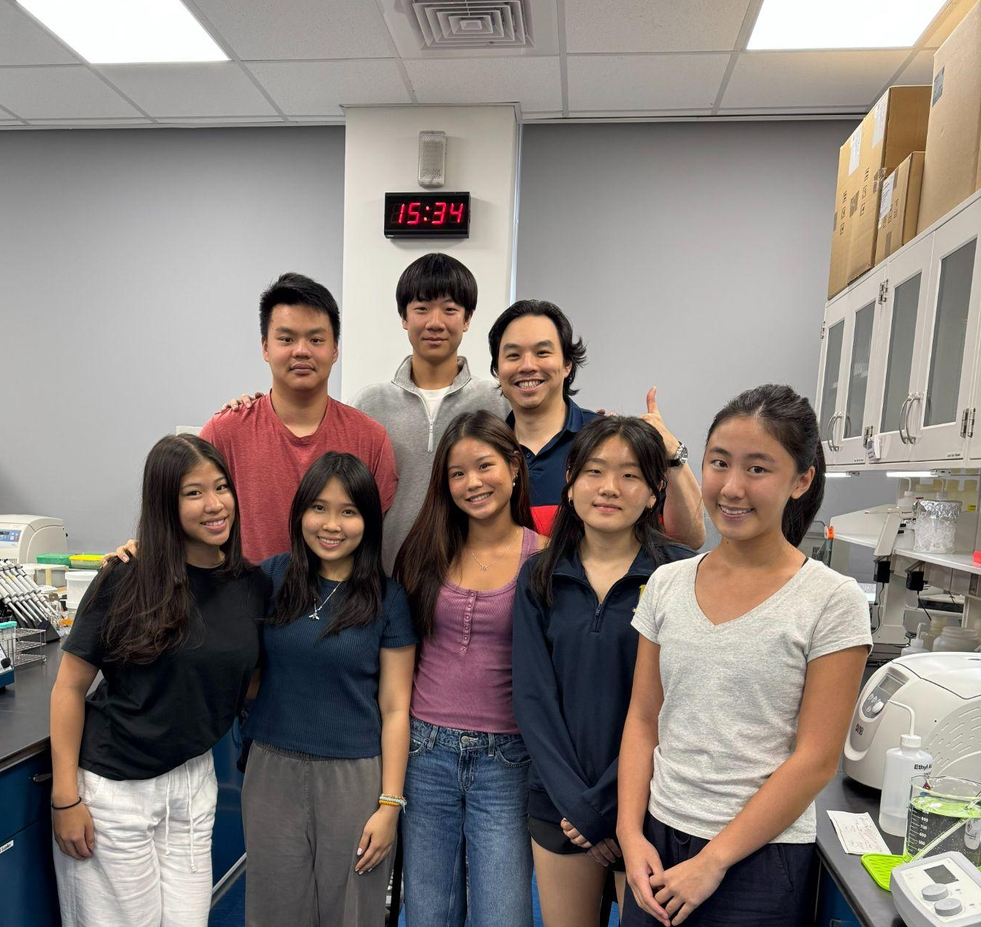
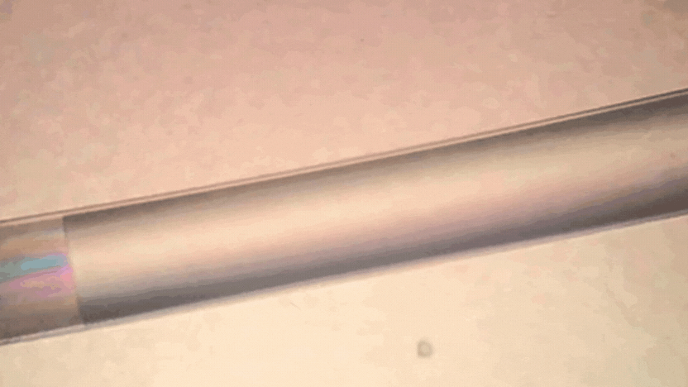
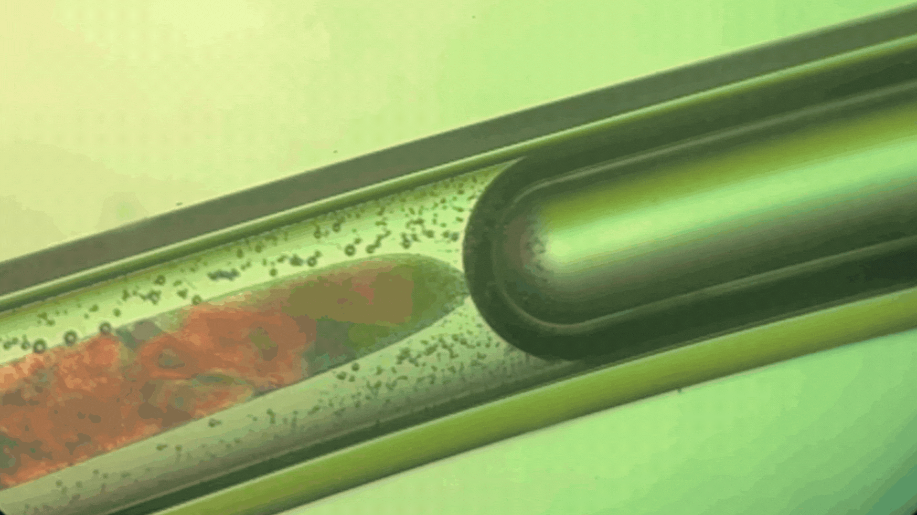

Say No to Ice Crystal Expansion: Cloning, Purifying, and Unleashing Antifreeze Proteins for Food, Aviation, and Cryopreservation
Taipei American School, Taipei, Taiwan
TAS_Taipei A: Day: Alivia Chen, Erika Chen, Mia Chen, Jocelyn Chiang, Conroy Chiu, Annabelle Huang, Jacquelyn Inocencio, Woojoo Jeong, Eva Lee, Adriel Leung, Tristin Wang, Myron Yu
TAS_Taipei B: Julie Bae, Ethan Chen, William Feung, Anya Kao, Felisha Liang, Laura Lee, Keera Tsai, Austin Wang, Florence Wu, Queenie Yeh, Dr. Hsu
Protein Purification Flow Chart
Worm Experiment - Preliminary Data
Figure 5. Flow Chart of AFP Synthesis
In order to synthesize AFP, genes from Zoarces americanus, Lycodichthys dearborni, Pseudopleuronectes americanus, and Daucus carota were purchased from Genomics, Inc. Taiwan
The expression of genes was done in E. coli BL21
We are currently in the process of purification
AFPs purified from these organisms will be tested for function using methodology mentioned throughout.
Figure 6. Picture of worms used in experiment
In order to test AFPs efficacy in worms, we developed a method to allow compounds to diffuse through the entire body of the worm.
We successfully injected the worm with a 0.30 M NaCl solution (to maintain isotonic conditions) combined with blue food coloring, which visibly diffused throughout the entirety of the worm’s body as shown in figure 6. Furthermore, worm survived post-injection.
Next step: test the method using purified AFPs inside the solution.
Visualization of Ice Crystallization/ Thawing - Preliminary Data
TAS Taipei B5
References / Acknowledgment
Figure 7. Microscopic Video of Ice crystallization & thawing
A 1.8 mm glass capillary tube was filled with H₂O and sealed at both ends with hot glue.
The tube was submerged under water and observed under a dissection microscope using cross-polarized filters to enhance crystal visibility.
Recorded ice crystal formation during freezing (Fig. a) & changes during thawing (Fig. b).
Future work will replace water with 10% glycerol as a cryoprotectant to compare differences in ice crystal patterns.
We’d like to thank BioBuilder for organizing this event, the wonderful Upper School organization for supporting this project, Mr. Tsao for helping us with ordering materials,
and Mr. Frankenberg, our HoS, for supporting this opportunity.
Figure a. Microscopic Observation of Ice crystallization
Figure b. Microscopic Observation of Ice thawing

