Slide 1


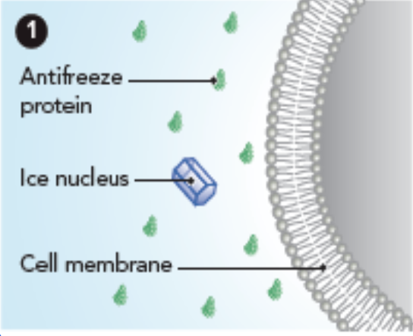

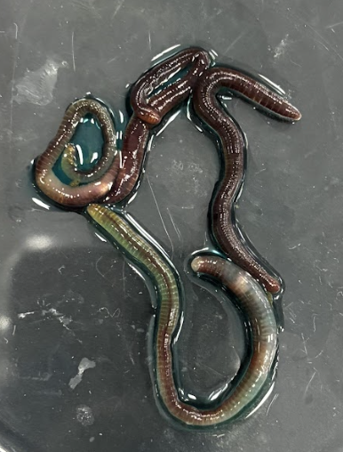
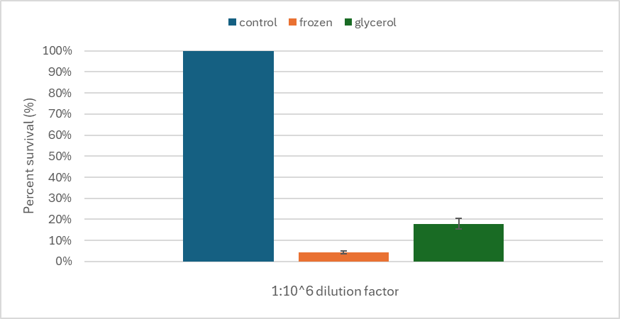
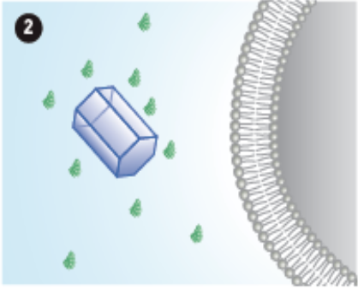
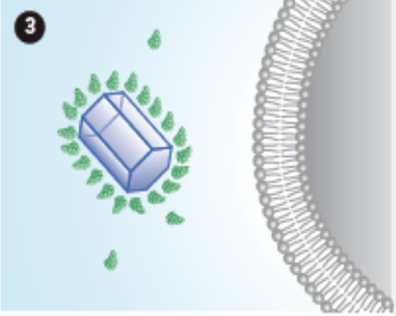






Say No to Ice Crystal Expansion: Cloning, Purifying, and Unleashing Antifreeze Proteins for Food, Aviation, and Cryopreservation
TAS_Taipei A: Day: Alivia Chen, Erika Chen, Mia Chen, Jocelyn Chiang, Conroy Chiu, Annabelle Huang, Jacquelyn Inocencio, Woojoo Jeong, Eva Lee, Adriel Leung, Tristin Wang, Myron Yu
TAS_Taipei B: Julie Bae, Ethan Chen, William Feung, Anya Kao, Felisha Liang, Laura Lee, Keera Tsai, Austin Wang, Florence Wu, Queenie Yeh, Dr. Hsu
Taipei American School, Taipei, Taiwan
OBJECTIVE: Our project aims to explore the potential of Antifreeze proteins (AFPs) in cryopreservation, food science, and anti-icing applications to enhance cryopreservation and food science
Figure 1. Flow Diagram of how Antifreeze proteins prevent ice crystallization
Click here for audio!!
Cell viability percentage based on the dilution factor
Glycerol (green) protects freezing!
Worm Experiment
The worms are entirely blue!
Notes:
To measure how AFPs protect living cells, we first established a baseline using E. coli. By monitoring colony growth, we confirmed that while our non-frozen control (blue bar) had the highest viability, the glycerol-treated group (green bar) significantly outperformed the untreated frozen group (orange bar). This benchmark proves our assay is sensitive enough to evaluate AFP efficacy in upcoming trials.

Slide 2
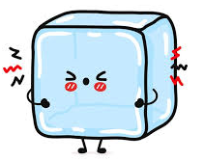
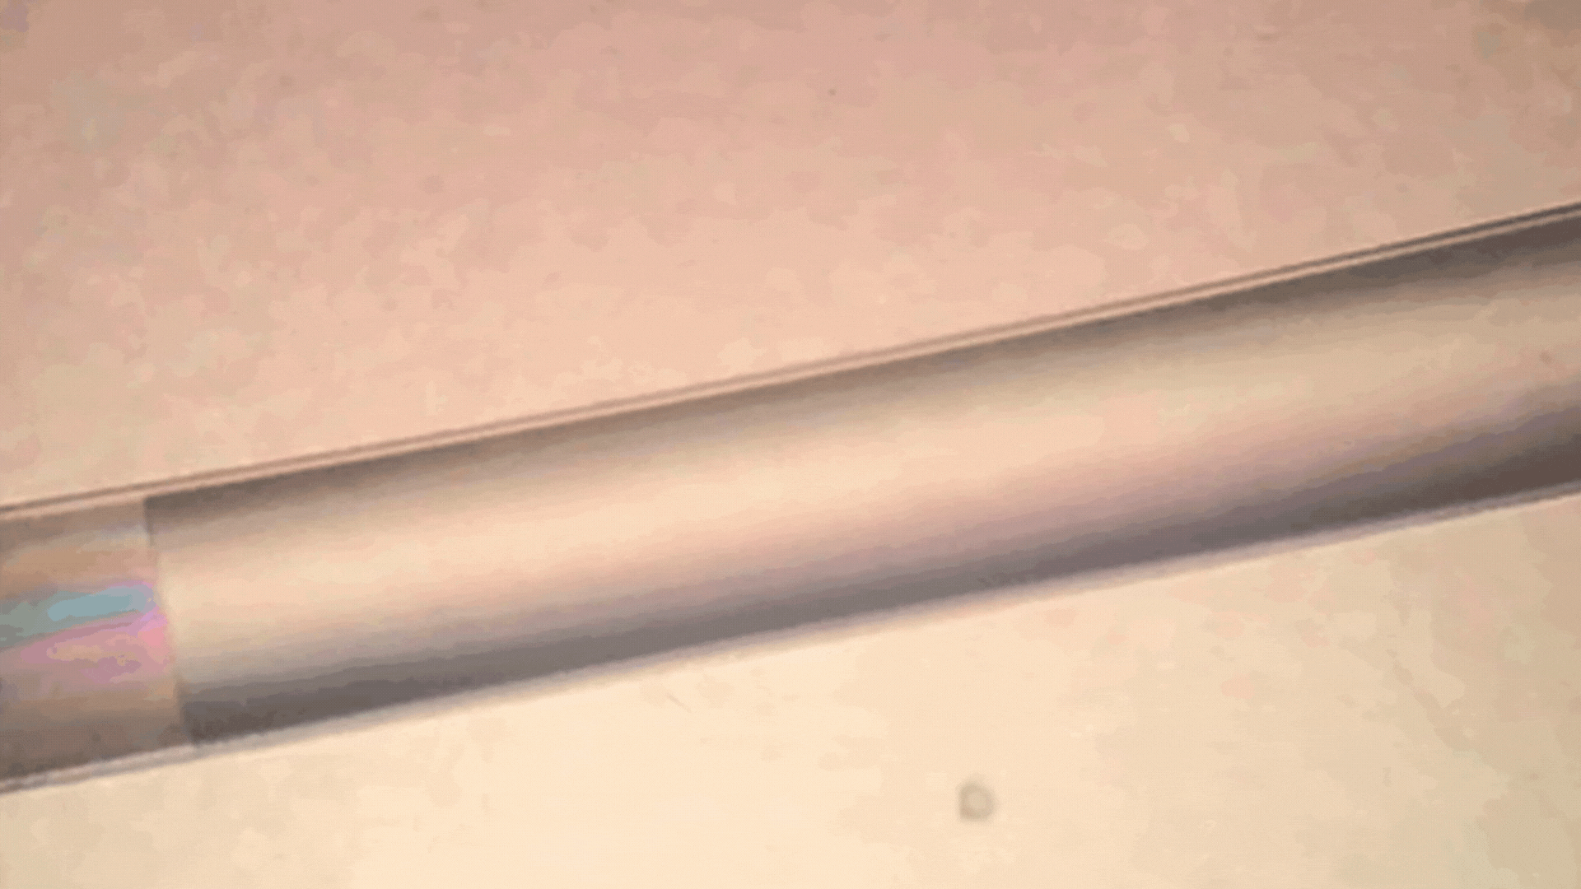
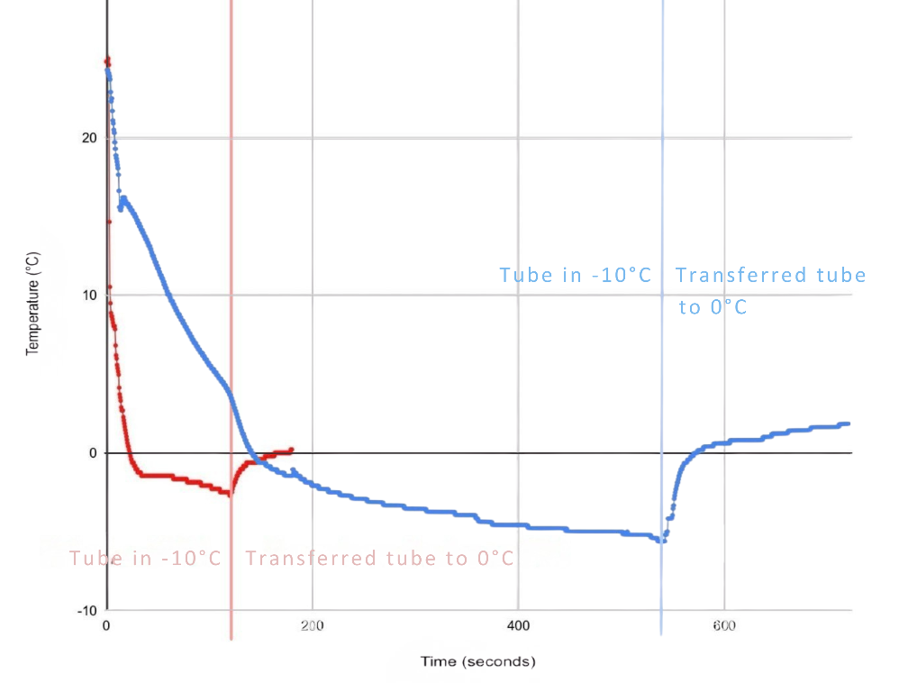
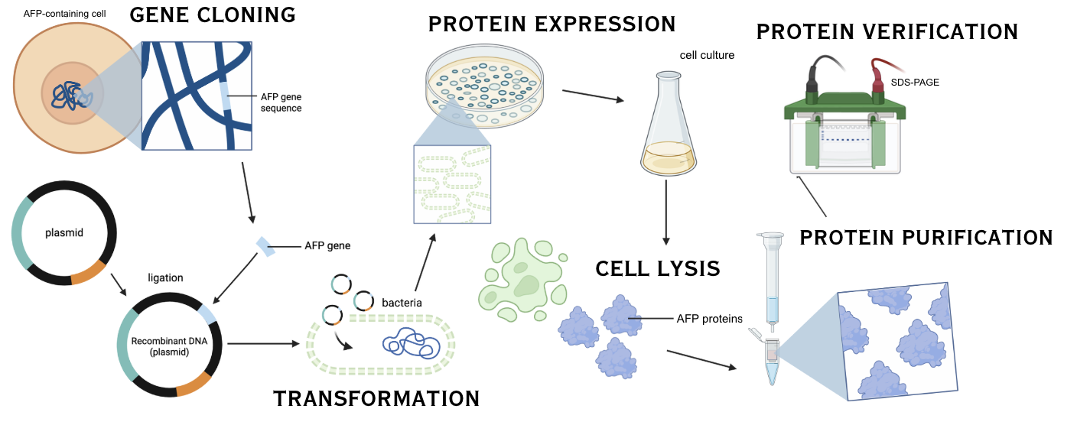
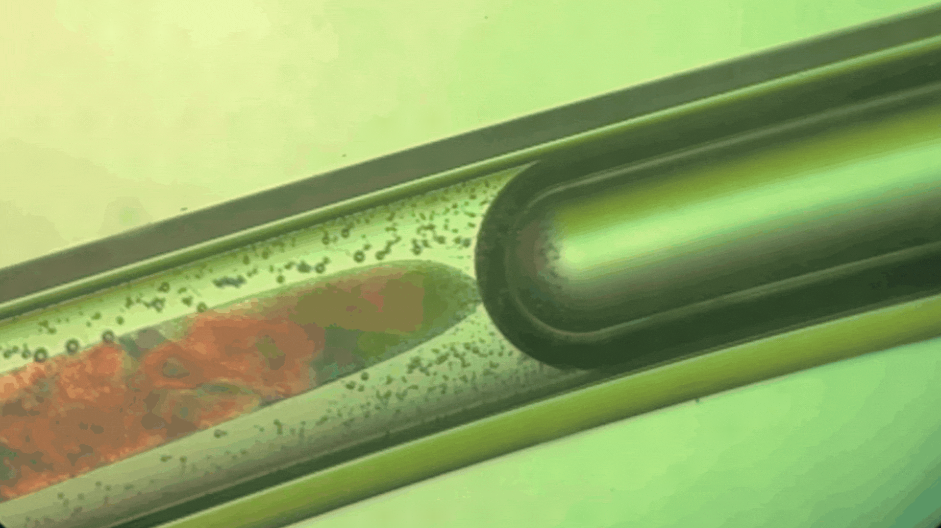
OBJECTIVE: Our project aims to explore the potential of Antifreeze proteins (AFPs) in cryopreservation, food science, and anti-icing applications to enhance cryopreservation and food science
Click here for audio!!
Figure 4. Graphical visualization of Thermal Hysteresis freezing and melting point difference of dH2O (red) and 5% glycerol (blue).
Figure 3. Ice crystallization (top) and thawing (bottom)
We can see Ice Freeze!!
Glycerol (a cryoprotectant) actually lowers the freezing point!
Figure 5. Flow chart of AFP purification

