Slide 1

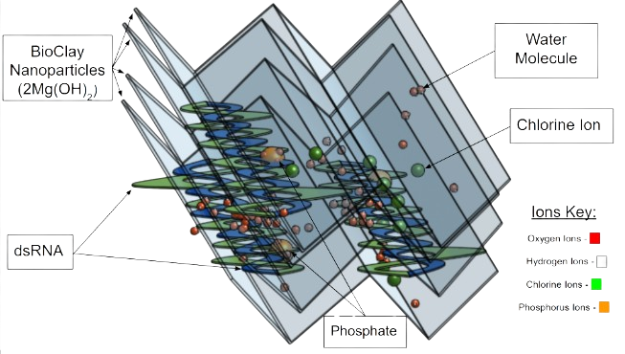
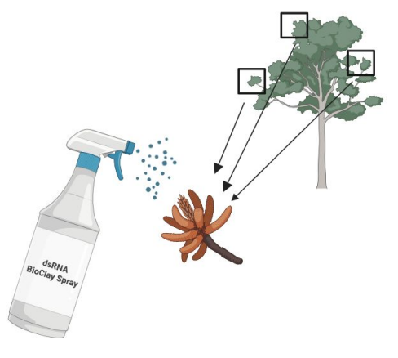
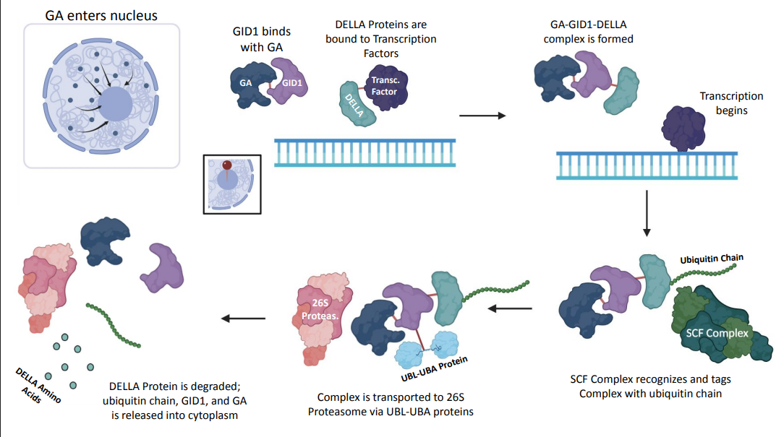
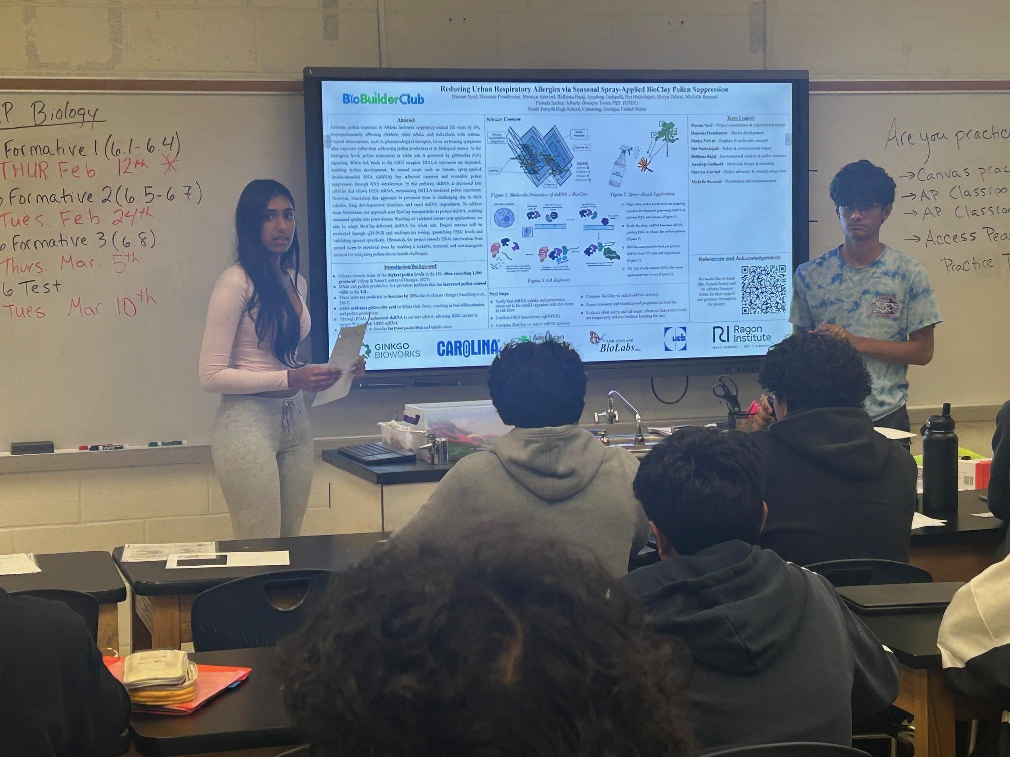






Reducing Urban Respiratory Allergies via Seasonal Spray-Applied BioClay Pollen Suppression
Hassan Syed, Hanssini Premkumar, Shreeya Aravind, Ridhima Bajaj, Anudeep Gadipalli, Siri Nuthalapati, Shriya Palwai, Michelle Rarasati
Pamala Seeley, Dr. Alberto Donayre Torres (UTEC)
South Forsyth High School, Cumming, Georgia, United States
Science Content
Hassan Syed – Project coordination Hanssini Premkumar – Device development
Shriya Palwai – Graphics & molecular concepts
Siri Nuthalapati – Safety & environmental impact
Ridhima Bajaj – Environmental analysis
Anudeep Gadipalli – Molecular design & modeling Shreeya Aravind – Project advocacy Michelle Rarasati – Communications
Abstract
Airborne pollen exposure in Atlanta increases respiratory-related ER visits by 8%, disproportionately affecting children, older adults, and individuals with asthma. Current interventions, such as pharmacological therapies, focus on treating symptoms after exposure rather than addressing pollen production at its biological source. At the biological level, pollen maturation in white oak is governed by gibberellin (GA) signaling. When GA binds to the GID1 receptor, DELLA repressors are degraded, enabling pollen development. In annual crops such as tomato, spray-applied double-stranded RNA (dsRNA) has achieved transient and reversible pollen suppression through RNA interference. In this pathway, dsRNA is processed into siRNAs that cleave GID1 mRNA, maintaining DELLA-mediated pollen repression. However, translating this approach to perennial trees is challenging due to thick cuticles, long developmental timelines, and rapid dsRNA degradation. To address these limitations, our approach uses BioClay nanoparticles to protect dsRNA, enabling sustained uptake into plant tissues. Building on validated tomato crop applications, we aim to adapt BioClay-delivered dsRNA for white oak. Project success will be evaluated through qRT-PCR and multispecies testing, quantifying GID1 levels and validating species specificity. Ultimately, the project extends RNAi intervention from annual crops to perennial trees by enabling a scalable, seasonal, and non-transgenic method for mitigating pollen-driven health challenges.
Team Content
Figure 1: Molecule Dynamics of dsRNA + BioClay
Figure 2: Spray-Based Application
Introduction/Background
Atlanta records some of the highest pollen levels in the US, often exceeding 1,500 grains/m³ (Sleep & Sinus Centers of Georgia, 2025)
White oak pollen production is a prevalent problem that has increased pollen-related visits to the ER.
These rates are predicted to increase by 29% due to climate change (Anenberg et al., 2017)
GID1 activates gibberellic acid in White Oak Trees, resulting in bud differentiation and pollen production
Through RNAi, engineered dsRNA is cut into siRNA, allowing RISC uptake to target White Oak GID1 mRNA
Binding dsRNA to Bioclay increase protection and uptake rates
Educating AP Biology students on project
References and Acknowledgements
We would like to thank Mrs. Pamala Seeley and Dr. Alberto Donayre Torres for their support and guidance throughout the project.
Figure 3: GA-GID1-DELLA Signaling Pathway
Next Steps
Verify that dsRNA uptake and persistence observed in the model organism will also occur in oak trees
Confirm GID1 knockdown (qRT-PCR)
Compare BioClay vs. naked dsRNA delivery
Compare BioClay vs. naked dsRNA delivery
Ensure transient and weatherproof properties of BioClay
Evaluate plant safety and off-target effects so that pollen levels are temporarily reduced without harming the tree

