Slide 1

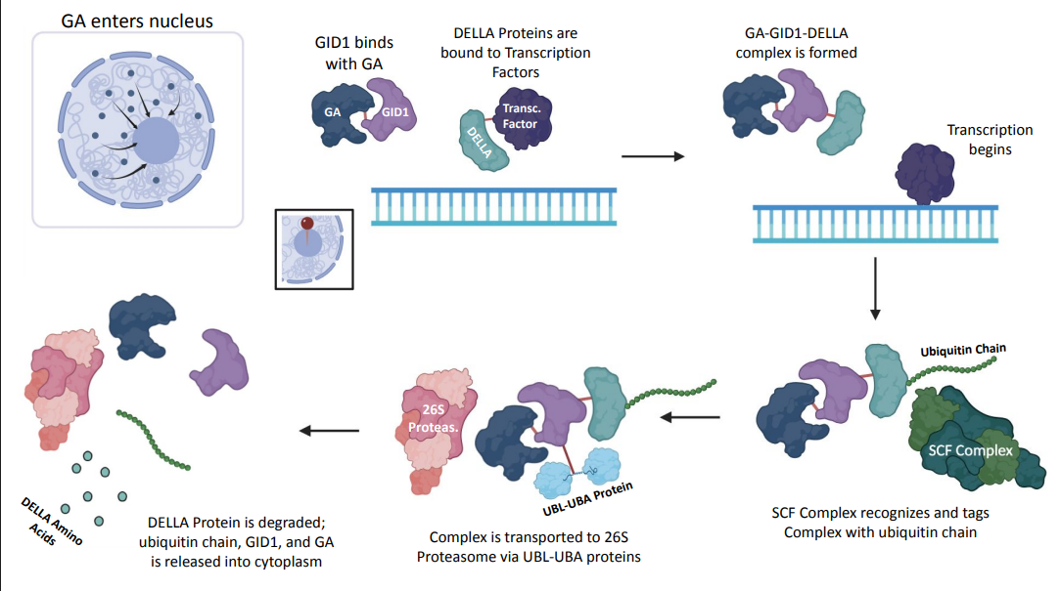
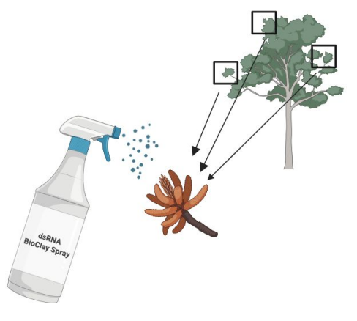





Reducing Urban Respiratory Allergies Using Spray Applied BioClay for Seasonal Pollen Suppression
Hassan Syed, Hansini Premkumar, Shreeya Aravind, Ridhima Bajaj, Anudeep Gadipalli, Siri Nuthalapati, Shriya Palwai, Michelle Rarasati
Pamala Seeley, Dr. Alberto Donayre Torres (UTEC)
South Forsyth High School, Cumming, Georgia, United States
Problem
Climate change → earlier and longer periods of pollen production
Higher pollen counts → increased respiratory concerns and issues
Current treatments address symptoms rather than reducing pollen production at the source.
Objective
Reduce pollen-caused respiratory issues by repressing the pollen production pathway through RNA interference
Targeting the white oak (a leading contributor)
Design
Double stranded RNA targets GID1 mRNA (protein initiating pollen production)
When GID1 is repressed, pollen production is slower and temporarily reduced.
dsRNA is delivered using a spray containing an agriculture technology called BioClay, which protects it from rain, UV, and harsh weather.
Figure 1: GID1 interaction with pollen production pathway
Figure 2: Spray-Based Application

