Slide 1

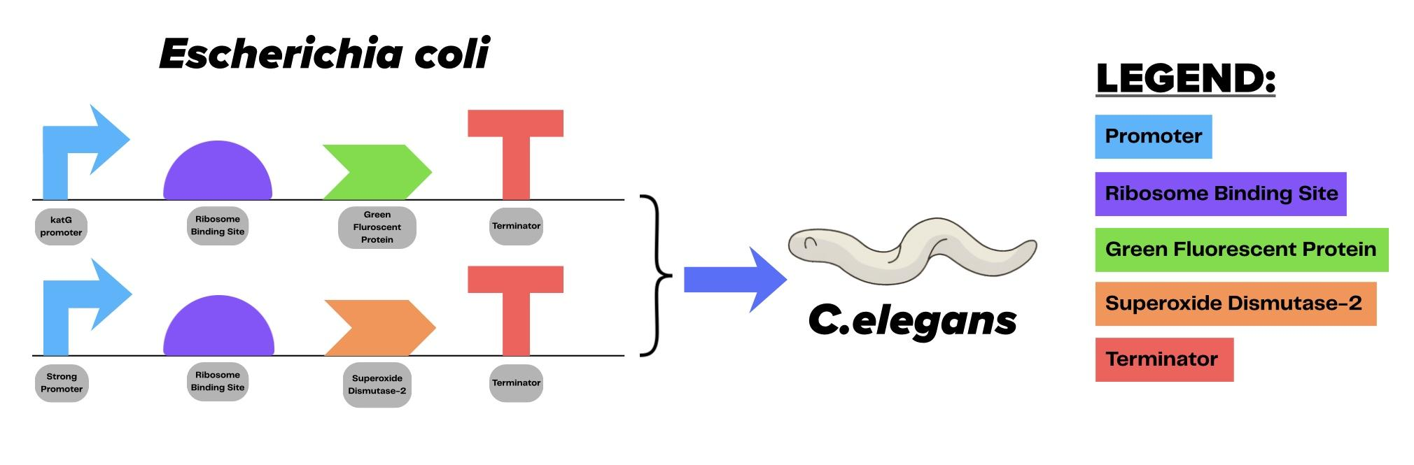
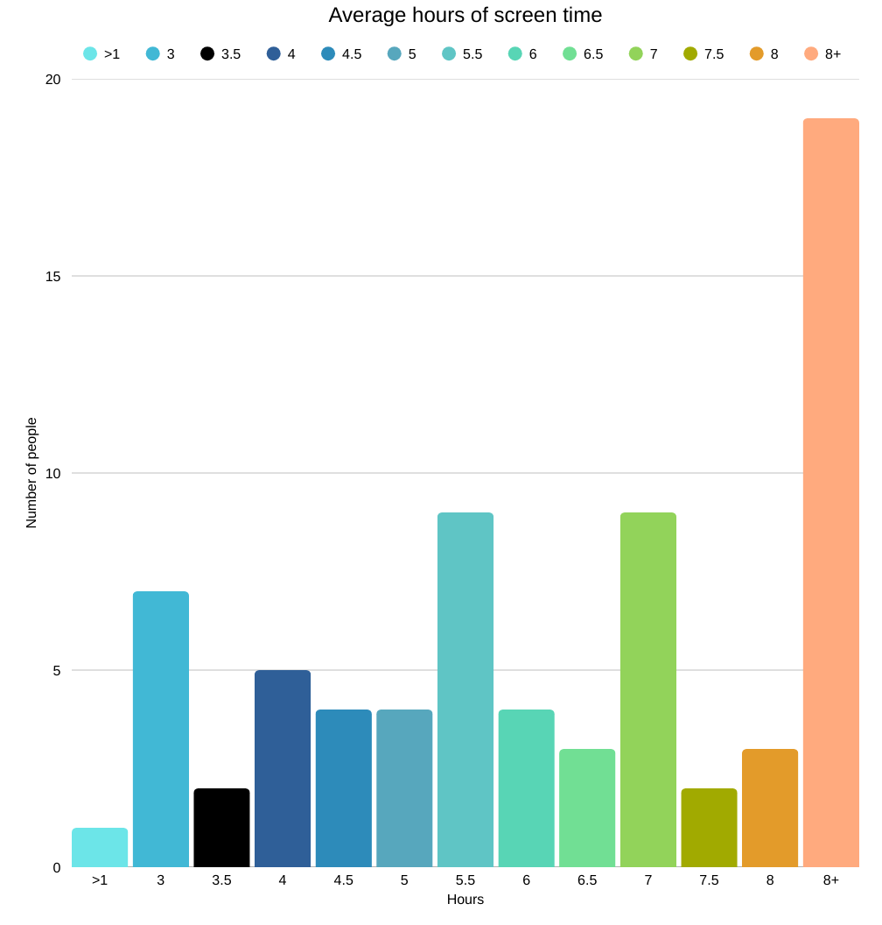
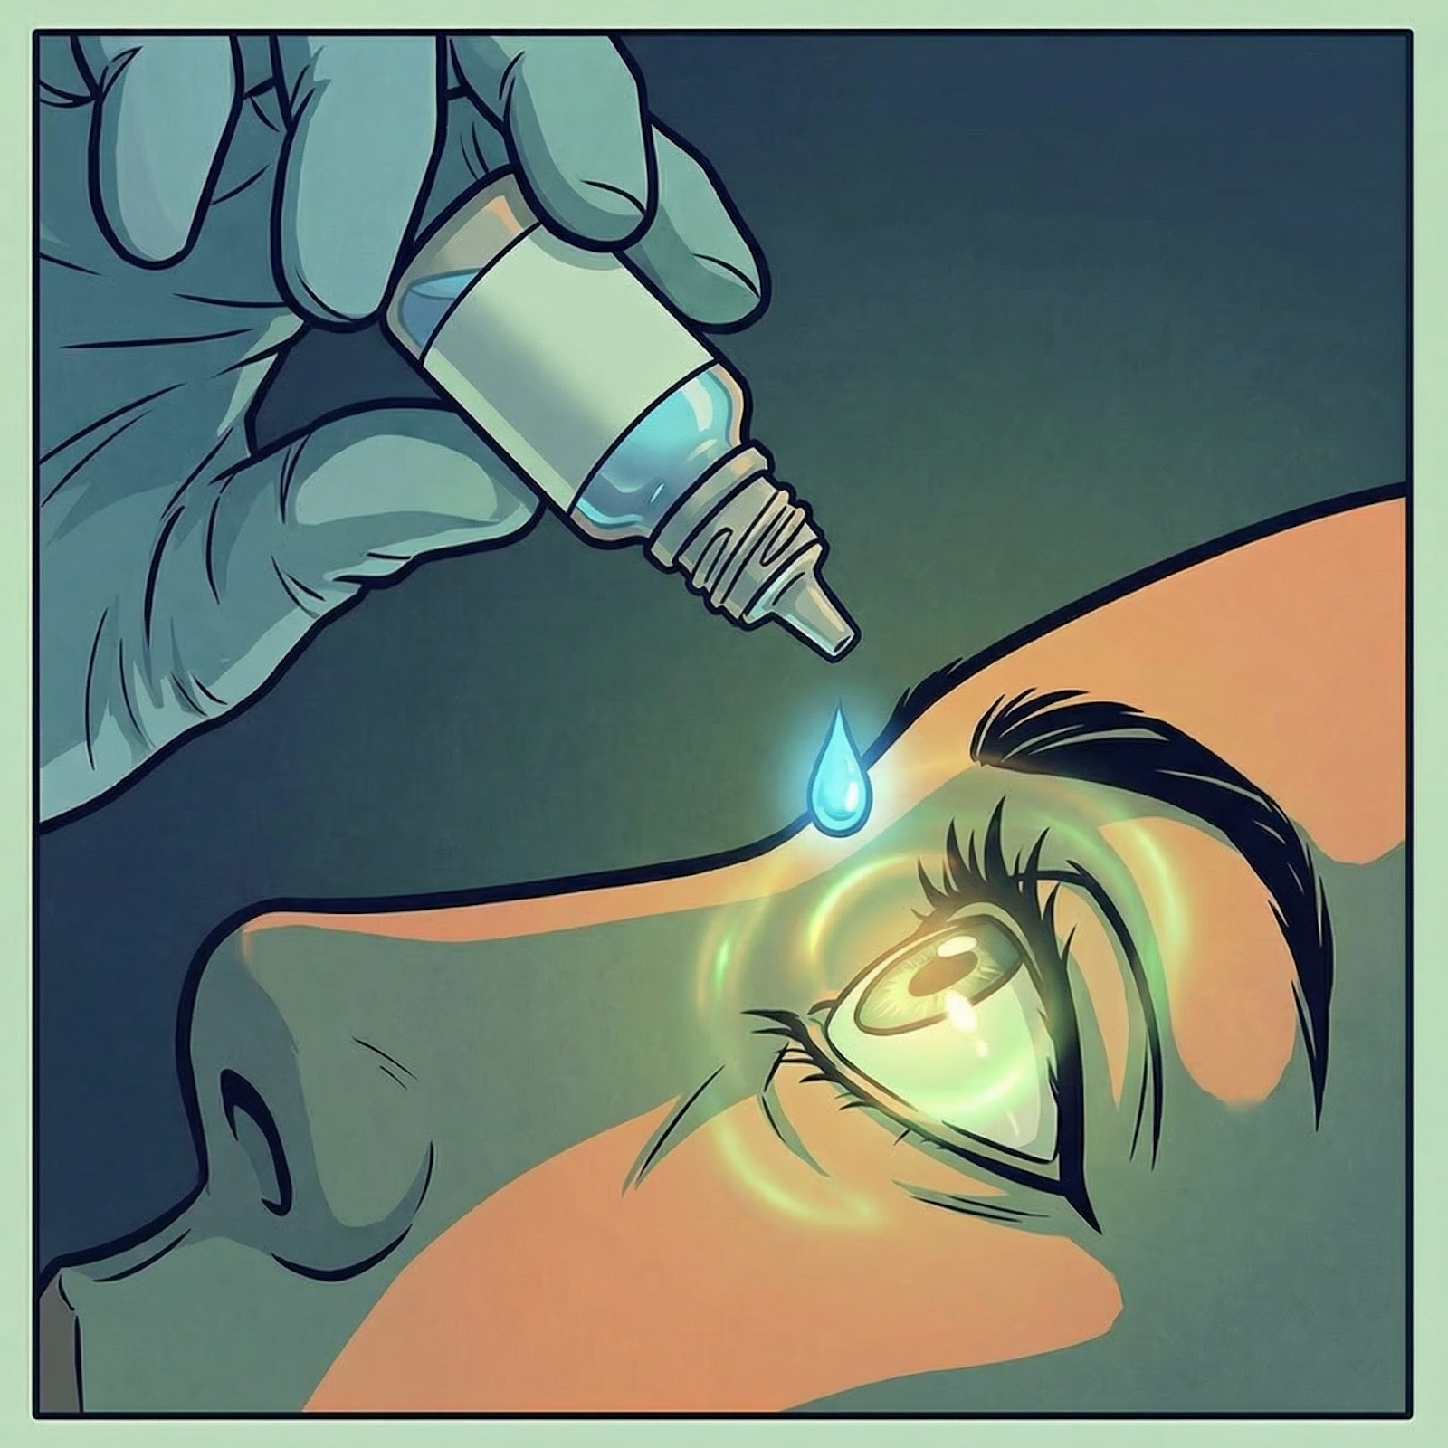
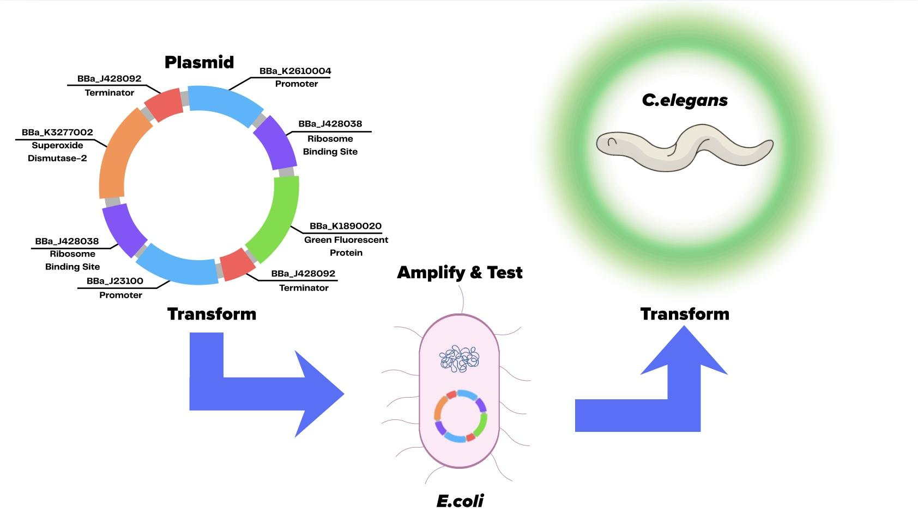
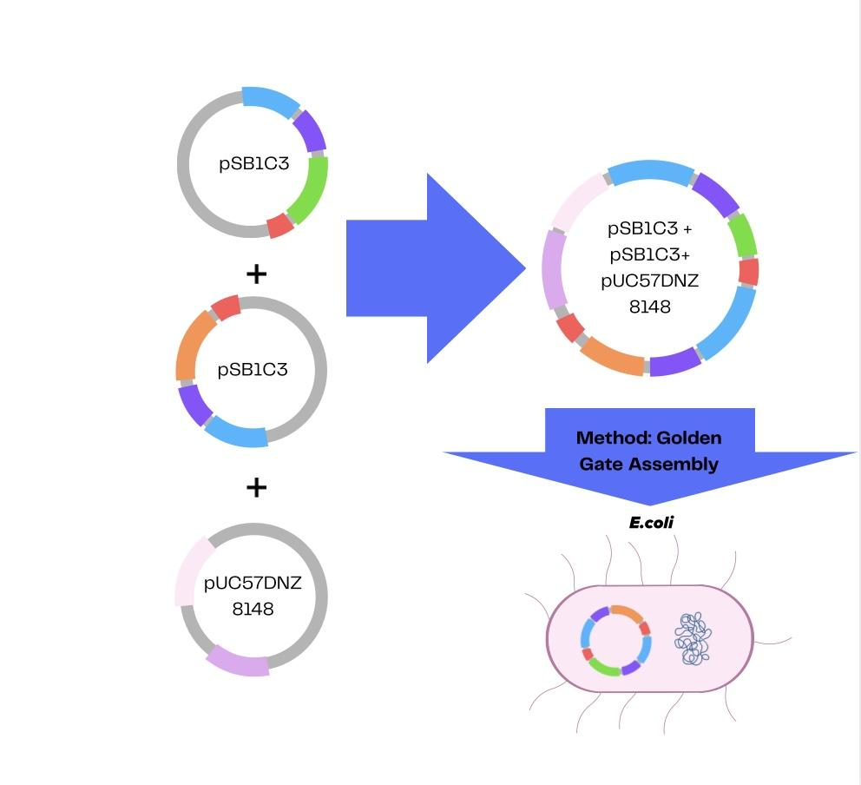
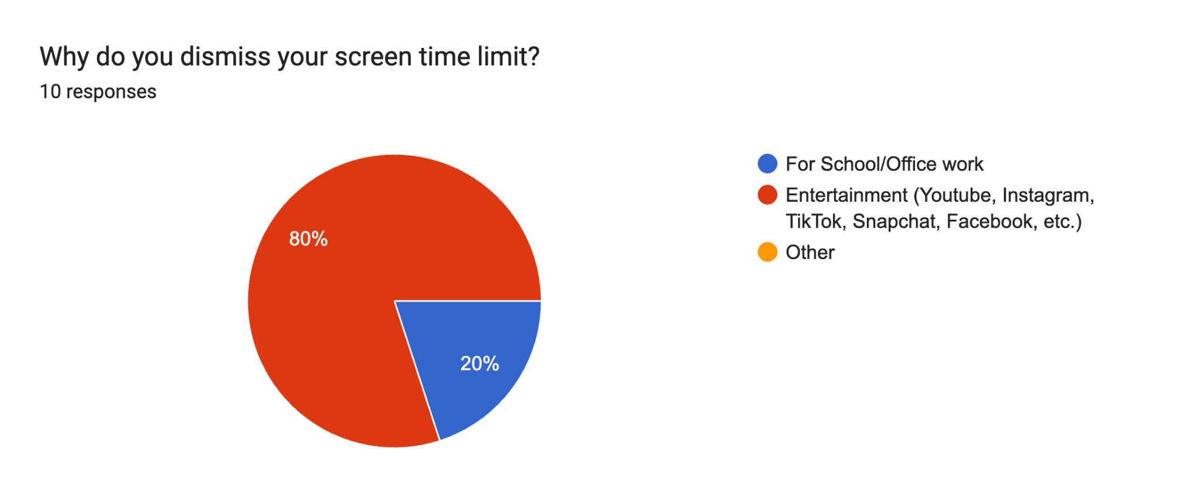







OPTOGENETIC CONTROL IN C.ELEGANS: ENGINEERING BLUE-LIGHT RESPONSIVE GENE EXPRESSION FOR THERAPEUTICS
Sarvesh Sathiyamoorthi¹, Arush Maridu¹, Raghav Bajaj¹, Ishani Sharma¹, Meera Paramagurusamy¹, Shaun Philip Mathew¹, Mukul Vishwakumar¹, Vedanth Vivekanand¹
Pamala Seeley¹, Dr. Peter Horanyi (UCB)
South Forsyth High School¹, Cumming, Georgia, USA
Next Steps
Test the biosensor with real blue-light exposure and real E.coli samples to confirm reliable performance in 0.90 - 0.97% NaCl levels, neutral pH, 27-35 (°C), and natural light exposure.
Convert the system to a safe, deployable format (cell-free or kill-switch) with a simple fluorescence readout and move away from using E.coli to make it safer to use in an eye-drop solution.
Run a small pilot for one use case (e.g., antioxidant screening) to verify usability and stability outside the lab.
Abstract
Constant digital device use makes blue light exposure unavoidable, increasing oxidative stress via reactive oxygen species (ROS) and damaging retinal tissue. Current solutions focus on prevention rather than mitigating underlying cellular damage. This project aims to both detect and neutralize blue light-induced ROS. We developed a dual-plasmid system: the first reports elevated ROS levels using GFP, while the second expresses superoxide dismutase (SOD-2) to reduce oxidative stress. These constructs were validated in E. coli and then fed to C. elegans, a transparent nematode model, for organism-level reporting. This light-regulated system links an external stimulus to a genetic response, enabling precise monitoring of cellular health and providing a foundation for future protective technologies.
Team Contributions:
Sarvesh Sathiyamoorthi - Project Coordination & Design
Arush Maridu - Background & Parts Research
Raghav Bajaj - Biosafety & Ethics
Ishani Sharma - Outreach & Background
Meera Paramagurusamy - Graphics & Modeling
Shaun Philip Mathew - Molecular
Concepts
Mukul Vishwakumar - Integration Vedanth Vivekanand - Systems
Science Content
Plasmids assembled via Golden Gate Assembly
Plasmids transformed into E. coli and cultivated into bacterial lawns as a food source for C. elegans
Cell membrane temporarily permeable via heat shock or chemical treatment allowing plasmid DNA to pass through the cell to be transferred to E. coli
The GFP gene in the plasmid would allow for fluorescence in C. elegans to allow for the measure of oxidative stress levels increasing
C. elegans used as a model organism to be replicated in the eye
Figure 2: Genetic circuit design showing two expression constructs assembled in E. coli and later introduced into C. elegans to test gene expression
Introduction
In recent decades, increased use of digital devices has led to prolonged exposure to blue light, and excessive exposure has raised concerns about its effects on retinal health. The retina is highly metabolically active and depends heavily on mitochondrial function. Studies show that high levels of blue light increase the productions of reactive oxygen species (ROS) in retinal cells (Godley et al., 2005). Under normal conditions, antioxidant systems such as superoxide dismutase (SOD-2) neutralize ROS. However, excessive blue light exposure can overwhelm these antioxidants, leading to oxidative stress and mitochondrial dysfunction (Beatty et al., 2000).
Figure 3: Average Screen Time
(# of Hours) of Students & Adults
Figure 4: Overview of our system-level design. Both plasmids will be tested and amplified in E.coli before transforming it into C. elegans
Although preventative measures such as limiting screen time and using blue light-filtering glasses exist, adherence remains low. Because behavioral interventions alone may be insufficient to mitigate chronic cellular damage, synthetic biology offers a promising alternative (Singh et al., 2021). We propose to enhance SOD activity in retinal cells, reducing ROS accumulation and keeping mitochondrial damage to a minimum.
Figure 5: Plasmid assembly strategy using Golden Gate cloning to build two expression plasmids before transformation into E. coli.
References
We are grateful to Mrs. Pamala Seeley and Dr. Peter Horanyi for their unwavering support and guidance throughout the different aspects of our BioBuilder project.
Figure 1: Distribution of screen time use by purpose

