Slide 1

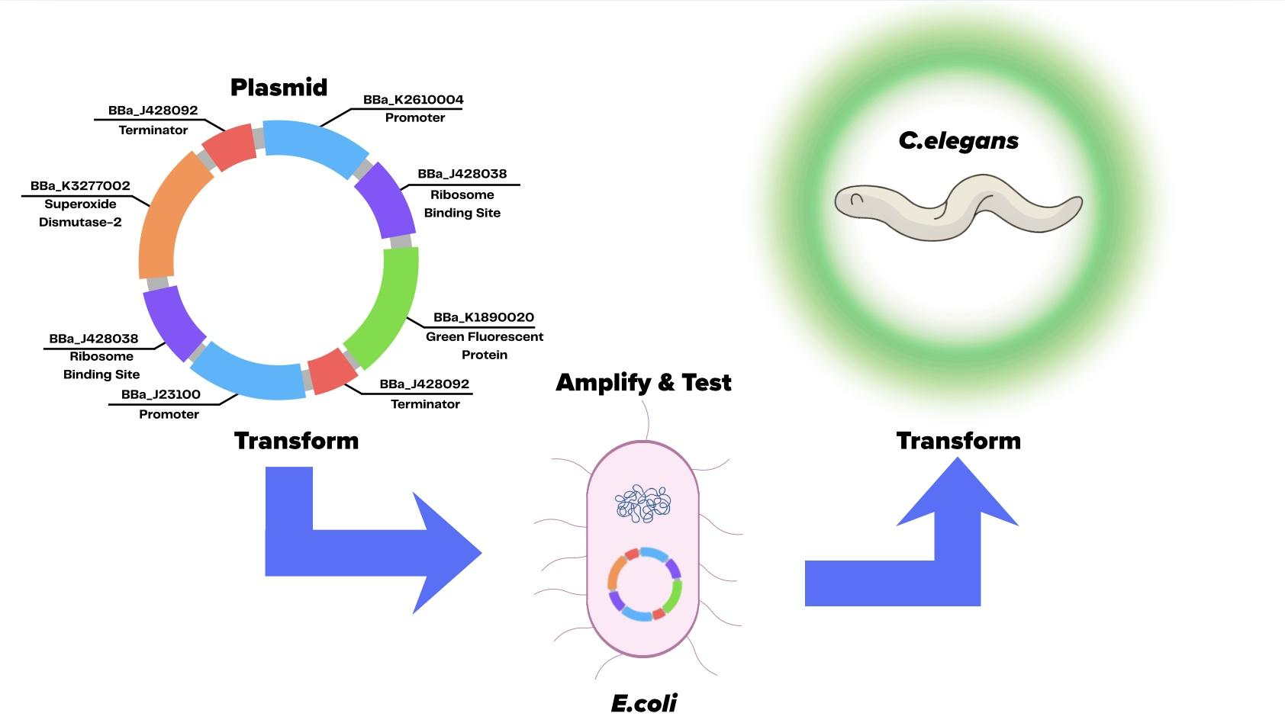
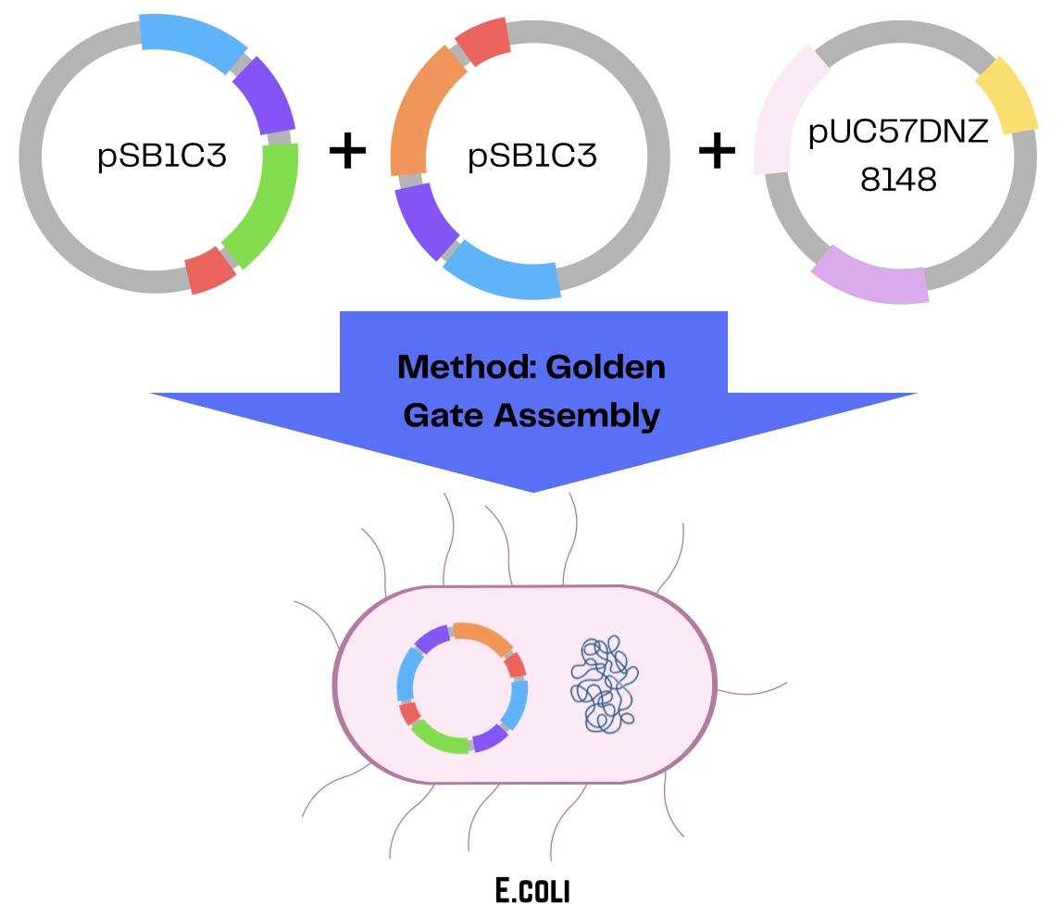
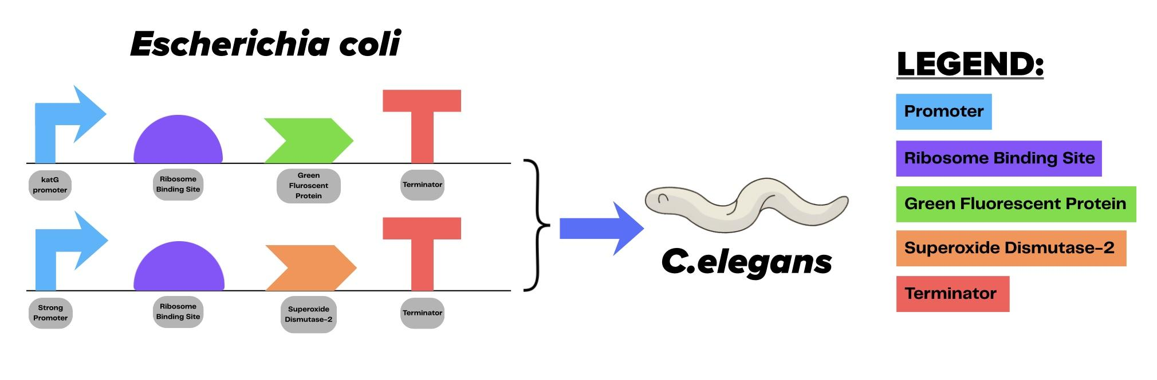





OPTOGENETIC CONTROL IN C.ELEGANS: ENGINEERING BLUE-LIGHT RESPONSIVE GENE EXPRESSION FOR THERAPEUTICS
Sarvesh Sathiyamoorthi¹, Arush Maridu¹, Raghav Bajaj¹, Ishani Sharma¹, Meera Paramagurusamy¹, Shaun Philip Mathew¹, Mukul Vishwakumar¹, Vedanth Vivekanand¹ , Pamala Seeley¹, Peter Horanyi (UCB)
South Forsyth High School¹, Cumming, Georgia, USA
Prolonged blue light exposure → Increased ROS → oxidative stress and retinal cell damage
Existing solutions (screen limits, blue-light filters) rely on behavior and don’t reverse cellular damage
Conducted two surveys regarding screentime to validate our hypothesis
Engineered dual-plasmid system: GFP reporter detects ROS + SOD-2 enzyme neutralizes ROS
Figure 4: Plasmid assembly strategy using Golden Gate cloning to build two expression plasmids before transformation into E. coli.
Figure 3: Overview of our system-level design. Both plasmids will be tested and amplified in E. coli before transforming it into C. elegans
Future Experiments:
Link environmental blue light exposure to measurable response by amplifying & cloning plasmids in E. coli
Let C. elegans uptake E.coli to see real-time response when exposed to blue light
Figure 1: Genetic circuit design showing two expression constructs assembled in E. coli and later introduced into C. elegans to test gene expression

