Slide 1



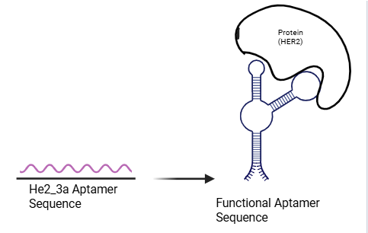
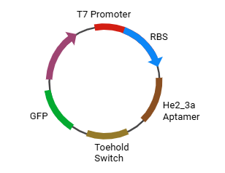
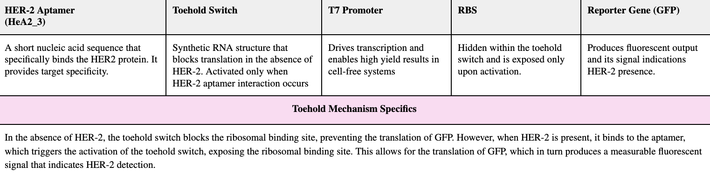






Reimagining Cancer Diagnostics: A Cell-free Biosensor for Early Detection of HER-2 Positive Breast Cancer
Abigail Sanchez Chavez, Chloe Martin, Bria Washington, Daniella Rico, Zion Jatta, Abigail Ejoga, Temitayo Fakunle, Dr. Tiffany Jones, Laura Guerrero (Jewett Lab, Stanford University)
South Cobb High School, Austell, Georgia, US
Abstract
Science Content
Next Steps
Breast cancer is known to be one of the most aggressive types of cancer in women, with an alarming estimate of 300,000 cases being diagnosed every year. Early detection of an aggressive and malignant cancer is imperative for receiving targeted therapy and treatment. Detecting the overexpression of the HER-2 protein, a major contributor to breast cancer, can be utilized in early stages to reduce the risk of the cancer spreading and fatal outcomes. This project aims to design a cell-free biosensor that detects HER-2 overexpression using a DNA aptamer with high specificity for the protein. Once the HER-2 aptamer and the protein bind, a toehold switch is then activated, producing a reporter signal that indicates HER-2 overexpression. With further experimental verification, the final design for the cell-free biosensor and research suggests that this approach offers a low-cost alternative for detecting HER-2 overexpression and improving the efficiency and accessibility of cancer detection methods.
Conceptual Flow
Future plans would include ordering and testing the plasmid to determine the test’s reliability and if it could be manufactured in a cheaper more efficient way than other available tests, potentially providing an at home, over the counter cancer detection option, assisting areas that lack medical service accessibility.
Additionally, this could be applied in future more tangentially related projects as this proof of concept shows a novel line of thinking, connecting synthetic biology and cancer research. This project could assist or guide others in their research and lead to new solutions or ideas of how to approach cancer and other rapid diseases
Experimental Progression
Designed the biosensor genetic circuit in silico to ensure proper arrangement and compatibility of T7 promoter, HeA2_3 aptamer, toehold switch, RBS, and GFP reporter gene
Ordered finalized sequence as a prebuilt plasmid to minimize cloning errors and for cost-effectiveness
Introduced the plasmid into a cell-free transcription/translation system, which allows for quicker and more versatile usage, as well as clearer GFP results
Transitioned to the PURExpress system to express the protein using purified transcriptional and translational components (reverse transcriptase)
Added purified HER-2 protein to activate the aptamer–toehold switch mechanism and initiate translation of the GFP reporter gene
Measured GFP fluorescence as a direct output indicating successful HER-2 detection.
Team Content
Introduction/Background
Plasmid Map & Biosensor Visual
We are a returning BBC team of 7 students from South Cobb High School!
Breast cancer (BC) is one of the most aggressive and common cancers in women, affecting 1 in 8 women. BC is a genetic disease caused by mutations that induce prolific cell growth in breast tissues, resulting in tumors. Cancers such as BC are generally associated with protein or biomarker expression. This study focuses on HER2-positive BC, a historically aggressive BC subtype compared to other types of BC (Chen et al., 2010). Human Epidermal Growth-Factor Receptor 2 (HER-2), a transmembrane receptor protein, is a key regulator in breast cell growth and division (Cleveland Clinic, 2023). In HER2 positive cancers, the HER2 gene is amplified and production of the protein is significantly increased. This over expression results in an aggressive fast growth developing a tumor in as little as a year. (Sandhya, 2024) In HER2-positive BC, the HER2 protein is overexpressed, making it a reliable biomarker for diagnosis. Therefore, this study aims to construct an aptamer-based biosensor for robust detection of HER2. HeA2_3, a well-characterized aptamer, was identified for the construct due to its high specificity and affinity to normal and overexpressed HER2 (Gijs et al., 2016). If the HeA2_3 aptamer is incorporated into the biosensor construct, then the sensitivity detection of HER2 in BC can be enhanced.
References and Acknowledgements
Key Biosensor Components
We would like to thank Dr. Tiffany Jones, Dr. Felicia Goodman, Mrs. Martha Sanderson-Gary, and Laura Guerrero for their support and guidance throughout this project and BBC Season. We would also like to thank New England Biolabs, K2 scientific, CobbTank, and the Georgia Teachers Initiative for funding lab supplies to give the team a hands-on experience this season.

