Slide 1

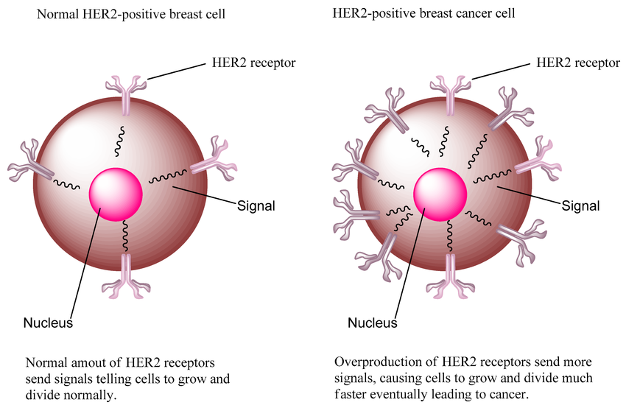
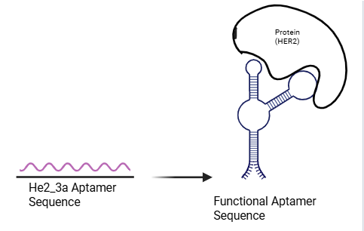
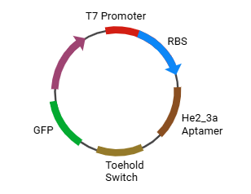





Reimagining Cancer Diagnostics: A Cell-free Biosensor for Early Detection of HER2 Positive Breast Cancer
Abigail Sanchez Chavez, Chloe Martin, Bria Washington, Daniella Rico, Zion Jatta, Abigail Ejoga, Temitayo Fakunle, Dr. Tiffany Jones, Laura Guerrero (Jewett Lab, Stanford University)
South Cobb High School, Austell, Georgia, US
Background & Objective
Breast Cancer is one of the most aggressive types of cancer in women. Detecting the overexpression of the HER-2 protein, a major contributor to breast cancer, can be utilized in early stages to reduce the risk of the cancer spreading and fatal outcomes.
This project aims to design a cell-free biosensor that detects HER-2 overexpression using a DNA aptamer with high specificity for the protein.
Fig. 1. Visual aid demonstrating the overexpression of HER-2 in comparison with a normal cell
Method & Expected Results
Prebuilt Plasmid —> Cell free Expression —-> PURExpress —-> HER-2 Detection
In the absence of HER-2, the toehold switch blocks the ribosomal binding site, preventing the translation of GFP. However, when HER-2 is present, it binds to the aptamer, which triggers the activation of the toehold switch, exposing the ribosomal binding site. This allows for the translation of GFP, which in turn produces a measurable fluorescent signal that indicates HER-2 detection.
Fig. 2. Demonstration of the HER-2-aptamer binding within the sequence, leading to fluorescence
Fig. 3. Plasmid map of Biosensor

