Slide 1

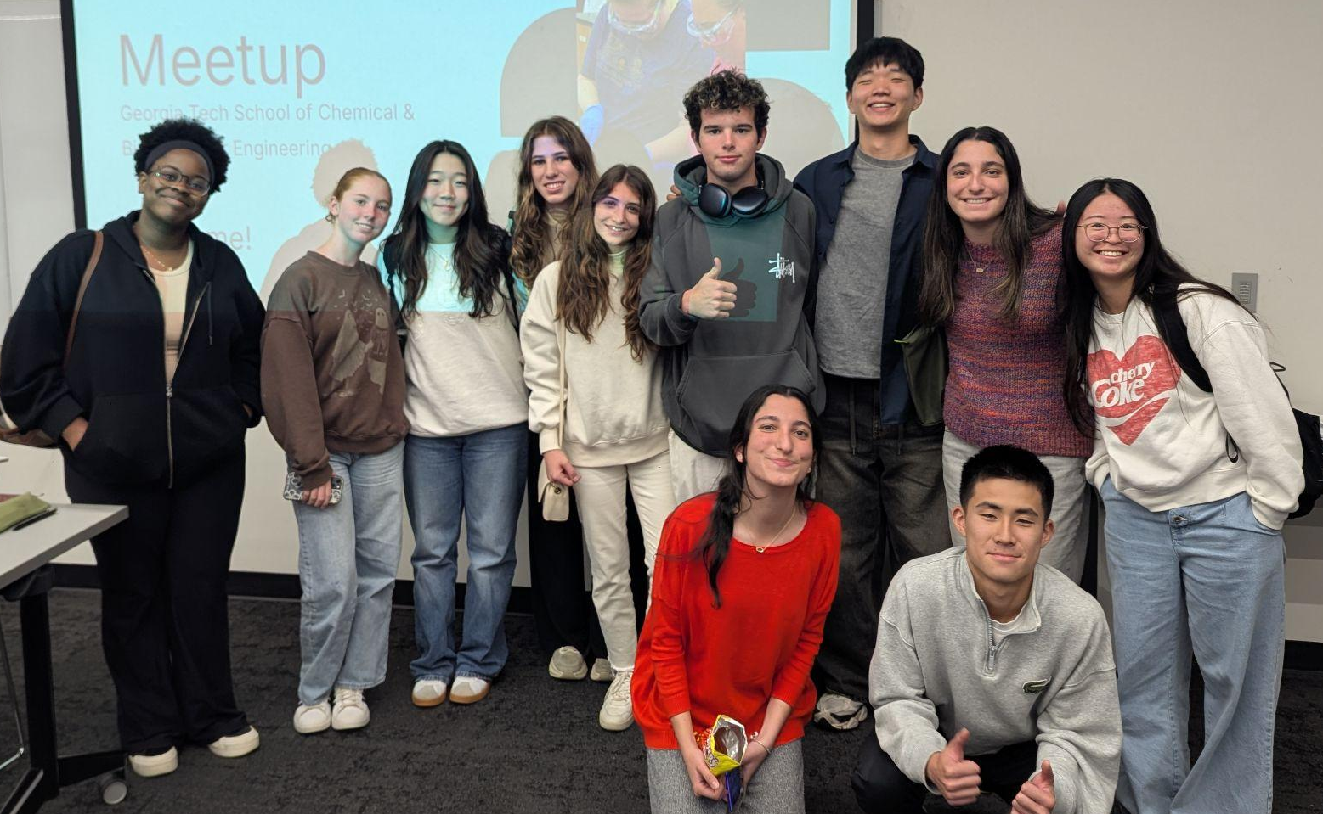
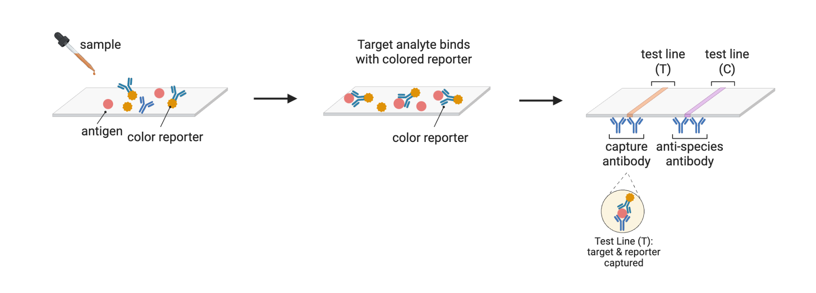
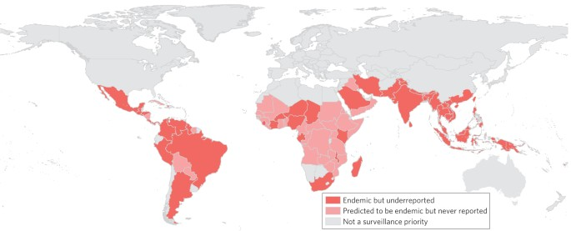





Rapid Detection of Melioidosis Using Synthetic Biology Approaches
Irmak Bilici, David Chen, Hitomi Nakamura, Chioma Nwanze, Clare Hwang, Margot Caffery-Draa, Greg Seok, Elizabeth Sweeney, Jackson Tyers, Maria Coutinho, Tanea Hibler, Aleigha Reynolds, Irene Reizman (Rose–Hulman Institute of Technology)
Rabun Gap-Nacoochee School, Rabun Gap, Georgia, United States
Abstract
Melioidosis (Whitmore’s disease), caused by Burkholderia pseudomallei, is a potentially fatal tropical infection often misdiagnosed due to nonspecific symptoms. The bacteria infect hosts via skin contact, ingestion, or inhalation and evade immune responses through intracellular invasion, phagosomal escape, and actin-mediated cell-to-cell spread (BimA), enabling systemic dissemination. Rapid and accurate detection remains a critical challenge for reducing mortality. Our research evaluates how melioidosis diagnostics can be adapted through synthetic biology to develop rapid, precise tools for emerging infectious diseases.
Current Diagnostic Methods
Previously, the disease Melioidosis was detected by developing a Burkholderia pseudomallei colony using a sample from the patient. While this method is 100% accurate, it grows slowly in a laboratory, taking up to a week. In addition, Burkholderia pseudomallei colonies often mimic environmental contaminants, requiring a skilled microbiologist to analyze them.
Researchers have recently used CRISPR to quickly and accurately diagnose Melioidosis using various bodily fluids. The Burkholderia pseudomallei bacteria is amplified in a recombinase polymerase amplification reaction where Cas19a enzymes detect the unique DNA signature of the bacteria. The sample is then combined with a CRISPR reaction and incubated for 30 minutes. A HybriDetect lateral flow dipstick is then immersed into the reaction for 5 minutes. A positive result develops an upper band which can be read by eye. This entire process resulted in diagnosis being given in 2-3 hours, and the test proved to be 93% accurate.
Team Content
This is our team’s first time participating in biobuilders. There are 10 students on the team. Our team has a mix of ap biology, regular biology, and synthetic biology experience, with two of our members participating in the Frugal Science Academy Summer Program and four people taking or have taken AP biology. We have no experience with Melioidosis prior to the project.
Next Steps
During this project, we learned more about the process of creating diagnostics for diseases, specifically melioidosis and about synthetic biology in general (i.e. how CRISPERs work, how to genetically modify bacteria etc). Going forward, we could duplicate this process to diagnose other diseases by using CRISPR to detect different unique DNA signatures. In addition, this process is not readily available nor affordable to use. Our team hopes to find a way to make CRISPR tool accessible for all communities by developing affordable education kits, such as the ones created by Stanford, and promoting global collaboration with microbiologists across the world.
Background
Melioidosis is caused by Burkholderia pseudomallei, an environmental Gram-negative bacterium found in soil and water. It is difficult to diagnose because it is a “mimicker,” meaning it can resemble many other infections. There are an estimated 165,000 cases and 89,000 deaths each year, although the disease is often underreported and underdiagnosed. Melioidosis is most common in Southeast Asia and Northern Australia, and the risk is higher for individuals with diabetes, kidney disease, lung disease, cancer, or frequent exposure to soil and surface water. People get melioidosis through exposure to soil or water contaminated with B. pseudomallei, with transmission occurring through skin cuts, ingestion, or inhalation of contaminated particles or dust.
References and Acknowledgements
Nandi, T., Holden, M. T. G., Didelot, X., et al. (2015). Burkholderia pseudomallei sequencing identifies genomic clades with distinct recombination, accessory, and epigenetic profiles. Genome Research, 25(1), 129–141. https://doi.org/10.1101/gr.177543.114
Pakdeerat, S., Boonklang, P., Angchagun, K., Chomkatekaew, C., Apichaidejudom, N., Dokket, Y., Faosap, A., Wongsuwan, G., Wuthiekanun, V., Aramrueung, P., Khamnoi, P., Thananchai, H., Siriboon, S., Chamnan, P., Peacock, S. J., Day, N. P. J., Thomson, N. R., Uttamapinant, C., Wongpalee, S. P., & Chewapreecha, C. (2024). Benchmarking CRISPR-BP34 for point-of-care melioidosis detection in low-income and middle-income countries: a molecular diagnostics study. The Lancet Microbe, 0(0). https://doi.org/10.1016/S2666-5247(23)00378-6
A New Rapid Diagnostic for Melioidosis. (2022, May 13). Nih.gov. https://www.niaid.nih.gov/research/new-rapid-diagnostic-melioidosis‌
New rapid melioidosis test could save lives — Centre for Tropical Medicine and Global Health. (2024, March 27). Ox.ac.uk. https://www.tropicalmedicine.ox.ac.uk/news/new-rapid-melioidosis-test-could-save-lives
BioRender. (2025). BioRender. Www.biorender.com; Biorender. https://www.biorender.com
Rueda, J., Beriain, M., & Montoliu, L. (2024). Affordable pricing of CRISPR treatments is a pressing ethical imperative. The CRISPR Journal, 7(5). https://doi.org/10.1089/crispr.2024.004
Pakdeerat, S., Boonklang, P., Angchagun, K., Chomkatekaew, C., Apichaidejudom, N., Dokket, Y., Faosap, A., Wongsuwan, G., Wuthiekanun, V., Aramrueung, P., Khamnoi, P., Thananchai, H., Siriboon, S., Chamnan, P., Peacock, S. J., Day, N. P. J., Thomson, N. R., Uttamapinant, C., Wongpalee, S. P., & Chewapreecha, C. (2024). Benchmarking CRISPR-BP34 for point-of-care melioidosis detection in low-income and middle-income countries: a molecular diagnostics study. The Lancet Microbe, 0(0). https://doi.org/10.1016/S2666-5247(23)00378-6‌
Melioidosis and Pythiosis.” Reviews of Infectious Diseases, vol. 11, 1989, pp. S1629–43. JSTOR, http://www.jstor.org/stable/4455412. Accessed 20 Mar. 2026.
We’d like to thank our teachers Ms. Hibler and Ms. Reynolds for helping lead our team in the right direction. We would also like to that our mentor Dr. Reizman for helping us in our project as well.

