Slide 1

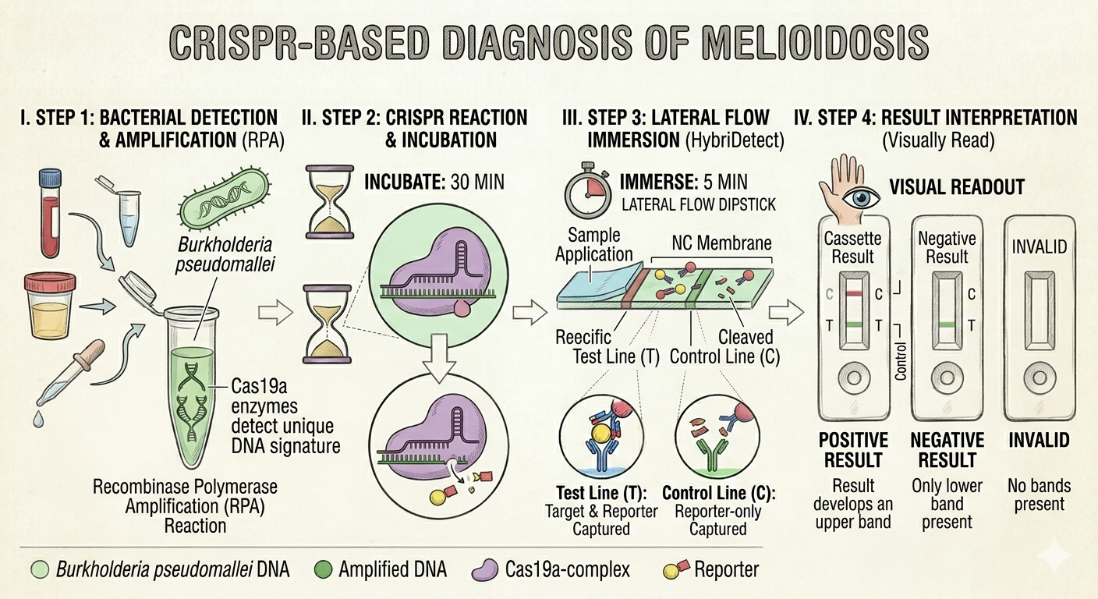
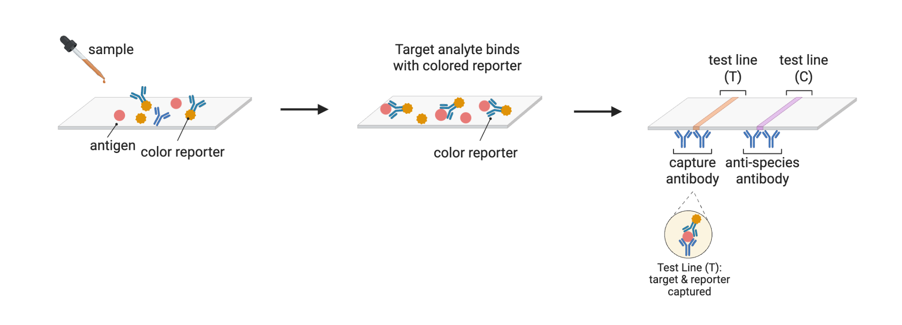
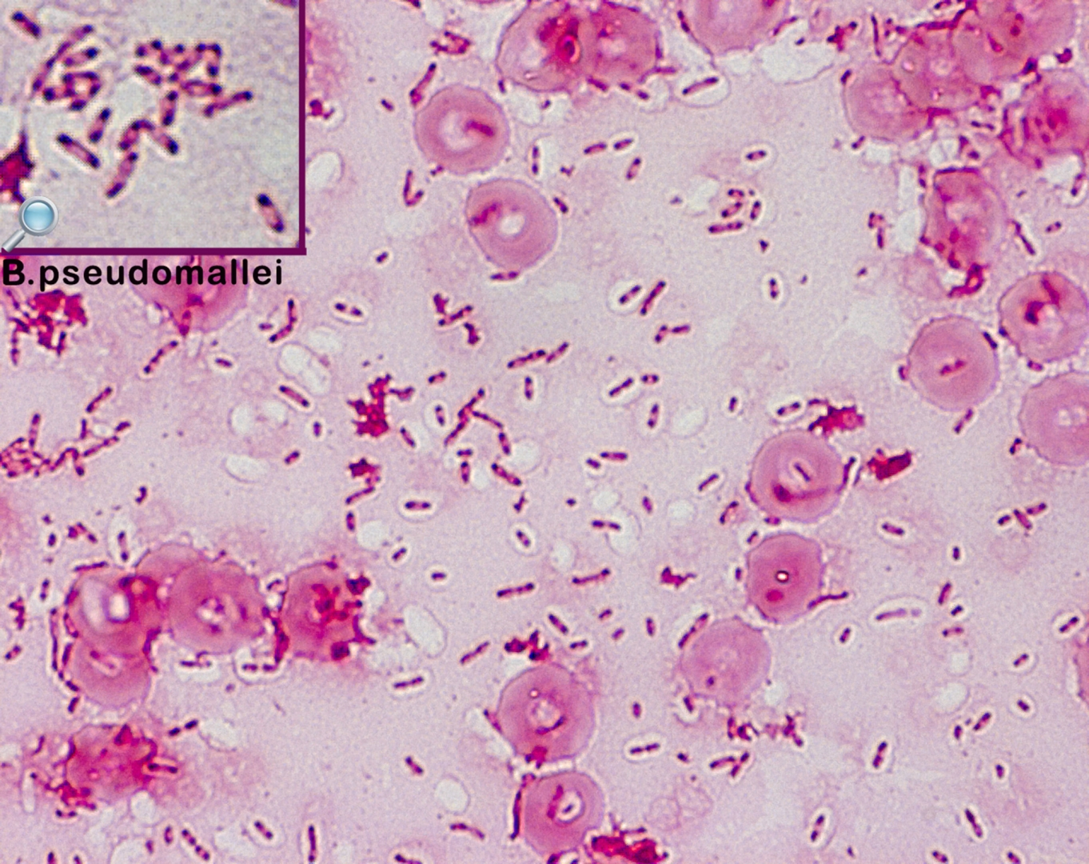
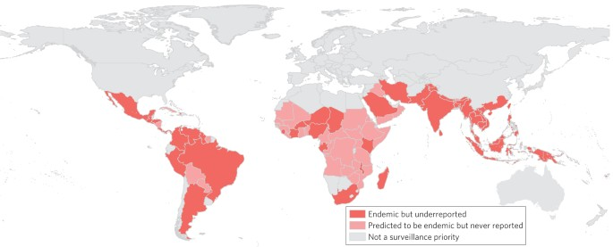





Rapid Detection of Melioidosis Using Synthetic Biology Approaches
Irmak Bilici, David Chen, Hitomi Nakamura, Chioma Nwanze, Clare Hwang, Margot Caffery-Draa, Greg Seok, Elizabeth Sweeney, Jackson Tyers, Maria Coutinho, Tanea Hibler, Aleigha Reynolds, Irene Reizman (Rose–Hulman Institute of Technology)
Rabun Gap-Nacoochee School, Rabun Gap, Georgia, United States
To find a feasible way to detect and diagnose Melioidosis accurately, efficiently, and cheaply.
CRISPR is used to detect unique DNA signatures in Melioidosis and develop a test strip in as little as 2-3 hours.
This test is 93% accurate, however it is very expensive and there are limited resources available.

