Slide 1

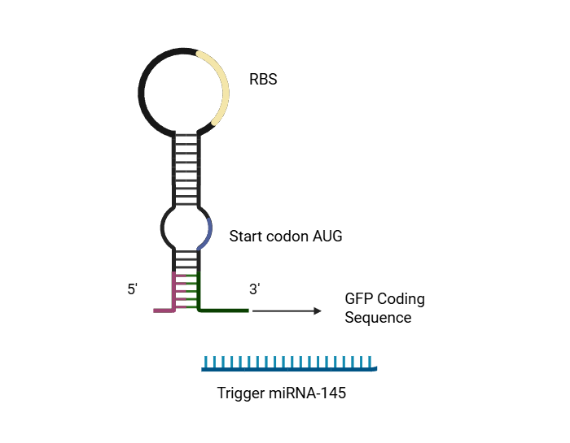
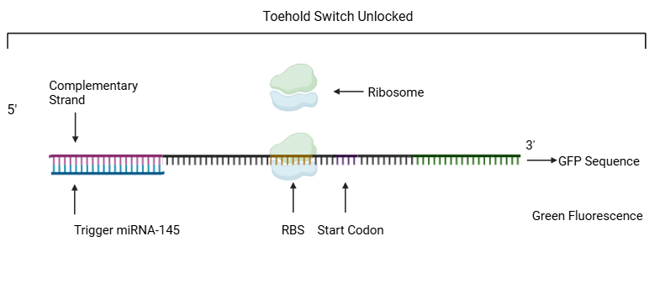
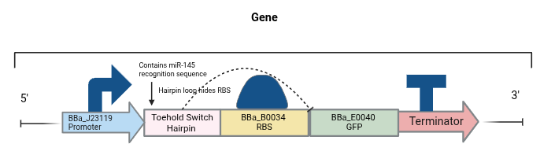
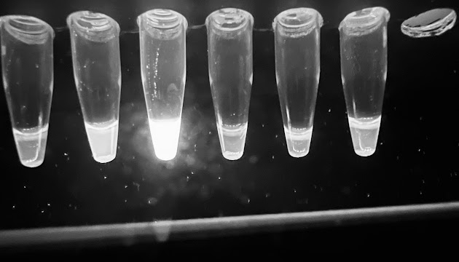







Multiple Sclerosis Point of Care With miRNA-145
Ireolukunmi Osikanlu, Lincoln Lundak, Dylan Lavery, Sara Holzer, Aidan Sjoblom, Henry Brown, Gabe Ardell, Lily Zort, Jeanette Zort, Kirkpatrick, Mr. Cherepashensky (Life Sciences Strategic Consulting)
Oak Park and River Forest High School, Oak Park, Illinois, United States of America
Abstract
Multiple sclerosis affects 2.8 million people worldwide, with diagnosis often delayed due to the high costs of MRI scans and invasive procedures. MicroRNA-145-5p has emerged as a promising MS biomarker, showing 79% sensitivity and 87% specificity in distinguishing patients from healthy controls. However, current detection methods require costly qRT-PCR equipment and trained personnel. We propose a plasmid-based fluorescent biosensor using engineered E. coli to detect miR-145 at point-of-care. Our design employs a toehold switch — an RNA hairpin complementary to miR-145 that blocks the ribosome binding site, preventing GFP translation. Upon miR-145 binding, the hairpin unfolds and activates GFP expression, producing measurable green fluorescence. If validated, this affordable biosensor could enable MS screening in resource-limited settings where MRI is unavailable, significantly improving diagnosis in underserved populations.
Science Content
We designed a gene containing 5 components (BBa_J23119 promoter, a custom toehold switch, BBa_B0034 RBS, BBa_E0040 GFP, and BBa_B0015 terminator) used for GFP synthesis. The toehold switch is engineered complementary to miR-145 creating an RNA hairpin that sequesters the RBS. When the mRNA is present, it binds to the single stranded toehold region through complementary base pairing. This binding causes the toehold switch to unpin exposing the hidden RBS to begin translating GFP.
For the experiment we woul d begin by cloning our DNA insert into the pUC19 vector, a high copy plasmid that conveys ampicillin resistance. The ampicillin resistance means that we can grow our plasmid on a medium with ampicillin, ensuring that only our bacteria survives. The positive control would be a synthetic 22-nt RNA strand matching to microRNA-145-5p. The negative control is a scrambled 22-nt RNA strand that does not contain the custom DNA insert.
Team Content
We are a first-year team. We have 9 members attending. Only 1 of our members participated in BioBuilders in previous years. A highlight has been getting a lot of new members to Boston. Additionally, we found a very pertinent topic, that future groups will likely find easy to pick up.
Next Steps
Our key needs for advancing the project are creating the synthetic toehold switch insert and ordering the synthetic miR-145. In order to perform the experiment we would use a Cell-Free kit, we will set up two tubes containing loose ribosomes and enzymes, to both of these tubes we will add our pUC19 plasmid, to one tube we will add the synthetic positive control and the other the negative control. The positive control should glow green as the synthetic RNA strand binds to the toehold switch and unfolds the hairpin allowing for a ribosome to bind to the RBS and for the GFP to be expressed, the negative control should not emit fluorescence as its synthetic RNA is not complementary to the toehold switch and the RBS will remain inaccessible to the ribosomes.
An example of GFP luminance using a cell free expression kit is shown below.
Introduction/Background
Our project intends to create a better diagnosis for Multiple Sclerosis (MS). Current Multiple Sclerosis diagnosis is produced by medical history, a physical and neurological exam, blood test (National Multiple Sclerosis Society), Magnetic Resonance Imaging (MRI scan), and spinal tap results (Mayo Clinic, 2024). There is no point of care test for MS but rather a series of procedures to rule out other similar neurodegenerative conditions. We propose a plasmid-based biosensor that fluoresces in the presence of microRNA-145, a biomarker for multiple sclerosis. MicroRNA-145 has a 79% sensitivity and 87% specificity in distinguishing patients from healthy controls.
References and Acknowledgements

