Slide 1

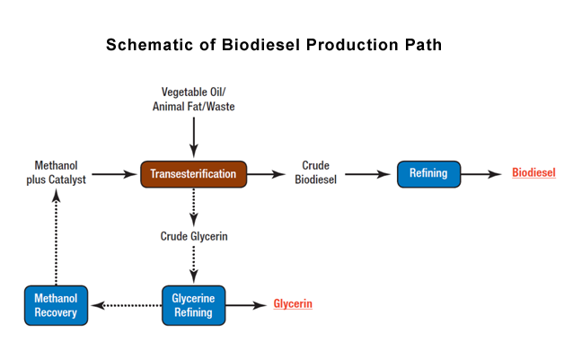





Combating Carbon Dioxide Output via An Innovative Approach to Biofuel Production
Prabha K., Alana J., Hrithiik R., Mateusz S., Sahasra T., Sahasra D., Nidhi D., Khaila C., Yue Z., Shahzoda S.,
Stephen Nelson, Dr. Ryan Tappel (Senior Scientist, LanzaTech)
North Forsyth High School, Cumming, Georgia, USA
ABSTRACT
Invasive plant species threaten ecosystems and agriculture by reducing biodiversity and disrupting natural systems, while climate change continues to worsen due to fossil fuel use and rising greenhouse gas emissions. This project proposes converting invasive plant biomass into renewable energy as a sustainable solution. An engineered BL21 E. coli strain produces lipase to break down plant biomass into biodiesel precursors through physical processing followed by enzymatic hydrolysis and transesterification. Microalgae such as Schizochytrium, known for high lipid content, further enhances fuel production. Overall, the system aims to control invasive species, lower carbon emissions, strengthen energy security, and support sustainable biofuel development.
Team Content
The North Forsyth BioBuilders team consists of four veteran members and eight additional participants who share equal dedication and interest. Each member has developed strong competencies in research and experimental design. Through hands-on laboratory experience, including an E. coli transformation experiment focused on recombinant expression of the banana genes, the team has strengthened its understanding of molecular cloning and gene expression techniques. Our collective experience supports the team’s ability to design and execute complex biotechnology-based investigations
Potential Next Steps:
The current goals for the project’s development includes:
Performing the planned experiment and transformation
Completing the plasmid
Finalizing and finishing the plan for the final stage (the process of increasing output) of the project
Finishing the research on the utilization of the waste product (carbohydrate) of the biomass breakdown.
Burning fossil fuels releases harmful pollutants that threaten both human health and the environment. Carbon monoxide, produced during incomplete combustion, reduces the blood’s ability to carry oxygen and can cause headaches, dizziness, and even death at high levels. Fossil fuel use also releases carbon dioxide and other greenhouse gases that trap heat in the atmosphere, contributing to climate change, rising global temperatures, extreme weather, and ecosystem damage. Continued dependence on fossil fuels worsens air quality and undermines long-term environmental sustainability. In this alternative process, the raw material is first physically broken down. Lipase is then added to break down lipids, and filtration separates the fats from other structural components. The lipase used for hydrolysis is produced by E. coli transformed with a plasmid containing the PLIP1 gene. The resulting products are then combined and undergo transesterification to produce biodiesel.
This project integrates lipid metabolism, recombinant DNA technology, enzyme kinetics, and biofuel chemistry to address fossil fuel dependence and invasive species. Fossil fuel combustion releases carbon monoxide and greenhouse gases that impair oxygen transport and drive climate change. Invasive plant biomass is converted into biodiesel through mechanical pretreatment and enzymatic hydrolysis using lipase produced by genetically transformed E. coli carrying a PLIP1 plasmid, which hydrolyzes triglycerides into fatty acids and glycerol. These products undergo transesterification to form fatty acid methyl esters, enabling a targeted renewable energy solution.
References and Acknowledgements
8.2 The Reaction of Biodiesel: Transesterification | EGEE 439: Alternative Fuels from Biomass Sources. (2025). Psu.edu. https://courses.ems.psu.edu/egee439/node/684
Al Shehhi, A., Souissi, Y., Nair, A. S., Usmani, Z., Sharma, M., & Sivakumar, N. (2025). Microbial lipid-based biodiesel production using wastewater: opportunities and challenges. Bioresources and Bioprocessing, 12(1). https://doi.org/10.1186/s40643-025-00897-2
Ashenhurst, J. (2022, November 10). Transesterification. Master Organic Chemistry. https://www.masterorganicchemistry.com/2022/11/10/transesterification/
We would like to sincerely thank Dr. Tappel, Senior Scientist at LanzaTech, for his insight into enzymatic behaviors, structure and industrial biotechnology applications. We hope to continue our project with him as a mentor and as a member of our team.
As always, Mrs. Franklin, thank you for the guidance of our rising biobuilder club
Finally, our teacher representative, Mr. Nelson, we are always grateful and appreciative of the time and effort he puts into our development as a group by managing our high schooler tendencies.

