Slide 1


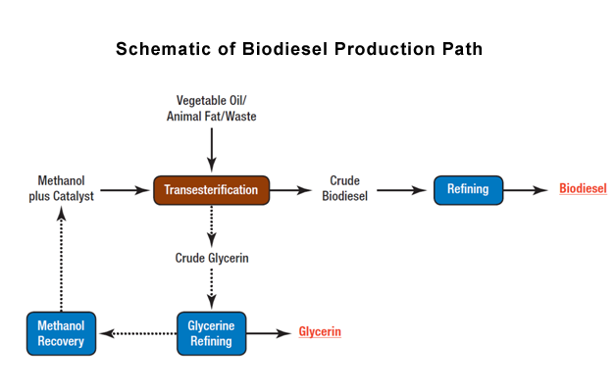





Combating Carbon Dioxide Output via An Innovative Approach to Biofuel Production
Prabha K., Alana J., Hrithiik R., Mateusz S., Sahasra T., Sahasra D., Nidhi D., Khaila C., Yue Z., Shahzoda S., Stephen Nelson, Dr. Ryan Tappel (Senior Scientist, LanzaTech)
North Forsyth High School, Cumming, Georgia, USA
Embedded Audio
The objective of our project is to develop a sustainable biofuel production system that converts invasive plant biomass into biodiesel. By integrating biomass management with renewable energy production, the project aims to reduce reliance on fossil fuels, lower greenhouse gas emissions, and help control invasive species populations.
The system involves a two-step biomass breakdown process: mechanical (physical) breakdown of plant material followed by enzymatic hydrolysis using lipase. The lipase is produced by E. coli(BL21) transformed with a plasmid carrying the PLIP1 gene. After lipid extraction and separation, the resulting fatty acids undergo transesterification to produce biodiesel.
Technical needs include reliable genetic transformation methods, controlled bacterial expression of lipase, efficient biomass pretreatment, and optimized transesterification conditions. Limitations include enzyme efficiency and substrate availability, scalability of bacterial production, biomass variability, cost of processing, and maintaining sterile lab conditions for microbial work.
We expect successful lipase production from engineered E. coli, effective lipid breakdown from invasive plant biomass, and measurable biodiesel yield after transesterification. Ultimately, we aim to demonstrate that invasive plant species can serve as a viable and sustainable source for biofuel production.

