Slide 1

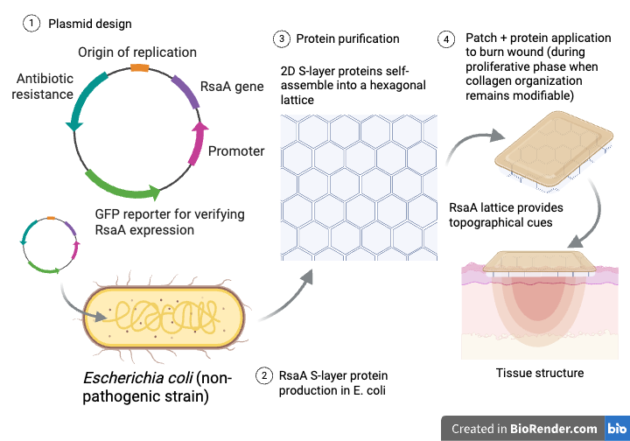
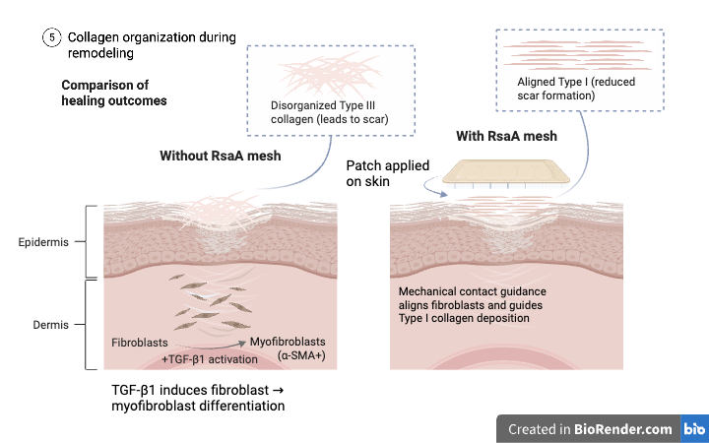


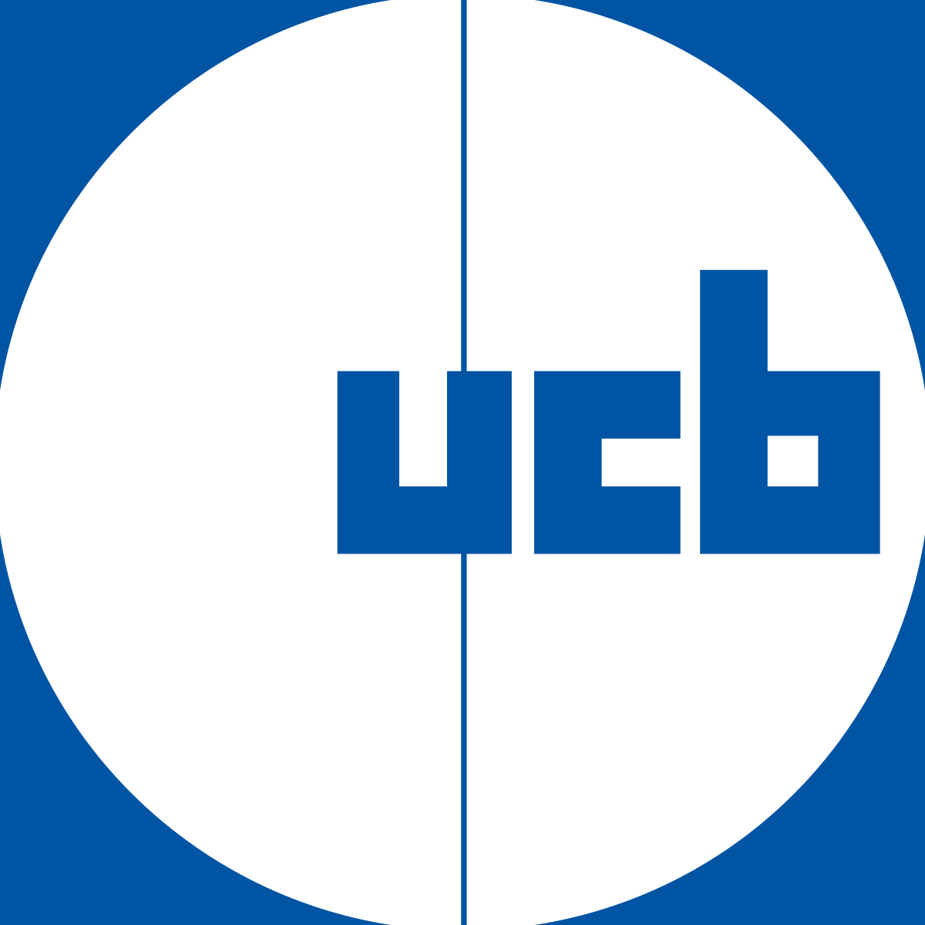




Patch Perfect: Guiding Collagen Deposition with an RsaA Protein Mesh
Ruby Quintiliani, Aneesa Maity, Tvesha Patel, Siena Elliffe, Elena Schuster, Leah Vaz, Sophia Hoffmann, Chloe Dias,
Paola Favaretto (supervisor), Sarah Hanna (supervisor), Dr. Kelly Doering (Mentor from KSBD, LLC)
Montrose School, Medfield, Massachusetts, United States
Abstract: Second-degree burns damage the epidermis and part of the dermis, resulting in scar formation during wound healing. During the proliferative phase, activation of TGF-β1 causes fibroblasts to differentiate into myofibroblasts, which rapidly deposit type III collagen, often poorly aligned and contributing to thick scar tissue. In early remodeling, type III collagen is gradually replaced by type I collagen, and fiber organization remains modifiable. Unlike post-scar treatments that cannot influence collagen alignment, our approach targets scar formation while it is actively occurring. We will use Escherichia coli, a non-pathogenic bacterial chassis, to produce RsaA S-layer proteins, which self-assemble into rigid hexagonal lattices and form a temporary, two-dimensional mesh. The proteins are then harvested and applied in an external patch. This mesh delivers nanoscale mechanical cues that provide contact guidance. By mimicking the structural features of the extracellular matrix, the lattice directs cell alignment, ensuring that as type III collagen is replaced by type I, the resulting fibers are organized. Successful protein production will be verified using a GFP reporter, and lattice formation will be confirmed through imaging techniques such as electron microscopy. This project presents a safe, preventative strategy to reduce scar formation following second-degree burns.
Team Content
We are a returning 8-member group from Montrose School with 6 returning members and 2 new members.
Next steps:
The next step in our project is to engineer E. coli to produce the RsaA S-layer proteins needed for mesh formation. We will introduce a plasmid containing the RsaA gene under a promoter to drive protein expression.
We will also develop a purification method by linking the RsaA gene to a short SpyTag sequence, creating an RsaA-SpyTag fusion protein. This tag binds strongly to SpyCatcher attached to a purification material, allowing us to isolate the target protein.
Finally, we will verify protein production using a GFP reporter and confirm lattice formation through imaging techniques such as electron microscopy. The purified proteins will then be incorporated into a patch to test their ability to guide cell alignment and reduce disorganized collagen formation.
Background: According to the Basics of Burn Care, hypertrophic scars develop in an estimated 32-72% of burn injuries. In many second and third-world countries, where burn injuries are most prevalent, access to specialized burn care is limited, and treatment is often delayed. We aim to provide a cost effective, efficient solution to the issue of burn scarring. While hypertrophic scars are often viewed primarily as an aesthetic concern, their physical and social impacts can be significant, affecting mobility, comfort, and quality of life. Our focus is on second-degree burns, which damage both the dermis and part of the dermis. During the wound healing process, these injuries can lead to hypertrophic scar formation, characterized by thick, raised tissue on the skin. This scarring results from the overproduction of unorganized type III collagen fibers during repair, which later remodel into type I collagen while retaining a disorganized structure. Skin grafting is a common treatment for severe burns, where skin is transplanted from one area of the body to the injured site. In contrast, our treatment is applied directly to the burn, supporting the skin as it regenerates and guiding collagen alignment to reduce the formation of disorganized, thick scar tissue.
References and acknowledgements
We would like to give special thanks to our mentor, Dr. Kelly Doering, for meeting with us, providing guidance, and advising us throughout the project. We also thank our supervisors, Ms. Sarah Hanna and Dr. Paola Favaretto, for their support and encouragement.

