Slide 1

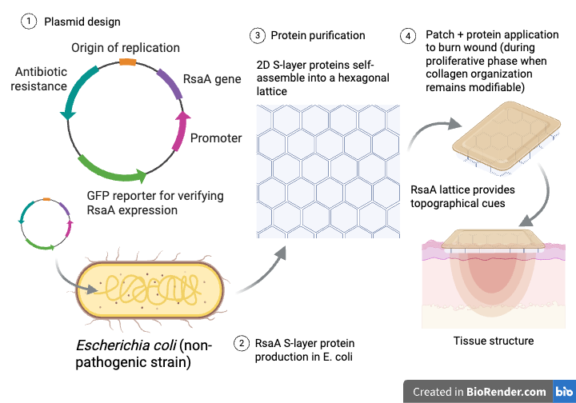
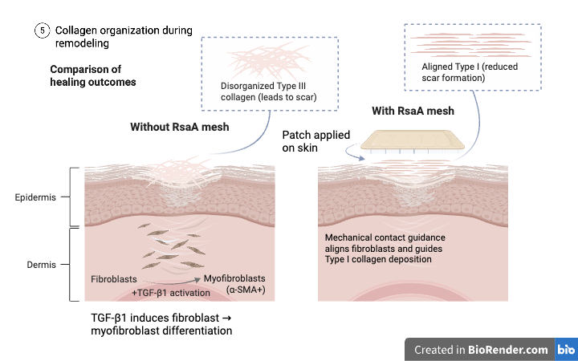






Patch Perfect: Guiding Collagen Deposition with an RsaA Protein Mesh
Ruby Quintiliani, Aneesa Maity, Tvesha Patel, Siena Elliffe, Elena Schuster, Leah Vaz, Sophia Hoffmann, Chloe Dias, Paola Favaretto (supervisor), Sarah Hanna (supervisor), Dr. Kelly Doering (mentor from KSBD, LLC)
Montrose School, Medfield, Massachusetts, United States
Problem: Second-degree burns damage the epidermis and dermis, often leading to hypertrophic scars caused by disorganized type III collagen deposition during wound healing. As collagen remodels into type I, poor alignment persists, resulting in thick, raised scar tissue that can impair mobility and quality of life.
Objective: Develop a bioengineered solution that guides collagen alignment during the active wound-healing process, reducing hypertrophic scar formation in second-degree burns.
Solution: Engineer Escherichia coli to produce RsaA S-layer proteins that self-assemble into hexagonal lattices. The purified proteins will be incorporated into an external patch that provides contact guidance, directing alignment of collagen fibers and promoting organization of those fibers.
Benefits: By intervening during early healing rather than treating scars after formation, this approach promotes organized type I collagen deposition, offering a cost-effective and accessible alternative to conventional post-scar treatments such as skin grafting.
Next Steps: Insert the RsaA gene into a plasmid under a promoter, and transform it into E. coli, fuse it with a SpyTag for purification, and verify expression using a GFP reporter. We will confirm lattice formation through imaging and test the patch with the incorporated protein mesh for its ability to guide cell alignment and reduce disorganization of collagen fibers.

