Slide 1

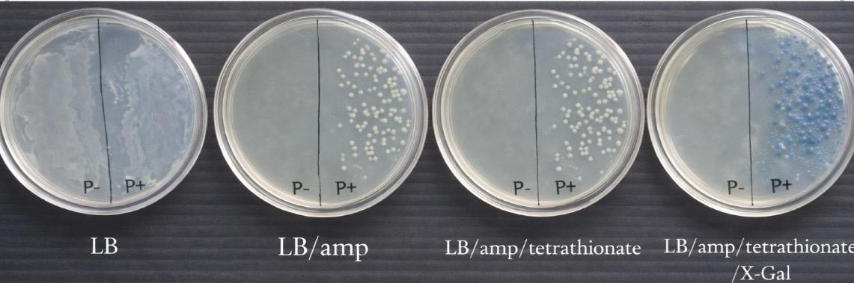
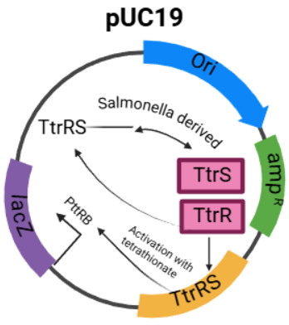







Engineering a Tetrathionate-Responsive Bacterial Biosensor for Detecting Gut Inflammation
Alexa Buonagurio, Allie Letourneau, Valentina Carideo, Jiya Patel, Brady Nguyen, Haiquis Dominguez, Maureen Melanson, Dr. Racquel Sherwood (Avantor)
Methuen High School, Methuen, Massachusetts, United States
Abstract: Gut inflammation often requires monitoring through invasive and costly procedures, creating a need for noninvasive diagnostic methods. This project focuses on designing a bacterial biosensor that detects intestinal inflammation by sensing tetrathionate, a biomarker produced during inflammatory responses in the gut. The biosensor uses the tetrathionate response promoter PttrB, regulated by the TtrS/TtrR two-component system identified in Salmonella. The membrane-bound sensor kinase TtrS detects tetrathionate and activates the response regulator TtrR through phosphorylation. Activated TtrR binds to the PttrB promoter and initiates transcription of a downstream reporter gene. The reporter gene lacZ was selected because it produces the enzyme β-galactosidase and functions without oxygen, making it suitable for anaerobic gut conditions. When lacZ is expressed in the presence of X-gal, bacterial colonies turn blue, providing a visible indicator that tetrathionate has been detected. This color change confirms detection of the inflammation marker. This project demonstrates the conceptual design of a gut-compatible bacterial biosensor capable of sensing an inflammation-associated biomarker and producing a measurable response. Such systems could support future development of noninvasive diagnostic or therapeutic engineered bacteria for monitoring and managing intestinal inflammation.
Anticipated results
Figure 2: Untransformed bacteria (P–) are expected to grow only on LB plates and show no growth on LB plates containing ampicillin. Transformed bacteria (P+) are expected to grow on both LB and LB/amp plates. Blue colonies are expected on LB/amp/tetrathionate/X-gal plates, indicating that tetrathionate activated the TtrS/TtrR two-component system, which in turn activated the PttrB promoter and induced lacZ expression. The absence of blue colonies on plates lacking tetrathionate demonstrates the specificity of the biosensor. Image generated by ChatGPT (OpenAI, 2026).
Introduction/Background
Inflammatory bowel diseases affect millions of people worldwide and are difficult to diagnose and monitor because many diagnostic methods are invasive and costly, such as colonoscopies, endoscopies, and blood-based assays. Current noninvasive stool tests often lack sensitivity or fail to capture real-time inflammatory activity within the gut. This study addresses the need for biologically relevant methods to detect intestinal inflammation in a minimally invasive way, through the conceptual design of a genetically engineered bacterial biosensor capable of detecting gut inflammation.
During gut inflammation, the host immune response generates reactive oxygen species (ROS) in the intestinal lumen. These ROS oxidize thiosulfate, normally present in the intestine, into tetrathionate. Salmonella uses tetrathionate to activate the tetrathionate respiration system (ttr genes), enabling anaerobic respiration. This allows bacteria to grow faster and outcompete the healthy gut microbiome during inflammation. As tetrathionate is produced and present during intestinal inflammation it serves as a reliable biomarker.
Advances in synthetic biology have enabled whole-cell bacterial biosensors to detect specific chemical signals and report their presence. In this study, tetrathionate activates a biosensor that regulates a genetic circuit in bacteria. Engineered gut bacteria can survive in the gastrointestinal environment, interact with luminal biomarkers, and be recovered noninvasively from fecal samples. Literature shows that many gut biosensors rely on fluorescent or bioluminescent reporters, which are not well suited for the anaerobic condition of the intestine and are difficult to visualize in vivo. To overcome this limitation, lacZ gene is used as an oxygen-independent reporter that produces a visible color (blue) when exposed to X-gal.
In this experimental design, bacteria are transformed with a plasmid containing a tetrathionate-responsive promoter (PttrB), regulated by the TtrRS two-component system, positioned upstream of the lacZ reporter gene. When tetrathionate is present, the promoter is activated, resulting in lacZ expression and a blue color change on X-gal–containing agar plates. Only bacteria exposed to tetrathionate are expected to show reporter activation, while control groups show no color change. This explores the design of a bacterial biosensor that detects tetrathionate as a marker of intestinal inflammation using an oxygen-independent reporter system.
Materials and Methods
Genetic Circuit Design
The objective is to introduce an engineered biosensor plasmid into E. coli to enable detection of tetrathionate. To begin, pUC19 (which contains the amp^{R} gene and LacZ gene), and the two-component system of PttrB/TtrRS are both cut with restriction enzymes to insert the two component system into the plasmid. The engineered biosensor plasmid contains the following components: the TtrS/TtrR two-component system, the PttrB promoter, and the lacZ reporter gene. The plasmid also includes an ampicillin resistance gene for selection. Untransformed E. coli (P−) served as a negative control, while transformed E. coli (P+) containing the biosensor plasmid represented the experimental group.
Bacterial Transformation
Two microcentrifuge tubes are prepared: one containing plasmid (P+) and one without plasmid (P−) as a control. 50 µL of competent E. coli cells are added to each tube, and 10 µL of the pUC19 plasmid are added only to the P+ tube. The cells are incubated on ice for 15 minutes, heat shocked for 45 seconds, and returned to the ice for 1 minute. Following transformation, 150 µL of LB broth are added to both tubes to allow the cells to recover. 50 µL on P+ and P- are added to all four plates (refer to figure 2). Samples are spread evenly on the indicated side, allowed to absorb at room temperature, and incubated inverted at 37 °C for 24–36 hours. Growth on ampicillin-containing plates indicates successful plasmid uptake, while blue colonies on X-gal plates indicate activation of the tetrathionate-responsive biosensor.
Future Directions
This project was limited by time, therefore designed as a proof-of-concept study to demonstrate how a bacterial biosensor could detect an inflammation-associated biomarker using a genetic circuit. Any biosensor intended for use in the human gut would require extensive testing and FDA approval, which is beyond the scope of this project.
Future work could build on this design by replacing the lacZ reporter gene with genes that produce therapeutic or probiotic molecules, allowing engineered bacteria to respond directly to inflammatory signals. Additional studies could also focus on improving biosensor stability, safety, and containment within the gut environment. If continued by other researchers or schools, this work could serve as a foundation for developing noninvasive tools to better monitor intestinal inflammation.
Acknowledgements
We thank our mentor, Dr. Racquel Sherwood, Region Director at Avantor, for her guidance and support throughout this project. We also acknowledge BioBuilder and our institutional sponsors for providing resources and opportunities to pursue this research.
Plasmid Design, Figure 1: The promoter PttrB, regulated by the TtrRS two-component system, drives expression of lacZ. In the presence of inflammation, tetrathionate activates TtrRS, which in turn activates PttrB, leading to lacZ expression. As a result, the system produces a blue colorimetric signal, indicating inflammation.
References
About Our Team: A newfound Biobuilder Team from Methuen, Massachusetts. Our team consist of six science loving seniors, who all plan to pursue STEM careers. Being able to practice our biotechnology skills with this experiment allows for us to continue our passion for scientific discovery and research.

