Slide 1

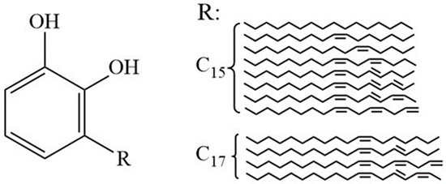
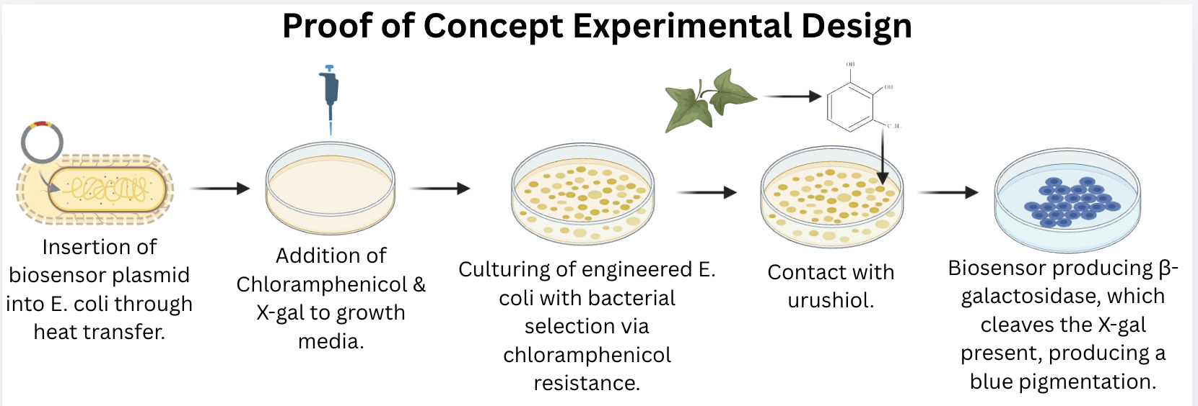
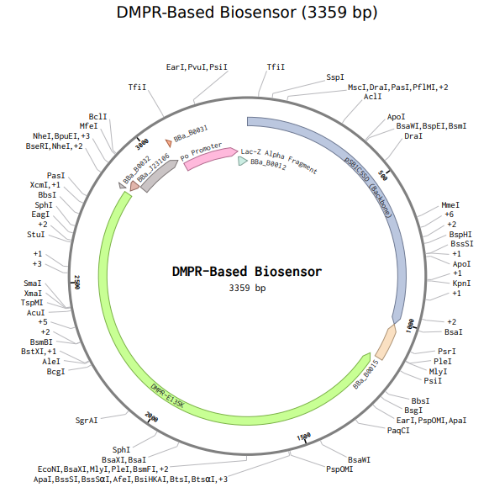







Detecting Urushiol Contact On Human Skin With a DmpR-Based Biosensor
Aarav Tandel, Thenulya Jayasinghe, Kennedy Brock, Ellen Gbolade, Cooper Murdock, Ricco Robinson Jr., Savannah Miles
Amanda Barrett, Dr. Ilenne Del Valle Kessra (Oak Ridge National Laboratory)
Marietta High School, Marietta, Georgia, USA
Abstract
Most people are allergic to members of the toxicodendron genus, most notably poison ivy. Adverse reactions from urushiol, an oil in members of the genus, occur due to an immune response caused by its binding to skin cells, yet no rapid detection method exists to prevent exposure before it penetrates the skin. Though visual identification and post-exposure treatments exist, there is a critical period between contact and treatment. Our biosensor fills this gap producing a visible blue-colored response on the skin upon contact. Escherichia coli serves as a proof-of-concept chassis in order to ensure future safety when used in a bacteria of the human skin microbiome. Our construct uses a catechol-responsive transcription factor, the DmpR-E135K gene, paired with the lacZ gene, which produces β-galactosidase that cleaves the X-gal to generate a visible blue coloration for urushiol detection across all skin tones. In the future, this biosensor could be incorporated in preventative dermatology systems.
Team Content
We are a new team of 7 new members.
Highlights: For us, the best part of this experience was developing lab orchestration skills, so that we could hopefully in the future conduct our own experimentation to produce data about our system.
Challenges: One of our biggest challenges was finding an appropriate enzyme for detecting urushiol, as we had initially explored laccase for breaking down urushiol before moving onto our detection-based approach. Designing the plasmid also required comprehensive research to find compatible genetic parts that would work together effectively. For example, an obstacle in our path was finding a constitutive promoter that corresponded with the DmpR transcription factor until we landed upon the P0 promoter.
Next Steps:
If successful, the biosensor will be implemented in skin-compatible bacteria, specifically Staphylococcus epidermidis. This transfer would require us to ensure the system would function properly in the human skin microbiome and wouldn’t give rise to any adverse effects on the human skin microbiome.
Some key considerations for future experimentation and design are manufacturing detection systems that work rapidly enough to alert users of urushiol contact on the skin, ensuring the biosensor’s capabilities in the environment of human skin with specific conditions such as pH, temperature, and moisture, and creating visible signals that can be detected across different skin tones. Furthermore, in future developments there could be a greater focus on strategies for incorporating our biosensor into topical products that contain X-gal that people could realistically use before potential poison ivy exposure, with a potential usage and market specifically for agricultural workers and outdoors recreational products.
Experiment details / plans
Escherichia coli was used as the chassis organism to validate the function of the biosensor construct for proof of concept. The experiment entails the transformation of E. coli cells with the modified plasmid, followed by exposure to urushiol to confirm the detection system. A growth medium containing an X-gal substrate, with color change serving as the primary sign for successful urushiol detection, will be used. Successfully transformed cells will be selected based on chloramphenicol antibiotic resistance, whereas control groups devoid of the plasmid or urushiol exposure will validate the specificity of the investigation. Data will be collected from visual observations of the intensity and timing of the blue coloration.
Expected Results
When exposed to urushiol, Escherichia coli cells containing the plasmid are anticipated to exhibit a noticeable blue pigment. The negative controls should maintain the original hue and show that the system reacts solely to the urushiol. The intensity of the blue hue will be varied with the concentration of urushiol, with larger quantities resulting in more vivid coloration.
Chemical structure of urushiol
Introduction/Background
Urushiol is an oil made up of numerous toxic compounds, and is commonly found in poison ivy, mangos, cashews, and other species in the toxicodendron genus. When urushiol makes contact with the skin, the chemicals in urushiol become oxidized and stick to the proteins in the skin cells, causing the immune system to perceive the skin cells as a threat and attack them. This damages the tissue and creates swelling, inflammation, and blistering. Furthermore, people who have encountered this allergic reaction before are more likely to experience it again in the future.
The biosensor uses a plasmid-based genetic construct to detect urushiol exposure on human skin. The system uses a catechol responsive transcription factor, DmpR-E135K, which activates in the presence of urushiol’s catechol structure. When urushiol is detected, DmpR binds to its specific promoter, and initiates transcription of the lacZ gene that codes for the 𝛃-galactosidase enzyme. This enzyme then cleaves the X-gal substrate to produce a visible blue coloration to alert exposure. The plasmid also has a constitutive promoter for transcription factor expression, lac-z gene alpha fragment for efficiency, and chloramphenicol resistance for selection during the experimental procedures.
Anticipated Data
Experimental data will first consist of qualitative observations of color development at various urushiol concentrations, comparing modified cells to controls. Later, quantitative data will be collected through the use of a colorimeter or spectro- photometer. To determine whether the detection occurs soon enough to be beneficial, the speed at which the blue pigment emerges following urushiol exposure will be timed. In order to determine the lowest urushiol concentration that the system could reliable detect, collecting data on the sensitivity threshold is anticipated.
References & Acknowledgements
We’d like to thank Dr. Ilenne Del Valle Kessra for her amazing expertise, mentoring, and support!

