Slide 1

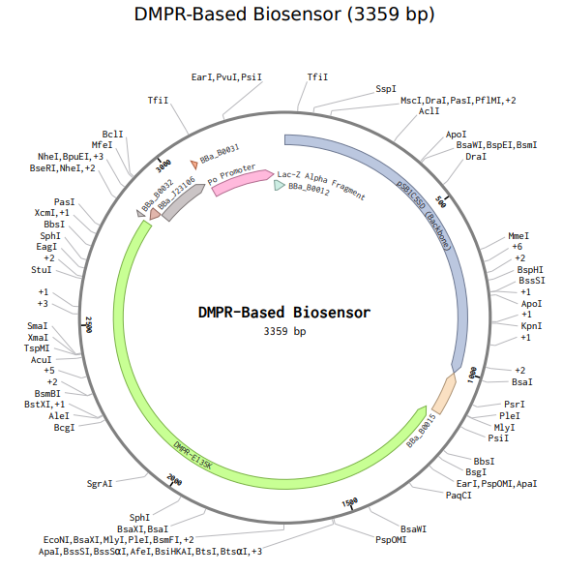
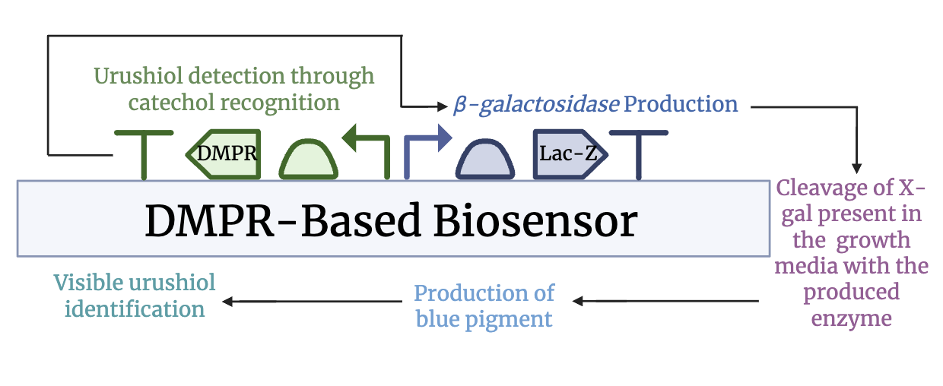
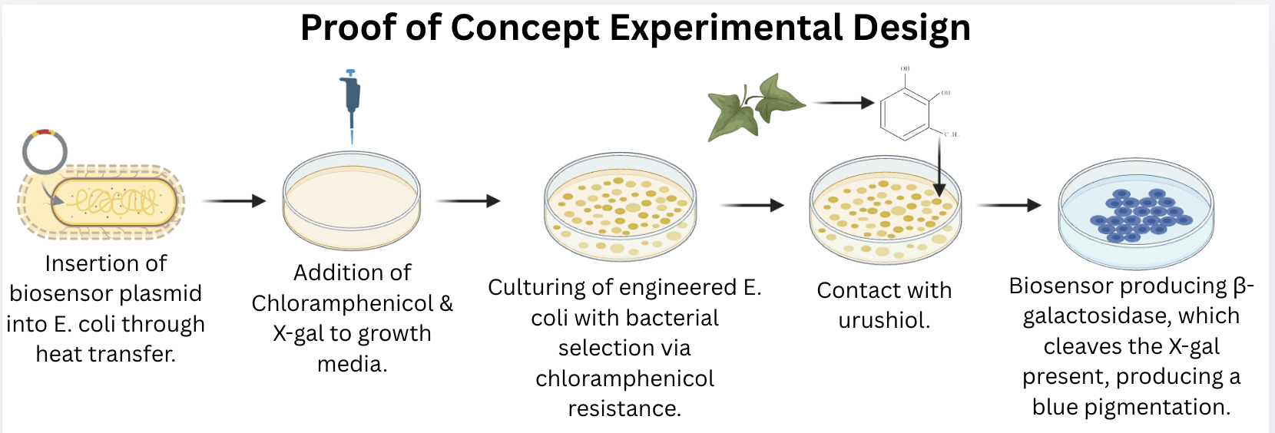





Detecting Urushiol Contact On Human Skin With A DmpR-Based Biosensor
Aarav Tandel, Thenulya Jayasinghe, Kennedy Brock, Ellen Gbolade, Cooper Murdock,
Ricco Robinson Jr., Savannah Miles
Amanda Barrett, Dr. Ilenne Del Valle Kessra (Oak Ridge National Laboratory)
Marietta High School, Marietta, Georgia, USA
Objective: Developing a biosensor that rapidly detects urushiol (the oil found in members of the toxicodendron species, specifically poison ivy) on skin before it triggers severe allergic reactions, providing an immediate visual alert so people can wash the area before blistering occurs.
Techniques: Engineering E. coli with a plasmid containing DmpR (catechol-responsive transcription factor) paired with lacZ gene. When urushiol is present, the system produces β-galactosidase, which cleaves X-gal, producing a visible blue color. The proof-of-concept chassis would be Escherichia coli in order to ensure a stable model. Future testing will move to skin bacteria, such as Staphylococcus epidermidis.
Technical Needs:
Adapting the system from E. coli to skin bacteria under varying skin conditions (pH, temperature, moisture)
Improving detection speed to match urushiol’s rapid skin penetration (minutes)
Ensuring that the engineered bacteria doesn't harm the skin barrier
Adding chloramphenicol resistance for selection in experimentation.
Expected Results: Plasmid-containing E. coli will produce visible blue coloration when exposed to urushiol, with color intensity corresponding to urushiol concentration. The detection time frame should be fast enough for realistic use. This proof of concept confirms the core mechanism before moving on to skin bacteria.
Future Applications: Future development of our project could focus more on strategies for incorporating the biosensor into topical products that people could actually use before potential poison ivy exposure.
Notes:
Objective of our project:
We’re developing a biosensor that rapidly detects urushiol (the toxic oil in poison ivy and other toxicodendron species) on human skin before it triggers severe allergic reactions. Since urushiol oxidizes and binds to skin proteins within minutes and causes inflammation and blistering in almost everyone who’s exposed to it, our goal is to create an immediate visual alert system that will allow people to wash and treat the area of contact before the reaction becomes severe. We are trying to address the critical period between initial urushiol contact and treatment that current solutions (like barrier creams and post-exposure washes) don’t solve.
Techniques we used/plan to use:
We decided to engineer a plasmid-based biosensor in E.coli as a proof-of-concept. Our construct has a catechol-responsive transcription factor (DmpR) that detects the urushiol’s chemical structure, and is paired with the lacZ gene encoding Beta- Galactosidase. x-gal in experiment, when urushiol is present the enzyme cleaves the x-gal to produce a visible blue color that will be detectable on various skin tones, and we hope to test this system in other skin bacteria flora, like Staphylococcus epidermidis.
Technical needs we have?
Main limitation would be moving from E.coli to skin bacteria, which would require us to focus on the functionality of our system under skin conditions (like varying pH’s, temperatures, and moisture levels. We also need to improve the detection speed, because Urushiol penetrates the skin in minutes, and we need to have a color change that’s noticeable quickly. We also need to make sure the engineered bacteria doesn’t cause adverse effects for the skin barrier.
Expected results:
We expect that our plasmid-containing E.coli will produce the visible coloration we want when it’s exposed to urushiol, and that the color intensity of our coloration will correspond to the urushiol concentration. We also expect the detection to be in a timeframe that’s short enough for realistic use. This proof of concept will help use confirm if our core mechanism for our project works before we move on to skin bacteria.
Future Applications: Future development of our project could focus more on strategies for incorporating our biosensor into topical products that people could actually use before potential poison ivy exposure.

