Slide 1

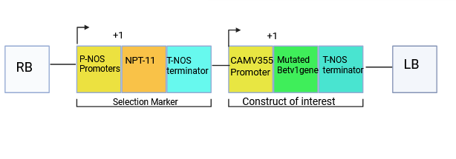
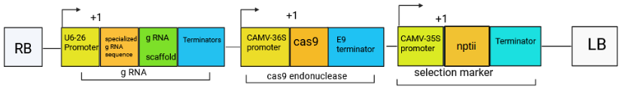
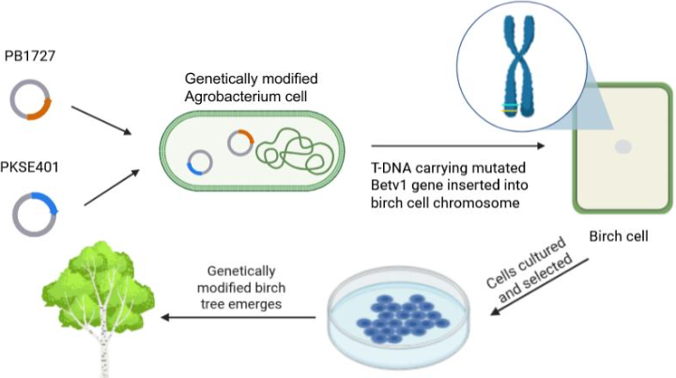







Remediation of Birch Pollen Allergies: Epitope Modification of Bet v 1 for Reduced IgE Binding in Humans
Amalya Fischer, Rebecca Gold, Eliana Goldenholz, Nessa Jaffe, Jeanette Pultman, Miriam Rosenblum, Avishag Salzman, Raya Sims
Dr. Maria Lazebnik (Massasoit Community College and Bentley University), Dr. Scott Gaines (Boston University)
Maimonides School, Brookline, Massachusetts, United States of America
Abstract
Pollen allergies affect a large proportion of the global population, and preexisting conditions such as asthma increase susceptibility and symptom severity. Due to its microscopic size and prevalence, pollen is difficult to avoid, particularly in spring —the primary reproductive period for many plants. Remediation is further complicated by pollen’s reproductive functions. Beyond acting as a vehicle for the transfer of male genetic information, pollen proteins, or allergens, perform key, non-allergenic roles, including supporting male gamete development, facilitating pollen-stigma recognition, driving metabolic processes in pollen tube growth, and contributing to plant immune responses. Consequently, removing allergen genes risks damaging plant health and fertility. This study proposes a synthetic biology based approach to selectively reduce pollen allergenicity while maintaining its reproductive functions. We targeted a birch tree allergen, Betula verrucosa allergen 1 (Bet v 1), which binds to Immunoglobulin E (IgE) antibodies in mucosal tissues and skin, triggering histamine release. Our approach involves modifying a key IgE-recognized epitope in Bet v 1 while maintaining its physiological role in birch trees. Using Agrobacterium-mediated transformation, a mutated Bet v 1 gene and a CRISPR-Cas9 structure designed to silence the allergenic allele may be introduced into birch tissue cultures through deactivated tumor-inducing (Ti) plasmids in Agrobacterium. This approach enables the production of hypoallergenic birch trees with preserved reproductive and physiological functions. Moreover, this approach offers a model for broader remediation of other pollen-producing species.
Design
Figure 1: Genetic circuit for the expression of mutated Bet v 1 in birch cells
Discussion and Future Outlook
This work presents a design for reducing the allergenicity of Bet v 1 allergens in birch tree pollen. By leveraging the Ti plasmid and replacing harmful tumor-inducing genes in Agrobacterium with CRISPR-Cas9 and DNA components, we can ensure selective integration of specific DNA segments in the birch genome.
The primary application of this approach is both environmental and social, focusing on safe remediation of birch pollen while promoting comfort for those living in pollen-dense areas. We hope that this study may be applied to the widespread remediation of other pollen-producing species, though such efforts may be compromised due to the large number of pollen allergens that are at play in many plant species.
Despite its potential, this design requires further development. The system has not yet been tested, and potential negative effects on Bet v 1 and birch reproduction have not been measured. Therefore, additional focus must be placed on ensuring the mutation of Bet v 1 does not prove detrimental for plant health and fertility before this approach may be further considered. Furthermore, this approach does not propose a method for remediating adult birch trees, limiting the possible effects it might have.
a)
b)
Agrobacterium infects wounded plants by transferring a DNA segment—T-DNA—from its tumor-inducing (Ti) plasmids into plant genomes. The transferred segment is located between two short T-DNA sequences, known as the left and right borders. The genetic circuits above propose two engineered Ti plasmids: pBI121 (Fig. 1A), and pKSE401 (Fig. 1B). Within pBI121, the mutated Bet v 1 gene, whose expression is controlled under the CAMV 35S promoter, may be expressed. In order to preserve the reproductive role of Bet v 1, this gene contains just one mutation in the codon coding for the key amino acid residue glutamic acid 45 (Glu45) within the IgE-recognized epitope of Bet v 1. Within pKSE401, a specialized CRISPR-Cas9 mechanism targets the natural, allergenic Bet v 1 gene for removal. Both vectors contain a Neomycin phosphotransferase II (nptII) gene, acting as a selectable marker to identify successfully transformed birch cells. nptII confers antibiotic resistance, so during antibiotic selection, only cells which have successfully integrated the DNA within the two Ti plasmids will survive. After selection, plant hormones may be utilized to regenerate whole birch plants, producing new lines of genetically modified, hypoallergenic, birch trees (Fig. 2)
References and acknowledgements
Introduction
Pollen triggers allergic symptoms when misidentified by the body as a foreign invader. In mucosal tissues, dendritic cells capture pollen, triggering an immune response involving the production of immunoglobulin E (IgE). Initially, IgE binds to mast cells in the lungs, nose, and eyes. Upon re-exposure, allergens interact with IgE, inducing histamine release. Histamine increases vascular permeability, stimulates pulmonary nerves, and increases mucus production, causing the swelling, redness, and airway constriction characteristic of pollen allergies. To remediate this, an IgE-recognized epitope in a birch pollen allergen, Betula verrucosa allergen 1 (Bet v 1), may be edited to reduce binding affinity. To achieve this, we can replace pathogenic tumor-inducing genes in Agrobacterium with selective CRISPR components and DNA, thus introducing a modified Bet v 1 sequence into the birch genome. This method ensures stable, inheritable modification as the tree grows
We would like to thank to thank Dr. Scott Gaines for mentoring us, and Dr. Maria Lazebnik for teaching us and helping us research our plasmid design. Thank you to Dr. Natalie Kuldell for founding this program for students such as ourselves, and Chloe Franklin for setting everything up!
Figure 2: Agrobacterium-mediated transformation of birch cells

