Slide 1

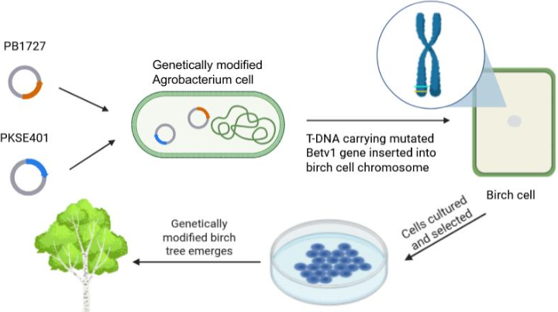






Remediation of Birch Pollen Allergies: Epitope Modification of Bet v 1 for Reduced IgE Binding in Humans
Amalya Fischer, Rebecca Gold, Eliana Goldenholz, Nessa Jaffe, Jeanette Pultman, Miriam Rosenblum, Avishag Salzman, Raya Sims, Dr. Maria Lazebnik (Massasoit Community College and Bentley University), Dr. Scott Gaines (Boston University)
Maimonides School, Brookline, Massachusetts, United States of America
This project aims to make birch pollen less allergenic by editing the main allergen, Bet v 1, to weaken its binding affinity to IgE, without breaking the protein’s normal roles in birch reproduction and physiology. The key idea is to change how the immune system sees it rather than removing the protein entirely, since allergen proteins also play key, non-allergenic roles in plant fitness and fertility.
Agrobacterium-mediated transformation of birch cells
To do that, we use a two-part strategy delivered by Agrobacterium-mediated transformation: first we introduce a near-identical Bet v 1 with a single targeted mutation at Glu45, a key amino acid in the IgE-recognized epitope of Bet v 1, to preserve function while reducing IgE binding; second, we use CRISPR-Cas9 to silence/remove the native allergenic Bet v 1 allele. Together, these edits are designed to produce stable, heritable hypoallergenic birch lines via Ti-plasmid delivery into tissue culture and regeneration.

