Slide 1

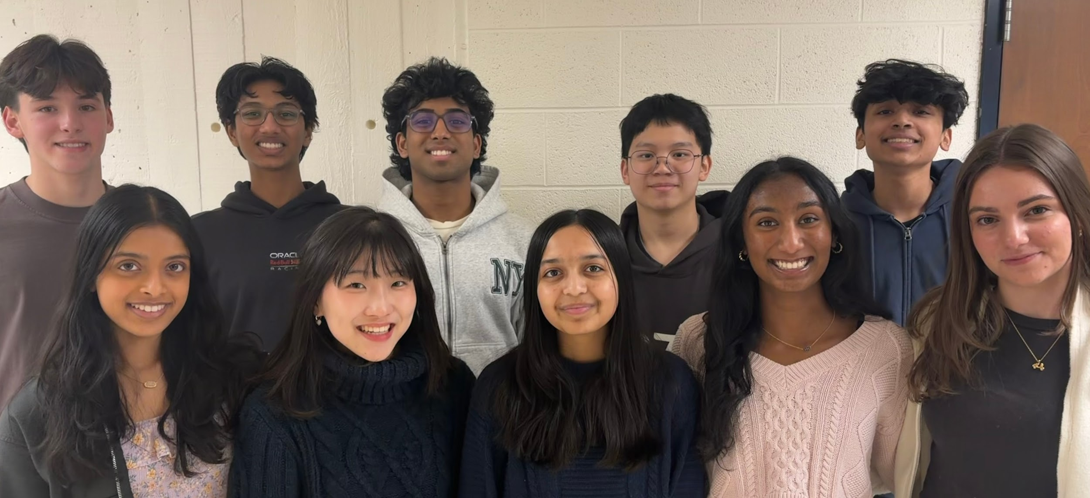
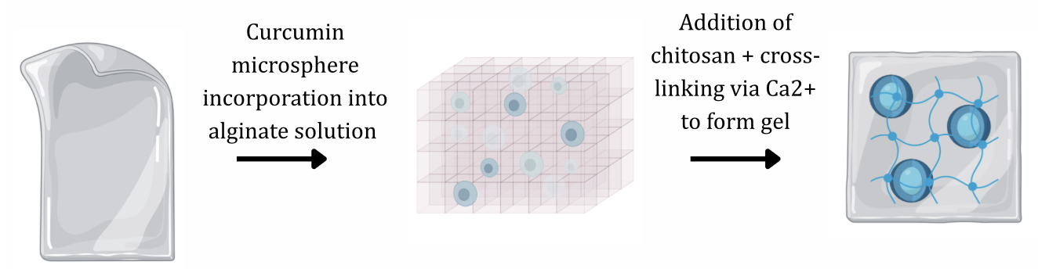
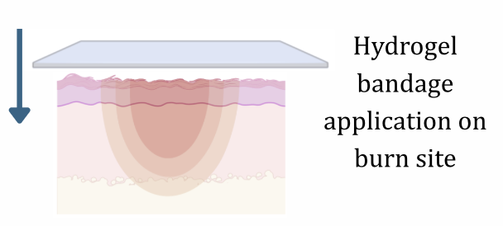

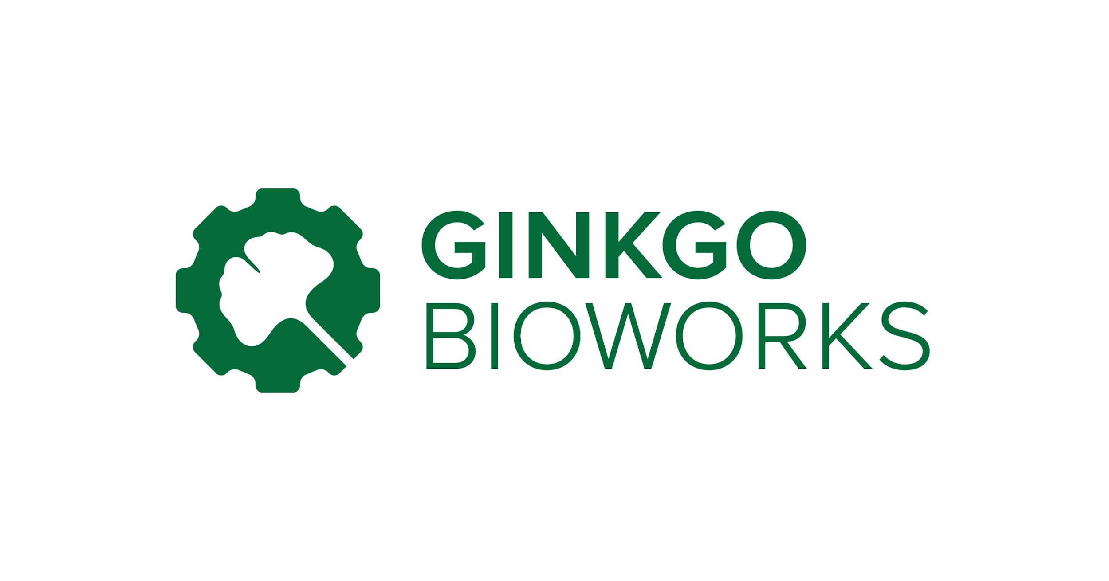






Combating Second-Degree Burn Conversion: Bioengineered Hydrogel Bandage
Tanya Jay, Annabel Volpe, Esther Kim, Tasheen Kashem, Charvi Talupuru, Aarav Phadnis, Tee Jarukulvanich, Julian Guevara Castellanos, Lakshya Kesanakurti, Nathaniel Lawrence, Mr. Reginald Hobbs, Ms. Susanna Donkor (Mirai Bio)
Lexington High School, Lexington, MA, United States
Next Steps
Abstract
Test timing of application, component interactions, hydrogel formation procedure, and more, to determine treatment window and confirm functionality of design.
Redesign:
Hydrogel format optimization: evaluate delivery formats like sprayable hydrogel or electrospun hydrogel-based dressings created via electrospinning.
Experiment with different burn-stabilizing agents: test combination of bioactive agents, and synthetic/natural polymers to optimize moisture retention, antimicrobial function, structural stability, etc.
A major unmet challenge in burn treatment is preventing burn conversion. We aim to bioengineer a hydrogel bandage that releases burn-stabilizing agents to stabilize the burn site and prevent burn conversion after injury. Our project will integrate a base hydrogel with an alginate-chitosan matrix, which will act as a structural and microbial barrier to retain moisture while enabling oxygen diffusion. Curcumin-loaded nanoparticles will be incorporated into biodegradable microspheres that are embedded throughout the hydrogel. This delivery system supports antioxidant activity, reduces inflammation, and helps preserve microvascular integrity within the zone of stasis. To maximise the beneficial properties of the hydrogel complex, we aim to replace the patch every 24-48 hours, providing a stable burn intervention solution that works alongside standard treatment and potentially obviates the need for surgical intervention for deep partial-thickness burns.
Design
Hydrogel Composition
Hydrogels are porous polymer networks that are promising in biomedical applications because they allow for controlled delivery of growth factors directly to wound sites.
Alginate: forms hydrogel that retains moisture in the wound environment, which is essential for re-epithelialization and tissue repair.
Within the hydrogel, cone shaped pores with gradient channel diameters will be utilized to mimic layers of the skin and maximize viability.
Chitosan: natural antimicrobial and anti-inflammatory agent derived from chitin, forming a polyelectrolyte complex with alginate that allows scaffold integration. Enhances cell migration and collagen deposition.
Curcumin Microspheres
Curcumin: bioactive component found in turmeric. A natural pharmacotherapeutic with antioxidant and anti-inflammatory effects.
  Efficacy of curcumin to slow burn progression has been supported in rat comb burn models; its administration after injury reduced burn conversion and reduced transition to necrosis.
Microspheres: due to curcumin’s hydrophobic nature, we will encapsulate curcumin in microspheres, allowing for release over 24-72 hours and protecting curcumin from rapid deterioration.
Team Info
Burn conversion: process where superficial, partial-thickness burns progress into a deeper, full thickness wound. Driven by oxidative stress, excessive inflammatory signaling, and ischemia in the early stages of injury.
Problem: Current treatments for second-degree burns do not directly address the underlying biochemical mechanisms that drive burn conversion.
Goal: To prevent burn conversion within the first few hours of injury, we aim to introduce a hydrogel patch composed of an alginate-chitosan complex and curcumin-loaded microspheres. With an acellular, and biocompatible design, this complex of burn-stabilizing agents directly addresses the drivers of burn conversion.
Introduction
We are a returning team with 10 members
We are a returning team of 10 members
Acknowledgments and References
We’d like to thank our mentors Ms. Susana Donkor and Mr. Reginald Hobbs. We would also like to thank our generous sponsor, AOPS Academy Lexington. To learn more, check out their website here.

