Slide 1


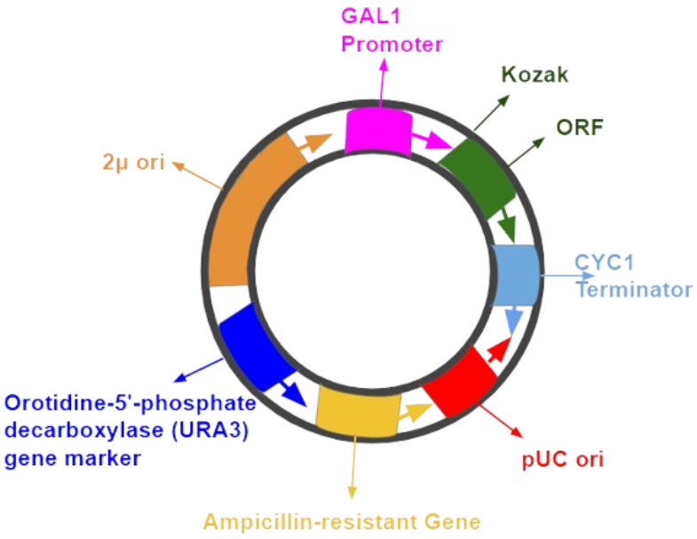
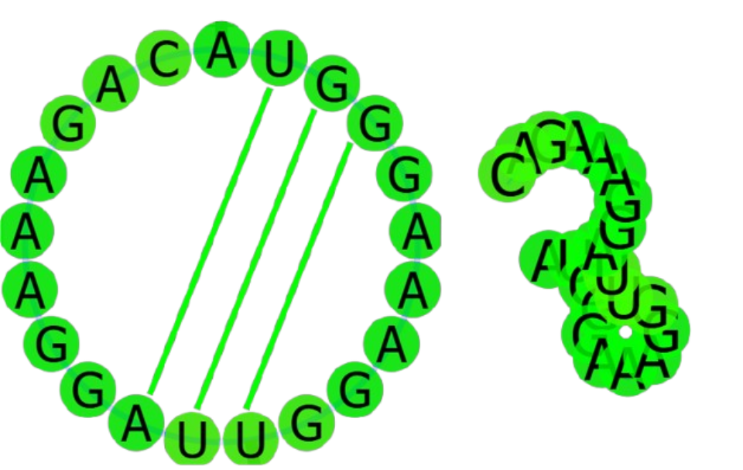
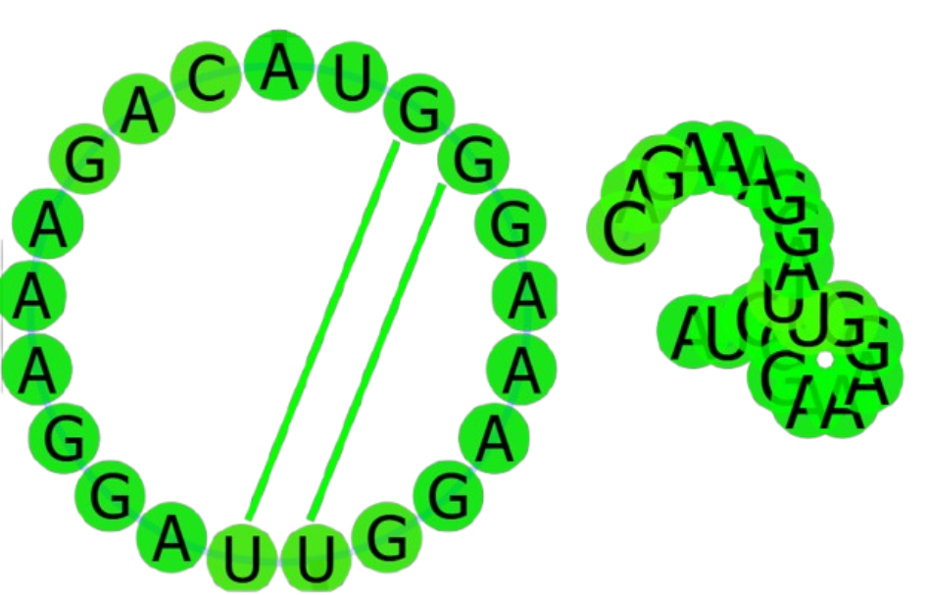
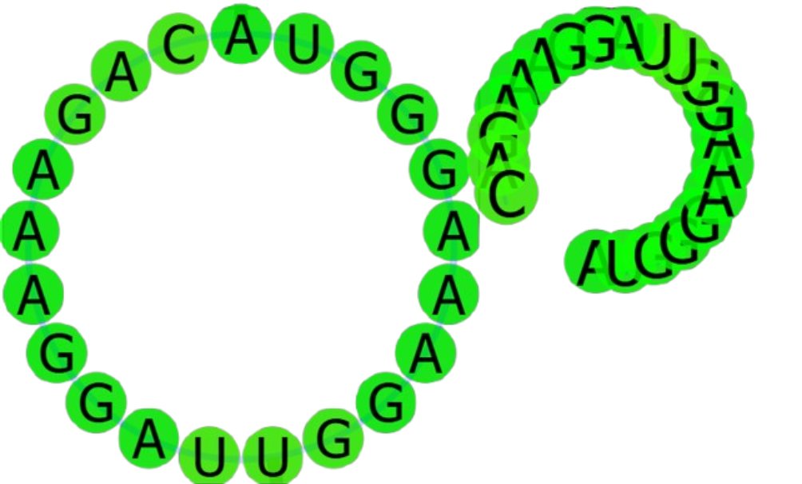
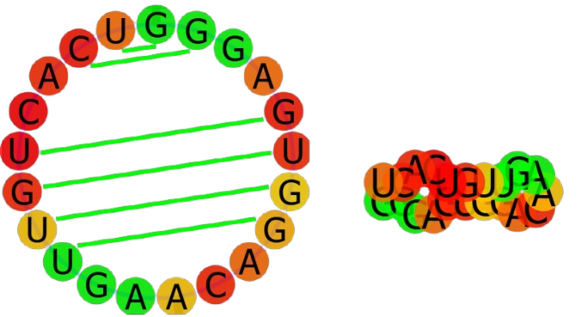
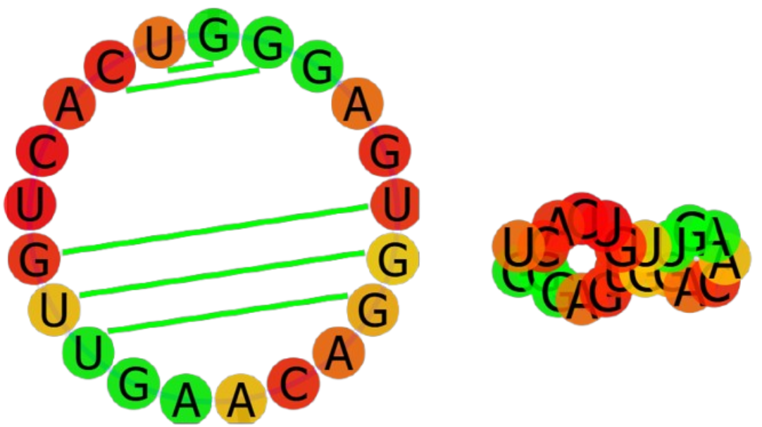
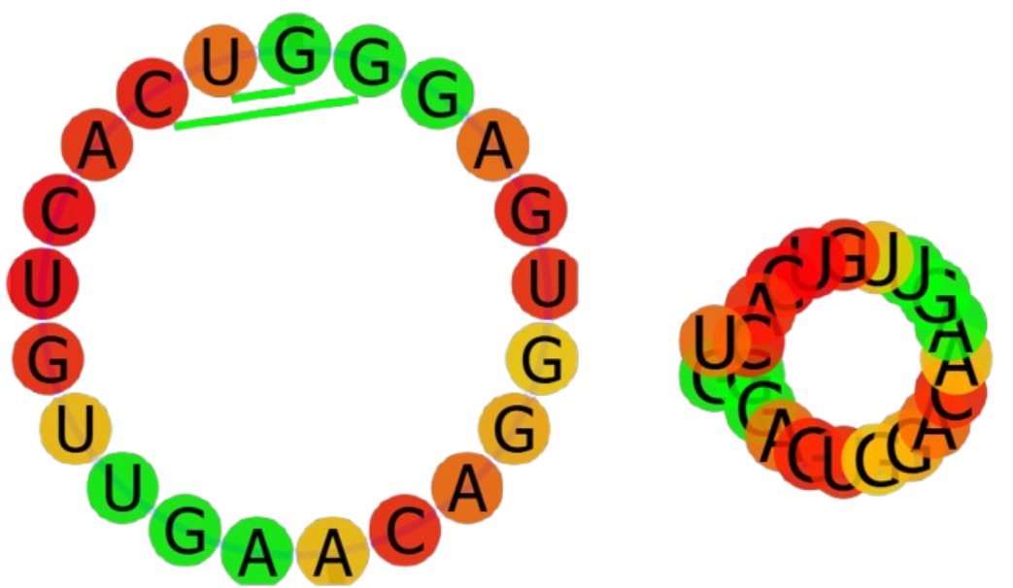
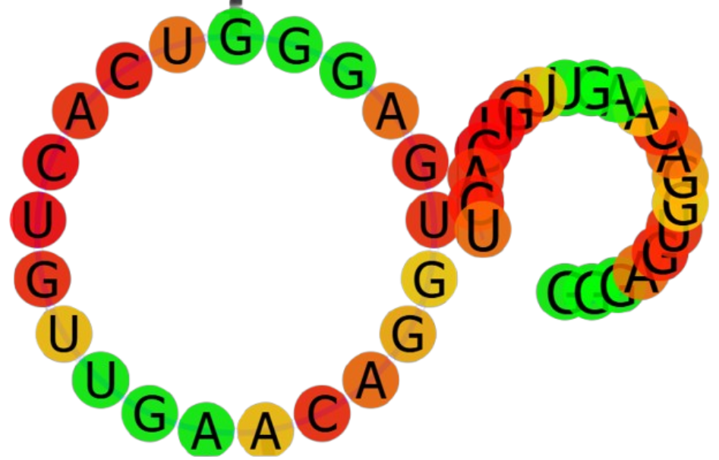
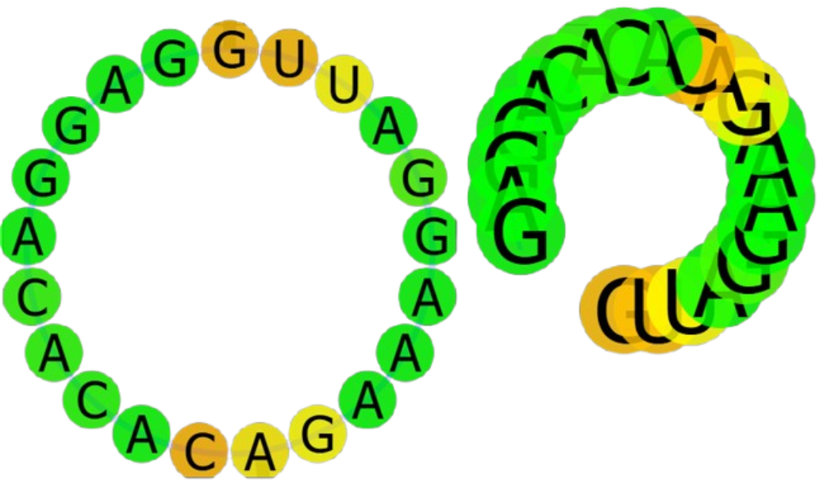
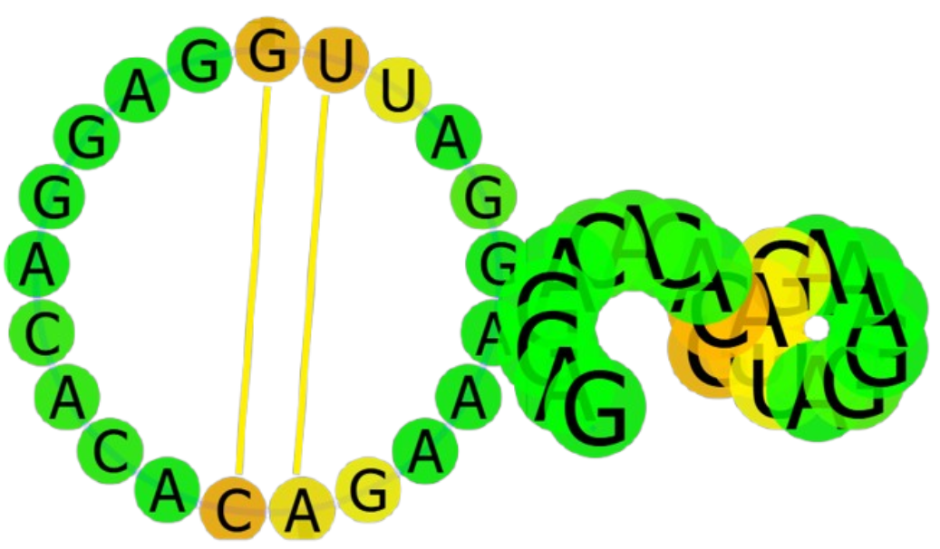
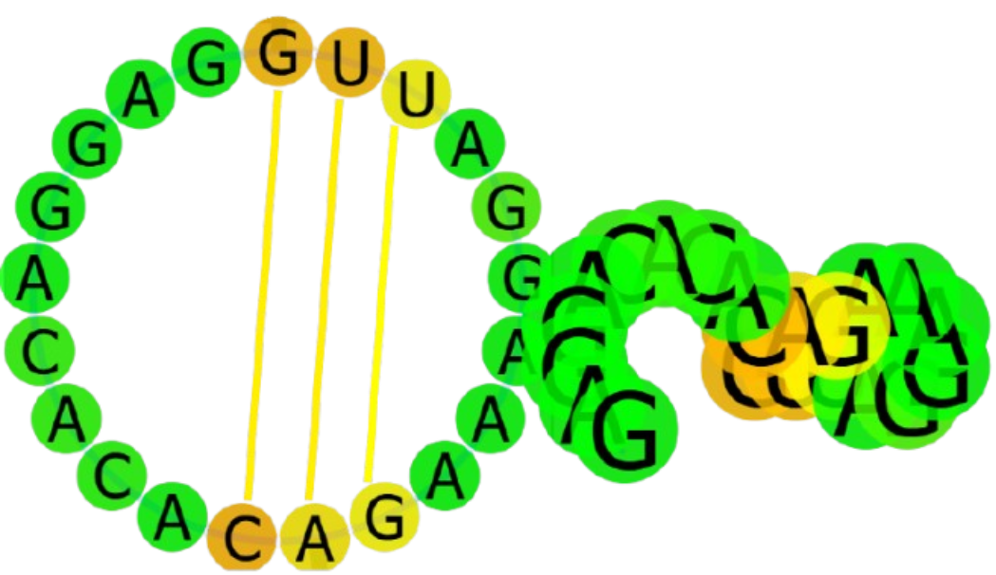
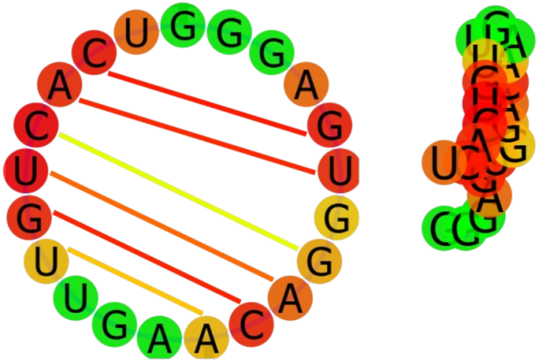
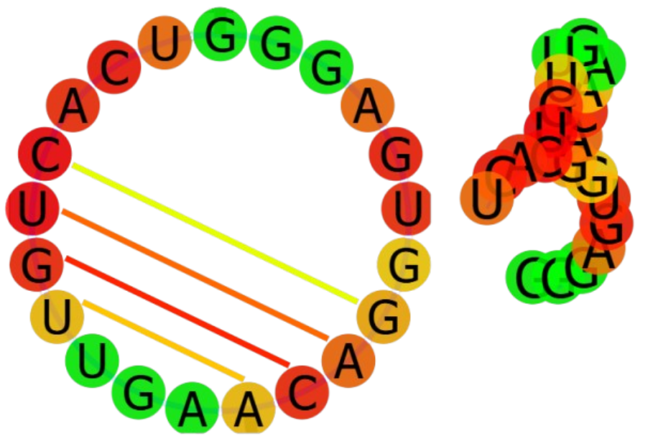
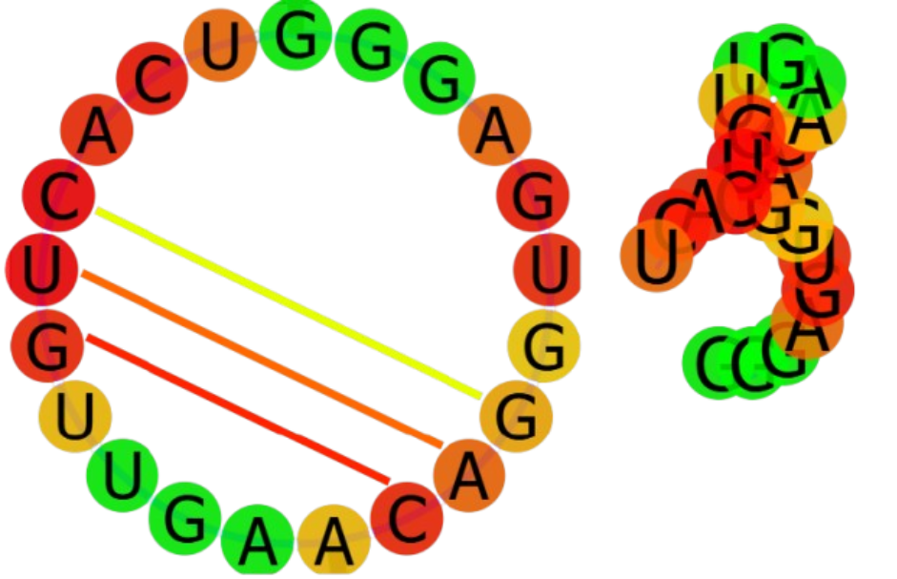
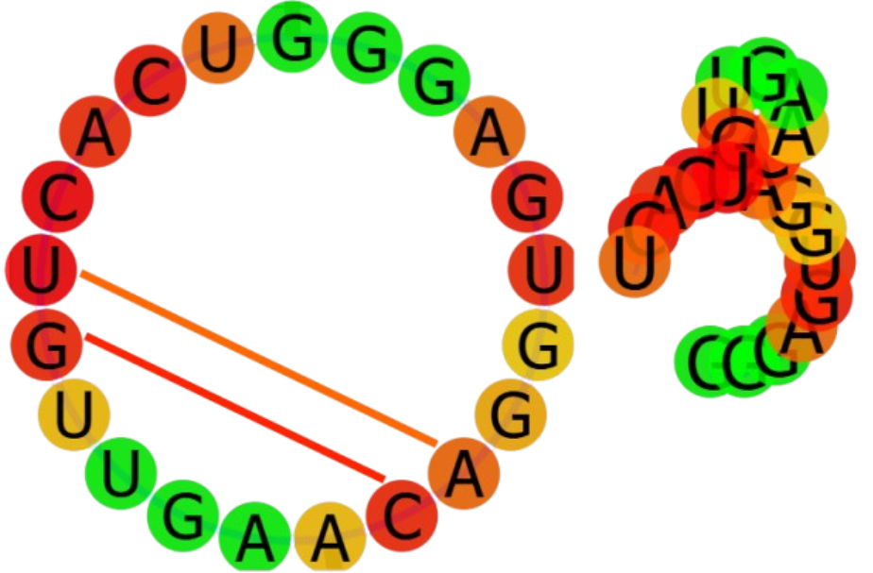
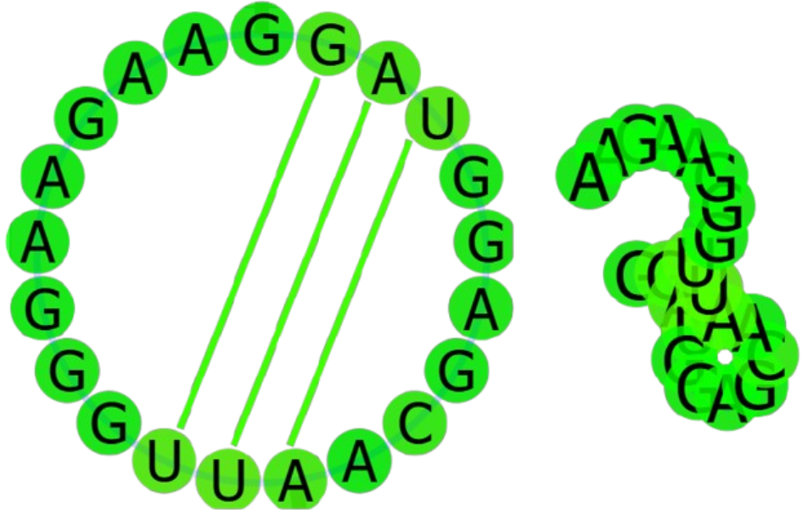
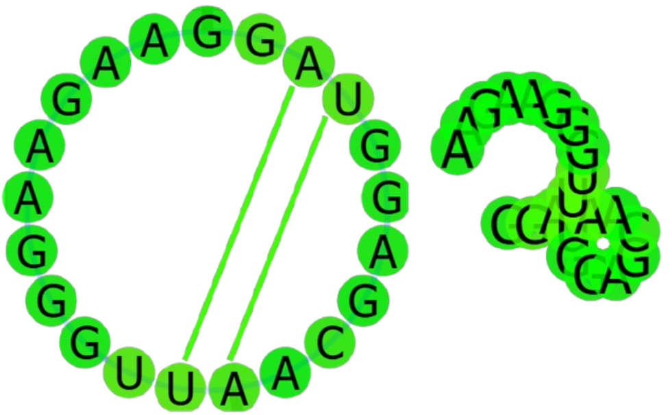
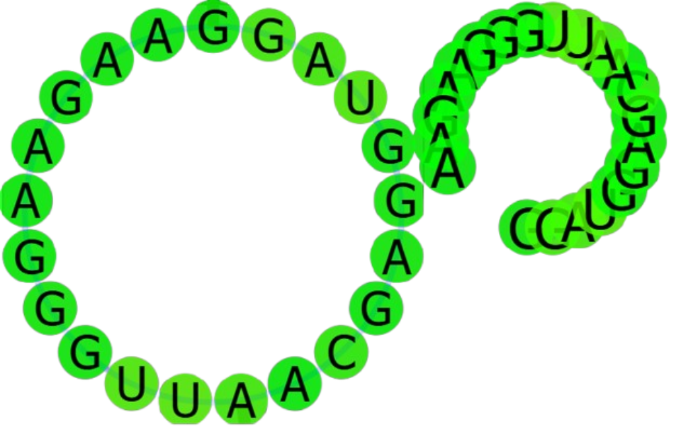
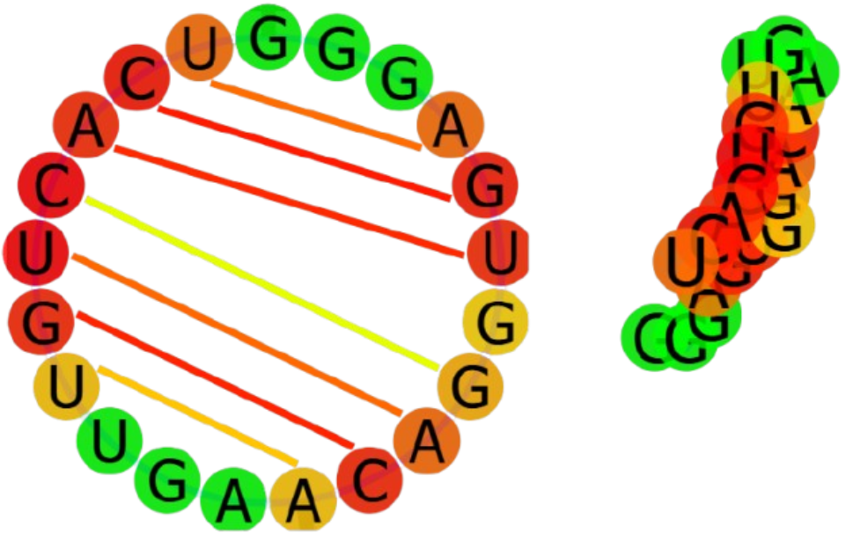
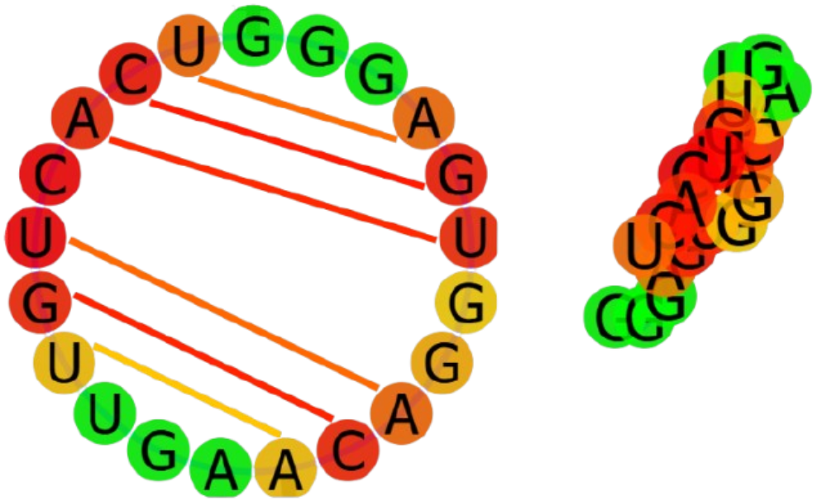
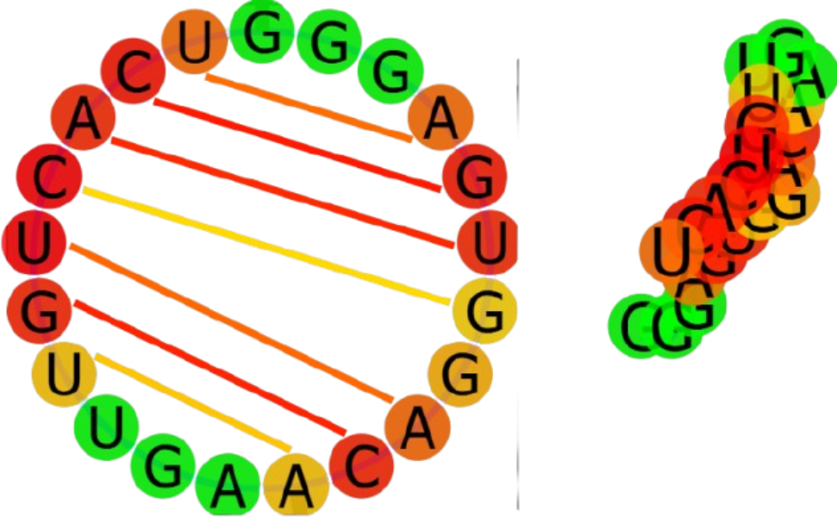








Degradation of Viral NS5 Polymerase from Mosquito-borne Diseases with Engineered RNAi
Rochan Saireddy, Raghavan Swaminathan, Nila Prabhu, Smyan Reddy, Sanel Lathiya, Sarah Manoj, Anish Anumakonda, Andrew Jiang, Chethas Chittipiralla, Mrs. Catherine Sharer, Dr. Alyssa Morrow
Lambert High School, Suwanee, Georgia, USA
INTRODUCTION/ABSTRACT
Mosquitos are such small things, and yet, they can cause much harm and damage. They often carry potent diseases, and transfer them to humans when they bite. Roughly 390 million people are affected by Dengue each year, with hundreds of thousands more being affected by Zika^{[7]}. Our project targets the viral NS5 polymerase (the enzyme that causes viral RNA to be replicated) of these viruses, attacking the source of the problem rather than treating. Our design originally started out by infusing Wolbachia pipientis with a custom-designed RNAi strand. However, due to the unavailability of W. pipientis, we created a proof-of-concept, using yeast as a medium to prove the likelihood of W. pipientis being a suitable host to our plasmid. Using Clustal, we matched up three genomes coding for NS5 polymerase from Zika, Dengue, and Yellow Fever to identify a set of common strands to target, and converted those to complementary RNA antisense strands. With ViennaRNA, we modeled the folding of each strand into a complex structure to find the most optimal to insert into our plasmid, which in turn will be propagated through Escherichia coli and transferred into yeast. Following this transfer, the yeast cell will express our RNA antisense strand and bind with the viral NS5 polymerase mRNA. Finally, the Dicer-2 protein cleaves our combined strand and prevents translation of NS5 mRNA.
EXPERIMENTAL DESIGN
4. Insertion Into E.coli and S. cerevisiae
Finding Conserved Sequences Between 3 Viral NS5 Genomes
Sense | Antisense (RNA)
ATGGGAAAGGTTAGGAAAGAC | UACCCUUUCCAAUCCUUUCUG
GTTAGGAAAGACACACAGGAG | CAAUCCUUUCUGUGUGUCCUC
GGGAGTGGACAAGTTGTCACT | CCCUCACCUGUUCAACAGUGA
GGATGGAGCAATTGGGAAGAA | CCUACCUCGUUAACCCUUCUU
[3] Strands Bind
Virus
Figure 1: Using Clustal as an aid, we identified 4 conserved sequences from the 3 NS5 polymerase genomes of Zika, Dengue, and Yellow Fever.
Yeast Cell
[1] Plasmid
[2] Antisense Expressed
2. Finding The Optimal Strand Using ViennaRNA
[4] Dicer-2 cleaves and destroys
Figure 4: Plasmid is propagated through E.coli and transferred to S.cerevisiae. Results in gene expression, RNA binding, and Dicer-2 cleaving.
1
3
NEXT STEPS
Our next steps include modeling the kinetics of the infusion of our plasmid into E.coli and its interaction with and transfer to the yeast cell. If time provides, we hope to attempt to assemble our plasmid in the lab, insert it into E.coli, and propagate it to transfer the plasmid into the S. cerevisiae cell. Additionally, we would like to simulate the interaction between the NS5 polymerase mRNA and our gene of interest using artificially created RNA resembling that of the viral NS5 polymerase. Validation of our system could potentially include quantifying target mRNA depletion with qPCR, assessing residual NS5 expression via western blotting, and characterizing cleavage of mRNA using mass spectrometry. Ultimately, the goal of this project was to create a proof-of-concept for using W. pipientis to express our gene of interest, but due to restrictions on availability, this project could only include a yeast-based system. Extending this project, given increased time and resources, this system could potentially be implemented in W. pipientis, being a naturally thriving bacteria in mosquitoes, the source of our problem.
TEAM CONTENT
Lambert Red Team is a new team to BioBuilder, with 9 members, excluding mentors and advisors. This experience is an eye-opener for many, with members learning a lot about biotechnology, engineering, and other skills. By meeting up every Friday to discuss the project, the Red Team really bonded and got to know each other well. Through working on different parts of the project, everyone in the team understood the skill set of each person and optimized their abilities.
2
4
Figures 2a - 2d: ViennaRNA provided the folding paths of each antisense strand. Using them, we identified that Strand 2 has the smallest number of structures (13) in an energy range of 8 kcal/mol above the minimum free energy while still having a probabilistic and definitive folding path (indicated by yellow). With only 13 possible structures in a relatively small energy range, our RNA strand will restrain from folding into haphazard and unpredictable structures, potentially inhibiting expression of our gene, as we want the most linear-like structure for RNA binding^{[1, 2, 3, 4]}
PROJECT SNAPSHOT
What: Degrading viral NS5 Polymerase RNA
Why: To reduce mosquito-borne diseases
How:
[1] Matching up 3 viral NS5 polymerase genomes
[2] Identifying best strand to target and designing strand
[3] Designing plasmid containing gene of interest
[4] Injecting plasmid into E.coli for expression in yeast
Outcome: Binding of two strands results in cleaving of combined strand and removal of NS5 polymerase mRNA
ACKNOWLEDGMENTS
We thank Dr. Alyssa Morrow for her mentorship, Mrs. Catherine Sharer for her funding and support, and the BioBuilder Competition sponsors, including Ginkgo Bioworks, Carolina, Britebound, New England BioLabs, ucb, and the Ragon Institute, for their continuous support.
3. Plasmid Design
GAL1 Promoter
Figure 3: Our episomal plasmid contains the GAL1 promoter, our nucleotide sequence for the sense strand (expresses antisense strand), the 2μ origin of replication for yeast, a pUC origin of replication for E.coli propagation, a URA3 yeast selectable gene marker, an ampicillin resistance gene, and the CYC1 terminator^{[10]}.
Kozak
ORF Containing Strand 2
2μ ori
CYC1 Terminator
REFERENCES
QR CODE:
Orotidine-5'-phosphate decarboxylase (URA3) gene marker
Ampicillin-resistant Gene
pUC ori

