Slide 1


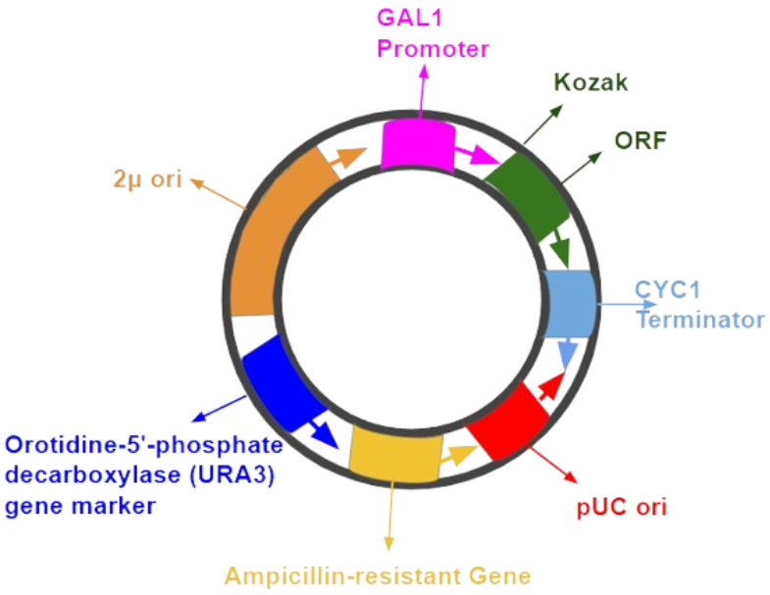
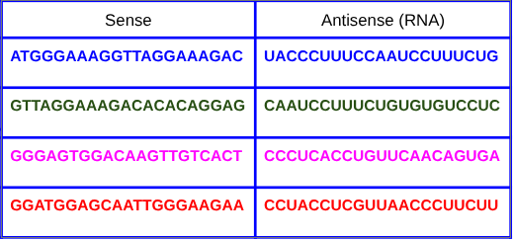
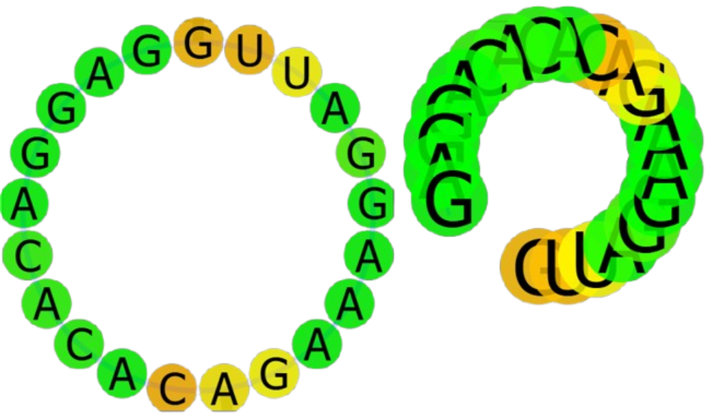
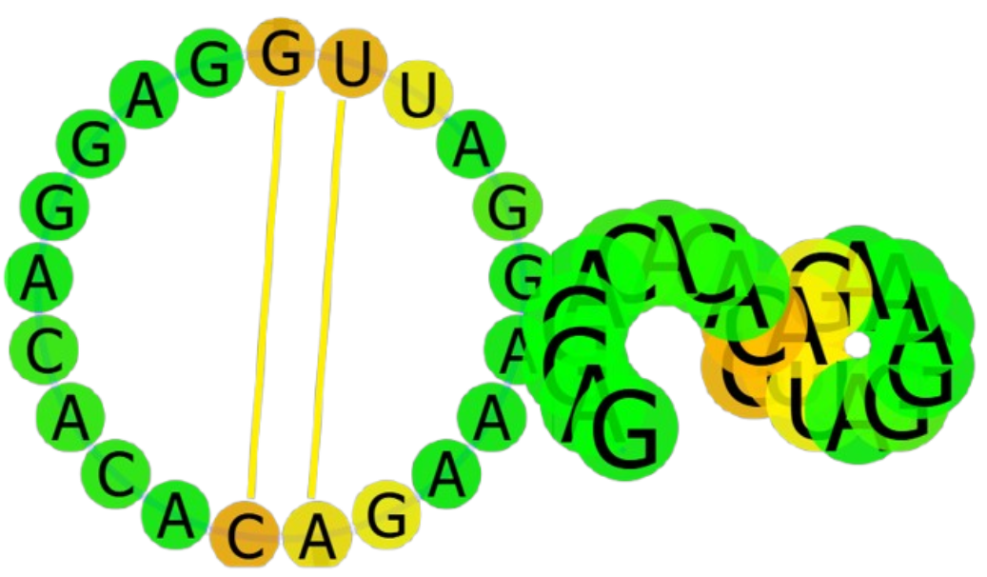
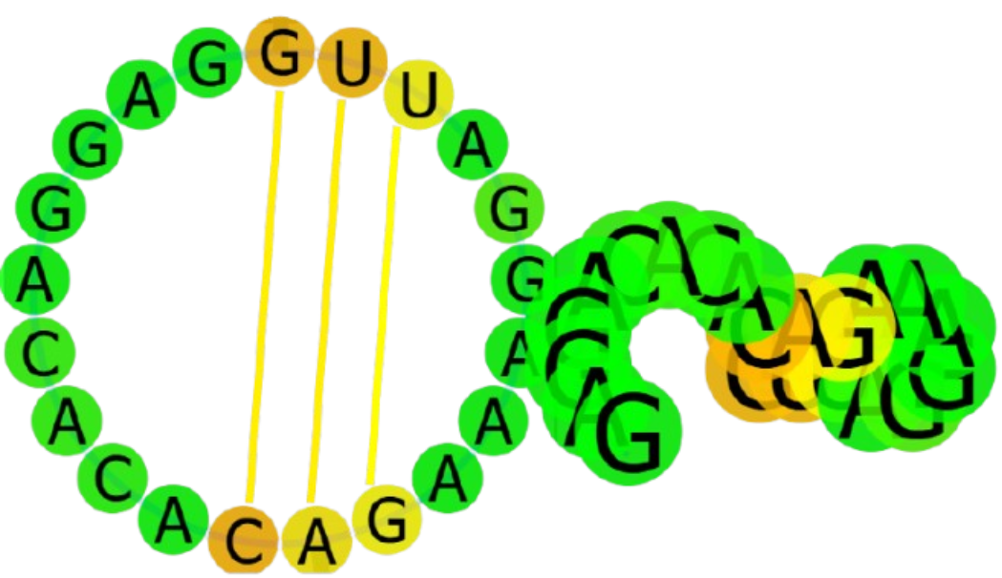






Degradation of Viral NS5 Polymerase from Mosquito-borne Diseases with Engineered RNAi
Rochan Saireddy, Raghavan Swaminathan, Nila Prabhu, Smyan Reddy, Sanel Lathiya, Sarah Manoj, Anish Anumukonda, Andrew Jiang, Chethas Chittipiralla, Catherine Sharer, Dr. Alyssa Morrow
Lambert High School, Suwanee, Georgia, USA
Our project is meant to degrade the NS5 Polymerase shared between three mosquito-borne diseases: Zika, Dengue, and Yellow Fever, three viruses that are extremely harmful and hard to stop at the source.
We used Clustal to locate the common regions to target and design our antisense strand. Using ViennaRNA, we narrowed our search down to the most optimal strand to insert into our plasmid.
Key Steps and Processes: Insert sense into plasmid → propagate through E.coli → antisense expresses from yeast → binds to NS5 polymerase mRNA → Dicer-2 protein cleaves
Technical needs include software such as ViennaRNA and COPASI to model our system design.
Expected results include proper binding of viral NS5 mRNA with gene of interest and proper protein function (Dicer-2).
Figure 3: Experimental Process
[3] Strands Bind
Virus
Yeast Cell
[1] Plasmid
RNAsubopt predicted 13 structures in an energy range of 8 kcal/mol above the minimum free energy.
[2] Antisense Expressed
[4] Dicer-2 cleaves and destroys
GAL1 Promoter
Kozak
ORF Containing Strand 2 Sense
Figure 2: Plasmid Design
2μ ori
CYC1
Terminator
Table 1: Conserved Sense and Antisense Strands
Figure 1: Folding Path and Structures of Optimal Strand (Strand 2)
Orotidine-5'-phosphate decarboxylase (URA3) gene marker
pUC ori
Ampicillin-resistant Gene

