Slide 1

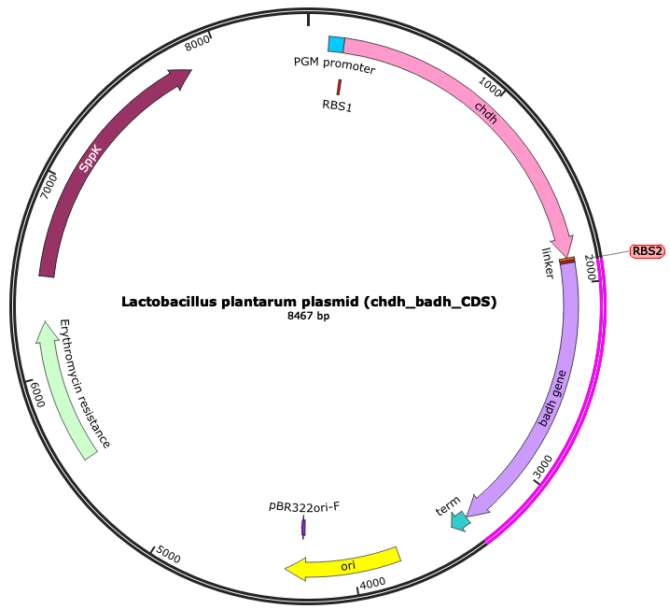
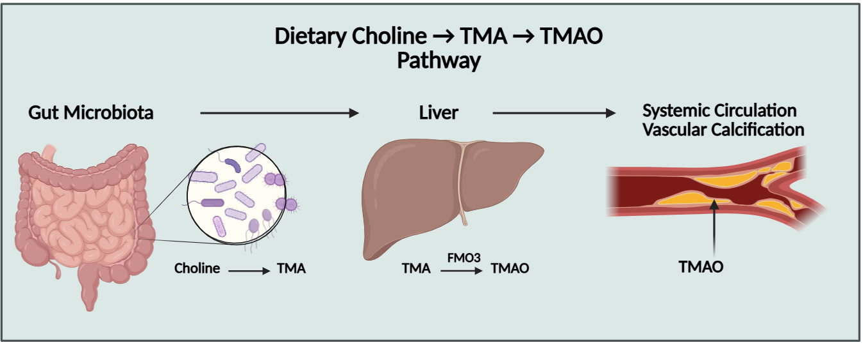

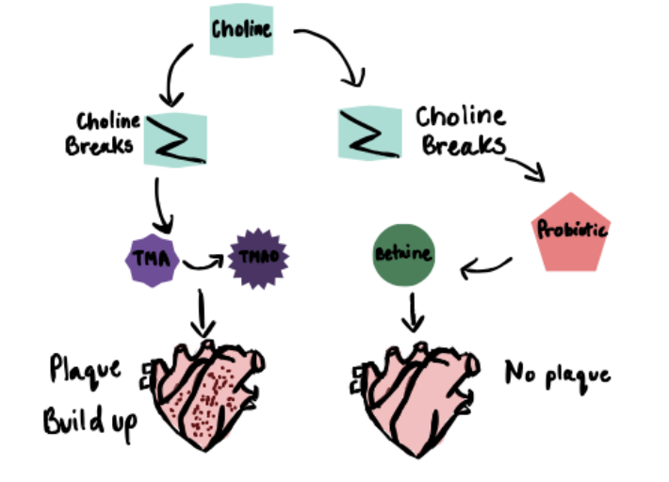





Genetically Engineering Lactobacillus plantarum Probiotic for Atherosclerosis Plaque Prevention
Aamir Motiwala, Hannah Park, Sarah Jiang, Nayesha Tamhaney, Ahaan Velaga, Ribhav Jha, Esther Hong, Saniha Shankar, Akshay Chenna, Priyanka Bose, Alikarim Mithwani, Mrs. Catherine Sharer, Ms. Kelly Teitel (MIT)
Lambert High School, Suwanee, Georgia, USA
Abstract
Atherosclerosis is the condition when fatty deposits build up inside the arteries, increasing the risk for heart attacks, strokes and peripheral artery disease.
Atherosclerosis-caused CVD (cardiovascular disease) affects over 523 million people globally.
Current treatments focus on reducing cholesterol levels and do not address metabolic or gut-derived causes.
Trimethylamine-N-oxide (TMAO)—a compound produced when gut bacteria metabolize choline—is a key factor in plaque formation.
To prevent this choline-to-TMAO conversion, we propose a probiotic solution that engineers Lactobacillus, a common gut bacteria, to express the enzymes Choline Dehydrogenase (CHDH) and Betaine Aldehyde Dehydrogenase (BADH).
These enzymes will convert choline to betaine (a beneficial metabolite) preventing TMAO synthesis, thereby preventing plaque buildup and atherosclerosis.
Figure C.
Our plasmid design, intended to express CHDH and BADH in Lactobacillus.
Science content
In order to transform Lactobacillus plantarum with the plasmid, we will use an electroporator, which uses short, high-voltage electrical pulses to create temporary pores in the cell membrane.
Once the Lactobacillus plantarum is transformed, the CHDH and BADH genes will be transcribed and translated to create the enzymes to then amplify the choline-to-betaine pathway, significantly decreasing the choline concentration. This will consequently decrease the TMA concentration and overall plaque buildup.
Given the competitive nature of choline metabolism in the gut microbiome, an additional plasmid-based regulatory system is not required. The probiotic system is short-lived and will eventually be flushed out, ensuring that essential choline thresholds will not be affected.
One way to quantify the amount of betaine is to use a high performance liquid chromatography (HPLC) method to determine the transformation efficiency of the Lactobacillus plantarum.
Key features:
PGM promoter
RBS 1
Choline Dehydrogenase (CHDH)
Linker gene
RBS 2
Betaine Aldehyde Dehydrogenase (BADH)
Terminator
Origin of Replication
Erythromycin Resistance
Team Content
Lambert Yellow Team consists of 11 members, a mix of sophomores and juniors all passionate about using synthetic biology for a brighter future in healthcare science.
Next steps:
Perform wet lab experiments by transforming Lactobacillus plantarum with the plasmid to express CHDH and BADH to convert choline into betaine.
Quantify choline degradation/betaine production.
Use software/hardware dry lab models to show the kinetics and expected results of the probiotic system.
Explore the effect of introducing the probiotic in to the human gut environment, seeing its fitness against gut microbiome competition.
References and acknowledgements
QR Code for References:
We’d like to thank our advisor, Mrs. Kate Sharer for guiding and supporting us throughout this whole process. We’d also like to thank Ms. Kelly Teitel for giving us invaluable feedback during this project, helping us modify and improve everything.
Plasmid Detail
The pSIP403 backbone was acquired from Addgene. pSIP403 has high gene of interest expression in Lactobacillus plantarum and can be used to express CHDH and BADH. This plasmid is inducible; transcription is “off” and must be turned on.
However, because of the competitive gut microbiome, and to achieve higher, growth-linked expression independent of inducer cost and variability, sppA (the original promoter found in the backbone) was replaced with the PGM promoter from this article: L. plantarum described in the paper Constitutive expression and cell-surface display of a bacterial β-mannanase in Lactobacillus plantarum. This ensures a strong, constitutive promoter that is able to have a strong expression to maximize efficiency against the other choline-metabolizing bacteria.
Choline Dehydrogenase (CHDH) is the enzyme that catalyzes choline into betaine aldehyde in human mitochondria. A linker gene linking the CHDH and BADH genes also was included.
Betaine Aldehyde Dehydrogenase (BADH) continues the conversion, oxidizing betaine aldehyde into betaine. This enzyme is also present in human mitochondria.
Figure A
Figure A. Metabolic pathway where choline is converted to TMA and TMAO by gut microbiota, causing atherosclerosis.
Figure B. Shows natural choline pathway with and without probiotic.
Figure B

