Slide 1

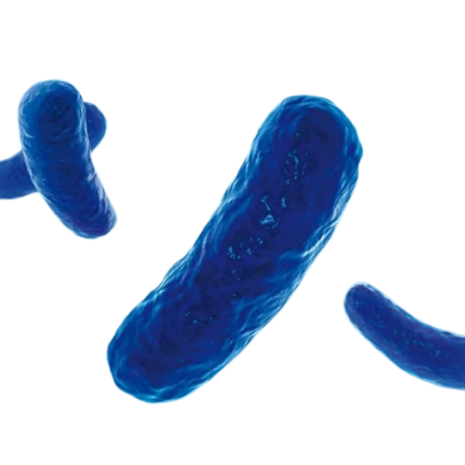
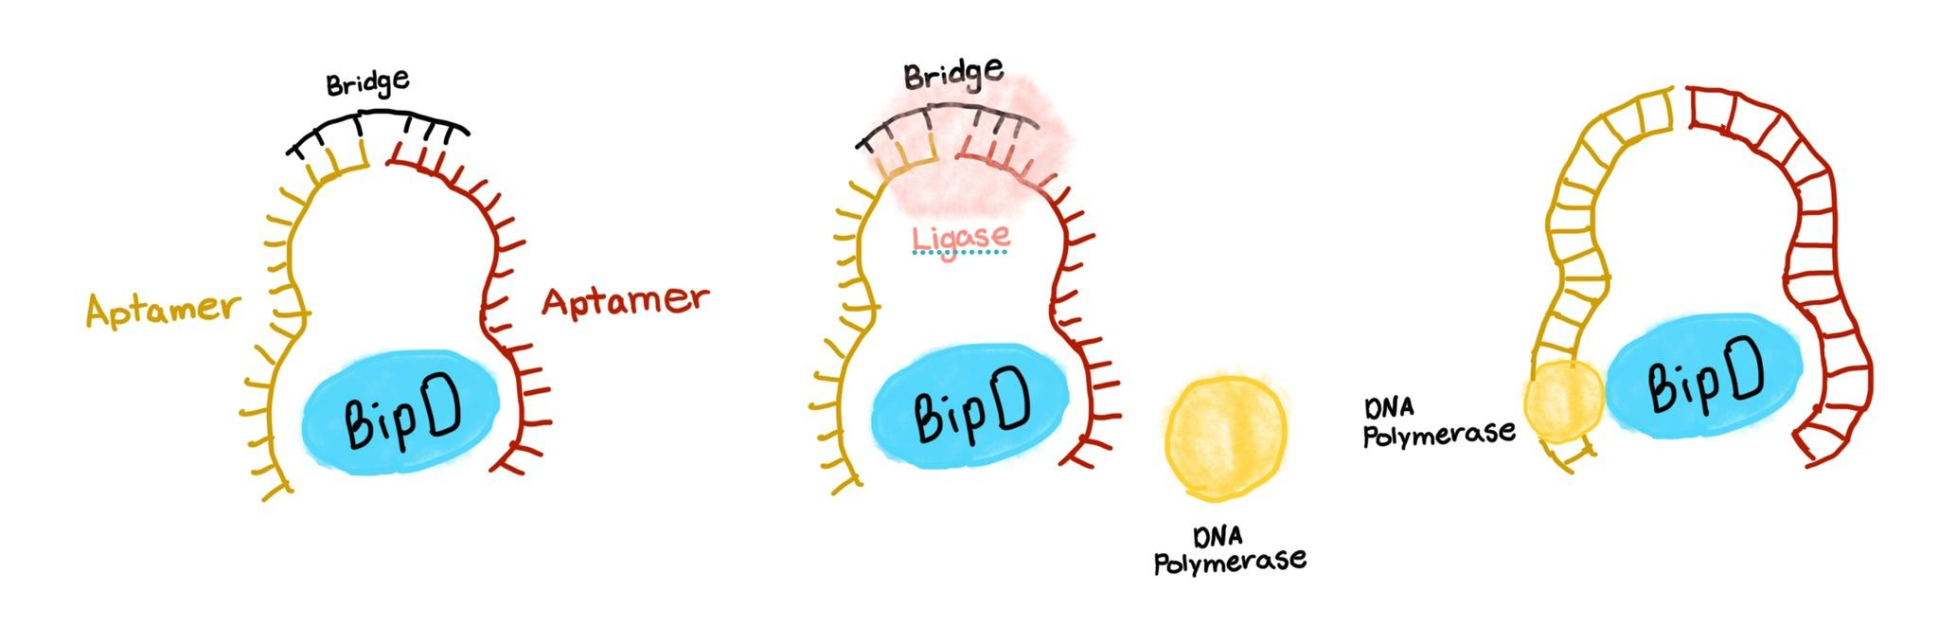
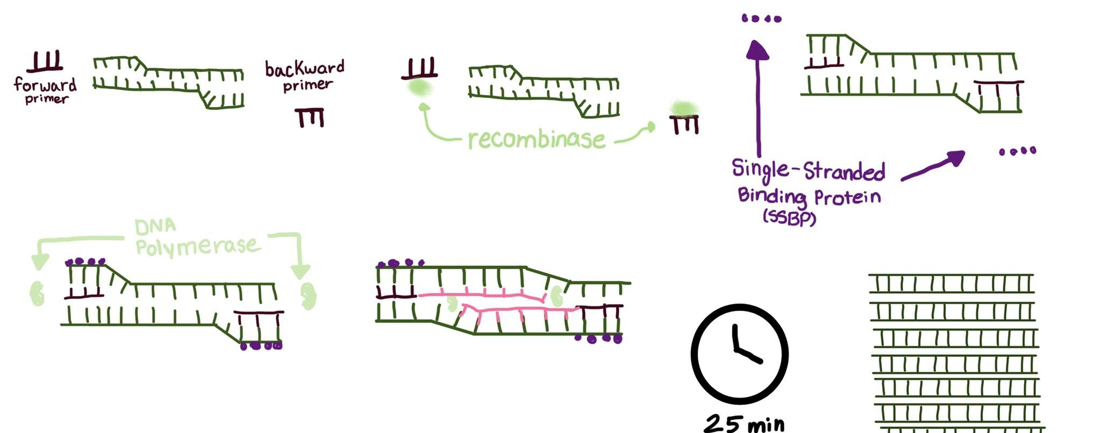
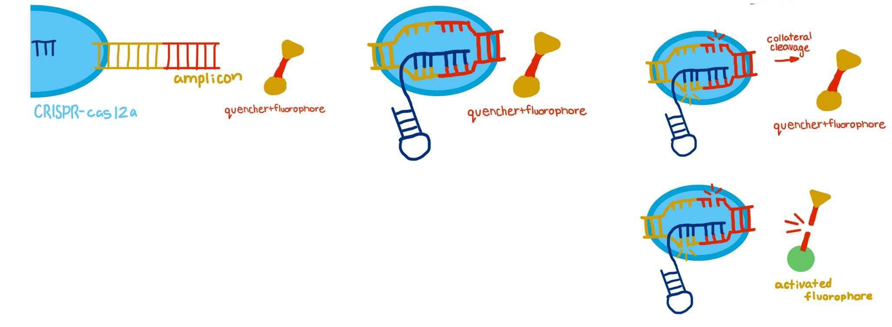

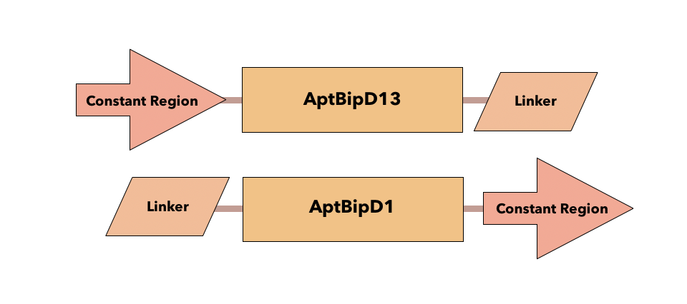
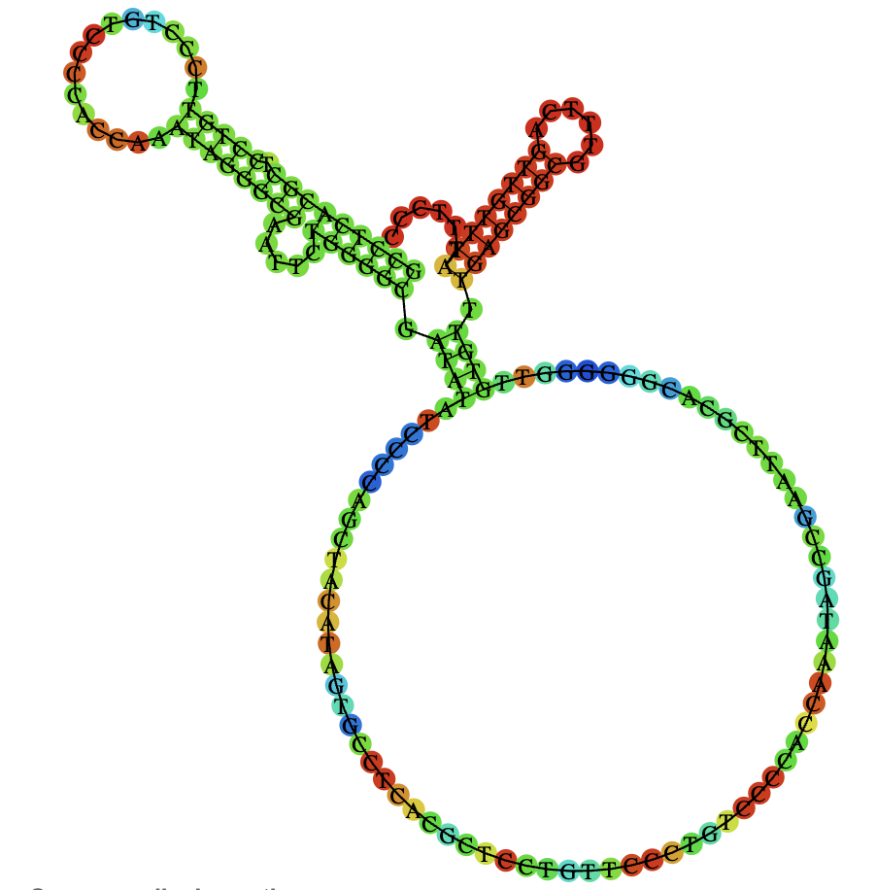
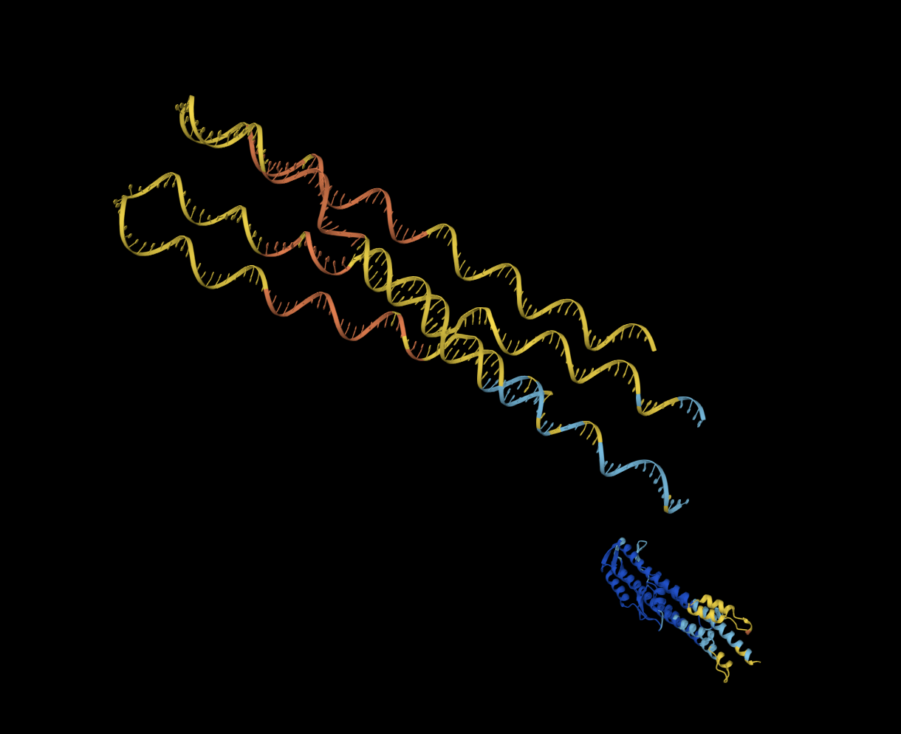







Designing a LANCET-Based Assay to Diagnose Burkholderia pseudomallei-Derived Melioidosis
Saesha Abraham, Arpitha Bepeta, Tejaswi Bhimini, Sujaal Gelle, Feier (Grace) Han, Alisha Jyotiprakash, Rachita Kawale, Dheyanesh Krishnamoorthy, Sruti Lekkala, Navya Neelam, Catherine Sharer (Teacher Leader), Nick Godzik (Mentor; Massachusetts Institute of Technology)
Lambert High School, Suwanee, Georgia, United States of America
Abstract
Results
Team Content and Future Directions
Melioidosis is a tropical infectious disease caused by the gram-negative bacterium Burkholderia pseudomallei, characterized by adverse outcomes ranging from systemic lesions to multi-organ failure. Although it affects over 165,000 individuals globally, typical diagnosis still relies on the culturing of clinical biofluids, resulting in diagnostic delays that sometimes outpace disease progression. To mitigate this, we utilize BipD, a B. pseudomallei virulence protein, with two high-affinity single-stranded deoxyribonucleic acid (ssDNA) aptamers to generate a detectable molecular signal prior to fulminance. Although our current predictions from AlphaFold3, RNAfold, and EZassay show low confidence, further in silico validation remains necessary.
i. How It Works: Proximity-Dependent Ligation (PDL), RPA, and DETECTR Graphics
ii. System Overview: AlphaFold3, RNAfold, ssDNA Construct
1) Our system begins with PDL, in which two ssDNA aptamers bind to BipD and bring their attached oligonucleotides into close proximity with the protein (Fig. 6) to enable both ligation and DNA template formation (Fredriksson et al., 2002). We selected AptBipD1 and AptBipD13 for their high binding affinity, determined through a study by Selvam et al. (2024). Core aptamers are flanked by linker and constant regions (Fig. 4).
2) RPA is an isothermal amplification method in which recombinase-primer complexes derived from T4-like bacteriophages facilitate strand interrogation and amplification using a strand-displacing DNA polymerase (Lobato & O’Sullivan, 2018). We developed suitable primers using EZassay, which carry a moderate primer-dimer risk of 20.69%. Our resulting amplicon is 114 nucleotides long (Fig. 5), within the optimal amplification range (Lobato & O’Sullivan, 2018).
i. Team Content
We are a new team comprised of four freshmen, three sophomores, and three juniors (see the team picture below)! Our experience greatly varies from little to no experience in biotechnology to moderate experience in biochemical processes and computational systems. Our interests rely primarily within medicine, biology, chemistry, biochemistry, and the intersection of these fields with engineering and computer science. We have a variety of skillsets, which we have made extensive and appropriate use of throughout this journey.
ii. Key Limitations
So far, key limitations within this project include a) potential aptamer dimerization leading to signal disruption, b) potential high local DNA concentration resulting in off-target aptamer binding, and c) the unreliability of in silico testing in the determination of aptamer-protein binding characteristics.
iii. “Why Advancement?” and Future Goals
This project needs to be advanced for the mitigation of fatalities within tropical regions. Additionally, as both aptamer-based detection systems that follow a similar design and RPA-based detection systems are largely uncommon, advancing this project could lead to direct improvements in, and developments of, similar technologies. Furthermore, in the future, we aim to test more aptamers and utilize a completed rapid review to validate our findings.
Figure 1.
Figure 2.
Fig. 1. Proximity-Dependent Ligation
Fig. 2. Recombinase Polymerase Amplification
Fig. 3. DETECTR System
Figure 3.
Introduction
i. Melioidosis
Melioidosis is a prominent and high-consequence tropical infectious disease transmitted by the gram-negative bacterial vector B. pseudomallei. Due to the unpredictability of this disease, diagnostic delay can sometimes outpace disease progression, resulting in unprecedented fatalities, nearing 40% in some regions. Although rapid diagnostics have been established, they remain largely unavailable within many rural tropical regions. To mitigate this, our project proposes a novel LANCET-based assay for rapid field detection.
ii. About LANCET
LANCET is a novel biotechnological system that utilizes PDL, Recombinase Polymerase Amplification (RPA), and CRISPR-Cas12a-based CspZ detection to effectively identify the presence of Lyme disease. This innovation has three (3) major steps:
1) DNA production through PDL, in which a PDL assay is utilized to detect CspZ and eventually form a dsDNA template to be replicated;
2) RPA amplification, in which the dsDNA is amplified;
3) DETECTR, in which the amplified DNA is converted into a quantifiable molecular signal through a combination of CRISPR-Cas12a, ssDNA reporter probes, and CRISPR RNA.
References
Figure 4. SsDNA construct orientation
Figure 5. Secondary structure of ssDNA aptamers
Figure 6. Tertiary structure of ssDNA aptamers and BipD
https://docs.google.com/document/d/1YwcCD5_Fp7HwOGIoWmJEnS035uMlUpBODVMCn6akVok/edit?tab=t.0
Acknowledgements
Thank you to Mr. Nick Godzik, Mrs. Catherine Sharer, and the Lambert iGEM Competition Team for the enormous time and patience put into guiding and supporting us throughout this project. We couldn’t have done it without you!

