Slide 1

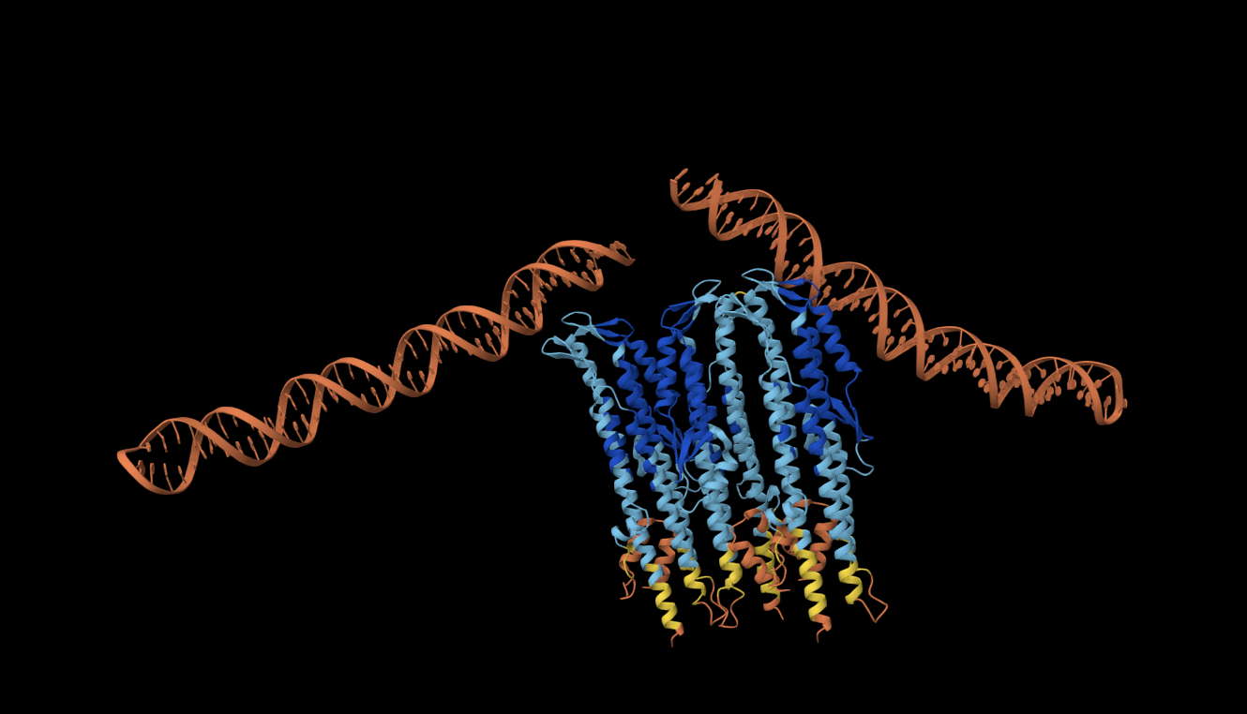
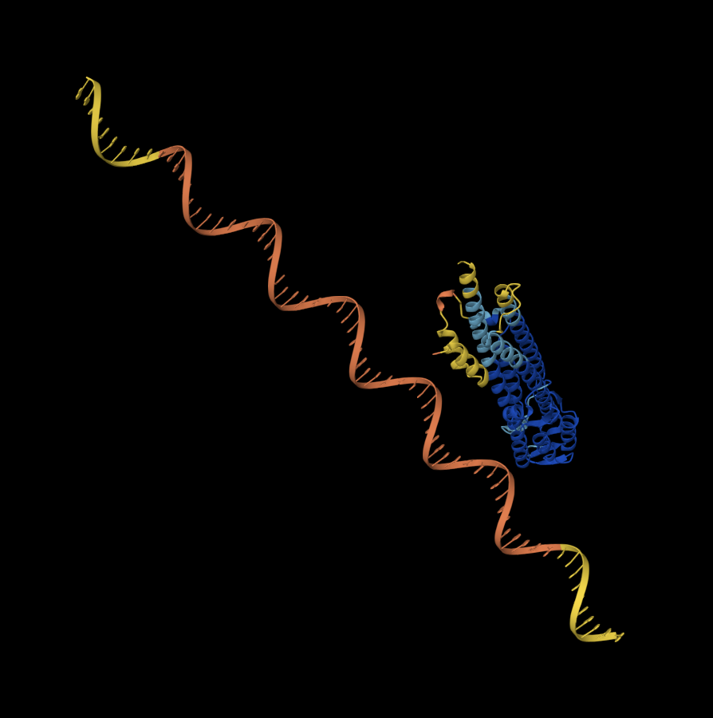
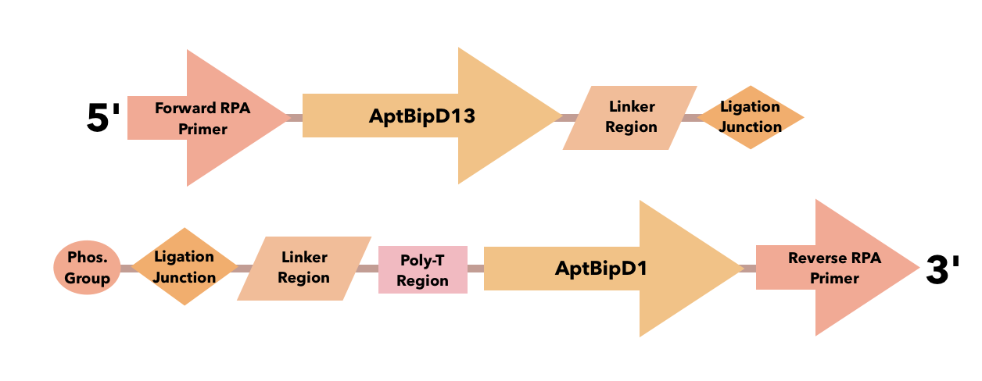
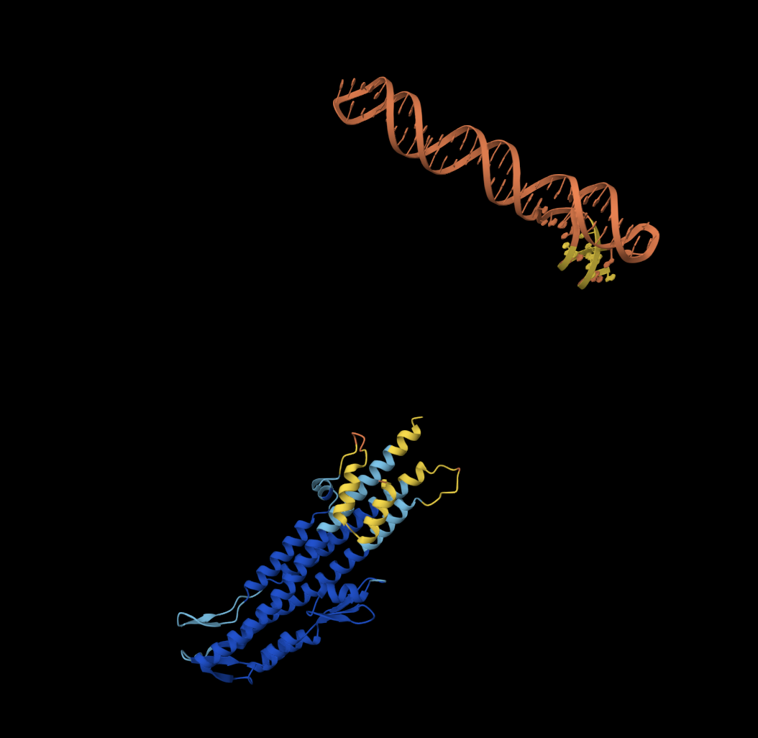






Designing a LANCET-Based Proximity-Dependent Ligation Assay to Diagnose Burkholderia pseudomallei-Derived Melioidosis
Saesha Abraham, Arpitha Bepeta, Tejaswi Bhimini, Sujaal Gelle, Feier (Grace) Han, Alisha Jyotiprakash, Rachita Kawale, Sruti Lekkala, Navya Neelam, Catherine Sharer, Nick Godzik (Massachusetts Institute of Technology)
Lambert High School, Suwanee, Georgia, United States of America
To use modified DNA aptamers to bind to the surface protein BipD to ultimately diagnose/ indicate the presence of the the disease Melioidosis.
We plan to use the framework from LANCET to utilize the surface protein BipD, along with two ssDNA aptamers to create an amplifiable molecular signal that can be effectively detected in early stages of the disease.
Some limitations are the fact that the tests that we have conducted may not be viable since the confidence intervals on the tests are so low.
With the tests of different ssDNA aptamers to BipD for targeted interference there is no major conclusion. With the basic sum up of the digital tests being that the aptamer and protein ratios will be inaccurate.
The DNA-based set up used to turn BipD binding into signals. It works by having two aptamers bind BipD, which brings their DNA strands together so it can be joined and detected by the CRISPR detection step.
Fig. 3. AptBipD13 x BipD x AptBipD1.
Fig. 4. AptBipD1 x BipD.
Fig. 2. AptBipD13 x BipD.

