Slide 1

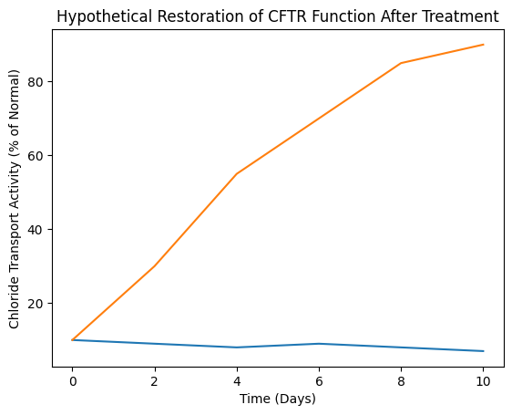







Engineering a Bacterium to Restore CFTR Function in Cystic Fibrosis
Neel Bhosale, Sandra Sanchez, Anderson Portillo, Ambika Bhosale, Amanda Ferrante (Northeastern University)
John P. Stevens High School, Edison, NJ, USA
Introduction/Background
Cystic Fibrosis is a rare genetic disease caused by mutations in the CFTR gene. This disrupts the transport of chloride and water, leading to thick mucus accumulation and lung infections. Current forms of treatment reduce the symptoms of Cystic Fibrosis, but fail to fully solve the mutation, causing lifelong treatment for patients. This project utilizes synthetic biology to create a cure for this genetic disease, which is hosted in a harmless bacterial chassis. Lactococcus lactis is a bacterium commonly used in food and medical research and can be used to deliver the correct genetic instructions for the CFTR gene. This information will be delivered in the form of mRNA to lung cells, allowing them to successfully produce a functional gene without high risks. This bacterium will also host parts that will help the functioning gene fold and work correctly, increasing the likelihood of it functioning accurately. Since the bacterium can be easily removed, this method could pave the way for future genetic medicine.
To determine whether this solution works, we can devise an experiment (hypothetical). In this experiment, we will test whether the engineered Lactococcus lactis restores the CFTR function in lung cells. First, we will grow two sets of human lung cells with the CFTR mutation. The first set will have no treatment and act as a control, while the other set will be treated with the engineered bacterium. Using a chloride-sensitive fluorescent dye, we will be able to detect the effectiveness of the product. A higher amount of chloride movement would mean that the CFTR protein is working. In the control set, we will see that the cells remain below 20% of normal CFTR activity, while the treated set will increase to above 70% of normal function. This would show strong improvements in CFTR activity.
Team Content
We have one returning member in our team and two new members in our team.
Next Steps
In order to advance this project into the real world, we would need to make some improvements and tweaks to our design. Firstly, we would need to increase the efficiency of the transfer of CFTR so that the treatment becomes more effective. We would also need to perform several tests to ensure there are no harmful side effects on humans before we implement this in the real world. Finally, we would require approval from world health agencies to allow pharmacies to sell our bacterium. If another school were to continue this project, the most important next experiment would be testing whether it works in a real lung environment. They would need to culture a tube of human airway cells at an air-liquid interface and apply the bacteria to those cells. The ALI would closely mimic the lung tissue, so this experiment would be extremely useful.
Introduction/Background
Cystic fibrosis is a rare genetic disease that originates from a mutation in the CFTR gene. This mutation causes a buildup of thick and sticky mucus that leads to difficulties breathing. Although current treatments do help the patients, they only reduce symptoms, forcing patients to take medication for life. Our design uses a harmless bacterium, Lactococcus lactis, as a delivery system that contains the correct CFTR instructions. The engineered bacterium will release instructions to lung cells, allowing functional CFTR proteins to be produced. This project uses genetic engineering to target a specific, faulty gene that causes issues and solves it with little to no harm done to the patient.
References and acknowledgements
References:

