Slide 1


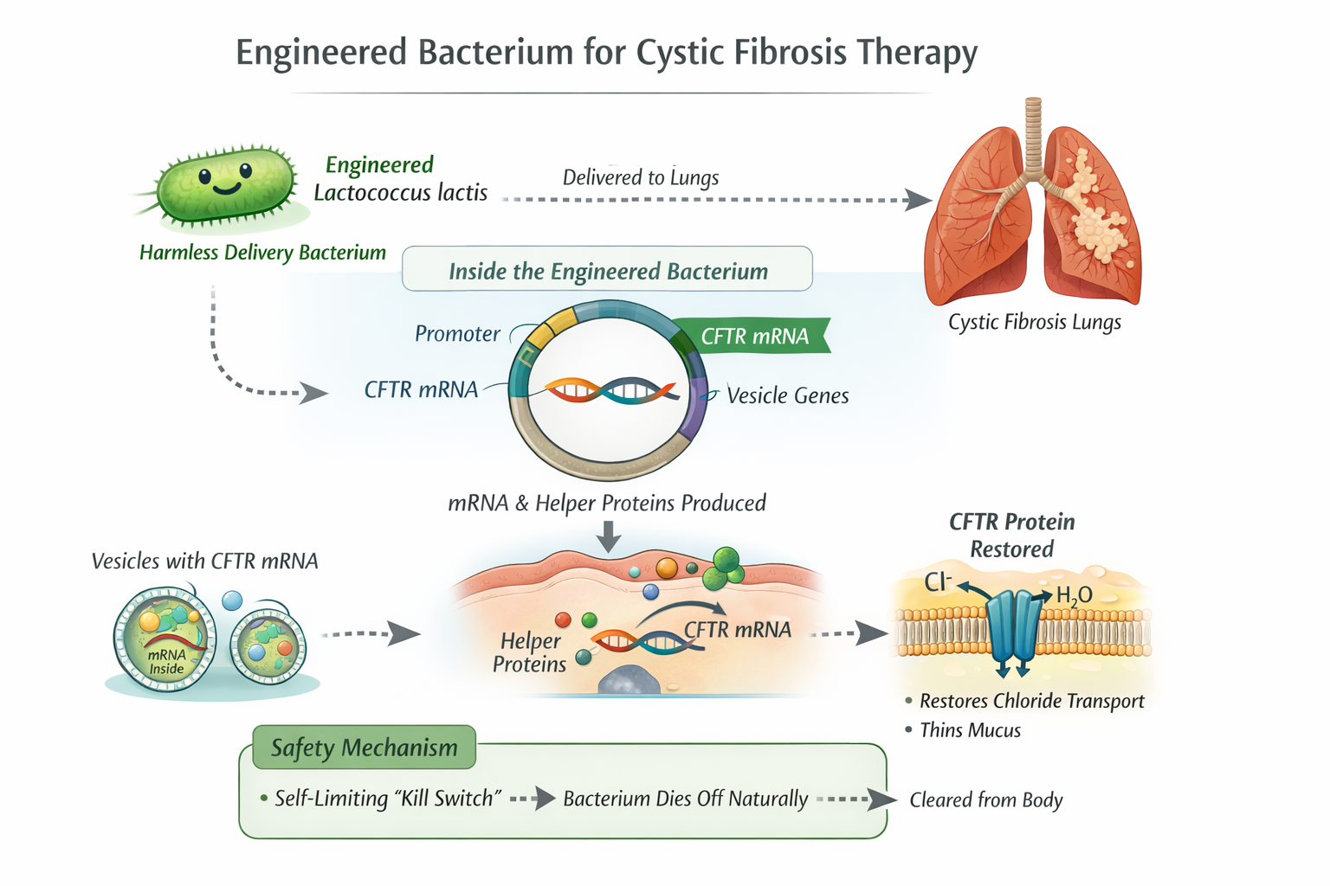
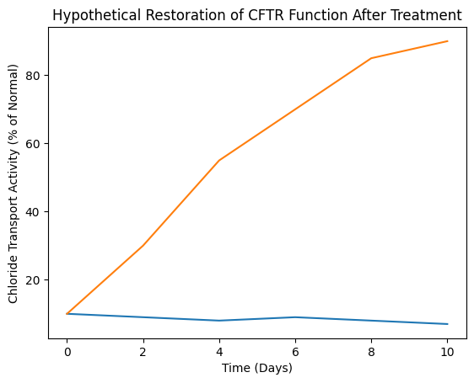
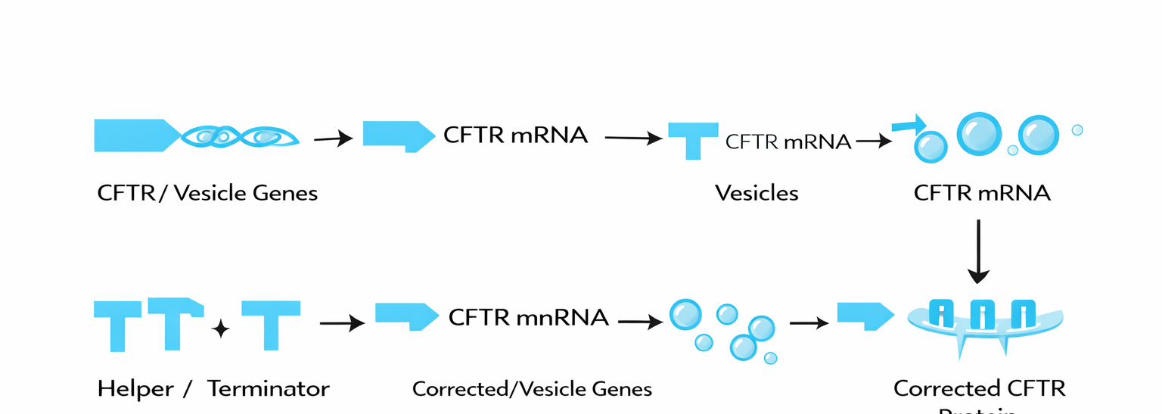






Engineering a Bacterium to Restore CFTR Function in Cystic Fibrosis
Neel Bhosale, Sandra Sanchez, Anderson Portillo, Ambika Bhosale, Amanda Ferrante (Northeastern University)
John P Stevens High School, Edison, New Jersey, USA
The objective of this project is to create a cure for the genetic disease, cystic fibrosis. This project utilizes synthetic biology to create a cure for this genetic disease, which is hosted in a harmless bacterial chassis.
We expect that patient no longer suffer from cystic fibrosis after taking this medication for a few days.
Hypothetical Experiment→

